Slide 1
7.1) Static particles

Slide 2
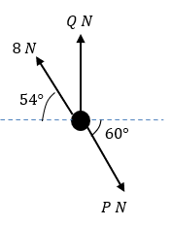
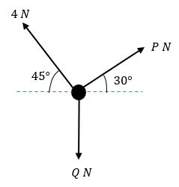
Worked example
Your turn
The diagram shows a particle in equilibrium under the forces shown. By resolving horizontally and vertically find the magnitudes of the forces $P$ and $Q$.
The diagram shows a particle in equilibrium under the forces shown. By resolving horizontally and vertically find the magnitudes of the forces $P$ and $Q$.
$P=3.27, Q=4.46$ (3 sf)
Diagrams/Graphs used with permission from DrFrostMaths: https://www.drfrostmaths.com/

Slide 3
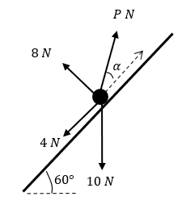
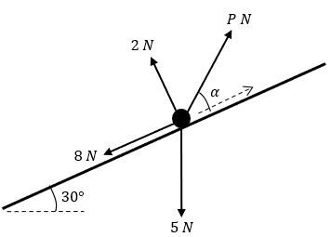
Worked example
Your turn
The diagram shows a particle in equilibrium on an inclined plane under the forces shown. Find the magnitude of the force $P$ and the size of the angle $α$.
The diagram shows a particle in equilibrium on an inclined plane under the forces shown. Find the magnitude of the force $P$ and the size of the angle $α$.
$P=10.8, α=12.5°$ (3 sf)
Diagrams/Graphs used with permission from DrFrostMaths: https://www.drfrostmaths.com/

Slide 4
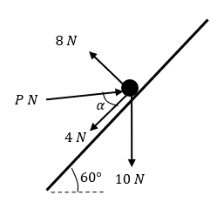
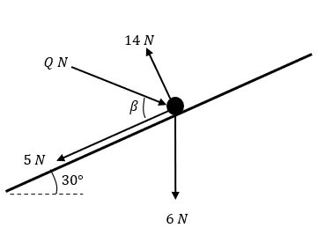
Worked example
Your turn
The diagram shows a particle in equilibrium on an inclined plane under the forces shown. Find the magnitude of the force $P$ and the size of the angle $α$.
The diagram shows a particle in equilibrium on an inclined plane under the forces shown. Find the magnitude of the force $Q$ and the size of the angle $β$.
$Q=11.9, β=47.7°$ (3 sf)
Diagrams/Graphs used with permission from DrFrostMaths: https://www.drfrostmaths.com/

