Slide 1
7.1) Hypothesis testing

Slide 2
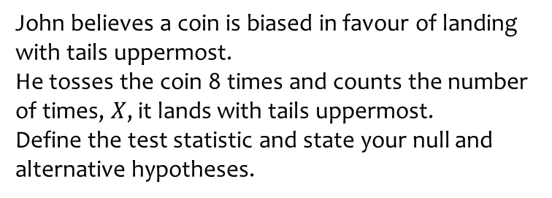
Worked example
Your turn
Joan believes a six-sided dice is biased in favour of rolling a $4$.
She rolls the dice 10 times and counts the number of times, $X$, it rolls a $4$.
Define the test statistic and state your null and alternative hypotheses.
John believes a coin is biased in favour of landing with tails uppermost.
He tosses the coin 8 times and counts the number of times, $X$, it lands with tails uppermost.
Define the test statistic and state your null and alternative hypotheses.
$X=$ number of tosses that land on tails
$p=$ probability/proportion of tosses that land on tails
$$H_{0}:p=0.5$$
$$H_{1}:p>0.5$$

Slide 3
Worked example
Your turn
An election candidate believes he has the support of 30% of the residents in a particular town.
A researcher wants to test, at the 10% significance level, whether the candidate is over-estimating his support.
The researcher asks 30 people whether they support the candidate or not. 2 people say they do.
Write down a suitable test statistic.
Write down two suitable hypotheses.
Explain the condition under which the null hypothesis would be rejected.
An election candidate believes she has the support of 40% of the residents in a particular town.
A researcher wants to test, at the 5% significance level, whether the candidate is over-estimating her support.
The researcher asks 20 people whether they support the candidate or not. 3 people say they do.
Write down a suitable test statistic.
Write down two suitable hypotheses.
Explain the condition under which the null hypothesis would be rejected.
a) $X=$ number of people who say they support the candidate
b) $p=$ probability/proportion of people that support the candidate
$$H_{0}:p=0.4$$
$$H_{1}:p<0.4$$
c) Reject $H_{0}$ if $P\left(X≤3\right)<0.05$

Slide 4
Worked example
Your turn
An election candidate believes he has the support of 30% of the residents in a particular town.
A researcher wants to test, at the 1% significance level, whether the candidate is under-estimating his support.
The researcher asks 30 people whether they support the candidate or not. 11 people say they do.
Write down a suitable test statistic.
Write down two suitable hypotheses.
Explain the condition under which the null hypothesis would be rejected.
An election candidate believes she has the support of 40% of the residents in a particular town.
A researcher wants to test, at the 2% significance level, whether the candidate is under-estimating her support.
The researcher asks 20 people whether they support the candidate or not. 12 people say they do.
Write down a suitable test statistic.
Write down two suitable hypotheses.
Explain the condition under which the null hypothesis would be rejected.
a) $X=$ number of people who say they support the candidate
b) $p=$ probability/proportion of people that support the candidate
$$H_{0}:p=0.4$$
$$H_{1}:p>0.4$$
c) Reject $H_{0}$ if $P\left(X≥12\right)<0.05$

Slide 5
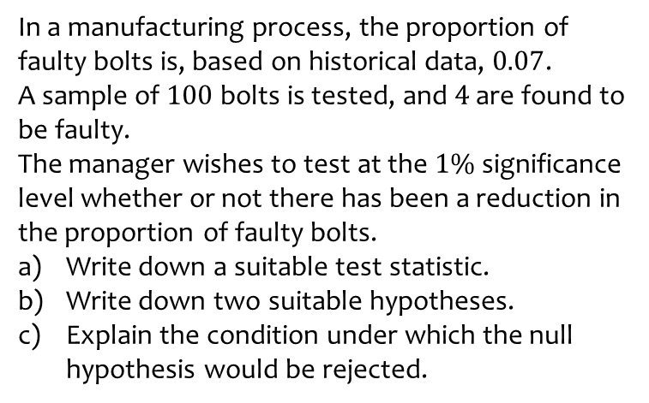
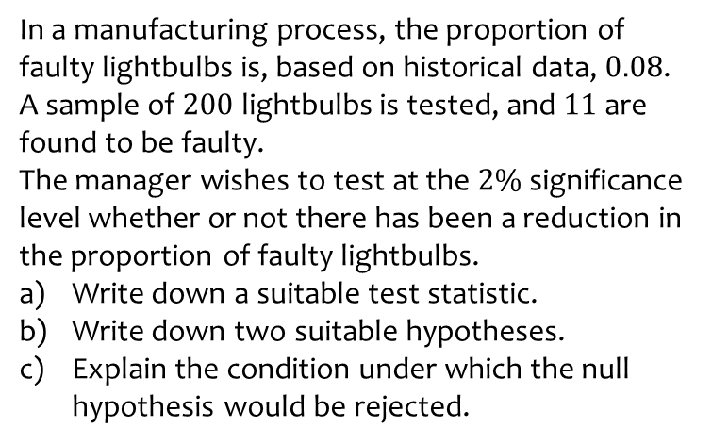
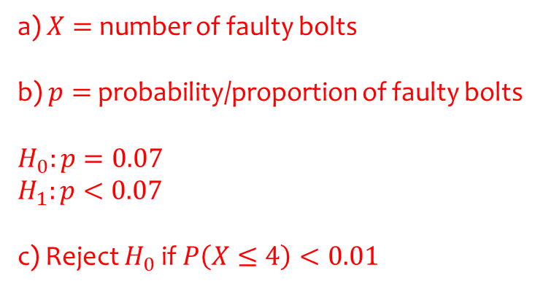
Worked example
Your turn
In a manufacturing process, the proportion of faulty lightbulbs is, based on historical data, $0.08$.
A sample of $200$ lightbulbs is tested, and $11$ are found to be faulty.
The manager wishes to test at the $2\%$significance level whether or not there has been a reduction in the proportion of faulty lightbulbs.
Write down a suitable test statistic.
Write down two suitable hypotheses.
Explain the condition under which the null hypothesis would be rejected.
In a manufacturing process, the proportion of faulty bolts is, based on historical data, $0.07$.
A sample of $100$ bolts is tested, and $4$ are found to be faulty.
The manager wishes to test at the $1\%$significance level whether or not there has been a reduction in the proportion of faulty bolts.
Write down a suitable test statistic.
Write down two suitable hypotheses.
Explain the condition under which the null hypothesis would be rejected.
a) $X=$ number of faulty bolts
b) $p=$ probability/proportion of faulty bolts
$$H_{0}:p=0.07$$
$$H_{1}:p<0.07$$
c) Reject $H_{0}$ if $P\left(X≤4\right)<0.01$

Slide 6
Worked example
Your turn
Joan believes the probability of rolling a $4$ on a six-sided dice is $\frac{1}{6}$.
She rolls the dice 10 times and counts the number of times, $X$, it rolls a $4$.
Define the test statistic and state your null and alternative hypotheses.
John believes a coin is lands on tails with probability $\frac{1}{2}$.
He tosses the coin 8 times and counts the number of times, $X$, it lands with tails uppermost.
Define the test statistic and state your null and alternative hypotheses.
$X=$ number of tosses that land on tails
$p=$ probability/proportion of tosses that land on tails
$$H_{0}:p=0.5$$
$$H_{1}:p≠0.5$$

Slide 7
Worked example
Your turn
An election candidate believes he has the support of 30% of the residents in a particular town.
A researcher wants to test, at the 10% significance level, whether this claim is true.
The researcher asks 30 people whether they support the candidate or not. 2 people say they do.
Write down a suitable test statistic.
Write down two suitable hypotheses.
Explain the condition under which the null hypothesis would be rejected.
An election candidate believes she has the support of 40% of the residents in a particular town.
A researcher wants to test, at the 5% significance level, whether this claim is true.
The researcher asks 20 people whether they support the candidate or not. 3 people say they do.
Write down a suitable test statistic.
Write down two suitable hypotheses.
Explain the condition under which the null hypothesis would be rejected.
a) $X=$ number of people who say they support the candidate
b) $p=$ probability/proportion of people that support the candidate
$$H_{0}:p=0.4$$
$$H_{1}:p≠0.4$$
c) Reject $H_{0}$ if $P\left(X≤3\right)<0.025$

Slide 8
Worked example
Your turn
An election candidate believes he has the support of 30% of the residents in a particular town.
A researcher wants to test, at the 1% significance level, whether this claim is true.
The researcher asks 30 people whether they support the candidate or not. 11 people say they do.
Write down a suitable test statistic.
Write down two suitable hypotheses.
Explain the condition under which the null hypothesis would be rejected.
An election candidate believes she has the support of 40% of the residents in a particular town.
A researcher wants to test, at the 2% significance level, whether this claim is true.
The researcher asks 20 people whether they support the candidate or not. 12 people say they do.
Write down a suitable test statistic.
Write down two suitable hypotheses.
Explain the condition under which the null hypothesis would be rejected.
a) $X=$ number of people who say they support the candidate
b) $p=$ probability/proportion of people that support the candidate
$$H_{0}:p=0.4$$
$$H_{1}:p≠0.4$$
c) Reject $H_{0}$ if $P\left(X≥12\right)<0.01$

Slide 9
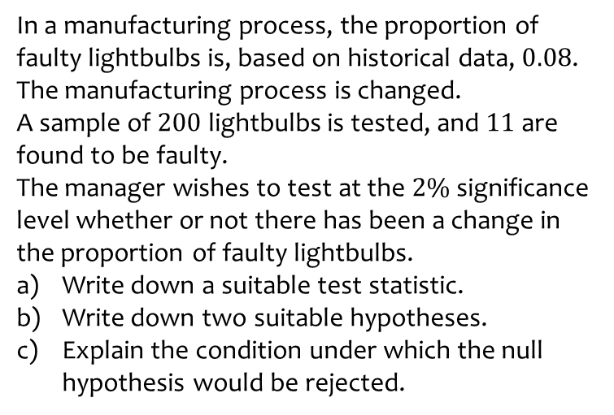
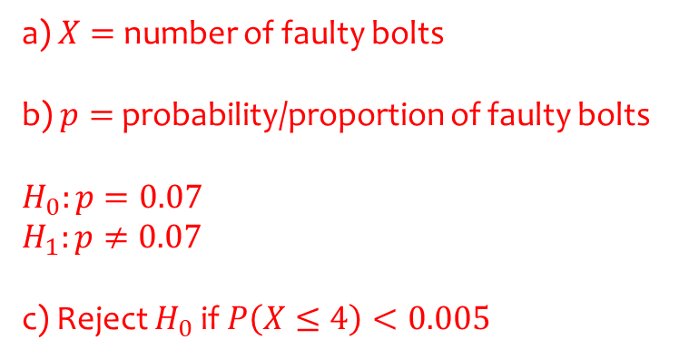
Worked example
Your turn
In a manufacturing process, the proportion of faulty lightbulbs is, based on historical data, $0.08$.
The manufacturing process is changed.
A sample of $200$ lightbulbs is tested, and $11$ are found to be faulty.
The manager wishes to test at the $2\%$significance level whether or not there has been a change in the proportion of faulty lightbulbs.
Write down a suitable test statistic.
Write down two suitable hypotheses.
Explain the condition under which the null hypothesis would be rejected.
In a manufacturing process, the proportion of faulty bolts is, based on historical data, $0.07$.
The manufacturing process is changed.
A sample of $100$ bolts is tested, and $4$ are found to be faulty.
The manager wishes to test at the $1\%$significance level whether or not there has been a change in the proportion of faulty bolts.
Write down a suitable test statistic.
Write down two suitable hypotheses.
Explain the condition under which the null hypothesis would be rejected.
a) $X=$ number of faulty bolts
b) $p=$ probability/proportion of faulty bolts
$$H_{0}:p=0.07$$
$$H_{1}:p≠0.07$$
c) Reject $H_{0}$ if $P\left(X≤4\right)<0.005$

