Slide 1
7.1) Addition formulae

Slide 2
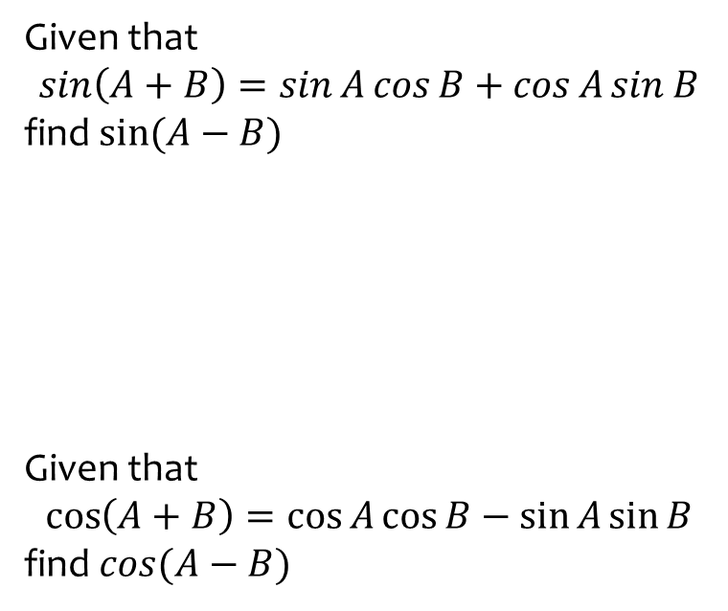
Worked example
Your turn
Given that
$$\sin\left(A+B\right)=\sin{A}\cos{B}+\cos{A}\sin{B}$$
find $sin⁡(A−B)$
Given that
$$\cos\left(A+B\right)=\cos{A}\cos{B}−\sin{A}\sin{B}$$
find $cos(A−B)$
Given that
$$\tan\left(A+B\right)=\frac{\tan{A}+\tan{B}}{1−\tan{A}\tan{B}}$$
find$\tan\left(A−B\right)$
$$\tan\left(A−B\right)=\frac{\tan{A}−\tan{B}}{1+\tan{A}\tan{B}}$$

Slide 3
Worked example
Your turn
Use the formulae for $\sin{(A−B)}$ and $cos⁡(A−B)$ to prove that
$$\tan\left(A−B\right)=\frac{\tan{A}−\tan{B}}{1+\tan{A}\tan{B}}$$
Use the formulae for $\sin{(A+B)}$ and $cos⁡(A+B)$ to prove that
$$\tan\left(A+B\right)=\frac{\tan{A}+\tan{B}}{1−\tan{A}\tan{B}}$$
Proof

Slide 4
Worked example
Your turn
Given that $3\sin{(x−y)}=2\cos\left(x+y\right)$ express $\tan{x}$ in terms of $\tan{y}$.
Given that $2\sin{(x+y)}=3\cos\left(x−y\right)$ express $\tan{x}$ in terms of $\tan{y}$.
$$\tan{x}=\frac{3−2\tan{y}}{2−3\tan{y}}$$

Slide 5
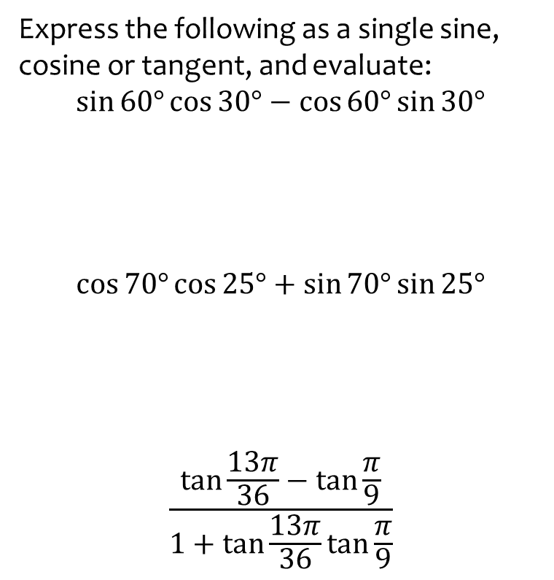

Worked example
Your turn
Express the following as a single sine, cosine or tangent, and evaluate:
$$\sin{30°}\cos{60°}+\cos{30°}\sin{60°}$$
$$\cos{20°}\cos{25°}−\sin{20°}\sin{25°}$$
$$\frac{\tan{\frac{π}{18}}+\tan{\frac{π}{9}}}{1−\tan{\frac{π}{18}}\tan{\frac{π}{9}}}$$
Express the following as a single sine, cosine or tangent, and evaluate:
$$\sin{60°}\cos{30°}−\cos{60°}\sin{30°}$$
$$\cos{70°}\cos{25°}+\sin{70°}\sin{25°}$$
$$\frac{\tan{\frac{13π}{36}}−\tan{\frac{π}{9}}}{1+\tan{\frac{13π}{36}}\tan{\frac{π}{9}}}$$
$$\sin{30°}=\frac{1}{2}$$
$$\cos{45°}=\frac{\sqrt{2}}{2}$$
$$\tan{\frac{π}{4}}=1$$

Slide 6
Worked example
Your turn
Write in the form $\sin{(x±θ})$ or $\cos{(x±θ})$ where $0<θ<\frac{π}{2}$:
$$\frac{1}{2}(\sqrt{3}\sin{x}+\cos{x})$$
$$\frac{1}{2}(\sqrt{3}\cos{x}−\sin{x})$$
Write in the form $\sin{(x±θ})$ or $\cos{(x±θ})$ where $0<θ<\frac{π}{2}$:
$$\frac{1}{2}(\sin{x}−\sqrt{3} cos{x})$$
$$\sin{(x+\frac{π}{3})}$$

Slide 7

Worked example
Your turn
Given that $\tan{(x+\frac{π}{6})}=\frac{1}{2}$ evaluate $\tan{x}$
Given that $\tan{(x−\frac{π}{3})}=\frac{1}{2}$ evaluate $\tan{x}$
Given that $\tan{(x+\frac{π}{4})}=\frac{1}{2}$ evaluate $\tan{x}$
$$\tan{x}=−\frac{1}{3}$$

