Slide 1
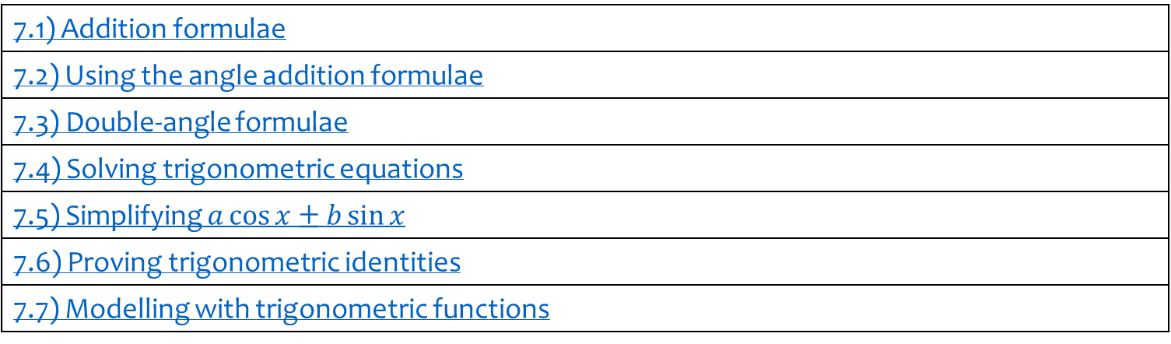
7) Trigonometry and modelling
7.1) Addition formulae
7.2) Using the angle addition formulae
7.3) Double-angle formulae
7.4) Solving trigonometric equations
7.5) Simplifying $a\cos{x}±b\sin{x}$
7.6) Proving trigonometric identities
7.7) Modelling with trigonometric functions

Slide 2
7.1) Addition formulae
Chapter CONTENTS

Slide 3
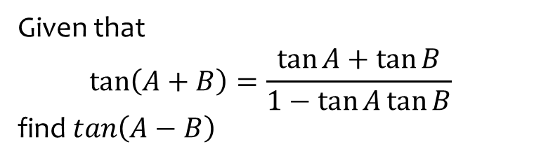
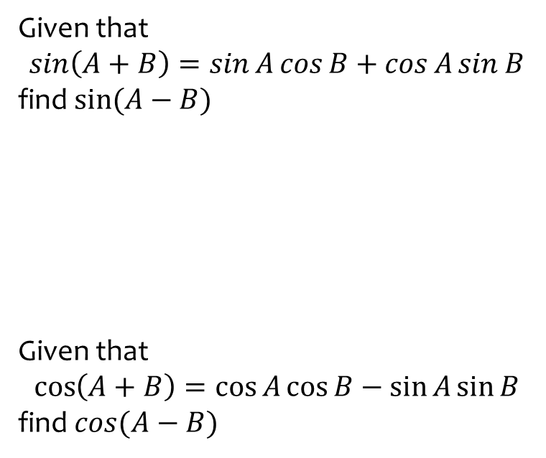

Worked example
Your turn
Given that
$$\sin\left(A+B\right)=\sin{A}\cos{B}+\cos{A}\sin{B}$$
find $sin⁡(A−B)$
Given that
$$\cos\left(A+B\right)=\cos{A}\cos{B}−\sin{A}\sin{B}$$
find $cos(A−B)$
Given that
$$\tan\left(A+B\right)=\frac{\tan{A}+\tan{B}}{1−\tan{A}\tan{B}}$$
find$\tan\left(A−B\right)$
$$\tan\left(A−B\right)=\frac{\tan{A}−\tan{B}}{1+\tan{A}\tan{B}}$$

Slide 4
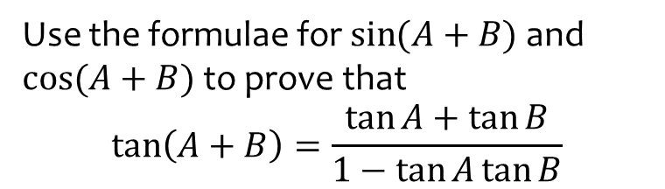
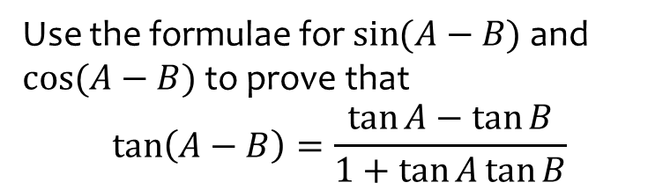
Worked example
Your turn
Use the formulae for $\sin{(A−B)}$ and $cos⁡(A−B)$ to prove that
$$\tan\left(A−B\right)=\frac{\tan{A}−\tan{B}}{1+\tan{A}\tan{B}}$$
Use the formulae for $\sin{(A+B)}$ and $cos⁡(A+B)$ to prove that
$$\tan\left(A+B\right)=\frac{\tan{A}+\tan{B}}{1−\tan{A}\tan{B}}$$
Proof

Slide 5
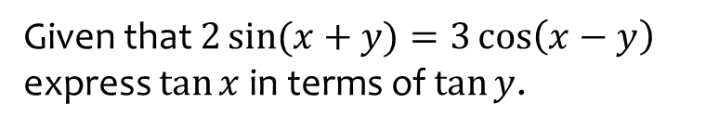
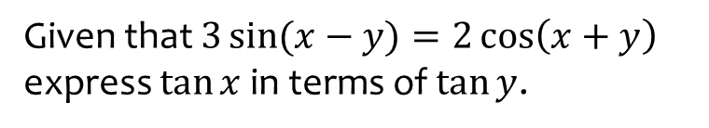

Worked example
Your turn
Given that $3\sin{(x−y)}=2\cos\left(x+y\right)$ express $\tan{x}$ in terms of $\tan{y}$.
Given that $2\sin{(x+y)}=3\cos\left(x−y\right)$ express $\tan{x}$ in terms of $\tan{y}$.
$$\tan{x}=\frac{3−2\tan{y}}{2−3\tan{y}}$$

Slide 6
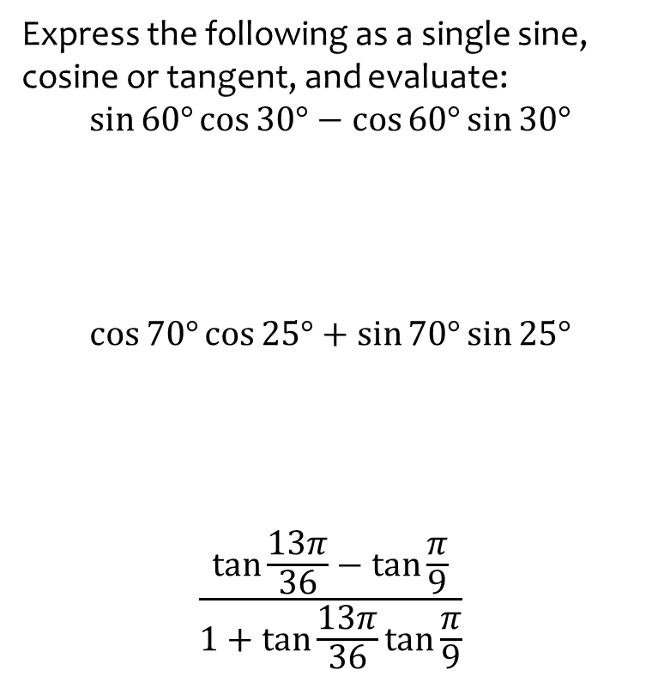
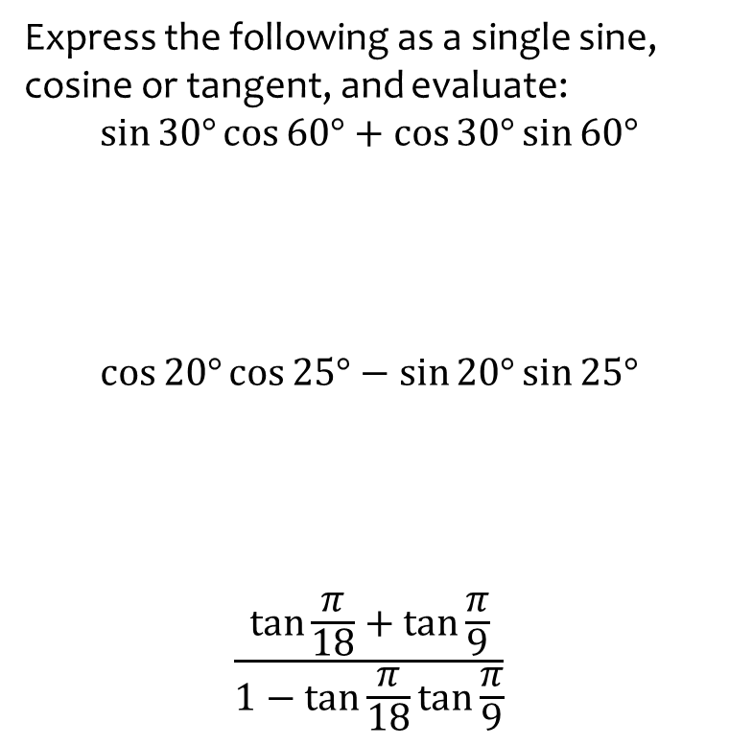

Worked example
Your turn
Express the following as a single sine, cosine or tangent, and evaluate:
$$\sin{30°}\cos{60°}+\cos{30°}\sin{60°}$$
$$\cos{20°}\cos{25°}−\sin{20°}\sin{25°}$$
$$\frac{\tan{\frac{π}{18}}+\tan{\frac{π}{9}}}{1−\tan{\frac{π}{18}}\tan{\frac{π}{9}}}$$
Express the following as a single sine, cosine or tangent, and evaluate:
$$\sin{60°}\cos{30°}−\cos{60°}\sin{30°}$$
$$\cos{70°}\cos{25°}+\sin{70°}\sin{25°}$$
$$\frac{\tan{\frac{13π}{36}}−\tan{\frac{π}{9}}}{1+\tan{\frac{13π}{36}}\tan{\frac{π}{9}}}$$
$$\sin{30°}=\frac{1}{2}$$
$$\cos{45°}=\frac{\sqrt{2}}{2}$$
$$\tan{\frac{π}{4}}=1$$

Slide 7
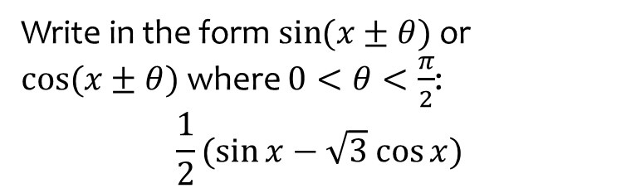


Worked example
Your turn
Write in the form $\sin{(x±θ})$ or $\cos{(x±θ})$ where $0<θ<\frac{π}{2}$:
$$\frac{1}{2}(\sqrt{3}\sin{x}+\cos{x})$$
$$\frac{1}{2}(\sqrt{3}\cos{x}−\sin{x})$$
Write in the form $\sin{(x±θ})$ or $\cos{(x±θ})$ where $0<θ<\frac{π}{2}$:
$$\frac{1}{2}(\sin{x}−\sqrt{3} cos{x})$$
$$\sin{(x+\frac{π}{3})}$$

Slide 8



Worked example
Your turn
Given that $\tan{(x+\frac{π}{6})}=\frac{1}{2}$ evaluate $\tan{x}$
Given that $\tan{(x−\frac{π}{3})}=\frac{1}{2}$ evaluate $\tan{x}$
Given that $\tan{(x+\frac{π}{4})}=\frac{1}{2}$ evaluate $\tan{x}$
$$\tan{x}=−\frac{1}{3}$$

Slide 9
7.2) Using the angle addition formulae
Chapter CONTENTS

Slide 10
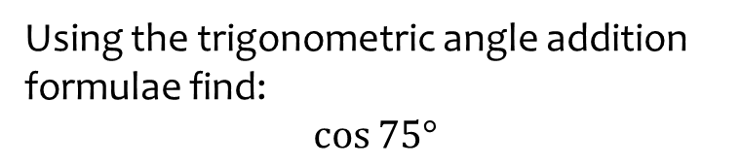


Worked example
Your turn
Using the trigonometric angle addition formulae find:
$$\sin{75°}$$
$$\tan{75°}$$
Using the trigonometric angle addition formulae find:
$$\cos{75°}$$
$$\frac{\sqrt{6}−\sqrt{2}}{4}$$

Slide 11
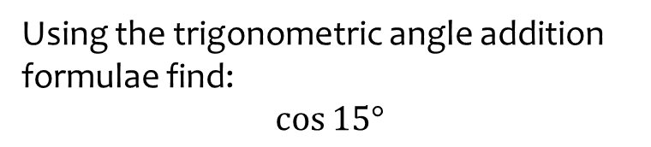


Worked example
Your turn
Using the trigonometric angle addition formulae find:
$$\sin{15°}$$
$$\tan{15°}$$
Using the trigonometric angle addition formulae find:
$$\cos{15°}$$
$$\frac{\sqrt{6}+\sqrt{2}}{4}$$

Slide 12
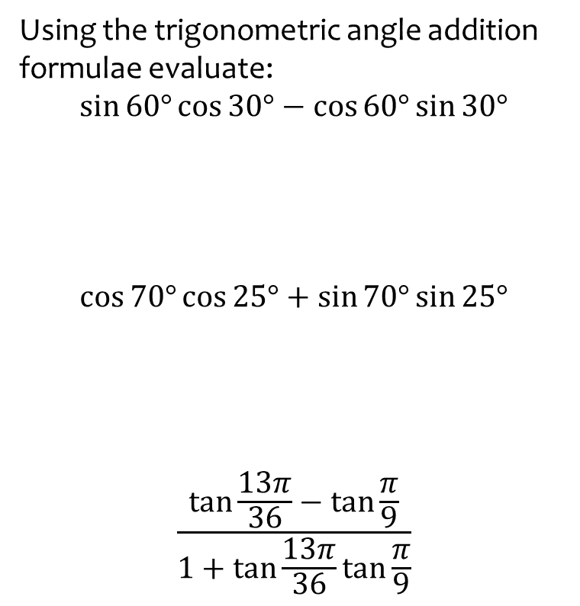
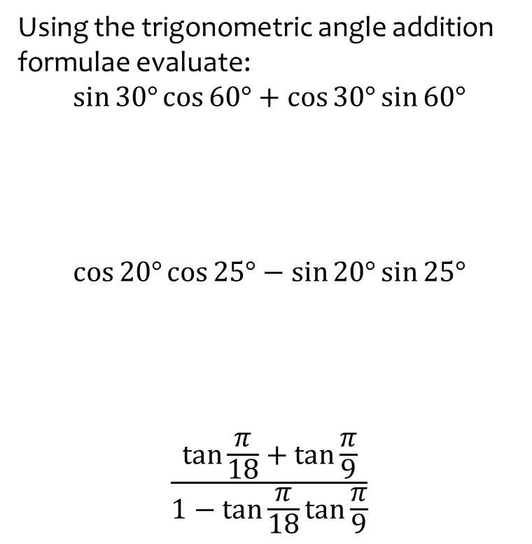
Worked example
Your turn
Using the trigonometric angle addition formulae evaluate:
$$\sin{30°}\cos{60°}+\cos{30°}\sin{60°}$$
$$\cos{20°}\cos{25°}−\sin{20°}\sin{25°}$$
$$\frac{\tan{\frac{π}{18}}+\tan{\frac{π}{9}}}{1−\tan{\frac{π}{18}}\tan{\frac{π}{9}}}$$
Using the trigonometric angle addition formulae evaluate:
$$\sin{60°}\cos{30°}−\cos{60°}\sin{30°}$$
$$\cos{70°}\cos{25°}+\sin{70°}\sin{25°}$$
$$\frac{\tan{\frac{13π}{36}}−\tan{\frac{π}{9}}}{1+\tan{\frac{13π}{36}}\tan{\frac{π}{9}}}$$
$$\sin{30°}=\frac{1}{2}$$
$$\cos{45°}=\frac{\sqrt{2}}{2}$$
$$\tan{\frac{π}{4}}=1$$

Slide 13
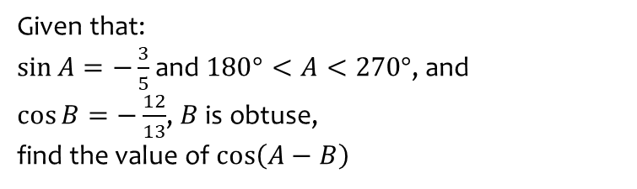
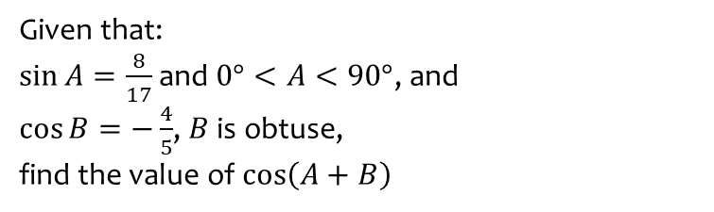

Worked example
Your turn
Given that:
$\sin{A}=\frac{8}{17}$ and $0°<A<90°$, and
$\cos{B}=−\frac{4}{5}$, $B$ is obtuse,
find the value of $\cos\left(A+B\right)$
Given that:
$\sin{A}=−\frac{3}{5}$ and $180°<A<270°$, and
$\cos{B}=−\frac{12}{13}$, $B$ is obtuse,
find the value of $\cos\left(A−B\right)$
$$\frac{33}{65}$$

Slide 14
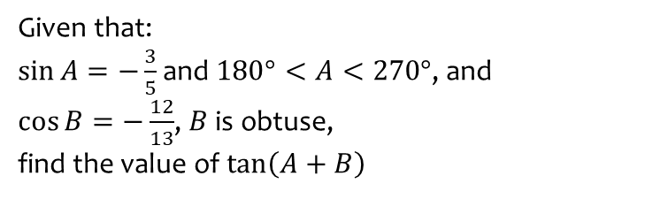
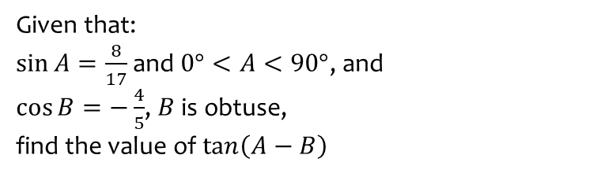

Worked example
Your turn
Given that:
$\sin{A}=\frac{8}{17}$ and $0°<A<90°$, and
$\cos{B}=−\frac{4}{5}$, $B$ is obtuse,
find the value of $\tan\left(A−B\right)$
Given that:
$\sin{A}=−\frac{3}{5}$ and $180°<A<270°$, and
$\cos{B}=−\frac{12}{13}$, $B$ is obtuse,
find the value of $\tan\left(A+B\right)$
$$\frac{16}{63}$$

Slide 15
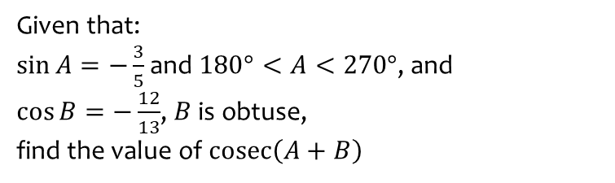
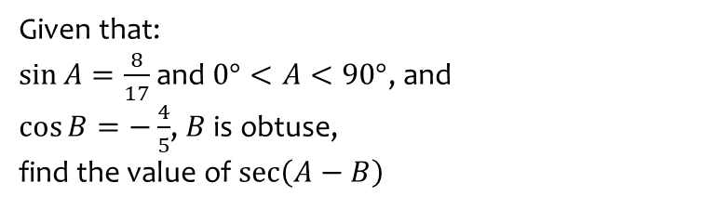

Worked example
Your turn
Given that:
$\sin{A}=\frac{8}{17}$ and $0°<A<90°$, and
$\cos{B}=−\frac{4}{5}$, $B$ is obtuse,
find the value of $\sec\left(A−B\right)$
Given that:
$\sin{A}=−\frac{3}{5}$ and $180°<A<270°$, and
$\cos{B}=−\frac{12}{13}$, $B$ is obtuse,
find the value of $\operatorname{cosec}\left(A+B\right)$
$$\frac{65}{16}$$

Slide 16
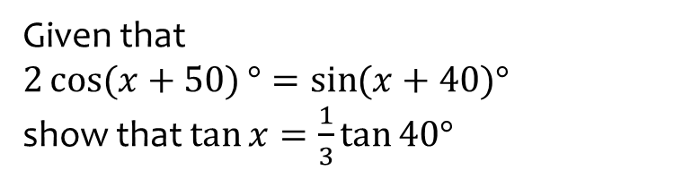
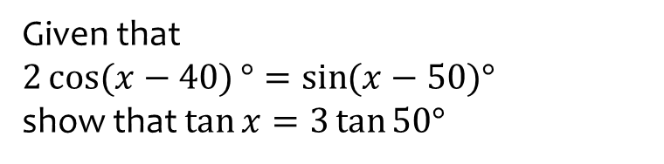
Worked example
Your turn
Given that
$2\cos{(x−40)}°=\sin{(x−50)°}$
show that $\tan{x}=3\tan{50°}$
Given that
$2\cos{(x+50)}°=\sin{(x+40)°}$
show that $\tan{x}=\frac{1}{3}\tan{40°}$
Shown

Slide 17
7.3) Double-angle formulae
Chapter CONTENTS

Slide 18
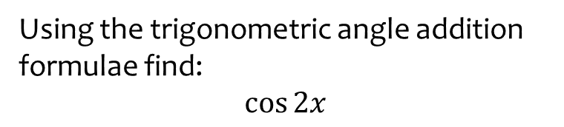

Worked example
Your turn
Using the trigonometric angle addition formulae, derive:
$$\sin{2x}$$
$$\tan{2x}$$
Using the trigonometric angle addition formulae find:
$$\cos{2x}$$
$$\cos^{2}{x}−\sin^{2}{x}$$

Slide 19
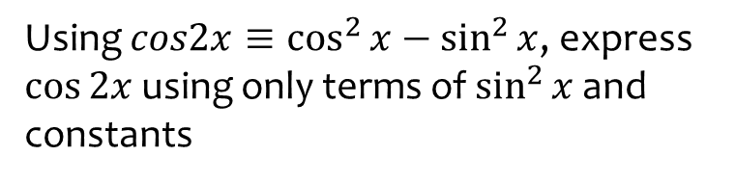
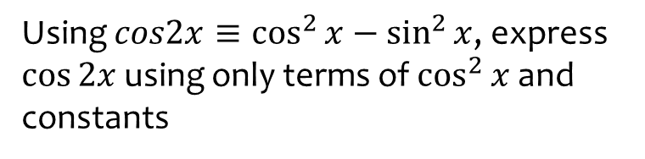
Worked example
Your turn
Using $cos2x≡\cos^{2}{x}−\sin^{2}{x}$, express $\cos{2x}$ using only terms of $\cos^{2}{x}$ and constants
Using $cos2x≡\cos^{2}{x}−\sin^{2}{x}$, express $\cos{2x}$ using only terms of $\sin^{2}{x}$ and constants
$$1−2\sin^{2}{x}$$

Slide 20



Worked example
Your turn
Use the double-angle formulae to write as a single trigonometric ratio:
$$\cos^{2}{50°}−\sin^{2}{50° }$$
$$2\cos^{2}{\frac{2π}{9}}−1$$
$$1−2\sin^{2}{30°}$$
Use the double-angle formulae to write as a single trigonometric ratio:
$$\cos^{2}{15°}−\sin^{2}{15° }$$
$$2\cos^{2}{22.5°}−1$$
$$1−2\sin^{2}{\frac{π}{4}}$$
$$\cos{30°}=\frac{\sqrt{3}}{2}$$
$$\cos{45°}=\frac{\sqrt{2}}{2}$$
$$\cos{\frac{π}{2}}=0$$

Slide 21



Worked example
Your turn
Use the double-angle formulae to write as a single trigonometric ratio:
$$\cos^{2}{2x}−\sin^{2}{2x}$$
$$4\cos^{2}{3x}−2$$
$$3−6\sin^{2}{4x}$$
Use the double-angle formulae to write as a single trigonometric ratio:
$$\cos^{2}{5x}−\sin^{2}{5x}$$
$$8\cos^{2}{6x}−4$$
$$5−10\sin^{2}{7x}$$
$$\cos{10x}$$
$$4\cos{12x}$$
$$5\cos{14x}$$

Slide 22
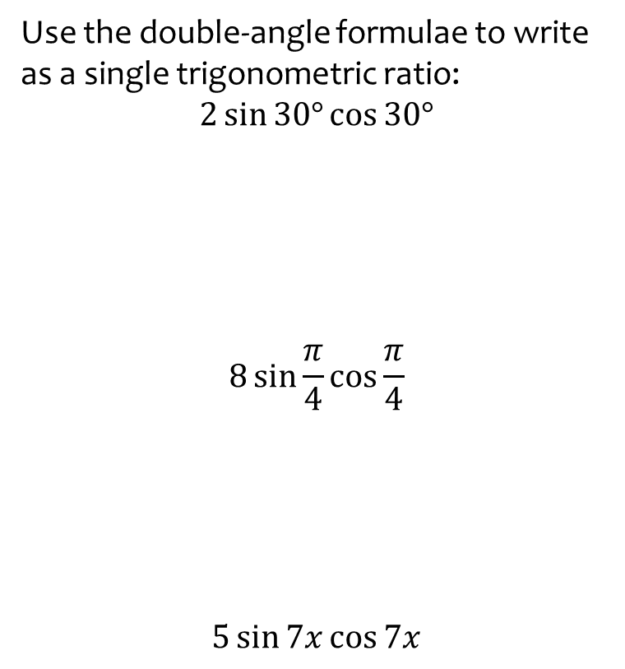
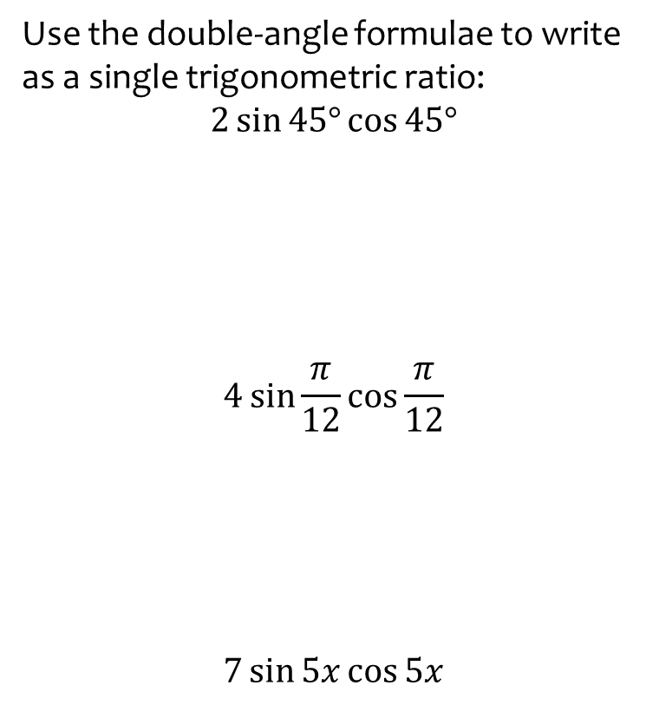

Worked example
Your turn
Use the double-angle formulae to write as a single trigonometric ratio:
$$2\sin{45°}\cos{45°}$$
$$4\sin{\frac{π}{12}}\cos{\frac{π}{12}}$$
$$7\sin{5x}\cos{5x}$$
Use the double-angle formulae to write as a single trigonometric ratio:
$$2\sin{30°}\cos{30°}$$
$$8\sin{\frac{π}{4}}\cos{\frac{π}{4}}$$
$$5\sin{7x}\cos{7x}$$
$$\sin{60°}=\frac{\sqrt{3}}{2}$$
$$16\sin{\frac{π}{2}}=16$$
$$10\sin{14x}$$

Slide 23
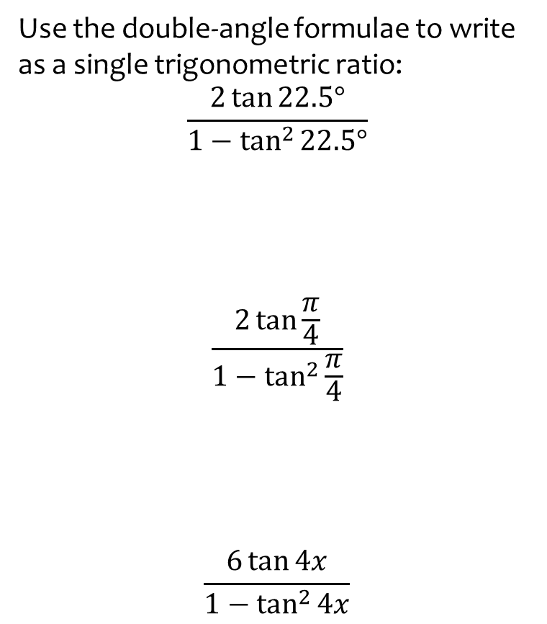
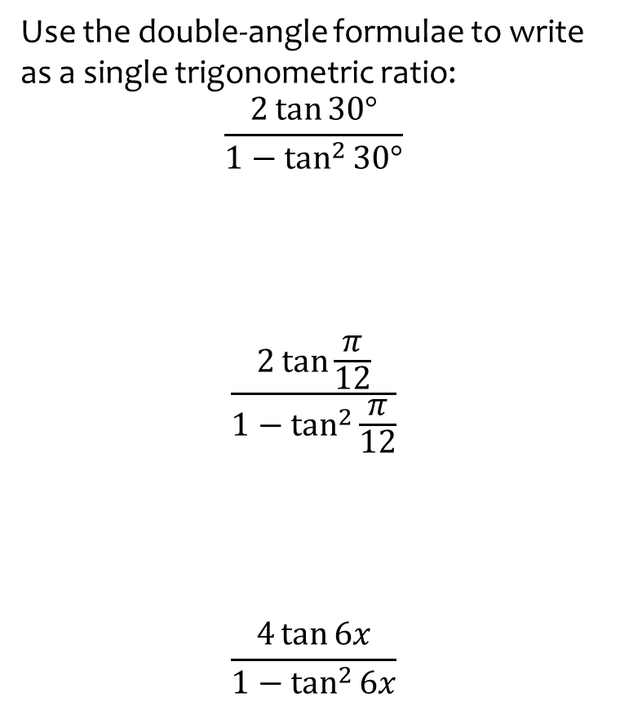

Worked example
Your turn
Use the double-angle formulae to write as a single trigonometric ratio:
$$\frac{2\tan{30°}}{1−\tan^{2}{30°}}$$
$$\frac{2\tan{\frac{π}{12}}}{1−\tan^{2}{\frac{π}{12}}}$$
$$\frac{4\tan{6x}}{1−\tan^{2}{6x}}$$
Use the double-angle formulae to write as a single trigonometric ratio:
$$\frac{2\tan{22.5°}}{1−\tan^{2}{22.5°}}$$
$$\frac{2\tan{\frac{π}{4}}}{1−\tan^{2}{\frac{π}{4}}}$$
$$\frac{6\tan{4x}}{1−\tan^{2}{4x}}$$
$$\tan{45°}=1$$
$$0$$
$$3\tan{8x}$$

Slide 24
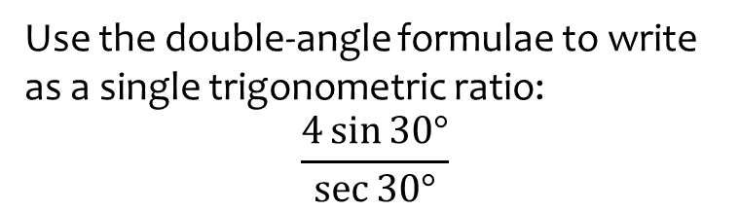
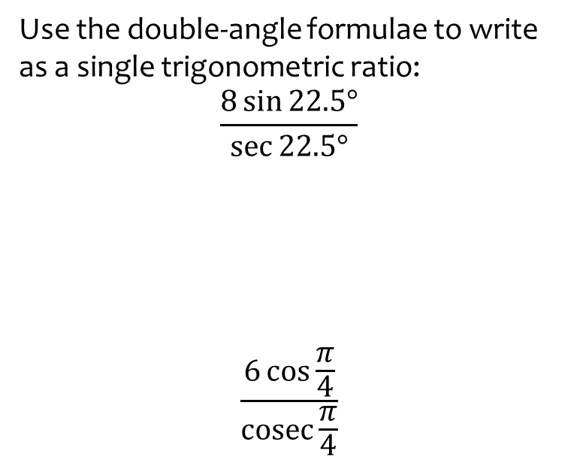
Worked example
Your turn
Use the double-angle formulae to write as a single trigonometric ratio:
$$\frac{8\sin{22.5°}}{\sec{22.5°}}$$
$$\frac{6\cos{\frac{π}{4}}}{\operatorname{cosec}{\frac{π}{4}}}$$
Use the double-angle formulae to write as a single trigonometric ratio:
$$\frac{4\sin{30°}}{\sec{30°}}$$
$$2\sin{60°}=\sqrt{3}$$

Slide 25
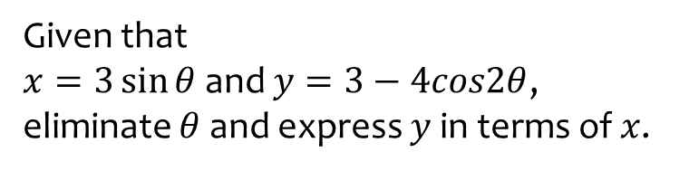


Worked example
Your turn
Given that
$x=2\sin{θ}$ and $y=4−3cos2θ$, eliminate $θ$ and express $y$ in terms of $x$.
Given that
$x=5\cos{θ}$ and $y=6−7cos2θ$, eliminate $θ$ and express $y$ in terms of $x$.
Given that
$x=3\sin{θ}$ and $y=3−4cos2θ$, eliminate $θ$ and express $y$ in terms of $x$.
$$y=\frac{8x^{2}}{9}−1$$

Slide 26
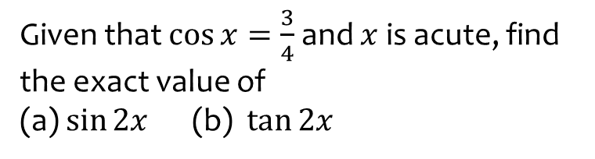
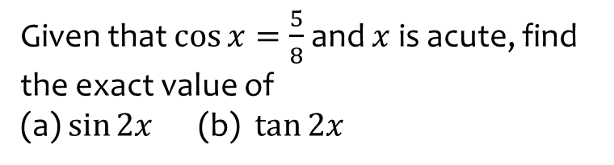
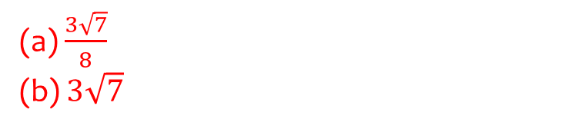
Worked example
Your turn
Given that $\cos{x}=\frac{5}{8}$ and $x$ is acute, find the exact value of
(a) $\sin{2x}$ (b) $\tan{2x}$
Given that $\cos{x}=\frac{3}{4}$ and $x$ is acute, find the exact value of
(a) $\sin{2x}$ (b) $\tan{2x}$
(a) $\frac{3\sqrt{7}}{8}$
(b) $3\sqrt{7}$

Slide 27



Worked example
Your turn
Using the double-angle formulae, evaluate:
$${\left(\sin{\frac{π}{3}}+\cos{\frac{π}{3}}\right)}^{2}$$
$${\left(\sin{\frac{π}{4}}−\cos{\frac{π}{4}}\right)}^{2}$$
Using the double-angle formulae, evaluate:
$${\left(\sin{\frac{π}{6}}+\cos{\frac{π}{6}}\right)}^{2}$$
$$\frac{2+\sqrt{3}}{2}$$

Slide 28


Worked example
Your turn
Given that $0<θ<π$, find the value of $\tan{\frac{θ}{2}}$ when $\tan{θ}=−\frac{3}{4}$
Given that $π<θ<\frac{3π}{2}$, find the value of $\tan{\frac{θ}{2}}$ when $\tan{θ}=\frac{3}{4}$
$$−3$$

Slide 29
7.4) Solving trigonometric equations
Chapter CONTENTS

Slide 30



Worked example
Your turn
Solve in the interval $0≤x≤360°$:
$$8\sin\left(θ+60°\right)=4\sqrt{2}\cos{θ}$$
Solve in the interval $0≤x≤360°$:
$$4\sin\left(θ+30°\right)=8\sqrt{2}\cos{θ}$$
$θ=69.6°, 249.6°$ (1 dp)

Slide 31



Worked example
Your turn
Solve in the interval $0≤x≤360°$:
$$8\cos\left(θ−60°\right)=4\sqrt{2}\sin{θ}$$
Solve in the interval $0≤x≤360°$:
$$4\cos\left(θ−30°\right)=8\sqrt{2}\sin{θ}$$
$θ=20.4°, 200.4°$ (1 dp)

Slide 32



Worked example
Your turn
Solve in the interval $0≤x≤360°$:
$$3\cos{2x}+\cos{x}+2=0$$
Solve in the interval $0≤x≤360°$:
$$3\cos{2x}−\cos{x}+2=0$$
$x=60.0°,109.5°, 250.5°, 300.0°$ (1 dp)

Slide 33



Worked example
Your turn
Solve in the interval $0≤x≤360°$:
$$3\cos{2x}−\sin{x}−2=0$$
Solve in the interval $0≤x≤360°$:
$$3\cos{2x}+\sin{x}−2=0$$
$x=30.0°,150.0°, 199.5°, 340.5°$ (1 dp)

Slide 34


Worked example
Your turn
Solve in the interval $0≤x≤360°$:
$$5\sin{2x}+4\sin{x}=0$$
$$4\sin{2x}−5\cos{x}=0$$
Solve in the interval $0≤x≤360°$:
$$5\sin{2x}−4\sin{x}=0$$
$x=0.0°,66.4°, 180.0°, 199.5°, 293.6°, 360.0°$ (1 dp)

Slide 35



Worked example
Your turn
Solve in the interval $0≤y≤2π$:
$$3\tan{2y}\tan{y}=2$$
Solve in the interval $0≤y≤2π$:
$$2\tan{2y}\tan{y}=3$$
$y=0.58, 2.56, 3.72, 5.70$ (2 dp)

Slide 36



Worked example
Your turn
Show that $\cos\left(3A\right)=4\cos^{3}{A}−3\cos{A}$.
Hence or otherwise, solve, for $0<θ<2π$, the equation $12\cos{θ}−16\cos^{3}{θ}−2\sqrt{3}=0$
Show that $\sin\left(3A\right)=3\sin{A}−4\sin^{3}{A}$.
Hence or otherwise, solve, for $0<θ<2π$, the equation $16\sin^{3}{θ}−12\sin{θ}−2\sqrt{3}=0$
a) Shown
b) $θ=\frac{4π}{9},\frac{5π}{9},\frac{10π}{9},\frac{11π}{9},\frac{16π}{9},\frac{17π}{9}$

Slide 37
7.5) Simplifying $a\cos{x}±b\sin{x}$
Chapter CONTENTS

Slide 38



Worked example
Your turn
Express $5\sin{x}+12\cos{x}$ in the form:
$$R\sin{(x+α}), R>0, 0<α<90°$$
Express $3\sin{x}+4\cos{x}$ in the form:
$$R\sin{(x+α}), R>0, 0<α<90°$$
$$5\sin{(x+53.1°})$$

Slide 39



Worked example
Your turn
Express $5\sin{x}+12\cos{x}$ in the form:
$$R\cos{(x−α}), R>0, 0<α<90°$$
Express $3\sin{x}+4\cos{x}$ in the form:
$$R\cos{(x−α}), R>0, 0<α<90°$$
$$5\cos{(x−36.9°)}$$

Slide 40



Worked example
Your turn
Express $5\sin{x}+12\cos{x}$ in the form:
$$R\sin{(x−α}), R>0, 0<α<180°$$
Express $3\sin{x}+4\cos{x}$ in the form:
$$R\sin{(x−α}), R>0, 0<α<180°$$
$$5\sin{(x+126.9°})$$

Slide 41



Worked example
Your turn
Express $5\sin{x}+12\cos{x}$ in the form:
$$R\cos{(x+α}), R>0, 0<α<180°$$
Express $3\sin{x}+4\cos{x}$ in the form:
$$R\cos{(x+α}), R>0, 0<α<180°$$
$$5\cos{(x+143.1°)}$$

Slide 42



Worked example
Your turn
Solve in the interval $0<θ<360°$:
$$5\cos{θ}+2\sin{θ}=3$$
Solve in the interval $0<θ<360°$:
$$2\cos{θ}+5\sin{θ}=3$$
$θ=12.1°, 124.3°$ (1 dp)

Slide 43



Worked example
Your turn
Solve in the interval $0≤θ<180°$:
$$5\sin{3θ}−12\cos{3θ}=1$$
Solve in the interval $0≤θ<180°$:
$$3\sin{3θ}−4\cos{3θ}=1$$
$θ=21.6°, 73.9°, 141.6°$ (1 dp)

Slide 44



Worked example
Your turn
Solve in the interval $0≤θ<180°$:
$$5\cos{3θ}−12\sin{3θ}=1$$
Solve in the interval $0≤θ<180°$:
$$3\cos{3θ}−4\sin{3θ}=1$$
$θ=8.4°, 76.1°, 128.4°$ (1 dp)

Slide 45



Worked example
Your turn
Solve in the interval $0≤θ<360°$:
$$\cot{θ}+4=cosec θ$$
Solve in the interval $0≤θ<360°$:
$$\cot{θ}+3=cosec θ$$
$θ=143.1°$ (1 dp)

Slide 46



Worked example
Your turn
Find the maximum value and the smallest positive value of $θ$ at which the maximum occurs for:
$$4\cos{θ}+3\sin{θ}$$
Find the maximum value and the smallest positive value of $θ$ at which the maximum occurs for:
$$12\cos{θ}+5\sin{θ}$$
Maximum $=13$ when $θ=22.6°$ (1 dp)

Slide 47



Worked example
Your turn
Find the minimum value and the smallest positive value of $θ$ at which the minimum occurs for:
$$4\cos{θ}+3\sin{θ}$$
Find the minimum value and the smallest positive value of $θ$ at which the minimum occurs for:
$$12\cos{θ}+5\sin{θ}$$
Minimum $=−13$ when $θ=202.6°$ (1 dp)

Slide 48



Worked example
Your turn
Find the maximum value and the smallest positive value of $θ$ at which the maximum occurs for:
$$\frac{5}{7+4\cos{θ}−3\sin{θ} }$$
Find the maximum value and the smallest positive value of $θ$ at which the maximum occurs for:
$$\frac{3}{17+12\cos{θ}−5\sin{θ}}$$
Maximum $=\frac{3}{4}$ when $θ=157.4°$ (1 dp)

Slide 49



Worked example
Your turn
Find the minimum value and the smallest positive value of $θ$ at which the minimum occurs for:
$$\frac{5}{7+4\cos{θ}−3\sin{θ} }$$
Find the minimum value and the smallest positive value of $θ$ at which the minimum occurs for:
$$\frac{3}{17+12\cos{θ}−5\sin{θ}}$$
Minimum $=\frac{1}{10}$ when $θ=337.4°$ (1 dp)

Slide 50
7.6) Proving trigonometric identities
Chapter CONTENTS

Slide 51


Worked example
Your turn
Prove that:
$$\cot{2θ}≡\frac{\cot{θ}−\tan{θ}}{2}$$
Prove that:
$$\tan{2θ}≡\frac{2}{\cot{θ}−\tan{θ}}$$
Proof

Slide 52


Worked example
Your turn
Prove that:
$$\frac{−\sin{2θ}}{\cos{2θ}−1}≡\cot{θ}$$
Prove that:
$$\frac{1−\cos{2θ}}{\sin{2θ}}≡\tan{θ}$$
Proof

Slide 53


Worked example
Your turn
Prove that:
$$\cot{2x}−cosec 2x≡−\tan{x}$$
Prove that:
$$\cot{2x}+cosec 2x≡\cot{x}$$
Proof

Slide 54


Worked example
Your turn
Prove, starting with the left-hand side:
$$\tan{2x}+sec 2x≡\frac{\cos{x}+\sin{x}}{\cos{x}−\sin{x}}$$
Prove, starting with the right-hand side:
$$\tan{2x}+sec 2x≡\frac{\cos{x}+\sin{x}}{\cos{x}−\sin{x}}$$
Proof

Slide 55


Worked example
Your turn
Show that:
$$\sin^{4}{θ}=\frac{3}{8}−\frac{1}{2}\cos{2θ}+\frac{1}{8}\cos{4θ}$$
Show that:
$$\cos^{4}{θ}=\frac{3}{8}+\frac{1}{2}\cos{2θ}+\frac{1}{8}\cos{4θ}$$
Shown

Slide 56


Worked example
Your turn
By writing $\cos{x}=\cos\left(2×\frac{x}{2}\right)$, prove the identity
$$\frac{1+\cos{x}}{1−\cos{x}}≡\cot^{2}\left(\frac{x}{2}\right)$$
By writing $\cos{x}=\cos\left(2×\frac{x}{2}\right)$, prove the identity
$$\frac{1−\cos{x}}{1+\cos{x}}≡\tan^{2}\left(\frac{x}{2}\right)$$
Proof

Slide 57
7.7) Modelling with trigonometric functions
Chapter CONTENTS

Slide 58



Worked example
Your turn
The cabin pressure, $P$ (psi) on an aeroplane at cruising altitude can be modelled by the equation
$$P=14.5−0.2\sin{(t−3)}$$
where $t$ is the time in hours since cruising altitude was first reached, and angles are in radians. Find:
The maximum and minimum cabin pressure
The time after reaching cruising altitude that the cabin first reaches a maximum pressure
The cabin pressure after 3 hours at cruising altitude
All the times within the first 10 hours of cruising that the cabin pressure would be exactly 14.42 psi
The cabin pressure, $P$ (psi) on an aeroplane at cruising altitude can be modelled by the equation
$$P=11.5−0.5\sin{(t−2)}$$
where $t$ is the time in hours since cruising altitude was first reached, and angles are in radians. Find:
The maximum and minimum cabin pressure
The time after reaching cruising altitude that the cabin first reaches a maximum pressure
The cabin pressure after 5 hours at cruising altitude
All the times within the first 8 hours of cruising that the cabin pressure would be exactly 11.3 psi
a) Maximum $=12$ psi ; Minimum $=11$psi
b) $0.43$hours $=26$minutes
c) $11.43$ psi
d) $2$ hours $25$ minutes, and $4$ hours $44$ minutes

Slide 59



Worked example
Your turn
Express $7\cos{θ}−5\sin{θ}$ in the form $R\cos{(θ}+α),$where $R>0$ and $0<α<\frac{π}{2}$. State the exact value of $R$ and give $α$ to four decimal places.
State the maximum value of $7\cos{θ}−5\sin{θ}$ and the value of $θ$, for $0<θ<2π$ at which this maximum occurs.
The height $H$ above ground of a passenger on a Ferris wheel is modelled by the equation
$$H=12−7\cos{(\frac{πt}{4}})+5 sin⁡(\frac{πt}{4})$$
where $H$ is measured in metres, and $t$ is the time in minutes after the wheel starts turning.
Calculate the maximum value of $H$ predicted by this model, and the value of $t$ when this maximum first occurs
Determine the time for the Ferris wheel to complete five revolutions
Express $9\cos{θ}−2\sin{θ}$ in the form $R\cos{(θ}+α),$where $R>0$ and $0<α<\frac{π}{2}$. State the exact value of $R$ and give $α$ to four decimal places.
State the maximum value of $9\cos{θ}−2\sin{θ}$ and the value of $θ$, for $0<θ<2π$ at which this maximum occurs.
The height $H$ above ground of a passenger on a Ferris wheel is modelled by the equation
$$H=10−9\cos{(\frac{πt}{5}})+2 sin⁡(\frac{πt}{5})$$
where $H$ is measured in metres, and $t$ is the time in minutes after the wheel starts turning.
Calculate the maximum value of $H$ predicted by this model, and the value of $t$ when this maximum first occurs
Determine the time for the Ferris wheel to complete two revolutions
a) $R=\sqrt{85}, α=0.2187$
b) Maximum $=\sqrt{85}$ when $θ=6.06$
c) Maximum $H=19.22m$ at $t=4.65$
d) $20$ minutes

Slide 60



Worked example
Your turn
Express $1.5\sin{θ}−2\cos{θ}$ in the form $R\sin{(θ}−α),$where $R>0$ and $0<α<\frac{π}{2}$. State the exact value of $R$ and give $α$ to four decimal places.
State the maximum value of$1.5\sin{θ}−2\cos{θ}$and the value of $θ$, for $0<θ<π$ at which this maximum occurs.
The height $H$ of sea water on a particular day can be modelled by the equation
$$H=8+1.5\sin\left(\frac{2πt}{25}\right)−2\cos\left(\frac{2πt}{25}\right), 0≤t<12$$
where $H$ is measured in metres, and $t$ is the number of hours after midnight.
Calculate the maximum value of $H$ predicted by this model, and the value of $t$ when this maximum occurs
Calculate, to the nearest minute, the times when the height of sea water is predicted, by this model, to be 7 metres.
Express $2\sin{θ}−1.5\cos{θ}$ in the form $R\sin{(θ}−α),$where $R>0$ and $0<α<\frac{π}{2}$. State the exact value of $R$ and give $α$ to four decimal places.
State the maximum value of $2\sin{θ}−1.5\cos{θ}$ and the value of $θ$, for $0<θ<π$ at which this maximum occurs.
The height $H$ of sea water on a particular day can be modelled by the equation
$$H=6+2\sin\left(\frac{4πt}{25}\right)−1.5\cos\left(\frac{4πt}{25}\right), 0≤t<12$$
where $H$ is measured in metres, and $t$ is the number of hours after midday.
Calculate the maximum value of $H$ predicted by this model, and the value of $t$ when this maximum occurs
Calculate, to the nearest minute, the times when the height of sea water is predicted, by this model, to be 7 metres.
a) $R=2.5, α=0.6435$
b) Maximum $=2.5$ when $θ=2.21$
c) Maximum $H=8.5m$ at $t=4.41$
d) $14:06$ and $18:43$

