Slide 1
7) Hypothesis testing
7.1) Hypothesis testing
7.2) Finding critical values
7.3) One-tailed tests
7.4) Two-tailed tests

Slide 2
7.1) Hypothesis testing
Chapter CONTENTS

Slide 3
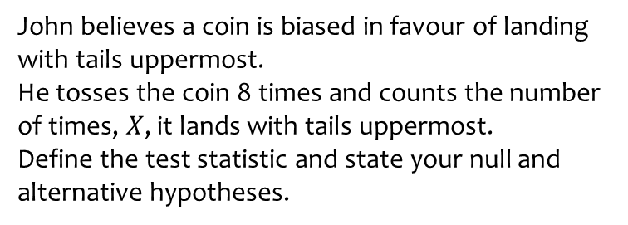
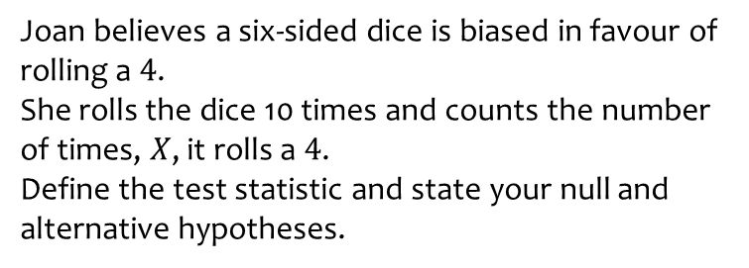
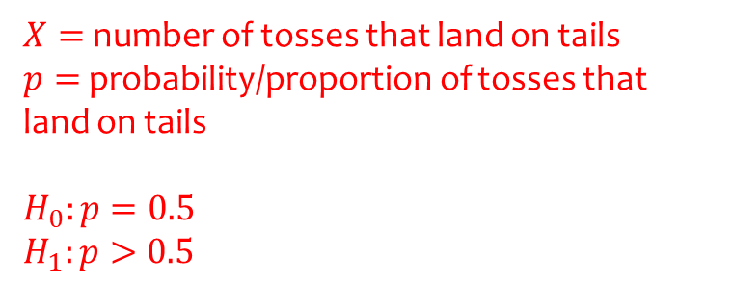
Worked example
Your turn
Joan believes a six-sided dice is biased in favour of rolling a $4$.
She rolls the dice 10 times and counts the number of times, $X$, it rolls a $4$.
Define the test statistic and state your null and alternative hypotheses.
John believes a coin is biased in favour of landing with tails uppermost.
He tosses the coin 8 times and counts the number of times, $X$, it lands with tails uppermost.
Define the test statistic and state your null and alternative hypotheses.
$X=$ number of tosses that land on tails
$p=$ probability/proportion of tosses that land on tails
$$H_{0}:p=0.5$$
$$H_{1}:p>0.5$$

Slide 4
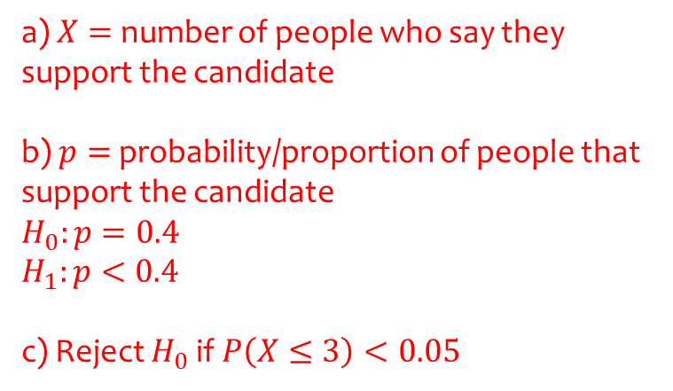
Worked example
Your turn
An election candidate believes he has the support of 30% of the residents in a particular town.
A researcher wants to test, at the 10% significance level, whether the candidate is over-estimating his support.
The researcher asks 30 people whether they support the candidate or not. 2 people say they do.
Write down a suitable test statistic.
Write down two suitable hypotheses.
Explain the condition under which the null hypothesis would be rejected.
An election candidate believes she has the support of 40% of the residents in a particular town.
A researcher wants to test, at the 5% significance level, whether the candidate is over-estimating her support.
The researcher asks 20 people whether they support the candidate or not. 3 people say they do.
Write down a suitable test statistic.
Write down two suitable hypotheses.
Explain the condition under which the null hypothesis would be rejected.
a) $X=$ number of people who say they support the candidate
b) $p=$ probability/proportion of people that support the candidate
$$H_{0}:p=0.4$$
$$H_{1}:p<0.4$$
c) Reject $H_{0}$ if $P\left(X≤3\right)<0.05$

Slide 5
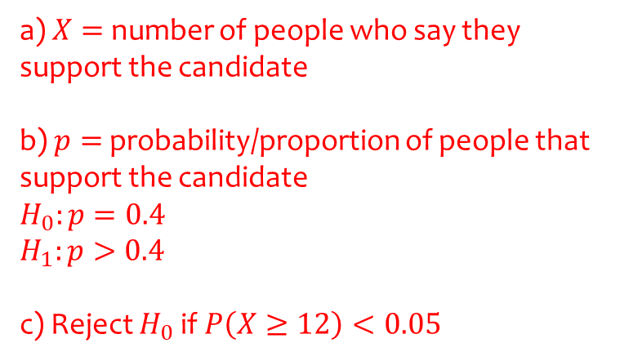
Worked example
Your turn
An election candidate believes he has the support of 30% of the residents in a particular town.
A researcher wants to test, at the 1% significance level, whether the candidate is under-estimating his support.
The researcher asks 30 people whether they support the candidate or not. 11 people say they do.
Write down a suitable test statistic.
Write down two suitable hypotheses.
Explain the condition under which the null hypothesis would be rejected.
An election candidate believes she has the support of 40% of the residents in a particular town.
A researcher wants to test, at the 2% significance level, whether the candidate is under-estimating her support.
The researcher asks 20 people whether they support the candidate or not. 12 people say they do.
Write down a suitable test statistic.
Write down two suitable hypotheses.
Explain the condition under which the null hypothesis would be rejected.
a) $X=$ number of people who say they support the candidate
b) $p=$ probability/proportion of people that support the candidate
$$H_{0}:p=0.4$$
$$H_{1}:p>0.4$$
c) Reject $H_{0}$ if $P\left(X≥12\right)<0.05$

Slide 6
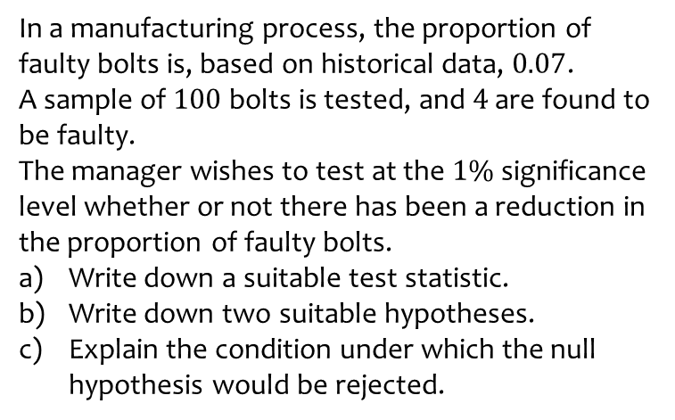
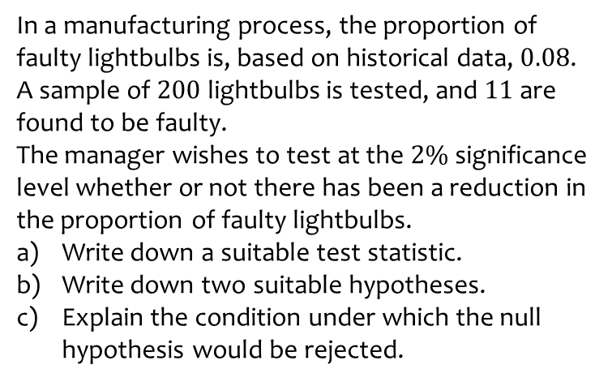
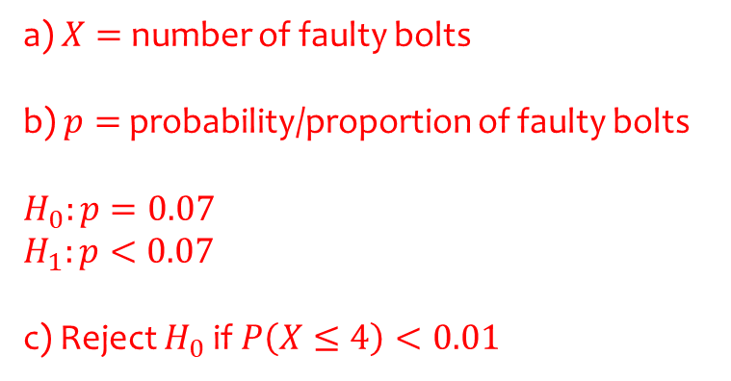
Worked example
Your turn
In a manufacturing process, the proportion of faulty lightbulbs is, based on historical data, $0.08$.
A sample of $200$ lightbulbs is tested, and $11$ are found to be faulty.
The manager wishes to test at the $2\%$significance level whether or not there has been a reduction in the proportion of faulty lightbulbs.
Write down a suitable test statistic.
Write down two suitable hypotheses.
Explain the condition under which the null hypothesis would be rejected.
In a manufacturing process, the proportion of faulty bolts is, based on historical data, $0.07$.
A sample of $100$ bolts is tested, and $4$ are found to be faulty.
The manager wishes to test at the $1\%$significance level whether or not there has been a reduction in the proportion of faulty bolts.
Write down a suitable test statistic.
Write down two suitable hypotheses.
Explain the condition under which the null hypothesis would be rejected.
a) $X=$ number of faulty bolts
b) $p=$ probability/proportion of faulty bolts
$$H_{0}:p=0.07$$
$$H_{1}:p<0.07$$
c) Reject $H_{0}$ if $P\left(X≤4\right)<0.01$

Slide 7
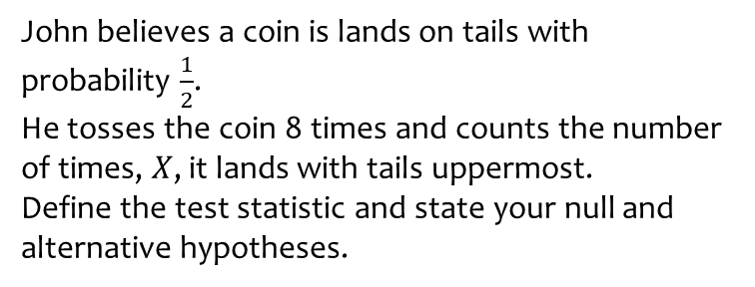
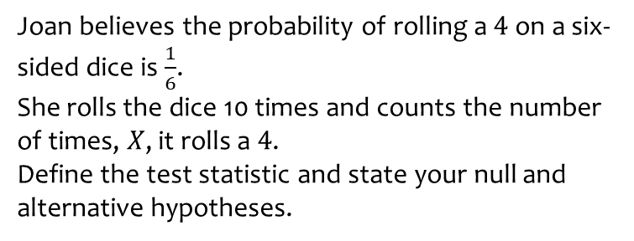
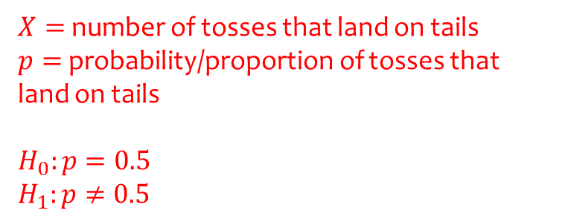
Worked example
Your turn
Joan believes the probability of rolling a $4$ on a six-sided dice is $\frac{1}{6}$.
She rolls the dice 10 times and counts the number of times, $X$, it rolls a $4$.
Define the test statistic and state your null and alternative hypotheses.
John believes a coin is lands on tails with probability $\frac{1}{2}$.
He tosses the coin 8 times and counts the number of times, $X$, it lands with tails uppermost.
Define the test statistic and state your null and alternative hypotheses.
$X=$ number of tosses that land on tails
$p=$ probability/proportion of tosses that land on tails
$$H_{0}:p=0.5$$
$$H_{1}:p≠0.5$$

Slide 8
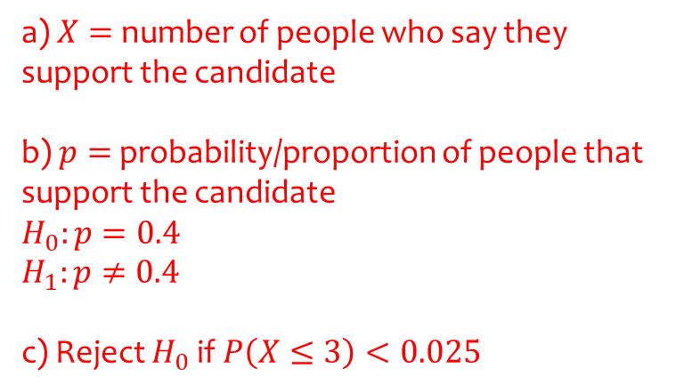
Worked example
Your turn
An election candidate believes he has the support of 30% of the residents in a particular town.
A researcher wants to test, at the 10% significance level, whether this claim is true.
The researcher asks 30 people whether they support the candidate or not. 2 people say they do.
Write down a suitable test statistic.
Write down two suitable hypotheses.
Explain the condition under which the null hypothesis would be rejected.
An election candidate believes she has the support of 40% of the residents in a particular town.
A researcher wants to test, at the 5% significance level, whether this claim is true.
The researcher asks 20 people whether they support the candidate or not. 3 people say they do.
Write down a suitable test statistic.
Write down two suitable hypotheses.
Explain the condition under which the null hypothesis would be rejected.
a) $X=$ number of people who say they support the candidate
b) $p=$ probability/proportion of people that support the candidate
$$H_{0}:p=0.4$$
$$H_{1}:p≠0.4$$
c) Reject $H_{0}$ if $P\left(X≤3\right)<0.025$

Slide 9
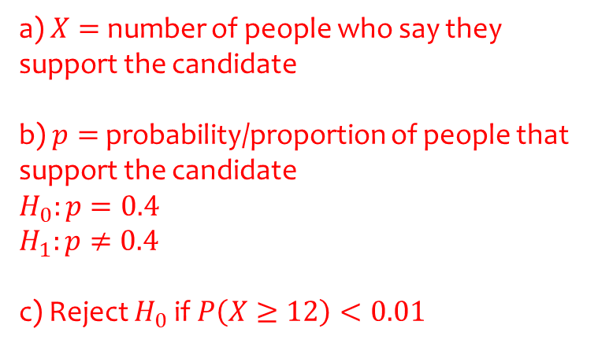
Worked example
Your turn
An election candidate believes he has the support of 30% of the residents in a particular town.
A researcher wants to test, at the 1% significance level, whether this claim is true.
The researcher asks 30 people whether they support the candidate or not. 11 people say they do.
Write down a suitable test statistic.
Write down two suitable hypotheses.
Explain the condition under which the null hypothesis would be rejected.
An election candidate believes she has the support of 40% of the residents in a particular town.
A researcher wants to test, at the 2% significance level, whether this claim is true.
The researcher asks 20 people whether they support the candidate or not. 12 people say they do.
Write down a suitable test statistic.
Write down two suitable hypotheses.
Explain the condition under which the null hypothesis would be rejected.
a) $X=$ number of people who say they support the candidate
b) $p=$ probability/proportion of people that support the candidate
$$H_{0}:p=0.4$$
$$H_{1}:p≠0.4$$
c) Reject $H_{0}$ if $P\left(X≥12\right)<0.01$

Slide 10
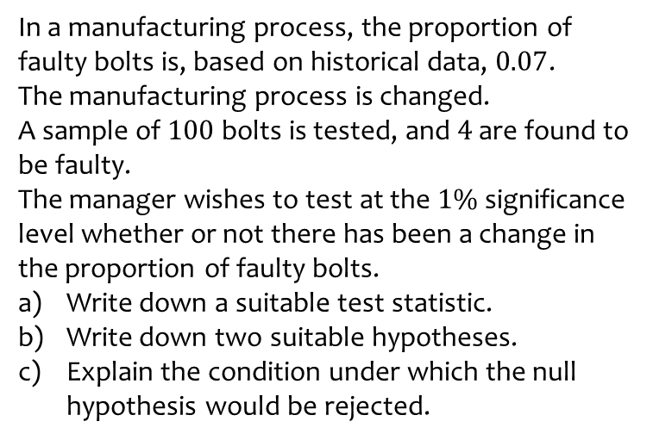
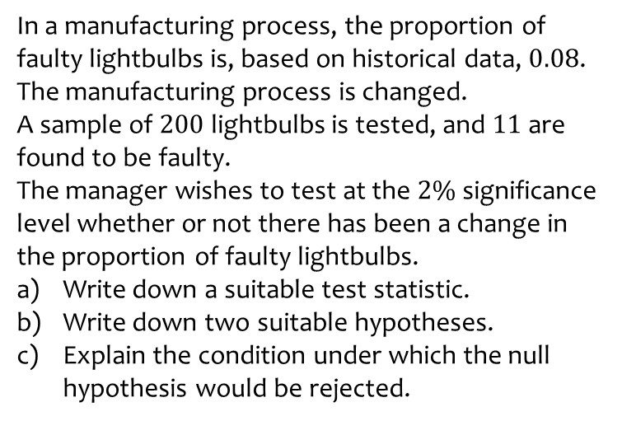
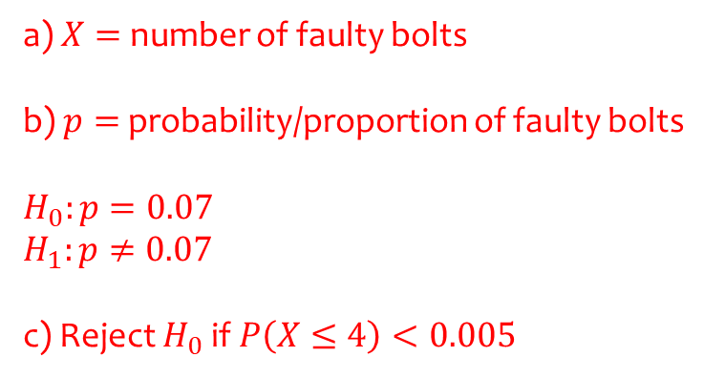
Worked example
Your turn
In a manufacturing process, the proportion of faulty lightbulbs is, based on historical data, $0.08$.
The manufacturing process is changed.
A sample of $200$ lightbulbs is tested, and $11$ are found to be faulty.
The manager wishes to test at the $2\%$significance level whether or not there has been a change in the proportion of faulty lightbulbs.
Write down a suitable test statistic.
Write down two suitable hypotheses.
Explain the condition under which the null hypothesis would be rejected.
In a manufacturing process, the proportion of faulty bolts is, based on historical data, $0.07$.
The manufacturing process is changed.
A sample of $100$ bolts is tested, and $4$ are found to be faulty.
The manager wishes to test at the $1\%$significance level whether or not there has been a change in the proportion of faulty bolts.
Write down a suitable test statistic.
Write down two suitable hypotheses.
Explain the condition under which the null hypothesis would be rejected.
a) $X=$ number of faulty bolts
b) $p=$ probability/proportion of faulty bolts
$$H_{0}:p=0.07$$
$$H_{1}:p≠0.07$$
c) Reject $H_{0}$ if $P\left(X≤4\right)<0.005$

Slide 11
7.2) Finding critical values
Chapter CONTENTS

Slide 12
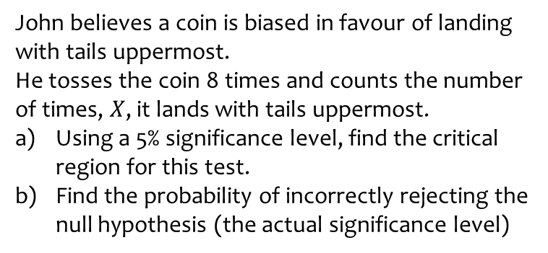
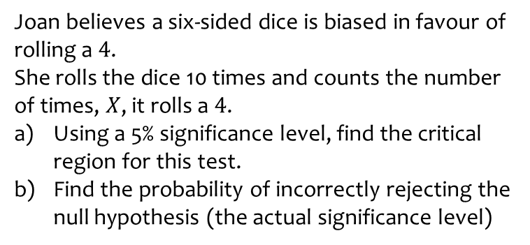
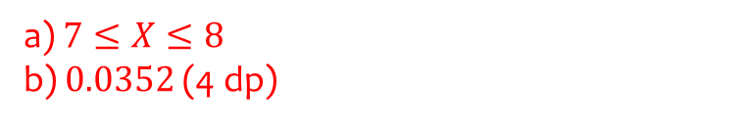
Worked example
Your turn
Joan believes a six-sided dice is biased in favour of rolling a $4$.
She rolls the dice 10 times and counts the number of times, $X$, it rolls a $4$.
Using a 5% significance level, find the critical region for this test.
Find the probability of incorrectly rejecting the null hypothesis (the actual significance level)
John believes a coin is biased in favour of landing with tails uppermost.
He tosses the coin 8 times and counts the number of times, $X$, it lands with tails uppermost.
Using a 5% significance level, find the critical region for this test.
Find the probability of incorrectly rejecting the null hypothesis (the actual significance level)
a) $7≤X≤8$
b) $0.0352$ (4 dp)

Slide 13

Worked example
Your turn
An election candidate believes he has the support of 30% of the residents in a particular town.
A researcher wants to test, at the 10% significance level, whether the candidate is over-estimating his support.
The researcher asks 30 people whether they support the candidate or not.
Find the critical region for this test.
Find the probability of incorrectly rejecting the null hypothesis (the actual significance level)
An election candidate believes she has the support of 40% of the residents in a particular town.
A researcher wants to test, at the 5% significance level, whether the candidate is over-estimating her support.
The researcher asks 20 people whether they support the candidate or not.
Find the critical region for this test.
Find the probability of incorrectly rejecting the null hypothesis (the actual significance level)
a) $0≤X≤3$
b) $0.0160$ (4 dp)

Slide 14
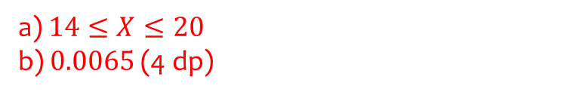
Worked example
Your turn
An election candidate believes he has the support of 30% of the residents in a particular town.
A researcher wants to test, at the 1% significance level, whether the candidate is under-estimating his support.
The researcher asks 30 people whether they support the candidate or not.
Find the critical region for this test.
Find the probability of incorrectly rejecting the null hypothesis (the actual significance level)
An election candidate believes she has the support of 40% of the residents in a particular town.
A researcher wants to test, at the 2% significance level, whether the candidate is under-estimating her support.
The researcher asks 20 people whether they support the candidate or not.
Find the critical region for this test.
Find the probability of incorrectly rejecting the null hypothesis (the actual significance level)
a) $14≤X≤20$
b) $0.0065$ (4 dp)

Slide 15
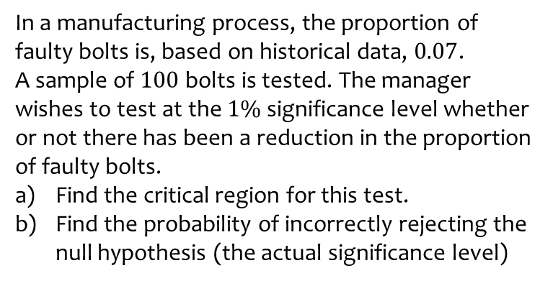
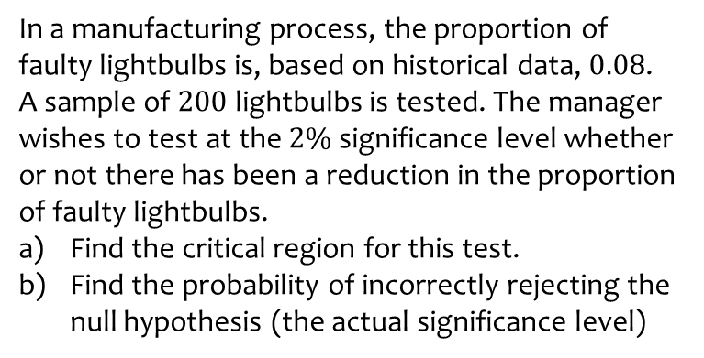

Worked example
Your turn
In a manufacturing process, the proportion of faulty lightbulbs is, based on historical data, $0.08$.
A sample of $200$ lightbulbs is tested. The manager wishes to test at the $2\%$significance level whether or not there has been a reduction in the proportion of faulty lightbulbs.
Find the critical region for this test.
Find the probability of incorrectly rejecting the null hypothesis (the actual significance level)
In a manufacturing process, the proportion of faulty bolts is, based on historical data, $0.07$.
A sample of $100$ bolts is tested. The manager wishes to test at the $1\%$significance level whether or not there has been a reduction in the proportion of faulty bolts.
Find the critical region for this test.
Find the probability of incorrectly rejecting the null hypothesis (the actual significance level)
a) $0≤X≤1$
b) $0.0060$ (4 dp)

Slide 16
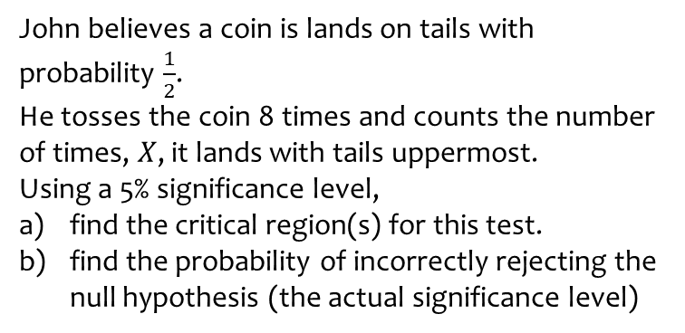
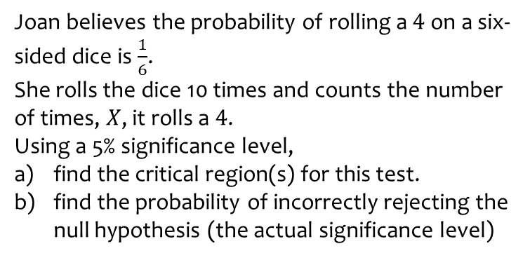
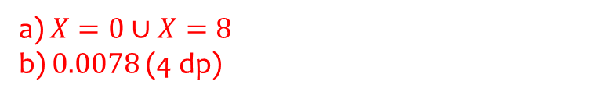
Worked example
Your turn
Joan believes the probability of rolling a $4$ on a six-sided dice is $\frac{1}{6}$.
She rolls the dice 10 times and counts the number of times, $X$, it rolls a $4$.
Using a 5% significance level,
find the critical region(s) for this test.
find the probability of incorrectly rejecting the null hypothesis (the actual significance level)
John believes a coin is lands on tails with probability $\frac{1}{2}$.
He tosses the coin 8 times and counts the number of times, $X$, it lands with tails uppermost.
Using a 5% significance level,
find the critical region(s) for this test.
find the probability of incorrectly rejecting the null hypothesis (the actual significance level)
a) $X=0∪X=8$
b) $0.0078$ (4 dp)

Slide 17

Worked example
Your turn
An election candidate believes he has the support of 30% of the residents in a particular town.
A researcher wants to test, at the 10% significance level, whether this claim is true.
The researcher asks 30 people whether they support the candidate or not.
Find the critical region(s) for this test.
Find the probability of incorrectly rejecting the null hypothesis (the actual significance level)
An election candidate believes she has the support of 40% of the residents in a particular town.
A researcher wants to test, at the 5% significance level, whether this claim is true.
The researcher asks 20 people whether they support the candidate or not.
Find the critical region(s) for this test.
Find the probability of incorrectly rejecting the null hypothesis (the actual significance level)
a) $0≤X≤3∪13≤X≤20$
b) $0.0370$ (4 dp)

Slide 18

Worked example
Your turn
An election candidate believes he has the support of 30% of the residents in a particular town.
A researcher wants to test, at the 1% significance level, whether this claim is true.
The researcher asks 30 people whether they support the candidate or not.
Find the critical region(s) for this test.
Find the probability of incorrectly rejecting the null hypothesis (the actual significance level)
An election candidate believes she has the support of 40% of the residents in a particular town.
A researcher wants to test, at the 2% significance level, whether this claim is true.
The researcher asks 20 people whether they support the candidate or not.
Find the critical region(s) for this test.
Find the probability of incorrectly rejecting the null hypothesis (the actual significance level)
a) $0≤X≤2∪14≤X≤20$
b) $0.0101$ (4 dp)

Slide 19
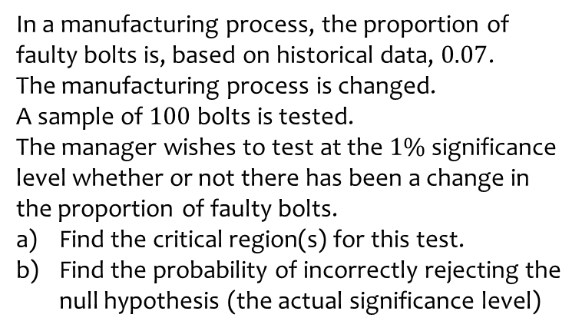
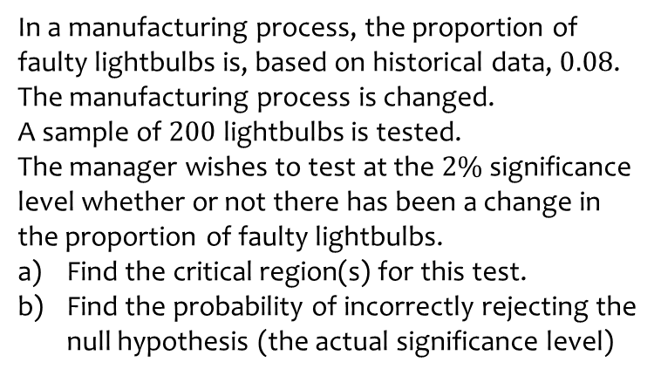
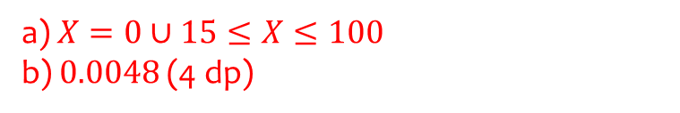
Worked example
Your turn
In a manufacturing process, the proportion of faulty lightbulbs is, based on historical data, $0.08$.
The manufacturing process is changed.
A sample of $200$ lightbulbs is tested.
The manager wishes to test at the $2\%$significance level whether or not there has been a change in the proportion of faulty lightbulbs.
Find the critical region(s) for this test.
Find the probability of incorrectly rejecting the null hypothesis (the actual significance level)
In a manufacturing process, the proportion of faulty bolts is, based on historical data, $0.07$.
The manufacturing process is changed.
A sample of $100$ bolts is tested.
The manager wishes to test at the $1\%$significance level whether or not there has been a change in the proportion of faulty bolts.
Find the critical region(s) for this test.
Find the probability of incorrectly rejecting the null hypothesis (the actual significance level)
a) $X=0∪15≤X≤100$
b) $0.0048$ (4 dp)

Slide 20
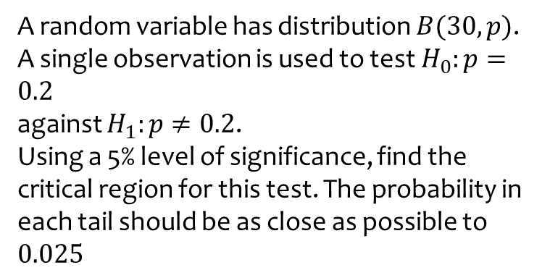
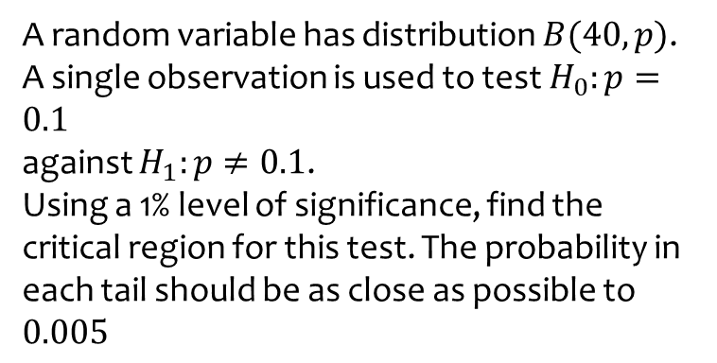
Worked example
Your turn
A random variable has distribution $B(40, p)$.
A single observation is used to test $H_{0}:p=0.1$
against $H_{1}:p≠0.1$.
Using a 1% level of significance, find the critical region for this test. The probability in each tail should be as close as possible to $0.005$
A random variable has distribution $B(30, p)$.
A single observation is used to test $H_{0}:p=0.2$
against $H_{1}:p≠0.2$.
Using a 5% level of significance, find the critical region for this test. The probability in each tail should be as close as possible to $0.025$
$$0≤X≤1∪11≤X≤30$$

Slide 21
7.3) One-tailed tests
Chapter CONTENTS

Slide 22

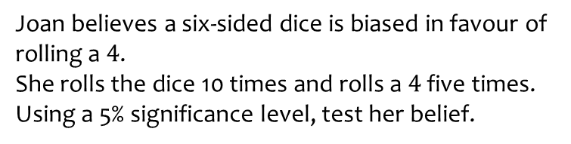
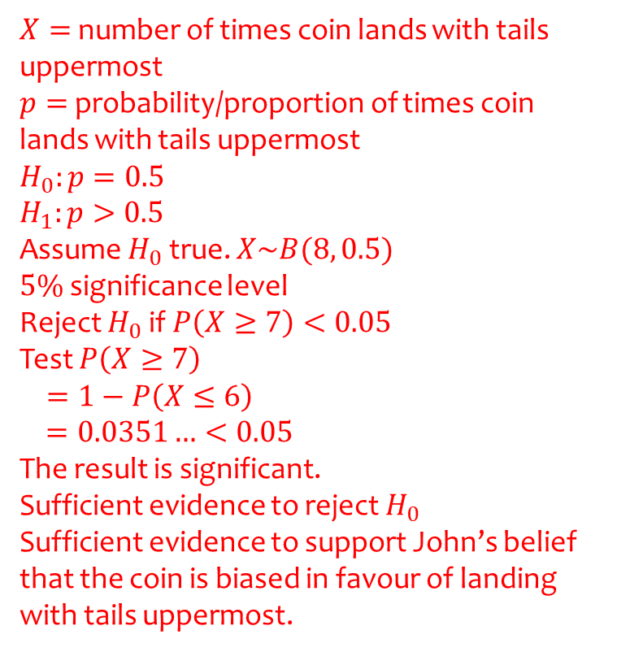
Worked example
Your turn
Joan believes a six-sided dice is biased in favour of rolling a $4$.
She rolls the dice 10 times and rolls a $4$ five times.
Using a 5% significance level, test her belief.
John believes a coin is biased in favour of landing with tails uppermost.
He tosses the coin 8 times and it lands on tails $7$ times. Using a 5% significance level, test his belief.
$X=$ number of times coin lands with tails uppermost
$p=$ probability/proportion of times coin lands with tails uppermost
$$H_{0}:p=0.5$$
$$H_{1}:p>0.5$$
Assume $H_{0}$ true. $X\sim B(8, 0.5)$
$5\%$ significance level
Reject $H_{0}$ if $P\left(X≥7\right)<0.05$
Test $P\left(X≥7\right)$
$$=1−P\left(X≤6\right)$$
$=0.0351…<0.05$
The result is significant.
Sufficient evidence to reject $H_{0}$
Sufficient evidence to support John’s belief that the coin is biased in favour of landing with tails uppermost.

Slide 23
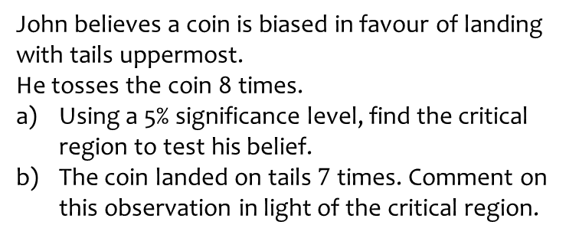
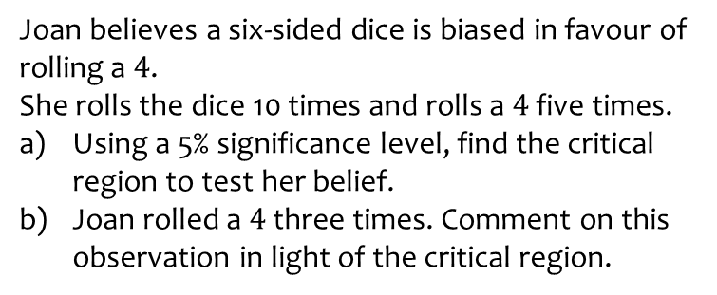
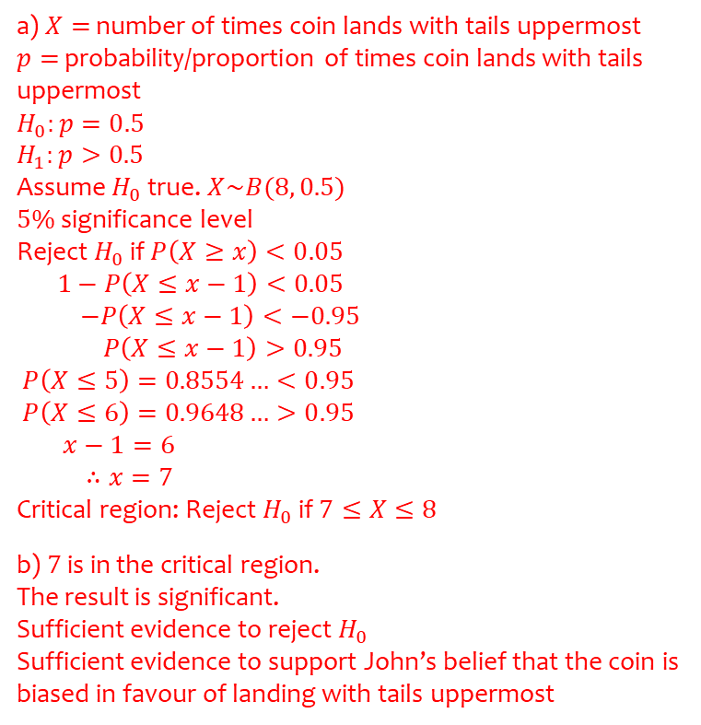
Worked example
Your turn
Joan believes a six-sided dice is biased in favour of rolling a $4$.
She rolls the dice 10 times and rolls a $4$ five times.
Using a 5% significance level, find the critical region to test her belief.
Joan rolled a $4$ three times. Comment on this observation in light of the critical region.
John believes a coin is biased in favour of landing with tails uppermost.
He tosses the coin 8 times.
Using a 5% significance level, find the critical region to test his belief.
The coin landed on tails $7$ times. Comment on this observation in light of the critical region.
a) $X=$ number of times coin lands with tails uppermost
$p=$ probability/proportion of times coin lands with tails uppermost
$$H_{0}:p=0.5$$
$$H_{1}:p>0.5$$
Assume $H_{0}$ true. $X\sim B(8, 0.5)$
$5\%$ significance level
Reject $H_{0}$ if $P\left(X≥x\right)<0.05$
$1−P\left(X≤x−1\right)<0.05$
$−P\left(X≤x−1\right)<−0.95$
$P\left(X≤x−1\right)>0.95$
$P\left(X≤5\right)=0.8554…<0.95$
$P\left(X≤6\right)=0.9648…>0.95$
$x−1=6$
$∴x=7$
Critical region: Reject $H_{0}$ if $7≤X≤8$
b) $7$ is in the critical region.
The result is significant.
Sufficient evidence to reject $H_{0}$
Sufficient evidence to support John’s belief that the coin is biased in favour of landing with tails uppermost

Slide 24
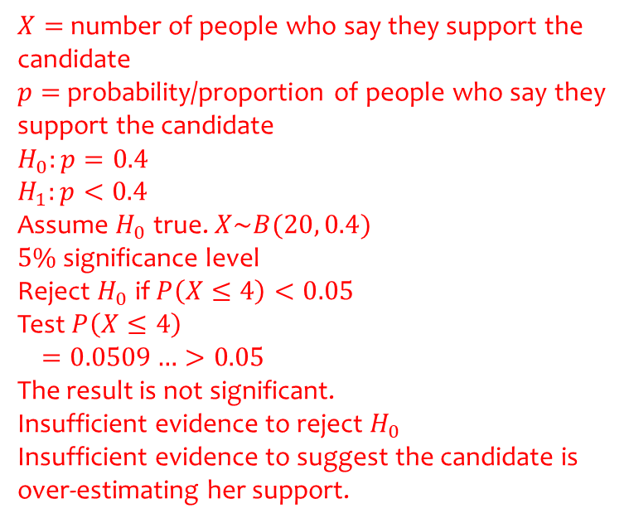
Worked example
Your turn
An election candidate believes he has the support of 30% of the residents in a particular town.
A researcher wants to test, at the 10% significance level, whether the candidate is over-estimating his support.
The researcher asks 30 people whether they support the candidate or not. 6 people say they support the candidate.
Carry out a hypothesis test for the researcher.
An election candidate believes she has the support of 40% of the residents in a particular town.
A researcher wants to test, at the 5% significance level, whether the candidate is over-estimating her support.
The researcher asks 20 people whether they support the candidate or not. 4 people say they support the candidate.
Carry out a hypothesis test for the researcher.
$X=$ number of people who say they support the candidate
$p=$ probability/proportion of people who say they support the candidate
$$H_{0}:p=0.4$$
$$H_{1}:p<0.4$$
Assume $H_{0}$ true. $X\sim B(20, 0.4)$
$5\%$ significance level
Reject $H_{0}$ if $P\left(X≤4\right)<0.05$
Test $P\left(X≤4\right)$
$$=0.0509…>0.05$$
The result is not significant.
Insufficient evidence to reject $H_{0}$
Insufficient evidence to suggest the candidate is over-estimating her support.

Slide 25
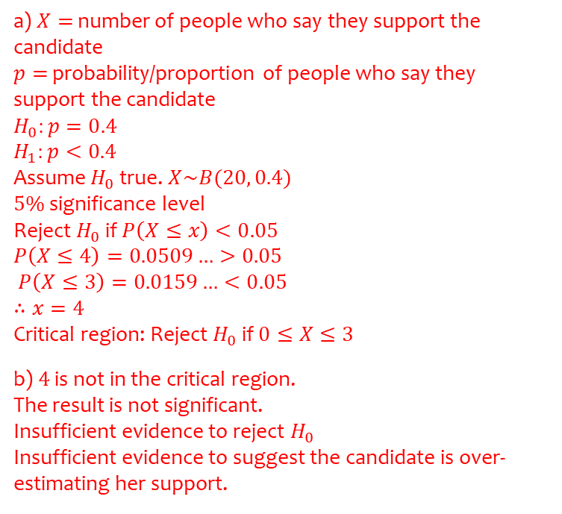
Worked example
Your turn
An election candidate believes he has the support of 30% of the residents in a particular town.
A researcher wants to test, at the 10% significance level, whether the candidate is over-estimating his support.
The researcher asks 30 people whether they support the candidate or not.
Find the critical region for this test.
6 people say they support the candidate. Comment on this observation in light of the critical region.
An election candidate believes she has the support of 40% of the residents in a particular town.
A researcher wants to test, at the 5% significance level, whether the candidate is over-estimating her support.
The researcher asks 20 people whether they support the candidate or not.
Find the critical region for this test.
4 people say they support the candidate. Comment on this observation in light of the critical region.
a) $X=$ number of people who say they support the candidate
$p=$ probability/proportion of people who say they support the candidate
$$H_{0}:p=0.4$$
$$H_{1}:p<0.4$$
Assume $H_{0}$ true. $X\sim B(20, 0.4)$
$5\%$ significance level
Reject $H_{0}$ if $P\left(X≤x\right)<0.05$
$$P\left(X≤4\right)=0.0509…>0.05$$
$P\left(X≤3\right)=0.0159…<0.05$
$$∴x=4$$
Critical region: Reject $H_{0}$ if $0≤X≤3$
b) $4$ is not in the critical region.
The result is not significant.
Insufficient evidence to reject $H_{0}$
Insufficient evidence to suggest the candidate is over-estimating her support.

Slide 26
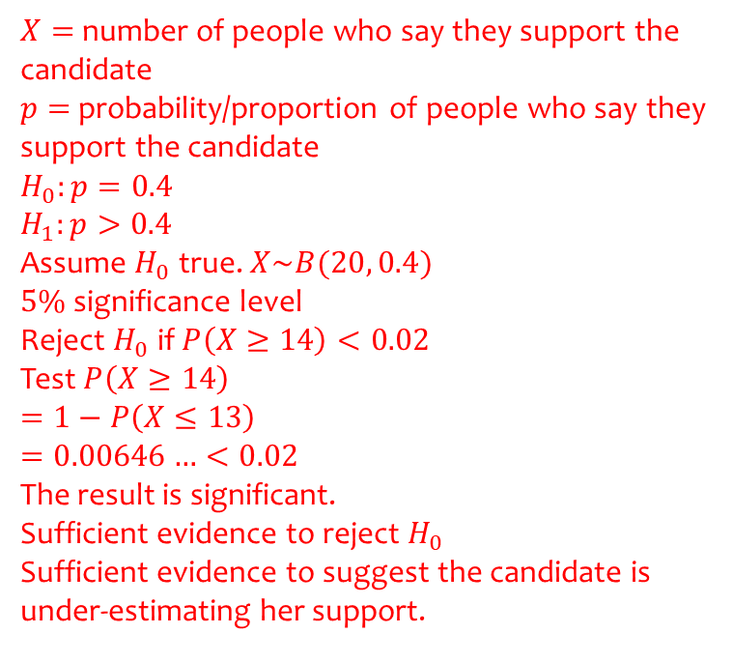
Worked example
Your turn
An election candidate believes he has the support of 30% of the residents in a particular town.
A researcher wants to test, at the 1% significance level, whether the candidate is under-estimating his support.
The researcher asks 30 people whether they support the candidate or not. 14 people say they support the candidate.
Carry out a hypothesis test for the researcher.
An election candidate believes she has the support of 40% of the residents in a particular town.
A researcher wants to test, at the 2% significance level, whether the candidate is under-estimating her support.
The researcher asks 20 people whether they support the candidate or not. 14 people say they support the candidate.
Carry out a hypothesis test for the researcher.
$X=$ number of people who say they support the candidate
$p=$ probability/proportion of people who say they support the candidate
$$H_{0}:p=0.4$$
$$H_{1}:p>0.4$$
Assume $H_{0}$ true. $X\sim B(20, 0.4)$
$5\%$ significance level
Reject $H_{0}$ if $P\left(X≥14\right)<0.02$
Test $P\left(X≥14\right)$
$$=1−P\left(X≤13\right)$$
$$=0.00646…<0.02$$
The result is significant.
Sufficient evidence to reject $H_{0}$
Sufficient evidence to suggest the candidate is under-estimating her support.

Slide 27
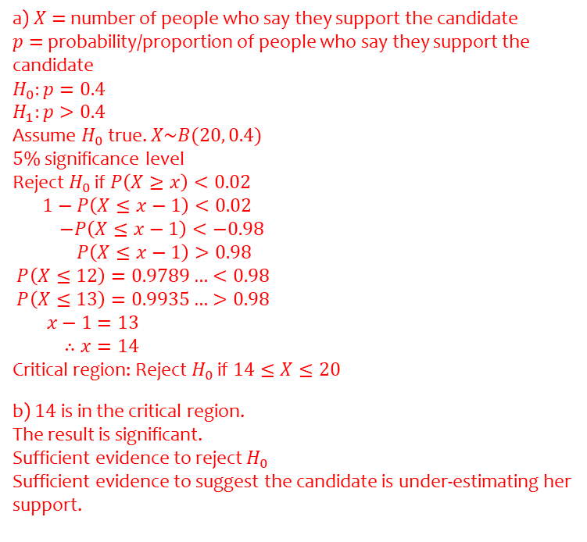
Worked example
Your turn
An election candidate believes he has the support of 30% of the residents in a particular town.
A researcher wants to test, at the 1% significance level, whether the candidate is under-estimating his support.
The researcher asks 30 people whether they support the candidate or not.
Find the critical region for this test.
14 people say they support the candidate. Comment on this observation in light of the critical region.
An election candidate believes she has the support of 40% of the residents in a particular town.
A researcher wants to test, at the 2% significance level, whether the candidate is under-estimating her support.
The researcher asks 20 people whether they support the candidate or not.
Find the critical region for this test.
14 people say they support the candidate. Comment on this observation in light of the critical region.
a) $X=$ number of people who say they support the candidate
$p=$ probability/proportion of people who say they support the candidate
$$H_{0}:p=0.4$$
$$H_{1}:p>0.4$$
Assume $H_{0}$ true. $X\sim B(20, 0.4)$
$5\%$ significance level
Reject $H_{0}$ if $P\left(X≥x\right)<0.02$
$1−P\left(X≤x−1\right)<0.02$
$−P\left(X≤x−1\right)<−0.98$
$P\left(X≤x−1\right)>0.98$
$P\left(X≤12\right)=0.9789…<0.98$
$P\left(X≤13\right)=0.9935…>0.98$
$x−1=13$
$∴x=14$
Critical region: Reject $H_{0}$ if $14≤X≤20$
b) $14$ is in the critical region.
The result is significant.
Sufficient evidence to reject $H_{0}$
Sufficient evidence to suggest the candidate is under-estimating her support.

Slide 28
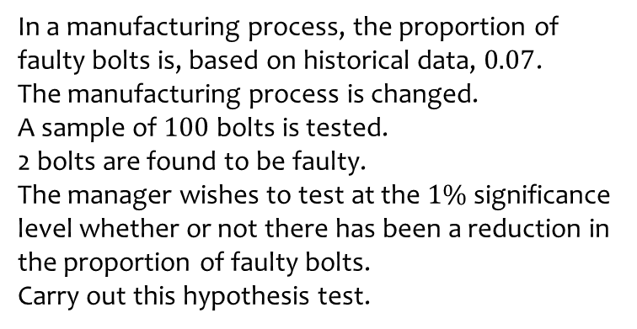
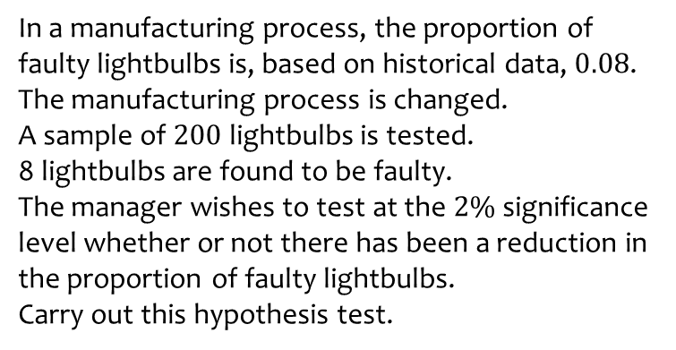
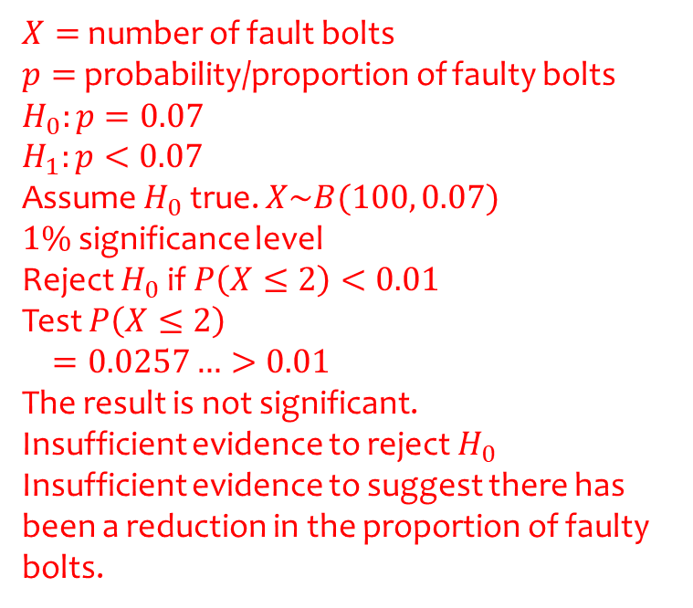
Worked example
Your turn
In a manufacturing process, the proportion of faulty lightbulbs is, based on historical data, $0.08$.
The manufacturing process is changed.
A sample of $200$ lightbulbs is tested.
8 lightbulbs are found to be faulty.
The manager wishes to test at the $2\%$significance level whether or not there has been a reduction in the proportion of faulty lightbulbs.
Carry out this hypothesis test.
In a manufacturing process, the proportion of faulty bolts is, based on historical data, $0.07$.
The manufacturing process is changed.
A sample of $100$ bolts is tested.
2 bolts are found to be faulty.
The manager wishes to test at the $1\%$significance level whether or not there has been a reduction in the proportion of faulty bolts.
Carry out this hypothesis test.
$X=$ number of fault bolts
$p=$ probability/proportion of faulty bolts
$$H_{0}:p=0.07$$
$$H_{1}:p<0.07$$
Assume $H_{0}$ true. $X\sim B(100, 0.07)$
$1\%$ significance level
Reject $H_{0}$ if $P\left(X≤2\right)<0.01$
Test $P\left(X≤2\right)$
$$=0.0257…>0.01$$
The result is not significant.
Insufficient evidence to reject $H_{0}$
Insufficient evidence to suggest there has been a reduction in the proportion of faulty bolts.

Slide 29
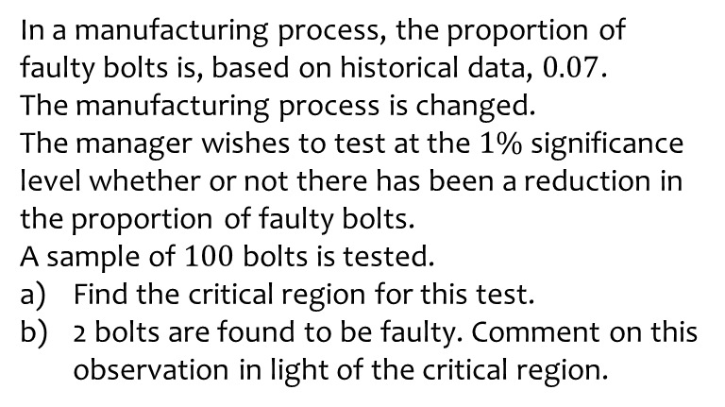
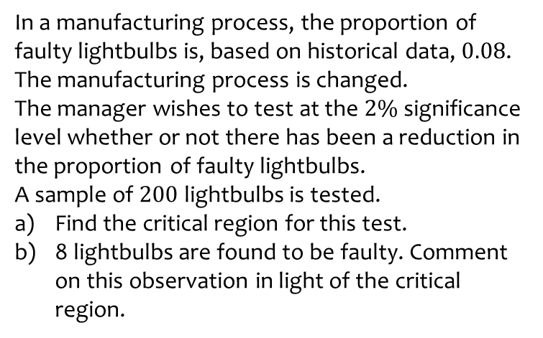
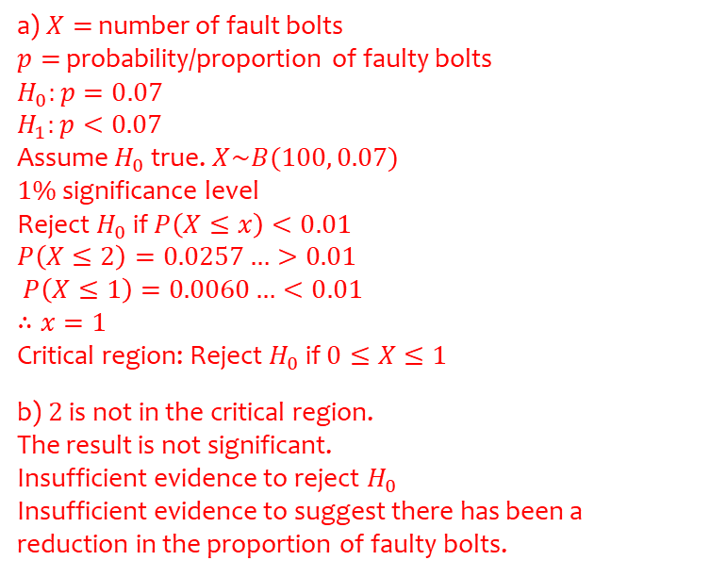
Worked example
Your turn
In a manufacturing process, the proportion of faulty lightbulbs is, based on historical data, $0.08$.
The manufacturing process is changed.
The manager wishes to test at the $2\%$significance level whether or not there has been a reduction in the proportion of faulty lightbulbs.
A sample of $200$ lightbulbs is tested.
Find the critical region for this test.
8 lightbulbs are found to be faulty. Comment on this observation in light of the critical region.
In a manufacturing process, the proportion of faulty bolts is, based on historical data, $0.07$.
The manufacturing process is changed.
The manager wishes to test at the $1\%$significance level whether or not there has been a reduction in the proportion of faulty bolts.
A sample of $100$ bolts is tested.
Find the critical region for this test.
2 bolts are found to be faulty. Comment on this observation in light of the critical region.
a) $X=$ number of fault bolts
$p=$ probability/proportion of faulty bolts
$$H_{0}:p=0.07$$
$$H_{1}:p<0.07$$
Assume $H_{0}$ true. $X\sim B(100, 0.07)$
$1\%$ significance level
Reject $H_{0}$ if $P\left(X≤x\right)<0.01$
$$P\left(X≤2\right)=0.0257…>0.01$$
$P\left(X≤1\right)=0.0060…<0.01$
$$∴x=1$$
Critical region: Reject $H_{0}$ if $0≤X≤1$
b) $2$ is not in the critical region.
The result is not significant.
Insufficient evidence to reject $H_{0}$
Insufficient evidence to suggest there has been a reduction in the proportion of faulty bolts.

Slide 30
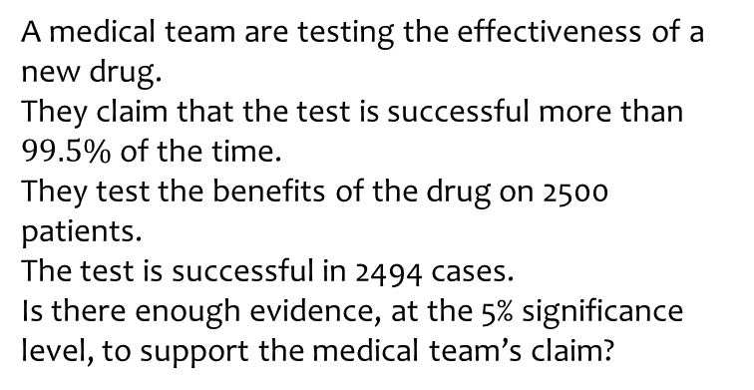
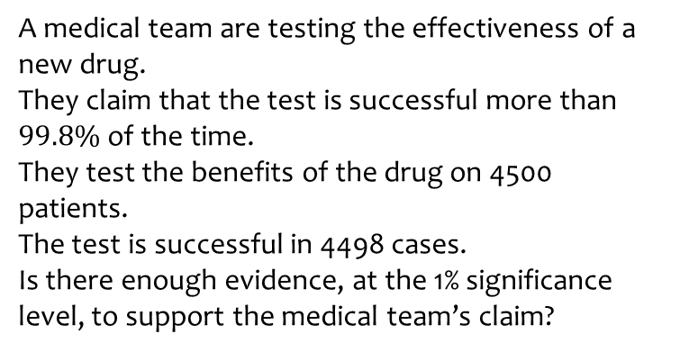
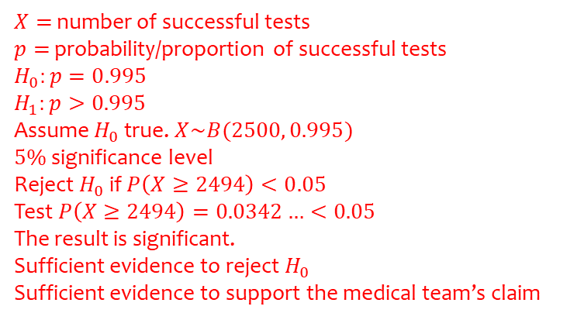
Worked example
Your turn
A medical team are testing the effectiveness of a new drug.
They claim that the test is successful more than $99.8\%$of the time.
They test the benefits of the drug on 4500 patients.
The test is successful in 4498 cases.
Is there enough evidence, at the 1% significance level, to support the medical team’s claim?
A medical team are testing the effectiveness of a new drug.
They claim that the test is successful more than $99.5\%$of the time.
They test the benefits of the drug on 2500 patients.
The test is successful in 2494 cases.
Is there enough evidence, at the 5% significance level, to support the medical team’s claim?
$X=$ number of successful tests
$p=$ probability/proportion of successful tests
$$H_{0}:p=0.995$$
$$H_{1}:p>0.995$$
Assume $H_{0}$ true. $X\sim B(2500, 0.995)$
$5\%$ significance level
Reject $H_{0}$ if $P\left(X≥2494\right)<0.05$
Test $P\left(X≥2494\right)=0.0342…<0.05$
The result is significant.
Sufficient evidence to reject $H_{0}$
Sufficient evidence to support the medical team’s claim

Slide 31
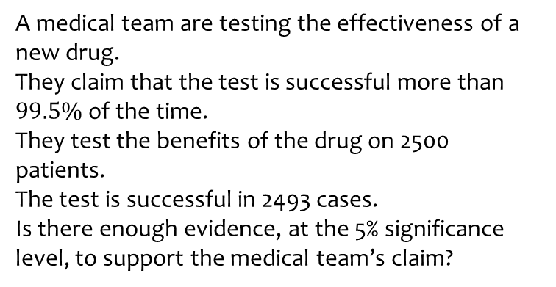
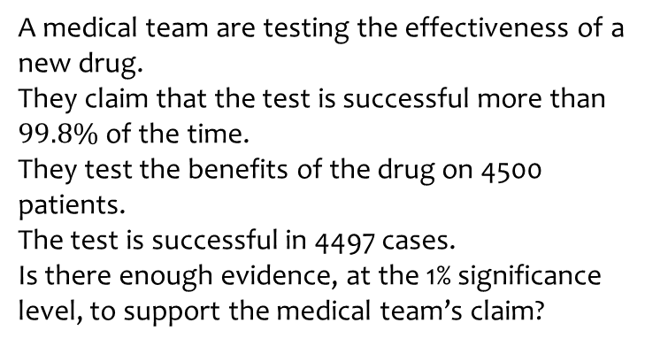

Worked example
Your turn
A medical team are testing the effectiveness of a new drug.
They claim that the test is successful more than $99.8\%$of the time.
They test the benefits of the drug on 4500 patients.
The test is successful in 4497 cases.
Is there enough evidence, at the 1% significance level, to support the medical team’s claim?
A medical team are testing the effectiveness of a new drug.
They claim that the test is successful more than $99.5\%$of the time.
They test the benefits of the drug on 2500 patients.
The test is successful in 2493 cases.
Is there enough evidence, at the 5% significance level, to support the medical team’s claim?
$X=$ number of successful tests
$p=$ probability/proportion of successful tests
$$H_{0}:p=0.995$$
$$H_{1}:p>0.995$$
Assume $H_{0}$ true. $X\sim B(2500, 0.995)$
$5\%$ significance level
Reject $H_{0}$ if $P\left(X≥2493\right)<0.05$
Test $P\left(X≥2493\right)=0.06934…>0.05$
The result is not significant.
Insufficient evidence to reject $H_{0}$
Insufficient evidence to support the medical team’s claim

Slide 32



Worked example
Your turn
A medical team are testing the effectiveness of a new drug.
They claim that the test is successful more than $99.8\%$of the time.
They test the benefits of the drug on 4500 patients.
Find the critical region for this test at the 1% significance level.
The test is successful in 4498 cases. Comment on this observation in light of the critical region.
A medical team are testing the effectiveness of a new drug.
They claim that the test is successful more than $99.5\%$of the time.
They test the benefits of the drug on 2500 patients.
Find the critical region for this test at the 5% significance level.
The test is successful in 2493 cases. Comment on this observation in light of the critical region.
a) $X=$ number of successful tests
$p=$ probability/proportion of successful tests
$$H_{0}:p=0.995$$
$$H_{1}:p>0.995$$
Under $H_{0}$, $X\sim B(2500, 0.995)$
$5\%$ significance level
Reject $H_{0}$ if $P\left(X≥x\right)<0.05$
$1−P\left(X≤x−1\right)<0.05$
$−P\left(X≤x−1\right)<−0.95$
$P\left(X≤x−1\right)>0.95$
$P\left(X≤2492\right)=0.9306…<0.95$
$P\left(X≤2493\right)=0.9657…>0.95$
$x−1=2493$
$∴x=2494$
Critical region: Reject $H_{0}$ if $2494≤x≤2500$
b) $2494$ is in the critical region.
The result is significant.
Sufficient evidence to reject $H_{0}$
Sufficient evidence to support the medical team’s claim

Slide 33



Worked example
Your turn
A medical team are testing the negative side effects of a new drug.
They claim that the drug gives negative side effects less than $0.2\%$ of the time.
They test the drug on 4500 patients.
The drug has negative side effects in 2 patients.
Is there enough evidence, at the 1% significance level, to support the medical team’s claim?
A medical team are testing the negative side effects of a new drug.
They claim that the drug gives negative side effects less than $0.5\%$ of the time.
They test the drug on 2500 patients.
The drug has negative side effects in 3 patients.
Is there enough evidence, at the 5% significance level, to support the medical team’s claim?
$X=$ number of tests with negative side effects
$p=$ probability/proportion of tests with negative side effects
$$H_{0}:p=0.005$$
$$H_{1}:p<0.005$$
Assume $H_{0}$ true. $X\sim B(2500, 0.005)$
$5\%$ significance level
Reject $H_{0}$ if $P\left(X≤3\right)<0.05$
Test $P\left(X≤3\right)=0.001525…<0.05$
The result is significant.
Sufficient evidence to reject $H_{0}$
Sufficient evidence to support the medical team’s claim

Slide 34



Worked example
Your turn
A medical team are testing the negative side effects of a new drug.
They claim that the drug gives negative side effects less than $0.2\%$ of the time.
They test the drug on 4500 patients.
The drug has negative side effects in 5 patients.
Is there enough evidence, at the 1% significance level, to support the medical team’s claim?
A medical team are testing the negative side effects of a new drug.
They claim that the drug gives negative side effects less than $0.5\%$ of the time.
They test the drug on 2500 patients.
The drug has negative side effects in 7 patients.
Is there enough evidence, at the 5% significance level, to support the medical team’s claim?
$X=$ number of tests with negative side effects
$p=$ probability/proportion of tests with negative side effects
$$H_{0}:p=0.005$$
$$H_{1}:p<0.005$$
Assume $H_{0}$ true. $X\sim B(2500, 0.005)$
$5\%$ significance level
Reject $H_{0}$ if $P\left(X≤7\right)<0.05$
Test $P\left(X≤7\right)=0.0693…>0.05$
The result is not significant.
Insufficient evidence to reject $H_{0}$
Insufficient evidence to support the medical team’s claim

Slide 35



Worked example
Your turn
A medical team are testing the negative side effects of a new drug.
They claim that the drug gives negative side effects less than $0.2\%$ of the time.
They test the drug on 4500 patients.
Find the critical region for this test at the 2% significance level.
The drug has negative side effects in 5 cases. Comment on this observation in light of the critical region.
A medical team are testing the negative side effects of a new drug.
They claim that the drug gives negative side effects less than $0.5\%$ of the time.
They test the drug on 2500 patients.
Find the critical region for this test at the 2% significance level.
The drug has negative side effects in 7 cases. Comment on this observation in light of the critical region.
a) $X=$ number of tests with negative side effects
$p=$ probability/proportion of tests with negative side effects
$$H_{0}:p=0.005$$
$$H_{1}:p<0.005$$
Under $H_{0}$, $X\sim B(2500, 0.005)$
$2\%$ significance level
Reject $H_{0}$ if $P\left(X≤x\right)<0.02$
$$P\left(X≤6\right)=0.0342…>0.02$$
$$P\left(X≤5\right)=0.0146…<0.02$$
$$∴x=5$$
Critical region: Reject $H_{0}$ if $0≤X≤5$
b) $7$ is not in the critical region.
The result is not significant.
Insufficient evidence to reject $H_{0}$
Insufficient evidence to support the medical team’s claim

Slide 36
7.4) Two-tailed tests
Chapter CONTENTS

Slide 37



Worked example
Your turn
Joan believes the probability of rolling a $4$ on a six-sided dice is $\frac{1}{6}$.
She rolls the dice 10 times and rolls a $4$ five times.
Using a 5% significance level, test her belief.
John believes a coin is lands on tails with probability $\frac{1}{2}$.
He tosses the coin 8 times and it lands on tails $8$ times.
Using a 5% significance level, test his belief.
$X=$ number of times coin lands on tails.
$p=$ probability/proportion of times coin lands on tails.
$$H_{0}:p=0.5$$
$$H_{1}:p≠0.5$$
Assume $H_{0}$ true. $X\sim B(8, 0.5)$
$5\%$ significance level
Reject $H_{0}$ if $P\left(X≥8\right)<0.05$
Test $P\left(X≥8\right)=0.0039…<0.05$
The result is significant.
Sufficient evidence to reject $H_{0}$
Sufficient evidence to reject John’s belief

Slide 38



Worked example
Your turn
Joan believes the probability of rolling a $4$ on a six-sided dice is $\frac{1}{6}$.
She rolls the dice 10 times.
Find the critical region(s) for this test at the 5% significance level.
A $4$ is rolled five times. Comment on this observation in light of the critical region.
John believes a coin is lands on tails with probability $\frac{1}{2}$.
He tosses the coin 8 times.
Find the critical region(s) for this test at the 5% significance level.
The coin lands on tails $8$ times. Comment on this observation in light of the critical region.
a) $X=$ number of times coin lands on tails.
$p=$ probability/proportion of times coin lands on tails.
$$H_{0}:p=0.5$$
$$H_{1}:p≠0.5$$
Assume $H_{0}$ true. $X\sim B(8, 0.5)$
$5\%$ significance level
Reject $H_{0}$ if $P\left(X≤x_{1}\right)<0.025$ or $P\left(X≥x_{2}\right)<0.025$
$P\left(X≤1\right)=0.0351…>0.025$ $1−P\left(X≤x_{2}−1\right)<0.025$
$P\left(X≤0\right)=0.0039…<0.025$ $−P\left(X≤x_{2}−1\right)<−0.975$
$∴x_{1}=0$ $P\left(X≤x_{2}−1\right)>0.975$
$P\left(X≤6\right)=0.9648…<0.975$
$P\left(X≤7\right)=0.9960…>0.975$
$x_{2}−1=7$
$∴x_{2}=8$
Lower tail: $X=0$ Upper tail $X=8$
Critical regions: Reject $H_{0}$ if $X=0∪X=8$
b) $8$ is in the critical region.
The result is significant.
Sufficient evidence to reject $H_{0}$
Sufficient evidence to reject John’s belief

Slide 39

Worked example
Your turn
An election candidate believes he has the support of 30% of the residents in a particular town.
The researcher asks 30 people whether they support the candidate or not. 1 person says they support the candidate.
Test, at the 1% significance level, whether the candidate’s claim is true.
An election candidate believes she has the support of 40% of the residents in a particular town.
The researcher asks 20 people whether they support the candidate or not. 3 people say they support the candidate.
Test, at the 2% significance level, whether the candidate’s claim is true.
$X=$ number of people who say they support the candidate
$p=$ probability/proportion of people who say they support the candidate
$$H_{0}:p=0.4$$
$$H_{1}:p≠0.4$$
Assume $H_{0}$ true. $X\sim B(20, 0.4)$
$5\%$ significance level
Reject $H_{0}$ if $P\left(X≤3\right)<0.01$
Test $P\left(X≤3\right)=0.0159…>0.01$
The result is not significant.
Insufficient evidence to reject $H_{0}$
Insufficient evidence to reject the candidate’s belief.

Slide 40

Worked example
Your turn
An election candidate believes he has the support of 30% of the residents in a particular town.
The researcher asks 30 people whether they support the candidate or not.
Find the critical region(s) for a test of the candidate’s claim at the 1% significance level.
1 person says they support the candidate. Comment on this observation in light of the critical region.
An election candidate believes she has the support of 40% of the residents in a particular town.
The researcher asks 20 people whether they support the candidate or not.
Find the critical region(s) for a test of the candidate’s claim at the 2% significance level.
3 people say they support the candidate. Comment on this observation in light of the critical region.
$X=$ number of people who say they support the candidate
$p=$ probability/proportion of people who say they support the candidate
$$H_{0}:p=0.4$$
$$H_{1}:p≠0.4$$
Assume $H_{0}$ true. $X\sim B(20, 0.4)$
$5\%$ significance level
Reject $H_{0}$ if $P\left(X≤x_{1}\right)<0.01$ or $P\left(X≥x_{2}\right)<0.01$
$P\left(X≤3\right)=0.0159…>0.01$ $1−P\left(X≤x_{2}−1\right)<0.01$
$P\left(X≤2\right)=0.0036…<0.01$ $−P\left(X≤x_{2}−1\right)<−0.99$
$∴x_{1}=2$ $P\left(X≤x_{2}−1\right)>0.99$
$P\left(X≤12\right)=0.9789…<0.99$
$P\left(X≤13\right)=0.9935…>0.99$
$x_{2}−1=13$
$∴x_{2}=14$
Lower tail: $0≤X≤2$ Upper tail $14≤X≤20$
Critical regions: Reject $H_{0}$ if $0≤X≤2∪14≤X≤20$
b) $3$ is not in the critical region.
The result is not significant.
Insufficient evidence to reject $H_{0}$
Insufficient evidence to reject the candidate’s belief.

Slide 41

Worked example
Your turn
An election candidate believes he has the support of 30% of the residents in a particular town.
The researcher asks 30 people whether they support the candidate or not. 16 people say they support the candidate.
Test, at the 1% significance level, whether the candidate’s claim is true.
An election candidate believes she has the support of 40% of the residents in a particular town.
The researcher asks 20 people whether they support the candidate or not. 14 people say they support the candidate.
Test, at the 2% significance level, whether the candidate’s claim is true.
$X=$ number of people who say they support the candidate
$p=$ probability/proportion of people who say they support the candidate
$$H_{0}:p=0.4$$
$$H_{1}:p≠0.4$$
Assume $H_{0}$ true. $X\sim B(20, 0.4)$
$5\%$ significance level
Reject $H_{0}$ if $P\left(X≥14\right)<0.01$
Test $P\left(X≥14\right)=0.0064…<0.01$
The result is significant.
Sufficient evidence to reject $H_{0}$
Sufficient evidence to reject the candidate’s belief.

Slide 42

Worked example
Your turn
An election candidate believes he has the support of 30% of the residents in a particular town.
The researcher asks 30 people whether they support the candidate or not.
Find the critical region(s) for a test of the candidate’s claim at the 1% significance level.
16 people say they support the candidate. Comment on this observation in light of the critical region.
An election candidate believes she has the support of 40% of the residents in a particular town.
The researcher asks 20 people whether they support the candidate or not.
Find the critical region(s) for a test of the candidate’s claim at the 2% significance level.
14 people say they support the candidate. Comment on this observation in light of the critical region.
$X=$ number of people who say they support the candidate
$p=$ probability/proportion of people who say they support the candidate
$$H_{0}:p=0.4$$
$$H_{1}:p≠0.4$$
Assume $H_{0}$ true. $X\sim B(20, 0.4)$
$5\%$ significance level
Reject $H_{0}$ if $P\left(X≤x_{1}\right)<0.01$ or $P\left(X≥x_{2}\right)<0.01$
$P\left(X≤3\right)=0.0159…>0.01$ $1−P\left(X≤x_{2}−1\right)<0.01$
$P\left(X≤2\right)=0.0036…<0.01$ $−P\left(X≤x_{2}−1\right)<−0.99$
$∴x_{1}=2$ $P\left(X≤x_{2}−1\right)>0.99$
$P\left(X≤12\right)=0.9789…<0.99$
$P\left(X≤13\right)=0.9935…>0.99$
$x_{2}−1=13$
$∴x_{2}=14$
Lower tail: $0≤X≤2$ Upper tail $14≤X≤20$
Critical regions: Reject $H_{0}$ if $0≤X≤2∪14≤X≤20$
b) $14$ is not in the critical region.
The result is significant.
Sufficient evidence to reject $H_{0}$.
Sufficient evidence to reject the candidate’s belief.

Slide 43



Worked example
Your turn
In a manufacturing process, the proportion of faulty lightbulbs is, based on historical data, $0.08$.
The manufacturing process is changed.
A sample of $200$ lightbulbs is tested.
7 lightbulbs are found to be faulty.
Test, at the $2\%$significance level, whether or not there has been a change in the proportion of faulty lightbulbs.
In a manufacturing process, the proportion of faulty bolts is, based on historical data, $0.07$.
The manufacturing process is changed.
A sample of $100$ bolts is tested.
1 bolt is found to be faulty.
Test, at the $1\%$significance level, whether or not there has been a change in the proportion of faulty bolts.
$X=$ number of fault bolts
$p=$ probability/proportion of faulty bolts
$$H_{0}:p=0.07$$
$$H_{1}:p<0.07$$
Assume $H_{0}$ true. $X\sim B(100, 0.07)$
$1\%$ significance level
Reject $H_{0}$ if $P\left(X≤1\right)<0.005$
Test $P\left(X≤1\right)=0.0060…>0.005$
The result is not significant.
Insufficient evidence to reject $H_{0}$
Insufficient evidence to suggest there has been a change in the proportion of faulty bolts.

Slide 44



Worked example
Your turn
In a manufacturing process, the proportion of faulty lightbulbs is, based on historical data, $0.08$.
The manufacturing process is changed.
The manager wants to test whether or not the proportion of faulty lightbulbs has changed.
A sample of $200$ lightbulbs is tested.
Find the critical region(s) for a test at the 2% significance level.
7 lightbulbs are found to be faulty. Comment on this observation in light of the critical region.
In a manufacturing process, the proportion of faulty bolts is, based on historical data, $0.07$.
The manufacturing process is changed.
The manager wants to test whether or not the proportion of faulty bolts has changed.
A sample of $100$ bolts is tested.
Find the critical region(s) for a test at the 1% significance level.
1 bolt is found to be faulty. Comment on this observation in light of the critical region.
a) $X=$ number of fault bolts
$p=$ probability/proportion of faulty bolts
$$H_{0}:p=0.07$$
$$H_{1}:p<0.07$$
Assume $H_{0}$ true. $X\sim B(100, 0.07)$
$1\%$ significance level
Reject $H_{0}$ if $P\left(X≤x_{1}\right)<0.005$ or $P\left(X≥x_{2}\right)<0.005$
$P\left(X≤1\right)=0.0060…>0.005$ $1−P\left(X≤x_{2}−1\right)<0.005$
$P\left(X≤0\right)=0.0007…<0.005$ $−P\left(X≤x_{2}−1\right)<−0.995$
$∴x_{1}=0$ $P\left(X≤x_{2}−1\right)>0.995$
$P\left(X≤13\right)=0.9900…<0.995$
$P\left(X≤14\right)=0.9959…>0.995$
$x_{2}−1=14$
$∴x_{2}=15$
Lower tail: $X=0$ Upper tail $15≤X≤100$
Critical regions: Reject $H_{0}$ if $X=0∪15≤X≤100$
b) $1$ is not in the critical region.
The result is not significant.
Insufficient evidence to reject $H_{0}$
Insufficient evidence to suggest the proportion of fault bolts has changed.

Slide 45



Worked example
Your turn
A medical team are testing the effectiveness of a new drug.
They claim that the test is successful $99.8\%$of the time.
They test the benefits of the drug on 4500 patients.
The test is successful in 4498 cases.
Is the medical team’s claim supported at the 1% significance level?
A medical team are testing the effectiveness of a new drug.
They claim that the test is successful $99.5\%$of the time.
They test the benefits of the drug on 2500 patients.
The test is successful in 2495 cases.
Is the medical team’s claim supported at the 5% significance level?
$X=$ number of successful tests
$p=$ probability/proportion of successful tests
$$H_{0}:p=0.995$$
$$H_{1}:p≠0.995$$
Under $H_{0}$, $X\sim B(2500, 0.995)$
$5\%$ significance level
Reject $H_{0}$ if $P\left(X≥2495\right)<0.025$
Test $P\left(X≥2495\right)=0.01464…<0.025$
The result is significant.
Sufficient evidence to reject $H_{0}$
Sufficient evidence to reject the medical team’s claim.

Slide 46



Worked example
Your turn
A medical team are testing the effectiveness of a new drug.
They claim that the test is successful $99.8\%$of the time.
They test the benefits of the drug on 4500 patients.
Find the critical region(s) for a test at the 1% significance level.
The test is successful in 4498 cases. Comment on this observation in light of the critical region.
A medical team are testing the effectiveness of a new drug.
They claim that the test is successful $99.5\%$of the time.
They test the benefits of the drug on 2500 patients.
Find the critical region(s) for a test at the 5% significance level.
The test is successful in 2495 cases. Comment on this observation in light of the critical region.
a) $X=$ number of successful tests
$p=$ probability/proportion of successful tests
$$H_{0}:p=0.995$$
$$H_{1}:p≠0.995$$
Under $H_{0}$, $X\sim B(2500, 0.995)$
$5\%$ significance level
Reject $H_{0}$ if $P\left(X≤x_{1}\right)<0.025$ or $P\left(X≥x_{2}\right)<0.025$
$P\left(X≤2480\right)=0.0302…>0.025$ $1−P\left(X≤x_{2}−1\right)<0.025$
$P\left(X≤2479\right)=0.0170…<0.025$ $−P\left(X≤x_{2}−1\right)<−0.975$
$∴x_{1}=2479$ $P\left(X≤x_{2}−1\right)>0.975$
$P\left(X≤2493\right)=0.9657…<0.975$
$P\left(X≤2494\right)=0.9853…>0.975$
$x_{2}−1=2494$
$∴x_{2}=2495$
Lower tail: $0≤X≤2479$ Upper tail $2495≤x≤2500$
Critical regions: Reject $H_{0}$ if $0≤X≤2479∪2495≤x≤2500$
b) $2495$ is in the critical region.
The result is significant.
Sufficient evidence to reject $H_{0}$
Sufficient evidence to reject the medical team’s claim.

Slide 47



Worked example
Your turn
A medical team are testing the effectiveness of a new drug.
They claim that the test is successful $99.8\%$of the time.
They test the benefits of the drug on 4500 patients.
Find the critical region(s) for a test at the 1% significance level.
The test is successful in 4482 cases. Comment on this observation in light of the critical region.
A medical team are testing the effectiveness of a new drug.
They claim that the test is successful $99.5\%$of the time.
They test the benefits of the drug on 2500 patients.
Find the critical region(s) for a test at the 5% significance level.
The test is successful in 2480 cases. Comment on this observation in light of the critical region.
a) $X=$ number of successful tests
$p=$ probability/proportion of successful tests
$$H_{0}:p=0.995$$
$$H_{1}:p≠0.995$$
Under $H_{0}$, $X\sim B(2500, 0.995)$
$5\%$ significance level
Reject $H_{0}$ if $P\left(X≤x_{1}\right)<0.025$ or $P\left(X≥x_{2}\right)<0.025$
$P\left(X≤2480\right)=0.0302…>0.025$ $1−P\left(X≤x_{2}−1\right)<0.025$
$P\left(X≤2479\right)=0.0170…<0.025$ $−P\left(X≤x_{2}−1\right)<−0.975$
$∴x_{1}=2479$ $P\left(X≤x_{2}−1\right)>0.975$
$P\left(X≤2493\right)=0.9657…<0.975$
$P\left(X≤2494\right)=0.9853…>0.975$
$x_{2}−1=2494$
$∴x_{2}=2495$
Lower tail: $0≤X≤2479$ Upper tail $2495≤x≤2500$
Critical regions: Reject $H_{0}$ if $0≤X≤2479∪2495≤x≤2500$
b) $2480$ is not in the critical region.
The result is not significant.
Insufficient evidence to reject $H_{0}$
Insufficient evidence to reject the medical team’s claim.

