Slide 1
7.4) Static rigid bodies

Slide 2
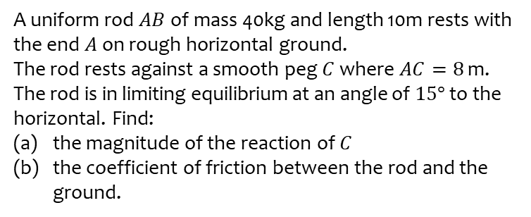
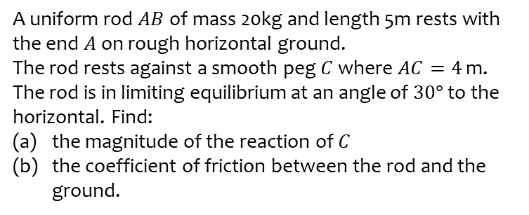
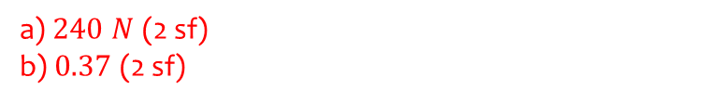
Worked example
Your turn
A uniform rod $AB$ of mass 20kg and length 5m rests with the end $A$ on rough horizontal ground.
The rod rests against a smooth peg $C$ where $AC=4$ m.
The rod is in limiting equilibrium at an angle of $30°$ to the horizontal. Find:
the magnitude of the reaction of $C$
the coefficient of friction between the rod and the ground.
A uniform rod $AB$ of mass 40kg and length 10m rests with the end $A$ on rough horizontal ground.
The rod rests against a smooth peg $C$ where $AC=8$ m.
The rod is in limiting equilibrium at an angle of $15°$ to the horizontal. Find:
the magnitude of the reaction of $C$
the coefficient of friction between the rod and the ground.
a) $240 N$ (2 sf)
b) $0.37$ (2 sf)

Slide 3
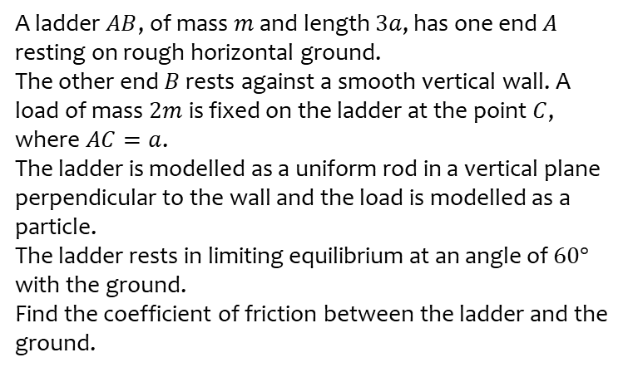
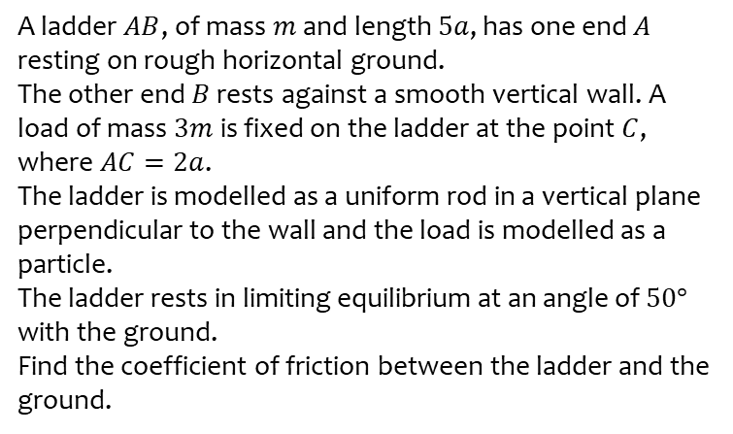
Worked example
Your turn
A ladder $AB$, of mass $m$ and length $5a$, has one end $A$ resting on rough horizontal ground.
The other end $B$ rests against a smooth vertical wall. A load of mass $3m$ is fixed on the ladder at the point $C$, where $AC=2a$.
The ladder is modelled as a uniform rod in a vertical plane perpendicular to the wall and the load is modelled as a particle.
The ladder rests in limiting equilibrium at an angle of $50°$ with the ground.
Find the coefficient of friction between the ladder and the ground.
A ladder $AB$, of mass $m$ and length $3a$, has one end $A$ resting on rough horizontal ground.
The other end $B$ rests against a smooth vertical wall. A load of mass $2m$ is fixed on the ladder at the point $C$, where $AC=a$.
The ladder is modelled as a uniform rod in a vertical plane perpendicular to the wall and the load is modelled as a particle.
The ladder rests in limiting equilibrium at an angle of $60°$ with the ground.
Find the coefficient of friction between the ladder and the ground.
$0.23$ (2 sf)

