Slide 1
7) Applications of forces
7.1) Static particles
7.2) Modelling with statics
7.3) Friction and static particles
7.5) Dynamics and inclined planes
7.6) Connected particles

Slide 2
7.1) Static particles
Chapter CONTENTS

Slide 3
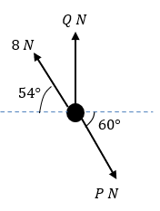
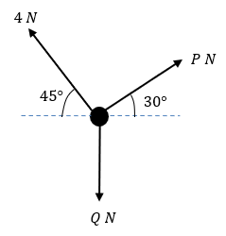
Worked example
Your turn
The diagram shows a particle in equilibrium under the forces shown. By resolving horizontally and vertically find the magnitudes of the forces $P$ and $Q$.
The diagram shows a particle in equilibrium under the forces shown. By resolving horizontally and vertically find the magnitudes of the forces $P$ and $Q$.
$P=3.27, Q=4.46$ (3 sf)
Diagrams/Graphs used with permission from DrFrostMaths: https://www.drfrostmaths.com/

Slide 4
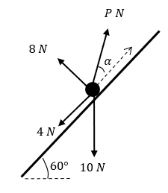
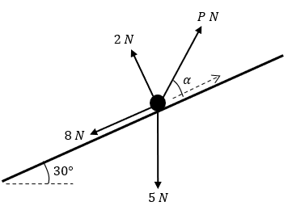
Worked example
Your turn
The diagram shows a particle in equilibrium on an inclined plane under the forces shown. Find the magnitude of the force $P$ and the size of the angle $α$.
The diagram shows a particle in equilibrium on an inclined plane under the forces shown. Find the magnitude of the force $P$ and the size of the angle $α$.
$P=10.8, α=12.5°$ (3 sf)
Diagrams/Graphs used with permission from DrFrostMaths: https://www.drfrostmaths.com/

Slide 5
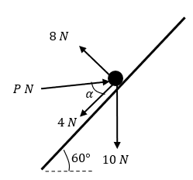
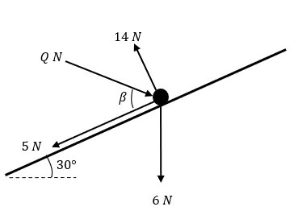
Worked example
Your turn
The diagram shows a particle in equilibrium on an inclined plane under the forces shown. Find the magnitude of the force $P$ and the size of the angle $α$.
The diagram shows a particle in equilibrium on an inclined plane under the forces shown. Find the magnitude of the force $Q$ and the size of the angle $β$.
$Q=11.9, β=47.7°$ (3 sf)
Diagrams/Graphs used with permission from DrFrostMaths: https://www.drfrostmaths.com/

Slide 6
7.2) Modelling with statics
Chapter CONTENTS

Slide 7
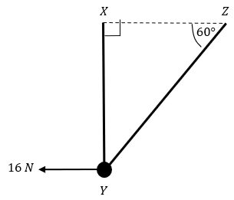
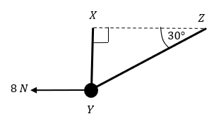
Worked example
Your turn
A smooth bead $Y$ is threaded on a light inextensible string. The ends of the string are attached to two fixed points, $X$ and $Y$, on the same horizontal level.
The bead is held in equilibrium by a horizontal force of magnitude 16 N acting parallel to $ZX$.
The bead $Y$ is vertically below $X$ and $∠XZY=60°$ as shown in the diagram.
Find the tension in the string and the weight of the bead.
A smooth bead $Y$ is threaded on a light inextensible string. The ends of the string are attached to two fixed points, $X$ and $Y$, on the same horizontal level.
The bead is held in equilibrium by a horizontal force of magnitude 8 N acting parallel to $ZX$.
The bead $Y$ is vertically below $X$ and $∠XZY=30°$ as shown in the diagram.
Find the tension in the string and the weight of the bead.
Tension $=9.24 N$ (3 sf)
Weight $=13.9 N$ (3 sf)
Diagrams/Graphs used with permission from DrFrostMaths: https://www.drfrostmaths.com/

Slide 8
Worked example
Your turn
A mass of 6kg rests on the surface of a smooth plane which is inclined at an angle of $30°$ to the horizontal.
The mass is attached to a cable which passes up the plane along the line of greatest slope and then passes over a smooth pulley at the top of the plane.
The cable carries a mass of 2kg freely suspended at the other end.
The masses are modelled as particles, and the cable as a light inextensible string.
There is a force of $P$ N acting horizontally on the 6kg mass and the system is in equilibrium.
Calculate:
the magnitude of $P$
the normal reaction between the mass and the plane
State how you have used the assumption that the pulley is smooth in your calculations.
A mass of 3kg rests on the surface of a smooth plane which is inclined at an angle of $45°$ to the horizontal.
The mass is attached to a cable which passes up the plane along the line of greatest slope and then passes over a smooth pulley at the top of the plane.
The cable carries a mass of 1kg freely suspended at the other end.
The masses are modelled as particles, and the cable as a light inextensible string.
There is a force of $P$ N acting horizontally on the 3kg mass and the system is in equilibrium.
Calculate:
the magnitude of $P$
the normal reaction between the mass and the plane
a) $P=16$ (2 sf)
b) $32$ (2 sf)

Slide 9
Worked example
Your turn
A particle of weight $4 N$ is attached at $C$ to the ends of two light inextensible strings $AC$ and $BC$.
The other ends, $A$ and $B$, are attached to a fixed horizontal ceiling. The particle hangs at rest in equilibrium, with the strings in a vertical plane. The string $AC$ is inclined at $45°$ to the horizontal and the string $BC$ is inclined at $15°$ to the horizontal. Find:
The tension in the string $AC$
The tension in the string $BC$
A particle of weight $8 N$ is attached at $C$ to the ends of two light inextensible strings $AC$ and $BC$.
The other ends, $A$ and $B$, are attached to a fixed horizontal ceiling. The particle hangs at rest in equilibrium, with the strings in a vertical plane. The string $AC$ is inclined at $35°$ to the horizontal and the string $BC$ is inclined at $25°$ to the horizontal. Find:
The tension in the string $AC$
The tension in the string $BC$
a) $8.4 N$ (2 sf)
b) $7.6 N$ (2 sf)

Slide 10
7.3) Friction and static particles
Chapter CONTENTS

Slide 11
Worked example
Your turn
A mass of 4 kg rests on a rough horizontal plane.
The mass may be modelled as a particle, and the coefficient of friction between the mass and plane is $0.25$. Find the magnitude of the maximum force $P$ $N$ which acts on this mass without causing it to move if:
a) The force $P$ is horizontal
b) The force $P$ acts at an angle of $30°$ above the horizontal
A mass of 8 kg rests on a rough horizontal plane.
The mass may be modelled as a particle, and the coefficient of friction between the mass and plane is $0.5$. Find the magnitude of the maximum force $P$ $N$ which acts on this mass without causing it to move if:
a) The force $P$ is horizontal
b) The force $P$ acts at an angle of $60°$ above the horizontal
a) $39 N$ (2 sf)
b) $42 N$ (2 sf)

Slide 12
Worked example
Your turn
A box of mass 20kg rests in limiting equilibrium on a rough plane inclined at $10°$ above the horizontal.
Find the coefficient of friction between the box and the plane.
A horizontal force of magnitude $P$ N is applied to the box. Given that the box remains in equilibrium,
(b) find the maximum possible value of $P$.
A box of mass 10kg rests in limiting equilibrium on a rough plane inclined at $20°$ above the horizontal.
Find the coefficient of friction between the box and the plane.
A horizontal force of magnitude $P$ N is applied to the box. Given that the box remains in equilibrium,
(b) find the maximum possible value of $P$.
a) $μ=0.36$ (2 sf)
b) $P=82 N$ (2 sf)

Slide 13
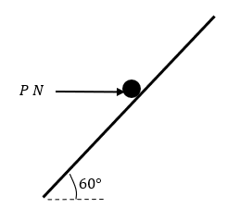
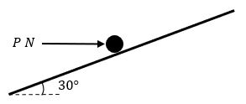
Worked example
Your turn
A parcel of weight $20 N$ lies on a rough plane inclined at an angle of $60°$ to the horizontal.
A horizontal force of magnitude $P$ Newtons acts on the parcel. The parcel is in equilibrium and on the point of slipping up the plane. The normal reaction of the plane on the parcel is $36 N$. The coefficient of friction between the parcel and the plane is $μ$. Find:
The value of $P$
The value of $μ$
The horizontal force is removed.
c) Determine whether or not the parcel moves.
A parcel of weight $10 N$ lies on a rough plane inclined at an angle of $30°$ to the horizontal.
A horizontal force of magnitude $P$ Newtons acts on the parcel. The parcel is in equilibrium and on the point of slipping up the plane. The normal reaction of the plane on the parcel is $18 N$. The coefficient of friction between the parcel and the plane is $μ$. Find:
The value of $P$
The value of $μ$
The horizontal force is removed.
c) Determine whether or not the parcel moves.
a) $19 N$ (2 sf)
b) $0.62$ (2 sf)
c) Does not slide
Diagrams/Graphs used with permission from DrFrostMaths: https://www.drfrostmaths.com/

Slide 14
7.5) Dynamics and inclined planes
Chapter CONTENTS

Slide 15
Worked example
Your turn
A particle is held at rest on a rough plane which is inclined to the horizontal at an angle $α$, where $\tan{α}=\frac{5}{12}$.
The coefficient of friction between the particle and the plane is 0.25.
The particle is released and slides down the plane. Find:
the acceleration of the particle.
the distance it slides in the first 4 seconds.
A particle is held at rest on a rough plane which is inclined to the horizontal at an angle $α$, where $\tan{α}=\frac{3}{4}$.
The coefficient of friction between the particle and the plane is 0.5.
The particle is released and slides down the plane. Find:
the acceleration of the particle.
the distance it slides in the first 2 seconds.
a) $2.0 ms^{−2}$ (2 sf)
b) $3.9 m$ (2 sf)

Slide 16
Worked example
Your turn
A box of mass $4 kg$ is pushed up a rough plane by a horizontal force of magnitude $50 N$.
The plane is inclined to the horizontal at an angle of $20°$.
Given that the coefficient of friction between the box and the plane is $0.1$, find the acceleration of the box.
A box of mass $2 kg$ is pushed up a rough plane by a horizontal force of magnitude $25 N$.
The plane is inclined to the horizontal at an angle of $10°$.
Given that the coefficient of friction between the box and the plane is $0.3$, find the acceleration of the box.
$7.1 ms^{−2}$ (2 sf) up the plane

Slide 17
Worked example
Your turn
A particle of mass $0.3 kg$ slides with constant acceleration down a line of greatest slope of a rough plane, which is inclined at $15°$ to the horizontal.
The particle passes through two points $A$ and $B$, where $AB=5 m$.
The speed of $P$ at $A$ is $4 ms^{−1}$.
It takes $7 s$ to move from $A$ to $B$. Find:
The speed of $P$ at $B$
The acceleration of $P$
The coefficient of friction between $P$ and the plane
A particle of mass $0.6 kg$ slides with constant acceleration down a line of greatest slope of a rough plane, which is inclined at $25°$ to the horizontal.
The particle passes through two points $A$ and $B$, where $AB=10 m$.
The speed of $P$ at $A$ is $2 ms^{−1}$.
It takes $3.5 s$ to move from $A$ to $B$. Find:
The speed of $P$ at $B$
The acceleration of $P$
The coefficient of friction between $P$ and the plane
a) $3.7 ms^{−1}$ (2 sf)
b) $0.49 ms^{−2}$ (2 sf)
c) $0.41$ (2 sf)

Slide 18
7.6) Connected particles
Chapter CONTENTS

Slide 19
Worked example
Your turn
Two particles $P$ and $Q$ of masses 4kg and 8kg respectively are connected by a light inextensible string.
The string passes over a small smooth pulley which is fixed at the top of a rough inclined plane.
$P$ rests on the inclined plane and $Q$ hangs on the edge of the plane with the string vertical and taut.
The plane is inclined to the horizontal at an angle $α$ where $\tan{α}=\frac{5}{12}$.
The coefficient of friction between $P$ and the plane is 0.3. The system is released from rest.
Find the acceleration of the system.
Find the tension in the string.
Two particles $P$ and $Q$ of masses 5kg and 10kg respectively are connected by a light inextensible string.
The string passes over a small smooth pulley which is fixed at the top of a rough inclined plane.
$P$ rests on the inclined plane and $Q$ hangs on the edge of the plane with the string vertical and taut.
The plane is inclined to the horizontal at an angle $α$ where $\tan{α}=\frac{3}{4}$.
The coefficient of friction between $P$ and the plane is 0.2. The system is released from rest.
Find the acceleration of the system.
Find the tension in the string.
a) $4.1 ms^{−2}$ (2 sf)
b) $57 N$ (2 sf)

Slide 20
Worked example
Your turn
One end of a light inextensible string is attached to a block $A$ of mass 4kg. The block $A$ is held at rest on a smooth fixed plane which is inclined to the horizontal at an angle of $45°$. The string lies along the line of greatest slope of the plane and passes over a smooth light pulley which is fixed at the top of the plane. The other end of the string is attached to a block $B$ of mass 10kg. The system is released from rest. By modelling the blocks as particles and ignoring air resistance,
(a)(i) find the acceleration of block $B$
(ii) find the tension in the string.
(b) State how you have used the fact that the string is inextensible in your calculations.
(c) Calculate the magnitude of the force exerted on the pulley by the string.
One end of a light inextensible string is attached to a block $A$ of mass 2kg. The block $A$ is held at rest on a smooth fixed plane which is inclined to the horizontal at an angle of $30°$. The string lies along the line of greatest slope of the plane and passes over a smooth light pulley which is fixed at the top of the plane. The other end of the string is attached to a block $B$ of mass 5kg. The system is released from rest. By modelling the blocks as particles and ignoring air resistance,
(a)(i) find the acceleration of block $B$
(ii) find the tension in the string.
(b) Calculate the magnitude of the force exerted on the pulley by the string.
a)
i) $5.6 ms^{−2}$
ii) $21 N$
b) $36 N$ (2 sf)

Slide 21
Worked example
Your turn
A fixed rough plane is inclined at $45°$ to the horizontal.
A small smooth pulley $P$ is fixed at the top of the plane.
Two particles $A$ and $B$, of mass $3 kg$ and $6 kg$ respectively, are attached to the ends of a light inextensible string which passes over the pulley $P$.
The part of the string from $A$ to $P$ is parallel to the line of greatest slope of the plane and $B$ hangs freely below $P$.
The coefficient of friction between $A$ and the plane is $\frac{1}{\sqrt{2}}$.
Initially $A$ is held at rest on the plane.
The particles are released from rest with the string taut and $A$ moves up the plane.
Find the tension in the string immediately after the particles are released.
A fixed rough plane is inclined at $30°$ to the horizontal.
A small smooth pulley $P$ is fixed at the top of the plane.
Two particles $A$ and $B$, of mass $2 kg$ and $4 kg$ respectively, are attached to the ends of a light inextensible string which passes over the pulley $P$.
The part of the string from $A$ to $P$ is parallel to the line of greatest slope of the plane and $B$ hangs freely below $P$.
The coefficient of friction between $A$ and the plane is $\frac{1}{\sqrt{3}}$.
Initially $A$ is held at rest on the plane.
The particles are released from rest with the string taut and $A$ moves up the plane.
Find the tension in the string immediately after the particles are released.
$26 N$ (2 sf)

