Slide 1
7) Algebraic methods
7.1) Algebraic fractions
7.2) Dividing polynomials
7.3) The factor theorem
7.4) Mathematical proof
7.5) Methods of proof

Slide 2
7.1) Algebraic fractions
Chapter CONTENTS

Slide 3



Worked example
Your turn
Simplify:
$\frac{x^{3}}{x}$ $\frac{x^{4}}{x}$
$\frac{x^{4}}{x^{2}}$ $\frac{6x^{4}}{x^{2}}$
$\frac{6x^{5}}{2x^{2}}$ $\frac{6x^{5}}{8x^{2}}$
$\frac{6x^{5}}{12x^{2}}$ $\frac{6x^{5}}{18x^{8}}$
Simplify:
$$\frac{8x^{7}}{12x^{3}}$$
$$\frac{9x^{5}}{15x^{9}}$$
$$\frac{2x^{4}}{3}$$
$$\frac{3}{5x^{4}}$$

Slide 4
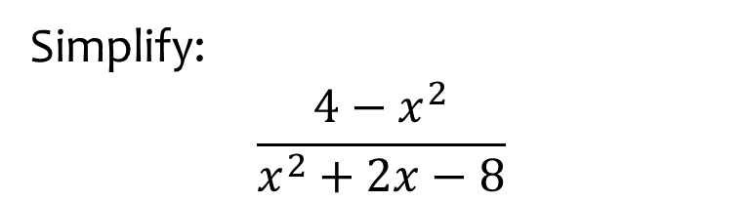
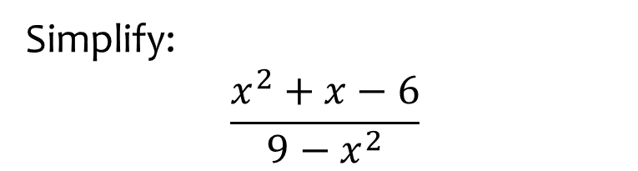

Worked example
Your turn
Simplify:
$$\frac{x^{2}+x−6}{9−x^{2}}$$
Simplify:
$$\frac{4−x^{2}}{x^{2}+2x−8}$$
$$−\frac{x+2}{x+4}$$

Slide 5
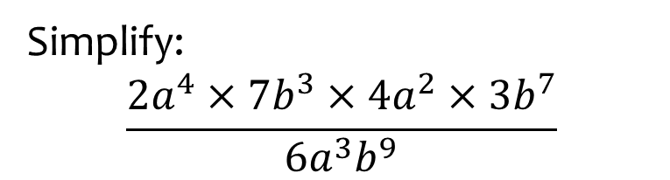


Worked example
Your turn
Simplify:
$$\frac{3x^{2}×5y^{3}×4x×2y^{5}}{10xy}$$
$$\frac{2x^{3}×3y^{5}×x^{4}×5y^{2}}{6x^{2}y^{3}}$$
Simplify:
$$\frac{2a^{4}×7b^{3}×4a^{2}×3b^{7}}{6a^{3}b^{9}}$$
$$28a^{3}b$$

Slide 6
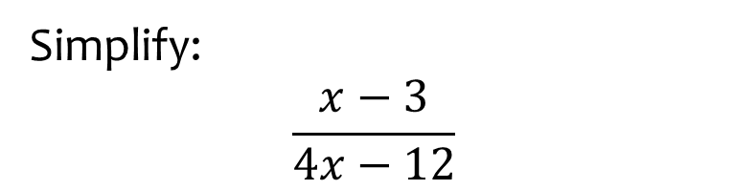


Worked example
Your turn
Simplify:
$$\frac{5x+10}{x+2}$$
$$\frac{x−7}{5x−35}$$
Simplify:
$$\frac{x−3}{4x−12}$$
$$\frac{1}{4}$$

Slide 7
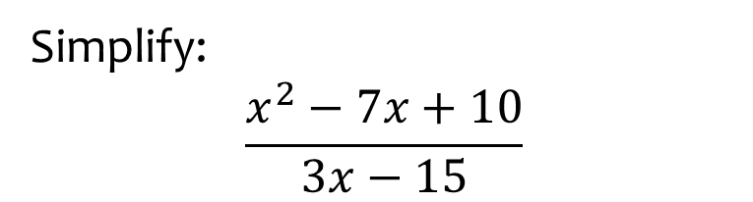


Worked example
Your turn
Simplify:
$$\frac{x^{2}+5x+6}{x+2}$$
$$\frac{4x−12}{x^{2}−5x+6}$$
Simplify:
$$\frac{x^{2}−7x+10}{3x−15}$$
$$\frac{x−2}{3}$$

Slide 8



Worked example
Your turn
Simplify:
$$\frac{x+3}{{\left(x+3\right)}^{3}}$$
$$\frac{{\left(x−4\right)}^{5}}{{\left(x−4\right)}^{2}}$$
$$\frac{2x+10}{{\left(x+5\right)}^{7}}$$
Simplify:
$$\frac{{\left(x−5\right)}^{2}}{{\left(x−5\right)}^{6}}$$
$$\frac{{\left(x+5\right)}^{3}}{3x+15}$$
$$\frac{1}{{\left(x−5\right)}^{4}}$$
$$\frac{{\left(x+5\right)}^{2}}{3}$$

Slide 9
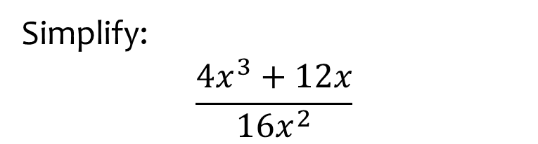


Worked example
Your turn
Simplify:
$$\frac{{3x}^{2}+6x}{15x}$$
$$\frac{5y^{2}−30y^{4}}{10y^{3}}$$
Simplify:
$$\frac{4x^{3}+12x}{16x^{2}}$$
$$\frac{x^{2}+3}{4x}$$

Slide 10
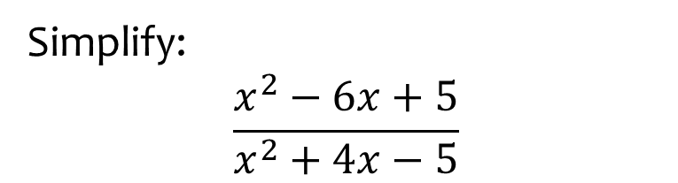


Worked example
Your turn
Simplify:
$$\frac{x^{2}+6x+5}{x^{2}+3x−10}$$
$$\frac{x^{2}−7x−8}{x^{2}−1}$$
Simplify:
$$\frac{x^{2}−6x+5}{x^{2}+4x−5}$$
$$\frac{x−5}{x+5}$$

Slide 11
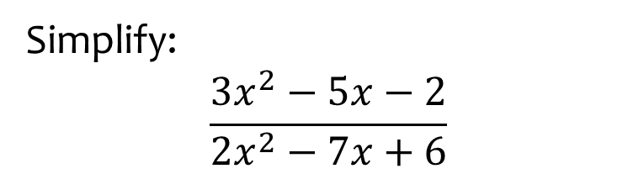


Worked example
Your turn
Simplify:
$$\frac{2x^{2}−5x−3}{3x^{2}−11x+6}$$
$$\frac{3x^{2}−x−10}{x^{2}−4}$$
Simplify:
$$\frac{3x^{2}−5x−2}{2x^{2}−7x+6}$$
$$\frac{3x+1}{2x−3}$$

Slide 12
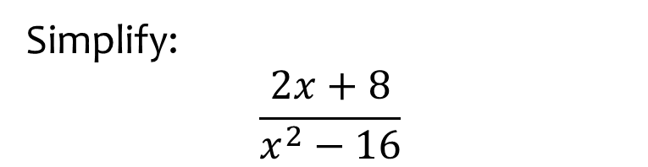


Worked example
Your turn
Simplify:
$$\frac{x^{2}−1}{x+1}$$
$$\frac{x−2}{x^{2}−4}$$
$$\frac{x^{2}−9}{2x−6}$$
Simplify:
$$\frac{2x+8}{x^{2}−16}$$
$$\frac{2}{x−4}$$

Slide 13
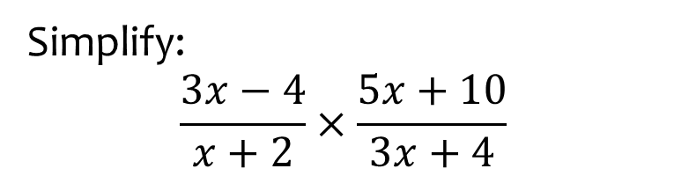


Worked example
Your turn
Simplify:
$$\frac{x+2}{x−3}×\frac{x−3}{x−2}$$
$$\frac{2x+3}{x−4}×\frac{2x−8}{2x+1}$$
Simplify:
$$\frac{3x−4}{x+2}×\frac{5x+10}{3x+4}$$
$$\frac{5\left(3x−4\right)}{3x+4}$$

Slide 14
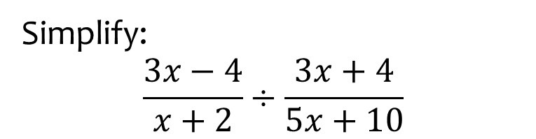


Worked example
Your turn
Simplify:
$$\frac{x+2}{x−3}÷\frac{x−2}{x−3}$$
$$\frac{2x+3}{x−4}÷\frac{2x+1}{2x−8}$$
Simplify:
$$\frac{3x−4}{x+2}÷\frac{3x+4}{5x+10}$$
$$\frac{5\left(3x−4\right)}{3x+4}$$

Slide 15
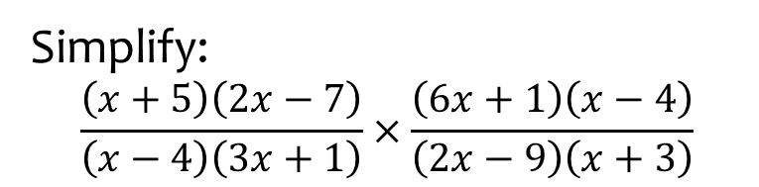

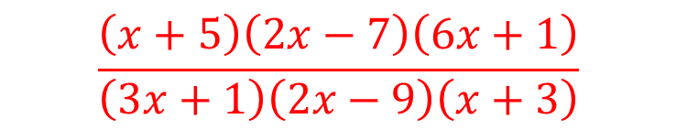
Worked example
Your turn
Simplify:
$$\frac{\left(x+2\right)\left(3x−4\right)}{\left(x−5\right)\left(6x+7\right)}×\frac{\left(7x+6\right)\left(x−5\right)}{\left(4x−3\right)\left(x+2\right)}$$
$$\frac{\left(x+7\right)\left(6x−5\right)}{\left(x−4\right)\left(3x+2\right)}×\frac{\left(x+4\right)\left(3x+2\right)}{\left(6x+5\right)\left(7x\right)}$$
Simplify:
$$\frac{\left(x+5\right)\left(2x−7\right)}{\left(x−4\right)\left(3x+1\right)}×\frac{\left(6x+1\right)\left(x−4\right)}{\left(2x−9\right)\left(x+3\right)}$$
$$\frac{\left(x+5\right)\left(2x−7\right)\left(6x+1\right)}{\left(3x+1\right)\left(2x−9\right)\left(x+3\right)}$$

Slide 16
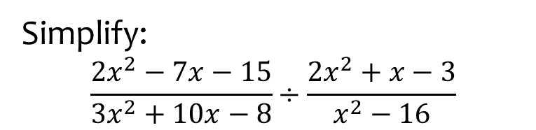
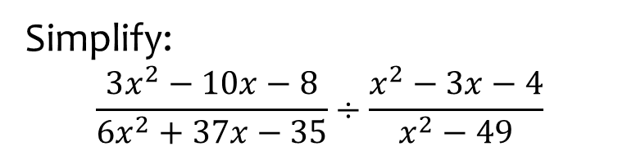

Worked example
Your turn
Simplify:
$$\frac{3x^{2}−10x−8}{6x^{2}+37x−35}÷\frac{x^{2}−3x−4}{x^{2}−49}$$
Simplify:
$$\frac{2x^{2}−7x−15}{3x^{2}+10x−8}÷\frac{2x^{2}+x−3}{x^{2}−16}$$
$$\frac{\left(x−5\right)\left(x−4\right)}{\left(3x−2\right)\left(x−1\right)}$$

Slide 17
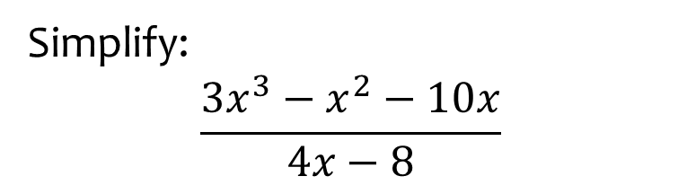
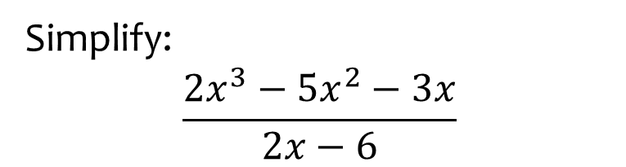

Worked example
Your turn
Simplify:
$$\frac{{2x}^{3}−5x^{2}−3x}{2x−6}$$
Simplify:
$$\frac{3x^{3}−x^{2}−10x}{4x−8}$$
$$\frac{x\left(3x+5\right)}{4}$$

Slide 18
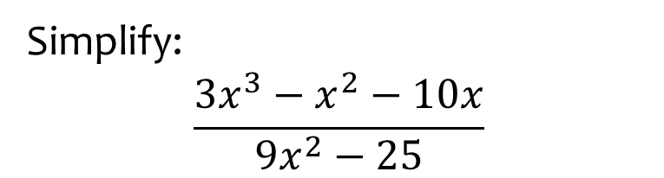
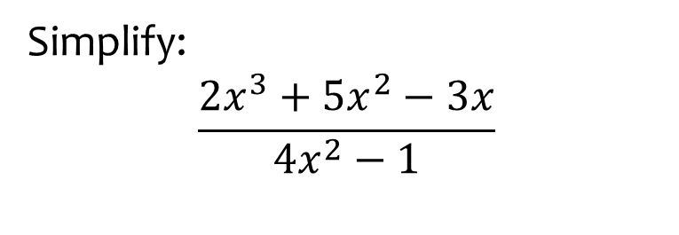

Worked example
Your turn
Simplify:
$$\frac{2x^{3}+5x^{2}−3x}{4x^{2}−1}$$
Simplify:
$$\frac{3x^{3}−x^{2}−10x}{9x^{2}−25}$$
$$\frac{x\left(x−2\right)}{3x−5}$$

Slide 19



Worked example
Your turn
Write as a single fraction:
$$3+\frac{5}{2x−1}$$
$$2−\frac{3}{5x+4}$$
Write as a single fraction:
$$5−\frac{3}{x+2}$$
$$\frac{5x+7}{x+2}$$

Slide 20
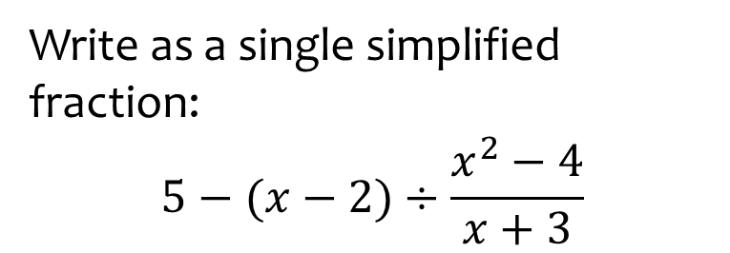
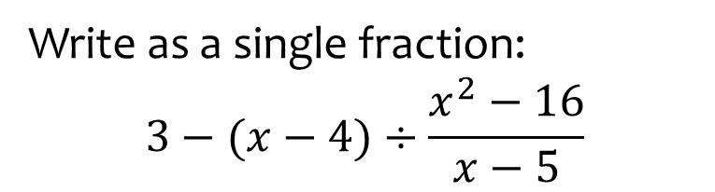

Worked example
Your turn
Write as a single fraction:
$$3−(x−4)÷\frac{x^{2}−16}{x−5}$$
Write as a single simplified fraction:
$$5−(x−2)÷\frac{x^{2}−4}{x+3}$$
$$\frac{4x−13}{x−2}$$

Slide 21
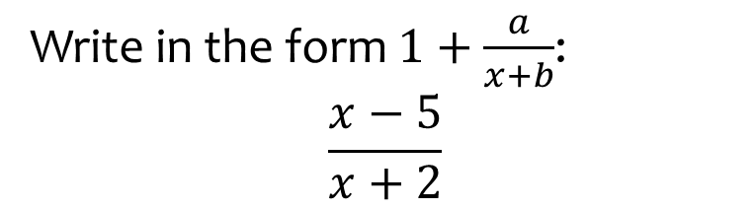


Worked example
Your turn
Write in the form $1+\frac{a}{x+b}$:
$$\frac{x+3}{x−5}$$
$$\frac{x−2}{x+7}$$
Write in the form $1+\frac{a}{x+b}$:
$$\frac{x−5}{x+2}$$
$$1−\frac{7}{x+2}$$

Slide 22



Worked example
Your turn
Simplify:
$$\frac{\frac{3}{x}+2}{1+\frac{5}{x}}$$
$$\frac{\frac{3}{2x}−2}{1−\frac{5}{2x}}$$
Simplify:
$$\frac{\frac{5}{3x}+3}{7+\frac{2}{3x}}$$
$$\frac{9x+5}{21x+2}$$

Slide 23
7.2) Dividing polynomials
Chapter CONTENTS

Slide 24


Worked example
Your turn
Divide $x^{3}−2x^{2}−17x+10$ by $(x−5)$
Divide $x^{3}+2x^{2}−17x+6$ by $(x−3)$
$$x^{2}+5x−2$$

Slide 25
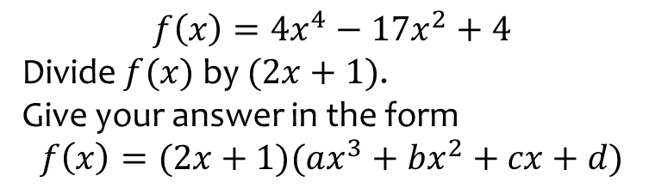
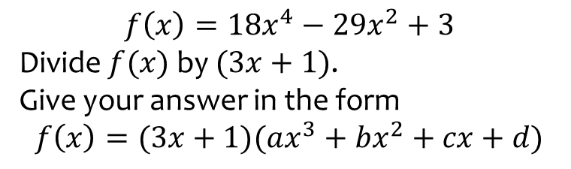

Worked example
Your turn
$$f\left(x\right)=18x^{4}−29x^{2}+3$$
Divide $f(x)$ by $(3x+1)$.
Give your answer in the form
$$f\left(x\right)=(3x+1)(ax^{3}+bx^{2}+cx+d)$$
$$f\left(x\right)=4x^{4}−17x^{2}+4$$
Divide $f(x)$ by $(2x+1)$.
Give your answer in the form
$$f\left(x\right)=(2x+1)(ax^{3}+bx^{2}+cx+d)$$
$$f\left(x\right)=(2x+1)(2x^{3}−x^{2}−8x+4)$$

Slide 26
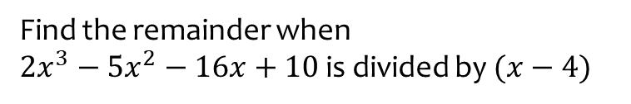
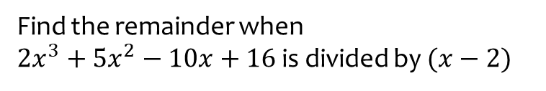
Worked example
Your turn
Find the remainder when
$2x^{3}+5x^{2}−10x+16$ is divided by $(x−2)$
Find the remainder when
$2x^{3}−5x^{2}−16x+10$ is divided by $(x−4)$
$$−6$$

Slide 27


Worked example
Your turn
Divide $27x^{3}−8$ by $3x−2$
Divide $8x^{3}−1$ by $2x−1$
$$4x^{2}+2x+1$$

Slide 28
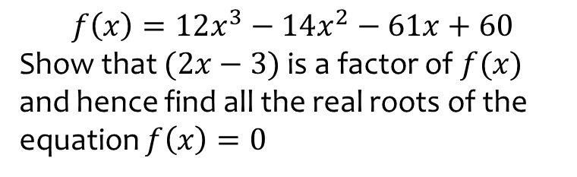
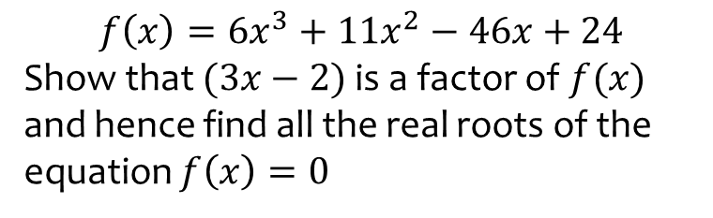

Worked example
Your turn
$$f\left(x\right)=6x^{3}+11x^{2}−46x+24$$
Show that $(3x−2)$ is a factor of $f(x)$ and hence find all the real roots of the equation $f\left(x\right)=0$
$$f\left(x\right)=12x^{3}−14x^{2}−61x+60$$
Show that $(2x−3)$ is a factor of $f(x)$ and hence find all the real roots of the equation $f\left(x\right)=0$
$$x=−\frac{5}{2},x=\frac{3}{2}, x=\frac{4}{3}$$

Slide 29
7.3) The factor theorem
Chapter CONTENTS

Slide 30


Worked example
Your turn
Show that $(x−3)$ is a factor of
$$x^{3}−2x^{2}−5x+6$$
Show that $(x−2)$ is a factor of
$$x^{3}+x^{2}−4x−4$$
Shown
(e.g. algebraic division or factor theorem)

Slide 31



Worked example
Your turn
Fully factorise $3x^{3}+x^{2}−12x−4$
Fully factorise $2x^{3}+x^{2}−18x−9$
$$(x−3)(2x+1)(x+3)$$

Slide 32
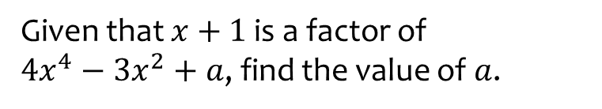
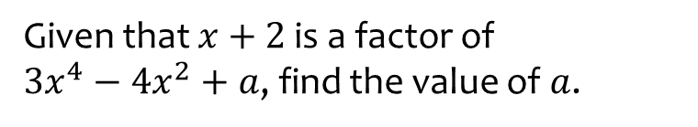
Worked example
Your turn
Given that $x+2$ is a factor of
$3x^{4}−4x^{2}+a$, find the value of $a$.
Given that $x+1$ is a factor of
$4x^{4}−3x^{2}+a$, find the value of $a$.
$$a=−1$$

Slide 33


Worked example
Your turn
Given that $3x+1$ is a factor of
$12x^{3}+ax^{2}+2$, find the value of $a$.
Given that $2x+1$ is a factor of
$6x^{3}+ax^{2}+1$, find the value of $a$.
$$a=−1$$

Slide 34


Worked example
Your turn
Given that $2x−1$ is a factor of
$2x^{3}+3x^{2}+ax+11$, find the value of $a$.
Given that $3x−1$ is a factor of
$3x^{3}+11x^{2}+ax+1$, find the value of $a$.
$$a=−7$$

Slide 35



Worked example
Your turn
Show that $(x−2)$ is a factor of
$$5x^{4}−16x^{3}−47x^{2}+130x−24$$
and hence find all the real solutions to
$$5x^{4}−16x^{3}−47x^{2}+130x−24=0$$
Show that $(x−3)$ is a factor of
$$4x^{4}+15x^{3}−48x^{2}−109x+30$$
and hence find all the real solutions to
$$4x^{4}+15x^{3}−48x^{2}−109x+30=0$$
$$x=−5, x=−2, x=\frac{1}{3}, x=3$$

Slide 36
7.4) Mathematical proof
Chapter CONTENTS

Slide 37


Worked example
Your turn
Prove that
$$\left(2x−3\right)\left(x−7\right)\left(x+5\right)≡2x^{3}−7x^{2}−64x+105$$
Prove that
$$\left(3x+2\right)\left(x−5\right)\left(x+7\right)≡3x^{3}+8x^{2}−101x−70$$
Proof

Slide 38

Worked example
Your turn
Prove that if three consecutive even integers are the sides of a right-angled triangle, they must be 6, 8 and 10.
Prove that if three consecutive integers are the sides of a right-angled triangle, they must be 3, 4 and 5.
Proof e.g. Pythagoras’ Theorem with $x, x+1, x+2$

Slide 39



Worked example
Your turn
Prove that $x^{2}+6x+11$ is positive for all values of $x$.
Prove that $x^{2}+4x+5$ is positive for all values of $x$.
$$x^{2}+4x+5={\left(x+2\right)}^{2}+1$$
$$k^{2}≥0$$
$${\left(x+2\right)}^{2}≥0$$
$${\left(x+2\right)}^{2}+1≥1$$

Slide 40
Worked example
Your turn
Prove that the sum of the squares of two consecutive even numbers is 4 more than a multiple of 8.
Prove that the sum of the squares of two consecutive odd numbers is 2 more than a multiple of 8.
Proof

Slide 41


Worked example
Your turn
Prove that $(1, 1)$, $(4,7)$ and $(10, 4)$ are the vertices of a right-angled triangle.
Prove that $(1, 1)$, $(3, 3)$ and $(4, 2)$ are the vertices of a right-angled triangle.
Proof e.g. Pythagoras’ Theorem or perpendicular gradients AB and BC

Slide 42


Worked example
Your turn
The equation $kx^{2}+5kx+3=0$, where $k$ is a constant, has no real roots.
Prove that $k$ satisfies the inequality $0≤k<\frac{12}{25}$
The equation $kx^{2}+3kx+2=0$, where $k$ is a constant, has no real roots.
Prove that $k$ satisfies the inequality $0≤k<\frac{8}{9}$
Proof

Slide 43



Worked example
Your turn
Prove that $4n−3+2n+7$ is a multiple of $2$ for all real integers $n$
Prove that $4n−3+2n−9$ is a multiple of $3$ for all real integers $n$
Prove that $4n−3+10n−11$ is a multiple of $7$ for all real integers $n$
$14n−14$
$$≡7\left(2n−2\right)$$
$$≡7k$$

Slide 44



Worked example
Your turn
Prove that the sum of five consecutive integers is a multiple of $5$.
Prove that the sum of three consecutive integers is a multiple of $3$.
Let the first integer be $n$:
$$n+n+1+n+2$$
$≡3n+3$
$$≡3\left(n+1\right)$$

Slide 45

Worked example
Your turn
Prove that the product of two odd numbers is an odd number.
Prove that the product of two even numbers is an even number.
Let even numbers be $2m$ and $2n$: $2m×2n$
$$≡4mn$$
$$≡2\left(2mn\right)$$

Slide 46



Worked example
Your turn
Prove algebraically that $n^{2}−2−{\left(n−2\right)}^{2}$ is always even, given $n$ is an integer greater than $1$
Prove algebraically that ${\left(2n+1\right)}^{2}−(2n+1)$ is an even number
$${\left(2n+1\right)}^{2}−\left(2n+1\right)$$
$$≡4n^{2}+4n+1−2n−1$$
$$≡4n^{2}+2n$$
$$≡2\left(2n^{2}+n\right)$$

Slide 47



Worked example
Your turn
Prove that ${\left(n−1\right)}^{2}+n^{2}+{\left(n+1\right)}^{2}$ is two more than a multiple of $3$ for all positive integer values of $n$
Prove that ${\left(n+1\right)}^{2}−n^{2}$ is one more than a multiple of $2$ for all positive integer values of $n$
$${\left(n+1\right)}^{2}−n^{2}$$
$$≡n^{2}+2n+1−n^{2}$$
$$≡2n+1$$

Slide 48



Worked example
Your turn
Prove that ${\left(2n+3\right)}^{2}−{\left(2n−3\right)}^{2}$ is a multiple of $8$ for all positive integer values of $n$
Prove that ${\left(3n+2\right)}^{2}−{\left(3n−2\right)}^{2}$ is a multiple of $8$ for all positive integer values of $n$
$${\left(3n+2\right)}^{2}−{\left(3n−2\right)}^{2}$$
$$≡9n^{2}+12n+4−\left(9n^{2}−12n+4\right)$$
$$≡9n^{2}+12n+4−9n^{2}+12n−4$$
$$≡24n$$
$$≡8\left(3n\right)$$

Slide 49


Worked example
Your turn
Prove algebraically that the difference between two different odd numbers is an even number.
Prove algebraically that the difference between two different even numbers is an even number.
Let even numbers be $2m$ and $2n$: $2m−2n$
$$≡2\left(m−n\right)$$

Slide 50


Worked example
Your turn
Prove that the product of four consecutive integers is always a multiple of $8$
Prove that the product of three consecutive integers is always a multiple of $6$
Proof by showing at least one is a multiple of 2, and one will be a multiple of 3…

Slide 51



Worked example
Your turn
Prove that, for all positive values of $n$, $\frac{{\left(n+3\right)}^{2}−{\left(n−2\right)}^{2}}{2n^{2}+n}=\frac{a}{b}$ where $a$ and $b$ are integers or variables.
Prove that, for all positive values of $n$, $\frac{{\left(n+2\right)}^{2}−{\left(n+1\right)}^{2}}{2n^{2}+3n}=\frac{a}{b}$ and find the integers $a$ and $b$
$$a=1, b=n$$

Slide 52
7.5) Methods of proof
Chapter CONTENTS

Slide 53


Worked example
Your turn
Prove by exhaustion that the sum of an integer and the square of the integer is even for all integers $n$
Prove by exhaustion that all square numbers are either a multiple of $4$ or $1$ more than a multiple of $4$
Proof

Slide 54



Worked example
Your turn
Disprove the statement:
$$\text{“}n^{2}−n+3 \text{is} \text{prime} \text{for} \text{all} \text{integers} n\text{.”}$$
Disprove the statement:
$$\text{“}n^{2}−n+41 \text{is} \text{prime} \text{for} \text{all} \text{integers} n\text{.”}$$
$$n=41, n^{2}−n+41={41}^{2}=1681$$
$1681$ has 3 factors: $1, 41$ and $1681$

Slide 55



Worked example
Your turn
a) Prove that for all positive values of $p$ and $q$
$$p+q>\sqrt{4pq}$$
b) Use a counter-example to show that this is not true when $p$ and $q$ are not both positive.
a) Prove that for all positive values of $x$ and $y$
$$\frac{x}{y}+\frac{y}{x}≥2$$
b) Use a counter-example to show that this is not true when $x$ and $y$ are not both positive.
a) ${\left(x−y\right)}^{2}≥0$
$x^{2}+y^{2}−2xy≥0$
$\frac{x^{2}+y^{2}−2xy}{xy}≥0$
[valid as $x,y>0$ $∴xy>0]$
$\frac{x^{2}}{xy}+\frac{y^{2}}{xy}−\frac{2xy}{xy}≥0$
$\frac{x}{y}+\frac{y}{x}−2≥0$
$\frac{x}{y}+\frac{y}{x}≥2$
b) e.g. $x=−3, y=6$
$$−\frac{3}{6}+\frac{6}{−3}=−\frac{1}{2}−2=−\frac{5}{2}<−2$$

