Slide 1
7) Algebraic methods
7.4) Mathematical proof
7.5) Methods of proof

Slide 2
7.4) Mathematical proof
Chapter CONTENTS

Slide 3
Worked example
Your turn
Prove that
$$\left(2x−3\right)\left(x−7\right)\left(x+5\right)≡2x^{3}−7x^{2}−64x+105$$
Prove that
$$\left(3x+2\right)\left(x−5\right)\left(x+7\right)≡3x^{3}+8x^{2}−101x−70$$
Proof

Slide 4
Worked example
Your turn
Prove that if three consecutive even integers are the sides of a right-angled triangle, they must be 6, 8 and 10.
Prove that if three consecutive integers are the sides of a right-angled triangle, they must be 3, 4 and 5.
Proof e.g. Pythagoras’ Theorem with $x, x+1, x+2$

Slide 5
Worked example
Your turn
Prove that $x^{2}+6x+11$ is positive for all values of $x$.
Prove that $x^{2}+4x+5$ is positive for all values of $x$.
$$x^{2}+4x+5={\left(x+2\right)}^{2}+1$$
$$k^{2}≥0$$
$${\left(x+2\right)}^{2}≥0$$
$${\left(x+2\right)}^{2}+1≥1$$

Slide 6
Worked example
Your turn
Prove that the sum of the squares of two consecutive even numbers is 4 more than a multiple of 8.
Prove that the sum of the squares of two consecutive odd numbers is 2 more than a multiple of 8.
Proof

Slide 7
Worked example
Your turn
Prove that $(1, 1)$, $(4,7)$ and $(10, 4)$ are the vertices of a right-angled triangle.
Prove that $(1, 1)$, $(3, 3)$ and $(4, 2)$ are the vertices of a right-angled triangle.
Proof e.g. Pythagoras’ Theorem or perpendicular gradients AB and BC

Slide 8
Worked example
Your turn
The equation $kx^{2}+5kx+3=0$, where $k$ is a constant, has no real roots.
Prove that $k$ satisfies the inequality $0≤k<\frac{12}{25}$
The equation $kx^{2}+3kx+2=0$, where $k$ is a constant, has no real roots.
Prove that $k$ satisfies the inequality $0≤k<\frac{8}{9}$
Proof

Slide 9

Worked example
Your turn
Prove that $4n−3+2n+7$ is a multiple of $2$ for all real integers $n$
Prove that $4n−3+2n−9$ is a multiple of $3$ for all real integers $n$
Prove that $4n−3+10n−11$ is a multiple of $7$ for all real integers $n$
$14n−14$
$$≡7\left(2n−2\right)$$
$$≡7k$$

Slide 10
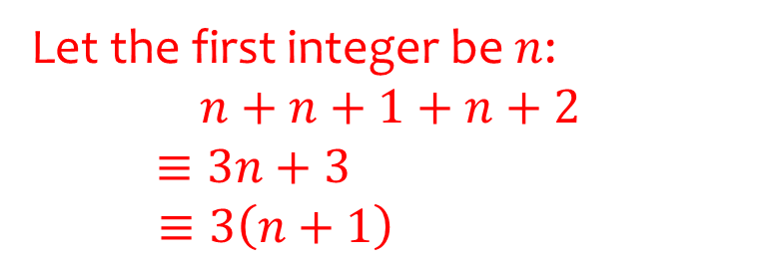
Worked example
Your turn
Prove that the sum of five consecutive integers is a multiple of $5$.
Prove that the sum of three consecutive integers is a multiple of $3$.
Let the first integer be $n$:
$$n+n+1+n+2$$
$≡3n+3$
$$≡3\left(n+1\right)$$

Slide 11
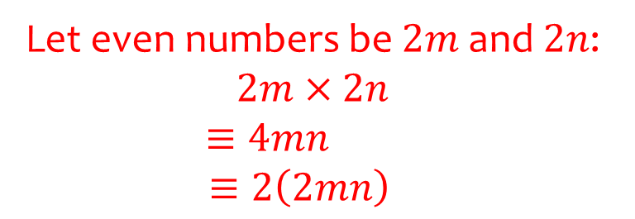
Worked example
Your turn
Prove that the product of two odd numbers is an odd number.
Prove that the product of two even numbers is an even number.
Let even numbers be $2m$ and $2n$: $2m×2n$
$$≡4mn$$
$$≡2\left(2mn\right)$$

Slide 12
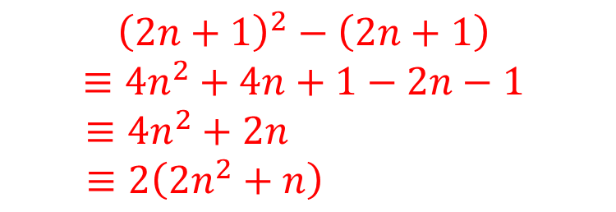
Worked example
Your turn
Prove algebraically that $n^{2}−2−{\left(n−2\right)}^{2}$ is always even, given $n$ is an integer greater than $1$
Prove algebraically that ${\left(2n+1\right)}^{2}−(2n+1)$ is an even number
$${\left(2n+1\right)}^{2}−\left(2n+1\right)$$
$$≡4n^{2}+4n+1−2n−1$$
$$≡4n^{2}+2n$$
$$≡2\left(2n^{2}+n\right)$$

Slide 13
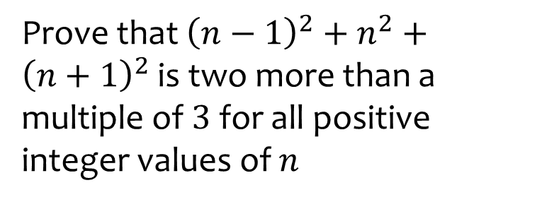
Worked example
Your turn
Prove that ${\left(n−1\right)}^{2}+n^{2}+{\left(n+1\right)}^{2}$ is two more than a multiple of $3$ for all positive integer values of $n$
Prove that ${\left(n+1\right)}^{2}−n^{2}$ is one more than a multiple of $2$ for all positive integer values of $n$
$${\left(n+1\right)}^{2}−n^{2}$$
$$≡n^{2}+2n+1−n^{2}$$
$$≡2n+1$$

Slide 14
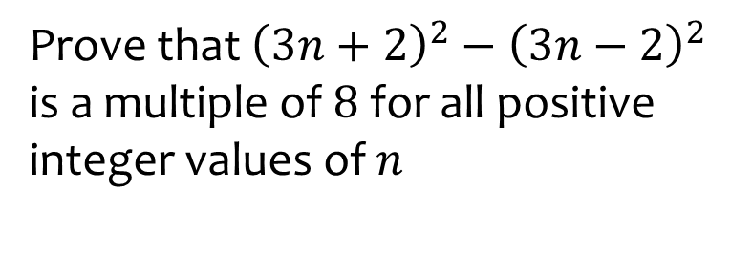
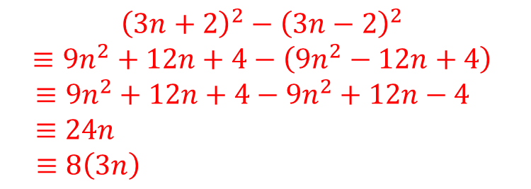
Worked example
Your turn
Prove that ${\left(2n+3\right)}^{2}−{\left(2n−3\right)}^{2}$ is a multiple of $8$ for all positive integer values of $n$
Prove that ${\left(3n+2\right)}^{2}−{\left(3n−2\right)}^{2}$ is a multiple of $8$ for all positive integer values of $n$
$${\left(3n+2\right)}^{2}−{\left(3n−2\right)}^{2}$$
$$≡9n^{2}+12n+4−\left(9n^{2}−12n+4\right)$$
$$≡9n^{2}+12n+4−9n^{2}+12n−4$$
$$≡24n$$
$$≡8\left(3n\right)$$

Slide 15
Worked example
Your turn
Prove algebraically that the difference between two different odd numbers is an even number.
Prove algebraically that the difference between two different even numbers is an even number.
Let even numbers be $2m$ and $2n$: $2m−2n$
$$≡2\left(m−n\right)$$

Slide 16
Worked example
Your turn
Prove that the product of four consecutive integers is always a multiple of $8$
Prove that the product of three consecutive integers is always a multiple of $6$
Proof by showing at least one is a multiple of 2, and one will be a multiple of 3…

Slide 17
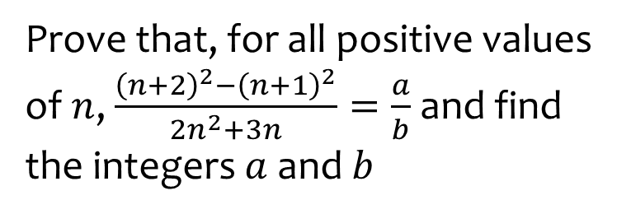
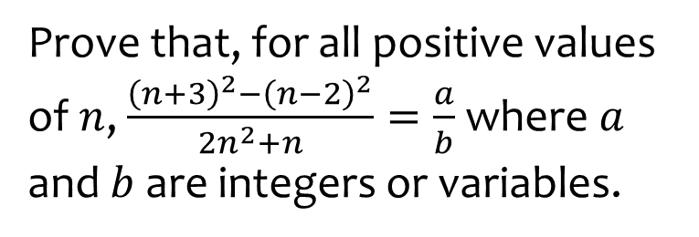
Worked example
Your turn
Prove that, for all positive values of $n$, $\frac{{\left(n+3\right)}^{2}−{\left(n−2\right)}^{2}}{2n^{2}+n}=\frac{a}{b}$ where $a$ and $b$ are integers or variables.
Prove that, for all positive values of $n$, $\frac{{\left(n+2\right)}^{2}−{\left(n+1\right)}^{2}}{2n^{2}+3n}=\frac{a}{b}$ and find the integers $a$ and $b$
$$a=1, b=n$$

Slide 18
7.5) Methods of proof
Chapter CONTENTS

Slide 19
Worked example
Your turn
Prove by exhaustion that the sum of an integer and the square of the integer is even for all integers $n$
Prove by exhaustion that all square numbers are either a multiple of $4$ or $1$ more than a multiple of $4$
Proof

Slide 20
Worked example
Your turn
Disprove the statement:
$$\text{“}n^{2}−n+3 \text{is} \text{prime} \text{for} \text{all} \text{integers} n\text{.”}$$
Disprove the statement:
$$\text{“}n^{2}−n+41 \text{is} \text{prime} \text{for} \text{all} \text{integers} n\text{.”}$$
$$n=41, n^{2}−n+41={41}^{2}=1681$$
$1681$ has 3 factors: $1, 41$ and $1681$

Slide 21
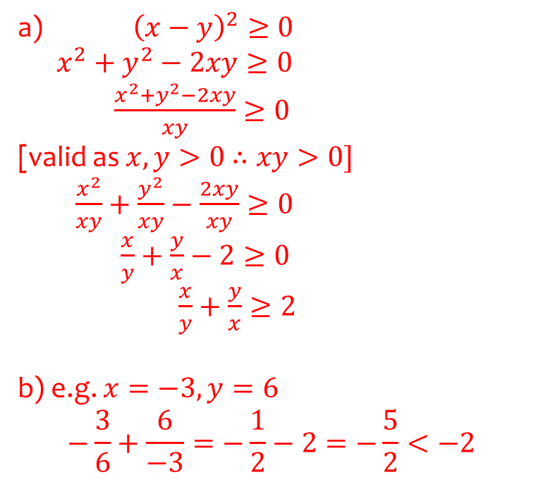
Worked example
Your turn
a) Prove that for all positive values of $p$ and $q$
$$p+q>\sqrt{4pq}$$
b) Use a counter-example to show that this is not true when $p$ and $q$ are not both positive.
a) Prove that for all positive values of $x$ and $y$
$$\frac{x}{y}+\frac{y}{x}≥2$$
b) Use a counter-example to show that this is not true when $x$ and $y$ are not both positive.
a) ${\left(x−y\right)}^{2}≥0$
$x^{2}+y^{2}−2xy≥0$
$\frac{x^{2}+y^{2}−2xy}{xy}≥0$
[valid as $x,y>0$ $∴xy>0]$
$\frac{x^{2}}{xy}+\frac{y^{2}}{xy}−\frac{2xy}{xy}≥0$
$\frac{x}{y}+\frac{y}{x}−2≥0$
$\frac{x}{y}+\frac{y}{x}≥2$
b) e.g. $x=−3, y=6$
$$−\frac{3}{6}+\frac{6}{−3}=−\frac{1}{2}−2=−\frac{5}{2}<−2$$

