Slide 1
7) Algebraic methods
7.1) Algebraic fractions
7.2) Dividing polynomials
7.3) The factor theorem

Slide 2
7.1) Algebraic fractions
Chapter CONTENTS

Slide 3



Worked example
Your turn
Simplify:
$\frac{x^{3}}{x}$ $\frac{x^{4}}{x}$
$\frac{x^{4}}{x^{2}}$ $\frac{6x^{4}}{x^{2}}$
$\frac{6x^{5}}{2x^{2}}$ $\frac{6x^{5}}{8x^{2}}$
$\frac{6x^{5}}{12x^{2}}$ $\frac{6x^{5}}{18x^{8}}$
Simplify:
$$\frac{8x^{7}}{12x^{3}}$$
$$\frac{9x^{5}}{15x^{9}}$$
$$\frac{2x^{4}}{3}$$
$$\frac{3}{5x^{4}}$$

Slide 4



Worked example
Your turn
Simplify:
$$\frac{x^{2}+x−6}{9−x^{2}}$$
Simplify:
$$\frac{4−x^{2}}{x^{2}+2x−8}$$
$$−\frac{x+2}{x+4}$$

Slide 5
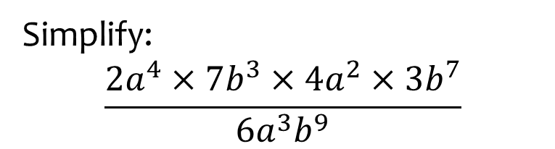


Worked example
Your turn
Simplify:
$$\frac{3x^{2}×5y^{3}×4x×2y^{5}}{10xy}$$
$$\frac{2x^{3}×3y^{5}×x^{4}×5y^{2}}{6x^{2}y^{3}}$$
Simplify:
$$\frac{2a^{4}×7b^{3}×4a^{2}×3b^{7}}{6a^{3}b^{9}}$$
$$28a^{3}b$$

Slide 6



Worked example
Your turn
Simplify:
$$\frac{5x+10}{x+2}$$
$$\frac{x−7}{5x−35}$$
Simplify:
$$\frac{x−3}{4x−12}$$
$$\frac{1}{4}$$

Slide 7



Worked example
Your turn
Simplify:
$$\frac{x^{2}+5x+6}{x+2}$$
$$\frac{4x−12}{x^{2}−5x+6}$$
Simplify:
$$\frac{x^{2}−7x+10}{3x−15}$$
$$\frac{x−2}{3}$$

Slide 8



Worked example
Your turn
Simplify:
$$\frac{x+3}{{\left(x+3\right)}^{3}}$$
$$\frac{{\left(x−4\right)}^{5}}{{\left(x−4\right)}^{2}}$$
$$\frac{2x+10}{{\left(x+5\right)}^{7}}$$
Simplify:
$$\frac{{\left(x−5\right)}^{2}}{{\left(x−5\right)}^{6}}$$
$$\frac{{\left(x+5\right)}^{3}}{3x+15}$$
$$\frac{1}{{\left(x−5\right)}^{4}}$$
$$\frac{{\left(x+5\right)}^{2}}{3}$$

Slide 9



Worked example
Your turn
Simplify:
$$\frac{{3x}^{2}+6x}{15x}$$
$$\frac{5y^{2}−30y^{4}}{10y^{3}}$$
Simplify:
$$\frac{4x^{3}+12x}{16x^{2}}$$
$$\frac{x^{2}+3}{4x}$$

Slide 10



Worked example
Your turn
Simplify:
$$\frac{x^{2}+6x+5}{x^{2}+3x−10}$$
$$\frac{x^{2}−7x−8}{x^{2}−1}$$
Simplify:
$$\frac{x^{2}−6x+5}{x^{2}+4x−5}$$
$$\frac{x−5}{x+5}$$

Slide 11



Worked example
Your turn
Simplify:
$$\frac{2x^{2}−5x−3}{3x^{2}−11x+6}$$
$$\frac{3x^{2}−x−10}{x^{2}−4}$$
Simplify:
$$\frac{3x^{2}−5x−2}{2x^{2}−7x+6}$$
$$\frac{3x+1}{2x−3}$$

Slide 12



Worked example
Your turn
Simplify:
$$\frac{x^{2}−1}{x+1}$$
$$\frac{x−2}{x^{2}−4}$$
$$\frac{x^{2}−9}{2x−6}$$
Simplify:
$$\frac{2x+8}{x^{2}−16}$$
$$\frac{2}{x−4}$$

Slide 13
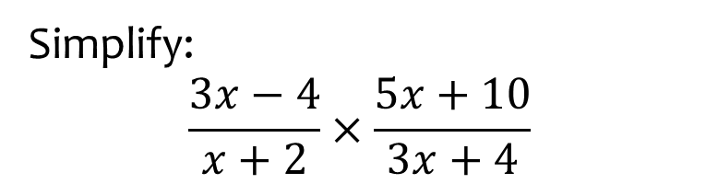


Worked example
Your turn
Simplify:
$$\frac{x+2}{x−3}×\frac{x−3}{x−2}$$
$$\frac{2x+3}{x−4}×\frac{2x−8}{2x+1}$$
Simplify:
$$\frac{3x−4}{x+2}×\frac{5x+10}{3x+4}$$
$$\frac{5\left(3x−4\right)}{3x+4}$$

Slide 14
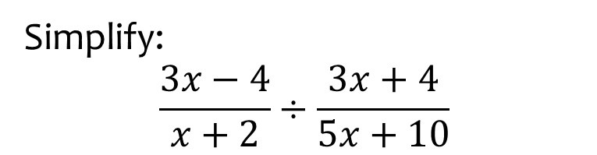


Worked example
Your turn
Simplify:
$$\frac{x+2}{x−3}÷\frac{x−2}{x−3}$$
$$\frac{2x+3}{x−4}÷\frac{2x+1}{2x−8}$$
Simplify:
$$\frac{3x−4}{x+2}÷\frac{3x+4}{5x+10}$$
$$\frac{5\left(3x−4\right)}{3x+4}$$

Slide 15
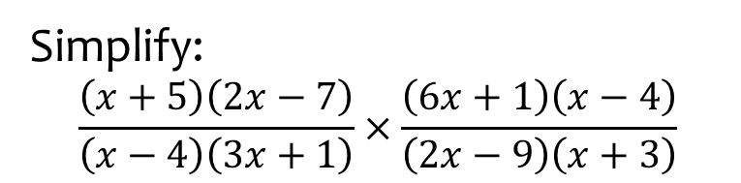

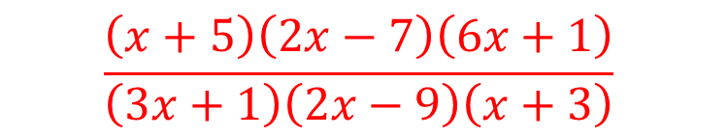
Worked example
Your turn
Simplify:
$$\frac{\left(x+2\right)\left(3x−4\right)}{\left(x−5\right)\left(6x+7\right)}×\frac{\left(7x+6\right)\left(x−5\right)}{\left(4x−3\right)\left(x+2\right)}$$
$$\frac{\left(x+7\right)\left(6x−5\right)}{\left(x−4\right)\left(3x+2\right)}×\frac{\left(x+4\right)\left(3x+2\right)}{\left(6x+5\right)\left(7x\right)}$$
Simplify:
$$\frac{\left(x+5\right)\left(2x−7\right)}{\left(x−4\right)\left(3x+1\right)}×\frac{\left(6x+1\right)\left(x−4\right)}{\left(2x−9\right)\left(x+3\right)}$$
$$\frac{\left(x+5\right)\left(2x−7\right)\left(6x+1\right)}{\left(3x+1\right)\left(2x−9\right)\left(x+3\right)}$$

Slide 16
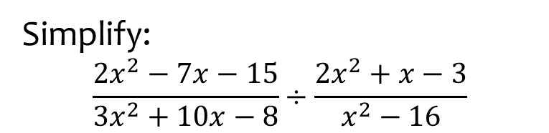
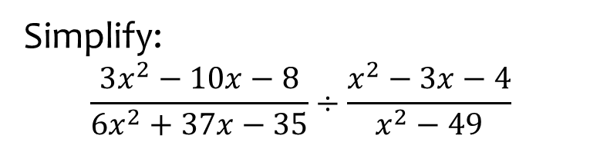

Worked example
Your turn
Simplify:
$$\frac{3x^{2}−10x−8}{6x^{2}+37x−35}÷\frac{x^{2}−3x−4}{x^{2}−49}$$
Simplify:
$$\frac{2x^{2}−7x−15}{3x^{2}+10x−8}÷\frac{2x^{2}+x−3}{x^{2}−16}$$
$$\frac{\left(x−5\right)\left(x−4\right)}{\left(3x−2\right)\left(x−1\right)}$$

Slide 17



Worked example
Your turn
Simplify:
$$\frac{{2x}^{3}−5x^{2}−3x}{2x−6}$$
Simplify:
$$\frac{3x^{3}−x^{2}−10x}{4x−8}$$
$$\frac{x\left(3x+5\right)}{4}$$

Slide 18

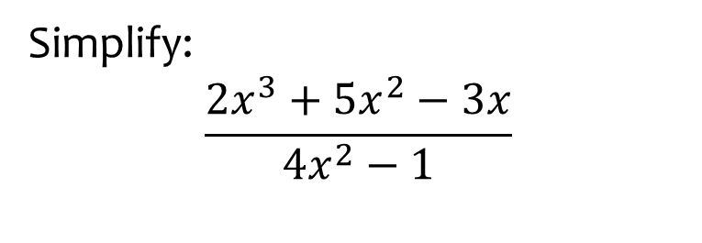

Worked example
Your turn
Simplify:
$$\frac{2x^{3}+5x^{2}−3x}{4x^{2}−1}$$
Simplify:
$$\frac{3x^{3}−x^{2}−10x}{9x^{2}−25}$$
$$\frac{x\left(x−2\right)}{3x−5}$$

Slide 19



Worked example
Your turn
Write as a single fraction:
$$3+\frac{5}{2x−1}$$
$$2−\frac{3}{5x+4}$$
Write as a single fraction:
$$5−\frac{3}{x+2}$$
$$\frac{5x+7}{x+2}$$

Slide 20
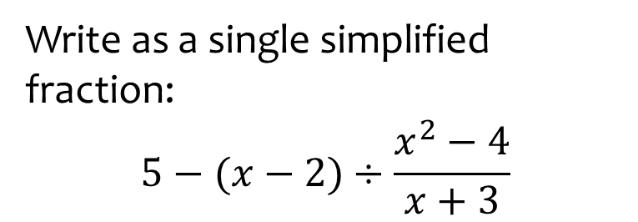
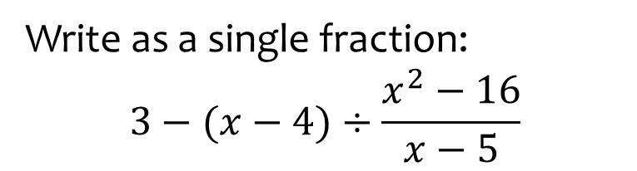

Worked example
Your turn
Write as a single fraction:
$$3−(x−4)÷\frac{x^{2}−16}{x−5}$$
Write as a single simplified fraction:
$$5−(x−2)÷\frac{x^{2}−4}{x+3}$$
$$\frac{4x−13}{x−2}$$

Slide 21
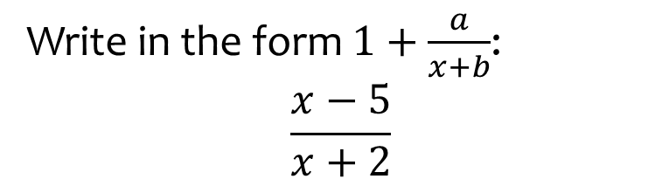


Worked example
Your turn
Write in the form $1+\frac{a}{x+b}$:
$$\frac{x+3}{x−5}$$
$$\frac{x−2}{x+7}$$
Write in the form $1+\frac{a}{x+b}$:
$$\frac{x−5}{x+2}$$
$$1−\frac{7}{x+2}$$

Slide 22



Worked example
Your turn
Simplify:
$$\frac{\frac{3}{x}+2}{1+\frac{5}{x}}$$
$$\frac{\frac{3}{2x}−2}{1−\frac{5}{2x}}$$
Simplify:
$$\frac{\frac{5}{3x}+3}{7+\frac{2}{3x}}$$
$$\frac{9x+5}{21x+2}$$

Slide 23
7.2) Dividing polynomials
Chapter CONTENTS

Slide 24


Worked example
Your turn
Divide $x^{3}−2x^{2}−17x+10$ by $(x−5)$
Divide $x^{3}+2x^{2}−17x+6$ by $(x−3)$
$$x^{2}+5x−2$$

Slide 25
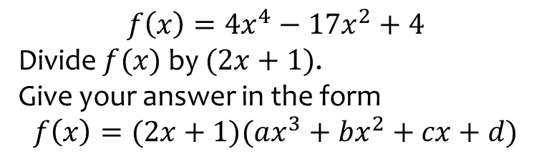
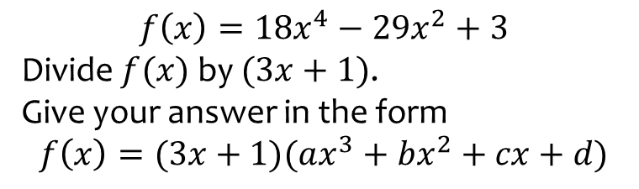

Worked example
Your turn
$$f\left(x\right)=18x^{4}−29x^{2}+3$$
Divide $f(x)$ by $(3x+1)$.
Give your answer in the form
$$f\left(x\right)=(3x+1)(ax^{3}+bx^{2}+cx+d)$$
$$f\left(x\right)=4x^{4}−17x^{2}+4$$
Divide $f(x)$ by $(2x+1)$.
Give your answer in the form
$$f\left(x\right)=(2x+1)(ax^{3}+bx^{2}+cx+d)$$
$$f\left(x\right)=(2x+1)(2x^{3}−x^{2}−8x+4)$$

Slide 26
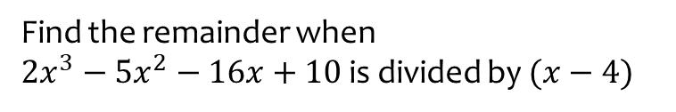
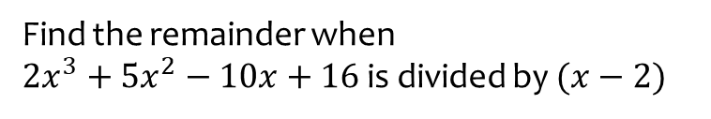
Worked example
Your turn
Find the remainder when
$2x^{3}+5x^{2}−10x+16$ is divided by $(x−2)$
Find the remainder when
$2x^{3}−5x^{2}−16x+10$ is divided by $(x−4)$
$$−6$$

Slide 27


Worked example
Your turn
Divide $27x^{3}−8$ by $3x−2$
Divide $8x^{3}−1$ by $2x−1$
$$4x^{2}+2x+1$$

Slide 28
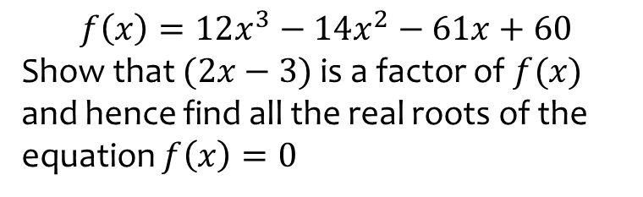
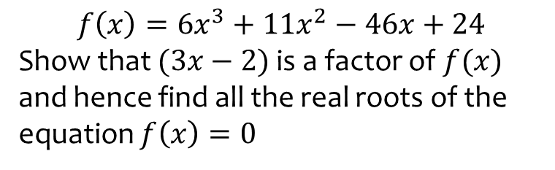

Worked example
Your turn
$$f\left(x\right)=6x^{3}+11x^{2}−46x+24$$
Show that $(3x−2)$ is a factor of $f(x)$ and hence find all the real roots of the equation $f\left(x\right)=0$
$$f\left(x\right)=12x^{3}−14x^{2}−61x+60$$
Show that $(2x−3)$ is a factor of $f(x)$ and hence find all the real roots of the equation $f\left(x\right)=0$
$$x=−\frac{5}{2},x=\frac{3}{2}, x=\frac{4}{3}$$

Slide 29
7.3) The factor theorem
Chapter CONTENTS

Slide 30


Worked example
Your turn
Show that $(x−3)$ is a factor of
$$x^{3}−2x^{2}−5x+6$$
Show that $(x−2)$ is a factor of
$$x^{3}+x^{2}−4x−4$$
Shown
(e.g. algebraic division or factor theorem)

Slide 31



Worked example
Your turn
Fully factorise $3x^{3}+x^{2}−12x−4$
Fully factorise $2x^{3}+x^{2}−18x−9$
$$(x−3)(2x+1)(x+3)$$

Slide 32
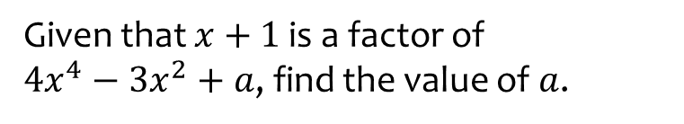
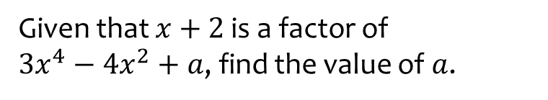
Worked example
Your turn
Given that $x+2$ is a factor of
$3x^{4}−4x^{2}+a$, find the value of $a$.
Given that $x+1$ is a factor of
$4x^{4}−3x^{2}+a$, find the value of $a$.
$$a=−1$$

Slide 33
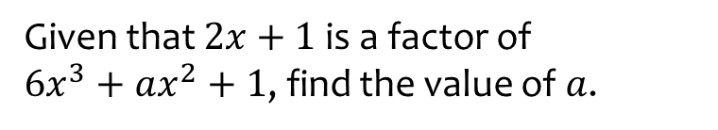
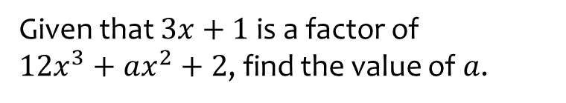
Worked example
Your turn
Given that $3x+1$ is a factor of
$12x^{3}+ax^{2}+2$, find the value of $a$.
Given that $2x+1$ is a factor of
$6x^{3}+ax^{2}+1$, find the value of $a$.
$$a=−1$$

Slide 34
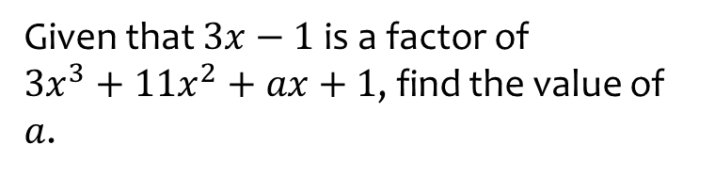
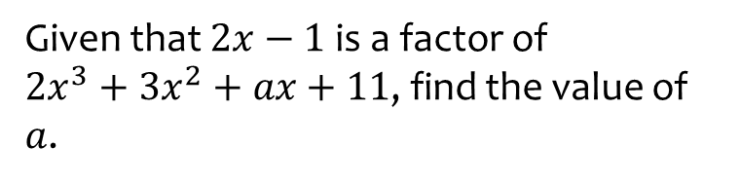
Worked example
Your turn
Given that $2x−1$ is a factor of
$2x^{3}+3x^{2}+ax+11$, find the value of $a$.
Given that $3x−1$ is a factor of
$3x^{3}+11x^{2}+ax+1$, find the value of $a$.
$$a=−7$$

Slide 35
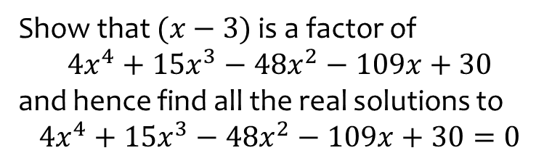
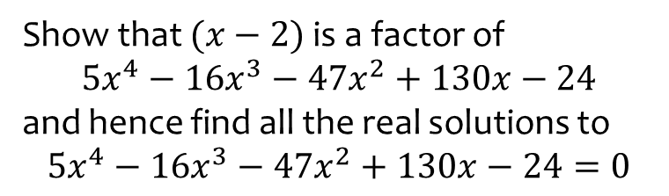

Worked example
Your turn
Show that $(x−2)$ is a factor of
$$5x^{4}−16x^{3}−47x^{2}+130x−24$$
and hence find all the real solutions to
$$5x^{4}−16x^{3}−47x^{2}+130x−24=0$$
Show that $(x−3)$ is a factor of
$$4x^{4}+15x^{3}−48x^{2}−109x+30$$
and hence find all the real solutions to
$$4x^{4}+15x^{3}−48x^{2}−109x+30=0$$
$$x=−5, x=−2, x=\frac{1}{3}, x=3$$

