Slide 1
6.5) Inverse trigonometric functions

Slide 2
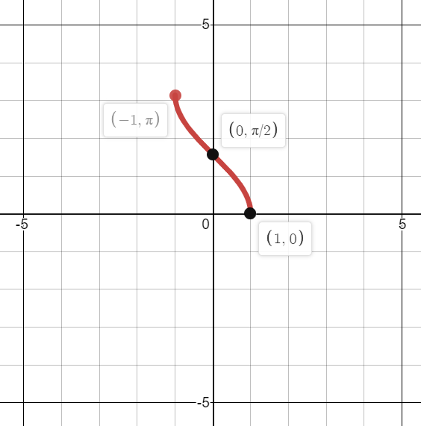
Worked example
Your turn
Sketch the graph of:
$$y=\arcsin{x}$$
$$y=\arctan{x}$$
Sketch the graph of:
$$y=\arccos{x}$$
Graphs used with permission from DESMOS: https://www.desmos.com/

Slide 3
Worked example
Your turn
Work out, in radians, the values of:
$\arcsin\left(\frac{\sqrt{2}}{2}\right)$
$\arccos\left(1\right)$
$\arctan\left(−\sqrt{3}\right)$
Work out, in radians, the values of:
$\arcsin\left(−\frac{\sqrt{2}}{2}\right)$
$\arccos\left(−1\right)$
$\arctan\left(\sqrt{3}\right)$
a) $−\frac{π}{4}$
b) $π$
c) $\frac{π}{3}$

Slide 4
Worked example
Your turn
Given that $y=\arcsin{x}, −1≤x≤1$ and $0≤y≤π$,
Express $\arccos{x}$in terms of $y$
Hence evaluate $\arcsin{x}−\arccos{x}$
Given that $y=\arccos{x}, −1≤x≤1$ and $0≤y≤π$,
Express $\arcsin{x}$in terms of $y$
Hence evaluate $\arccos{x}+\arcsin{x}$
a) $\arcsin{x}=\frac{π}{2}−y$
b) $\frac{π}{2}$

Slide 5
Worked example
Your turn
Prove that for $0≤x≤1$, $\arcsin{x}=\arccos{\sqrt{1−x^{2}}}$and give a reason why this result is not true for $−1≤x≤0$
Prove that for $0≤x≤1$, $\arccos{x}=\arcsin{\sqrt{1−x^{2}}}$and give a reason why this result is not true for $−1≤x≤0$
Proof
Then reason e.g. counter example $x=−\frac{1}{\sqrt{2}}$

