Slide 1
6.4) Use tangent and chord properties

Slide 2
Worked example
Your turn
Find the equation of the tangent to $x^{2}+y^{2}=25$ at the point $(3, 4)$
Find the equation of the tangent to $x^{2}+y^{2}=25$ at the point $(4, 3)$
$$y=−\frac{4}{3}x+\frac{25}{3}$$

Slide 3
Worked example
Your turn
Find the equation of the tangent to $x^{2}+y^{2}=169$ at the point $(5, 12)$
Find the equation of the tangent to $x^{2}+y^{2}=169$ at the point $(−5, 12)$
$$y=\frac{5}{12}x+\frac{169}{12}$$

Slide 4
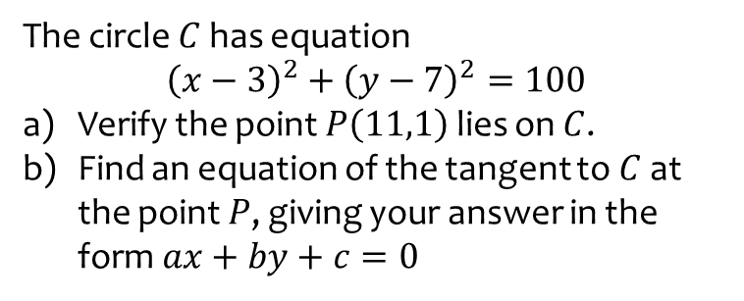
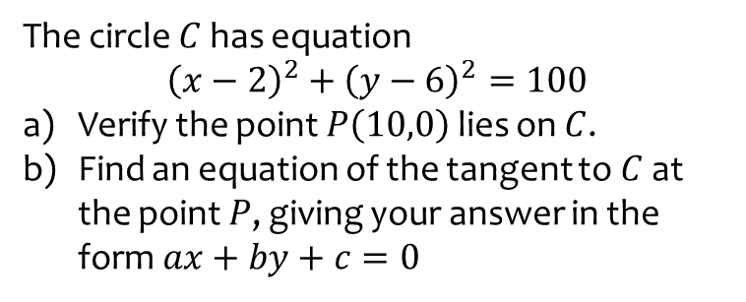
Worked example
Your turn
The circle $C$ has equation $${\left(x−3\right)}^{2}+{\left(y−7\right)}^{2}=100$$
Verify the point $P\left(11,1\right)$ lies on $C$.
Find an equation of the tangent to $C$ at the point $P$, giving your answer in the form $ax+by+c=0$
The circle $C$ has equation $${\left(x−2\right)}^{2}+{\left(y−6\right)}^{2}=100$$
Verify the point $P\left(10,0\right)$ lies on $C$.
Find an equation of the tangent to $C$ at the point $P$, giving your answer in the form $ax+by+c=0$
a) Verified using substitution
b) $4x−3y=40=0$

Slide 5
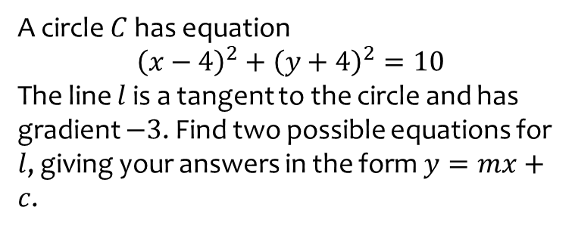
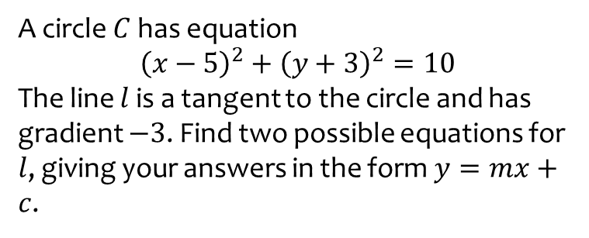
Worked example
Your turn
A circle $C$ has equation $${\left(x−4\right)}^{2}+{\left(y+4\right)}^{2}=10$$
The line $l$ is a tangent to the circle and has gradient $−3$. Find two possible equations for $l$, giving your answers in the form $y=mx+c$.
A circle $C$ has equation $${\left(x−5\right)}^{2}+{\left(y+3\right)}^{2}=10$$
The line $l$ is a tangent to the circle and has gradient $−3$. Find two possible equations for $l$, giving your answers in the form $y=mx+c$.
$y=−3x+2$ and $y=−3x+22$

Slide 6
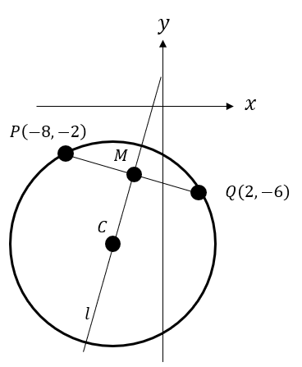
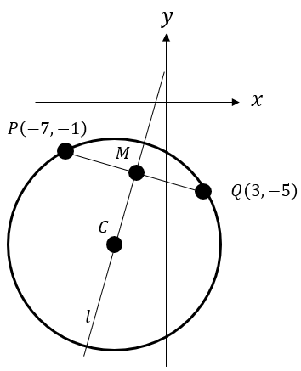
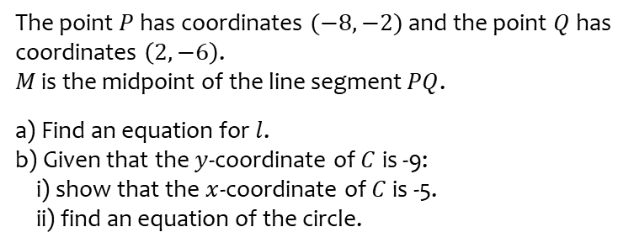
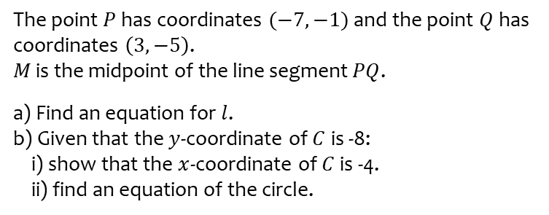
Worked example
Your turn
The point $P$ has coordinates $(−8,−2)$ and the point $Q$ has coordinates $\left(2,−6\right)$.
$M$ is the midpoint of the line segment $PQ$.
a) Find an equation for $l$.
b) Given that the $y$-coordinate of $C$ is -9: i) show that the $x$-coordinate of $C$ is -5. ii) find an equation of the circle.
The point $P$ has coordinates $(−7,−1)$ and the point $Q$ has coordinates $\left(3,−5\right)$.
$M$ is the midpoint of the line segment $PQ$.
a) Find an equation for $l$.
b) Given that the $y$-coordinate of $C$ is -8: i) show that the $x$-coordinate of $C$ is -4. ii) find an equation of the circle.
a) $y=\frac{5}{2}x+2$
b) i) Shown
ii) ${\left(x+4\right)}^{2}+{\left(y+8\right)}^{2}=58$

Slide 7
Worked example
Your turn
The line with equation $4x+y−5=0$ is a tangent to the circle with equation
${\left(x−3\right)}^{2}+{\left(y−p\right)}^{2}=2$.
Find the two possible values of $p$
The line with equation $4x+y−3=0$ is a tangent to the circle with equation
${\left(x−2\right)}^{2}+{\left(y−p\right)}^{2}=5$.
Find the two possible values of $p$
$$p=3±\sqrt{19}$$

Slide 8
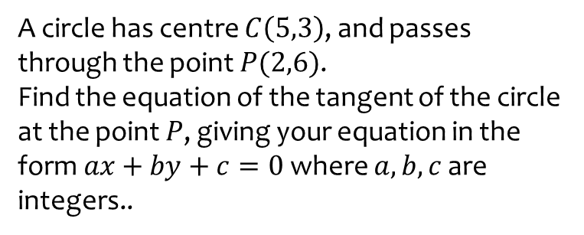
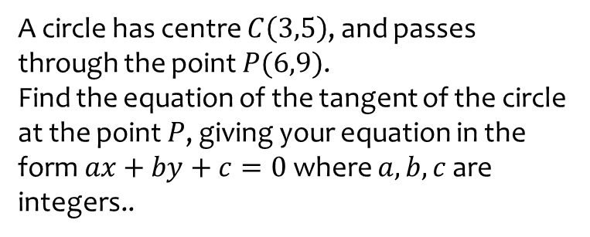
Worked example
Your turn
A circle has centre $C\left(5,3\right)$, and passes through the point $P(2,6)$.
Find the equation of the tangent of the circle at the point $P$, giving your equation in the form $ax+by+c=0$ where $a,b,c$ are integers..
A circle has centre $C\left(3,5\right)$, and passes through the point $P(6,9)$.
Find the equation of the tangent of the circle at the point $P$, giving your equation in the form $ax+by+c=0$ where $a,b,c$ are integers..
$$3x+4y−54=0$$

Slide 9
Worked example
Your turn
A circle passes through the points $A(0,0)$ and $B\left(2,8\right)$.
The centre of the circle has $x$ value $−2$. Determine the equation of the circle.
A circle passes through the points $A(0,0)$ and $B\left(4,2\right)$.
The centre of the circle has $x$ value $−1$. Determine the equation of the circle.
$${\left(x+1\right)}^{2}+{\left(y−7\right)}^{2}=50$$

