Slide 1
6.4) Projectile motion formulae

Slide 2
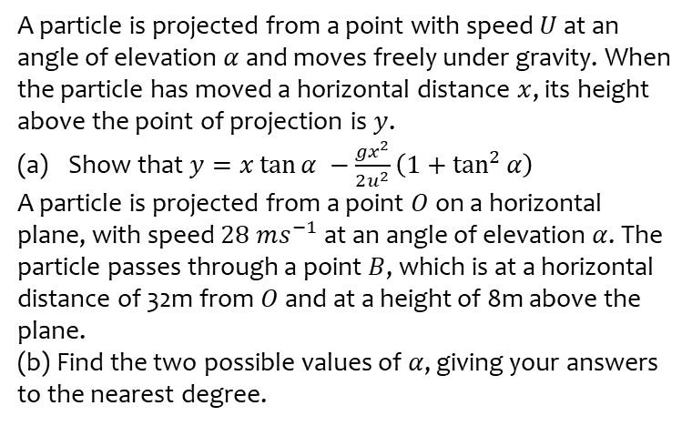
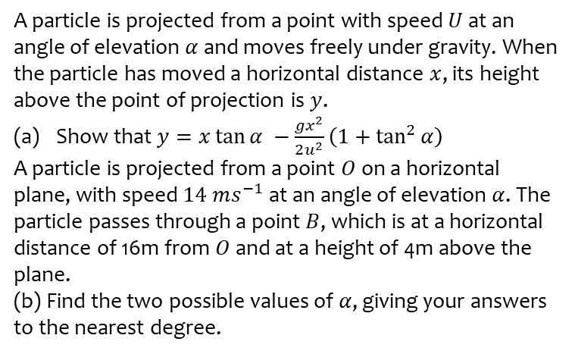

Worked example
Your turn
A particle is projected from a point with speed $U$ at an angle of elevation $α$ and moves freely under gravity. When the particle has moved a horizontal distance $x$, its height above the point of projection is $y$.
Show that $y=x\tan{α −\frac{gx^{2}}{2u^{2}}\left(1+\tan^{2}{α}\right)}$
A particle is projected from a point $O$ on a horizontal plane, with speed $14 ms^{−1}$ at an angle of elevation $α$. The particle passes through a point $B$, which is at a horizontal distance of 16m from $O$ and at a height of 4m above the plane.
(b) Find the two possible values of $α$, giving your answers to the nearest degree.
A particle is projected from a point with speed $U$ at an angle of elevation $α$ and moves freely under gravity. When the particle has moved a horizontal distance $x$, its height above the point of projection is $y$.
Show that $y=x\tan{α −\frac{gx^{2}}{2u^{2}}\left(1+\tan^{2}{α}\right)}$
A particle is projected from a point $O$ on a horizontal plane, with speed $28 ms^{−1}$ at an angle of elevation $α$. The particle passes through a point $B$, which is at a horizontal distance of 32m from $O$ and at a height of 8m above the plane.
(b) Find the two possible values of $α$, giving your answers to the nearest degree.
Shown
$α=27°, 77°$ (nearest degree)

