Slide 1
6.2) Equation of a circle

Slide 2
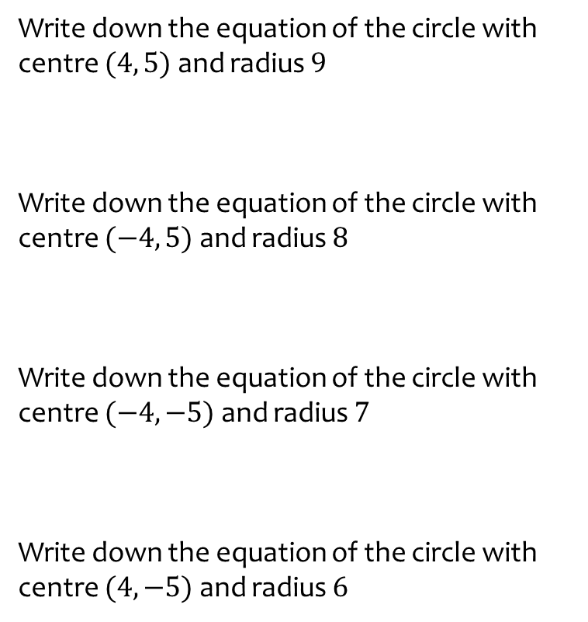
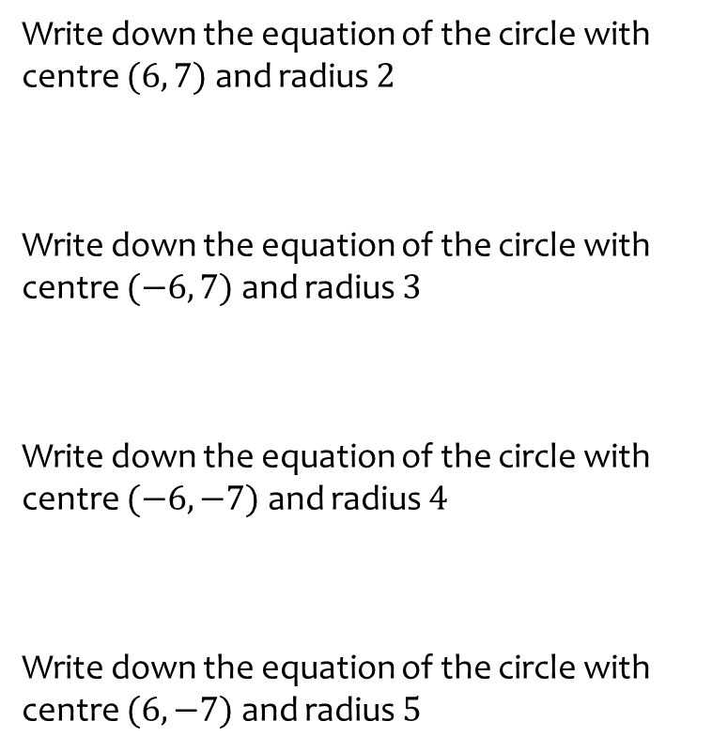

Worked example
Your turn
Write down the equation of the circle with centre $(6, 7)$ and radius $2$
Write down the equation of the circle with centre $(−6, 7)$ and radius $3$
Write down the equation of the circle with centre $(−6, −7)$ and radius $4$
Write down the equation of the circle with centre $(6, −7)$ and radius $5$
Write down the equation of the circle with centre $(4, 5)$ and radius $9$
Write down the equation of the circle with centre $(−4, 5)$ and radius $8$
Write down the equation of the circle with centre $(−4, −5)$ and radius $7$
Write down the equation of the circle with centre $(4, −5)$ and radius $6$
$${\left(x−4\right)}^{2}+{\left(y−5\right)}^{2}=81$$
$${\left(x+4\right)}^{2}+{\left(y−5\right)}^{2}=64$$
$${\left(x+4\right)}^{2}+{\left(y+5\right)}^{2}=49$$
$${\left(x−4\right)}^{2}+{\left(y+5\right)}^{2}=36$$

Slide 3
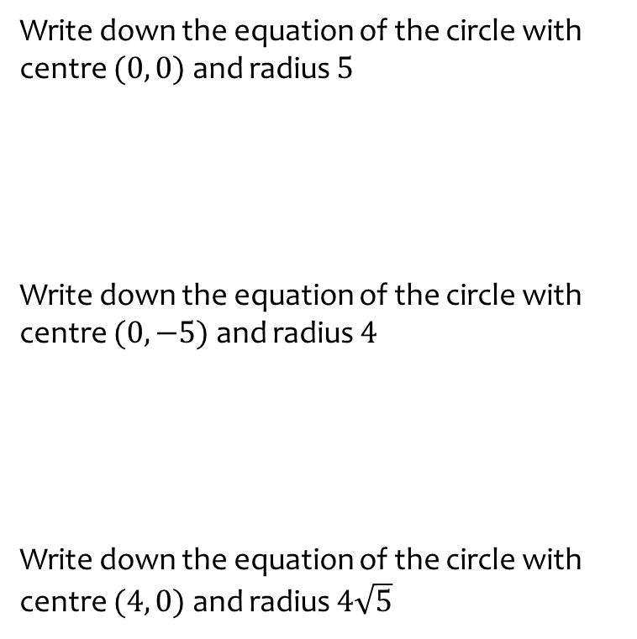
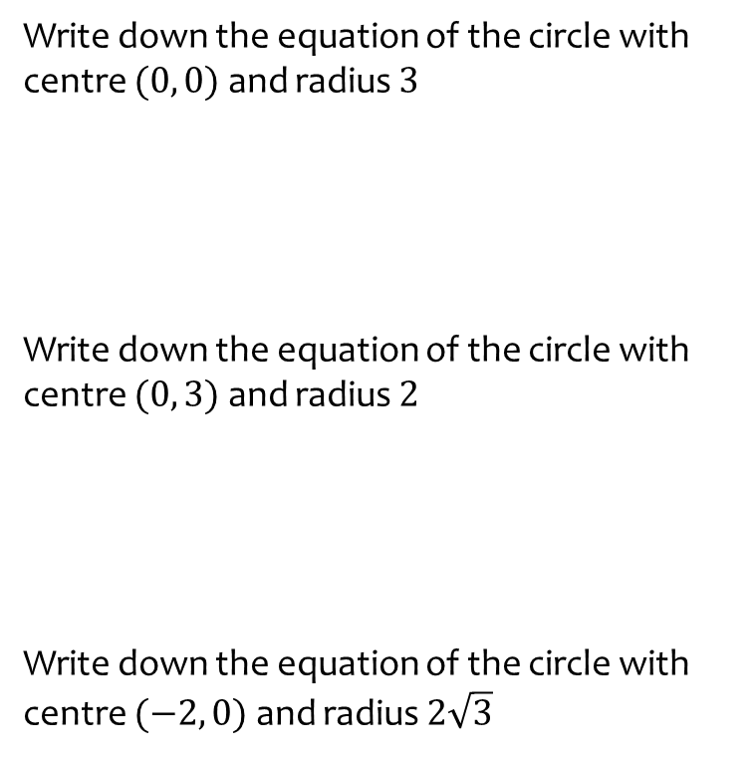

Worked example
Your turn
Write down the equation of the circle with centre $(0, 0)$ and radius $3$
Write down the equation of the circle with centre $(0, 3)$ and radius $2$
Write down the equation of the circle with centre $(−2, 0)$ and radius $2\sqrt{3}$
Write down the equation of the circle with centre $(0, 0)$ and radius $5$
Write down the equation of the circle with centre $(0, −5)$ and radius $4$
Write down the equation of the circle with centre $(4, 0)$ and radius $4\sqrt{5}$
$$x^{2}+y^{2}=25$$
$$x^{2}+{\left(y+5\right)}^{2}=16$$
$${\left(x−4\right)}^{2}+y^{2}=80$$

Slide 4
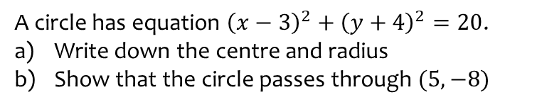
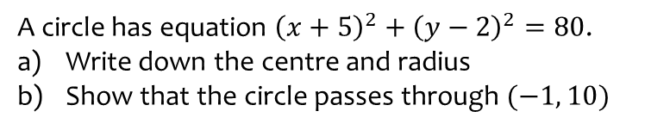
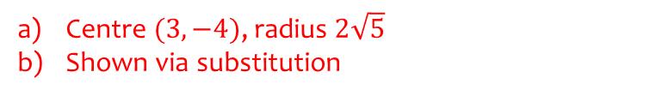
Worked example
Your turn
A circle has equation ${\left(x+5\right)}^{2}+{\left(y−2\right)}^{2}=80$.
Write down the centre and radius
Show that the circle passes through $(−1, 10)$
A circle has equation ${\left(x−3\right)}^{2}+{\left(y+4\right)}^{2}=20$.
Write down the centre and radius
Show that the circle passes through $(5, −8)$
Centre $(3, −4)$, radius $2\sqrt{5}$
Shown via substitution

Slide 5
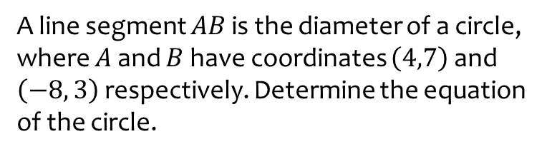
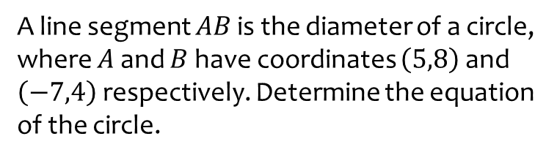
Worked example
Your turn
A line segment $AB$ is the diameter of a circle, where $A$ and $B$ have coordinates $\left(5,8\right)$ and $\left(−7,4\right)$ respectively. Determine the equation of the circle.
A line segment $AB$ is the diameter of a circle, where $A$ and $B$ have coordinates $\left(4,7\right)$ and $\left(−8, 3\right)$ respectively. Determine the equation of the circle.
$${\left(x+2\right)}^{2}+{\left(y−5\right)}^{2}=40$$

Slide 6
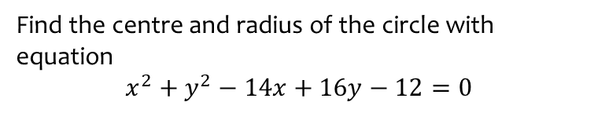
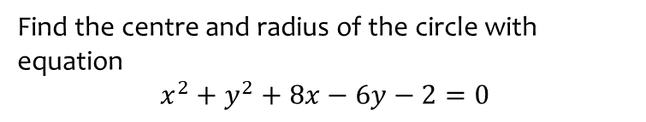
Worked example
Your turn
Find the centre and radius of the circle with equation
$$x^{2}+y^{2}+8x−6y−2=0$$
Find the centre and radius of the circle with equation
$$x^{2}+y^{2}−14x+16y−12=0$$
Centre $(7, −8)$, radius $5\sqrt{5}$

Slide 7
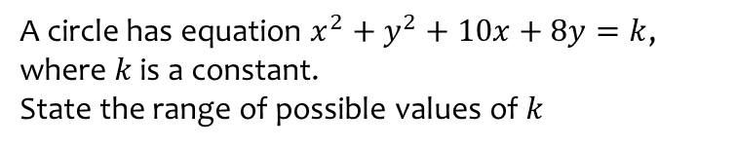
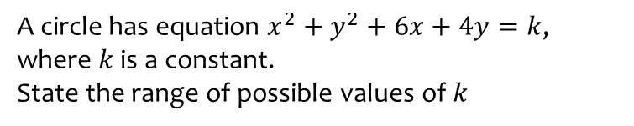
Worked example
Your turn
A circle has equation $x^{2}+y^{2}+6x+4y=k$, where $k$ is a constant.
State the range of possible values of $k$
A circle has equation $x^{2}+y^{2}+10x+8y=k$, where $k$ is a constant.
State the range of possible values of $k$
$$k>−41$$

Slide 8
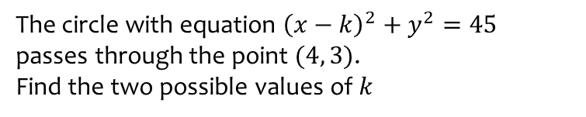
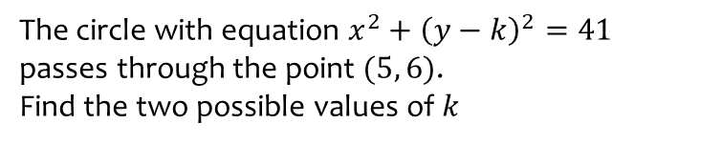
Worked example
Your turn
The circle with equation $x^{2}+{\left(y−k\right)}^{2}=41$ passes through the point $(5, 6)$.
Find the two possible values of $k$
The circle with equation ${\left(x−k\right)}^{2}+y^{2}=45$ passes through the point $(4, 3)$.
Find the two possible values of $k$
$$k=−2, k=10$$

