Slide 1
6.3) Cumulative probabilities

Slide 2
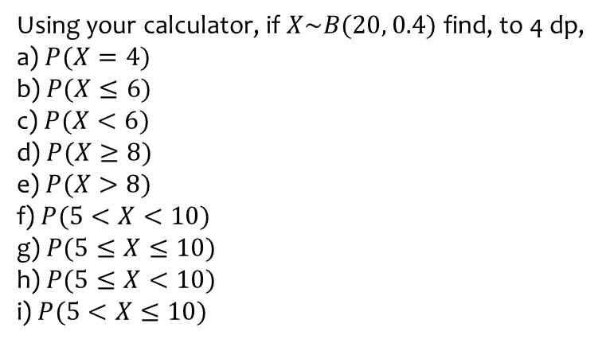
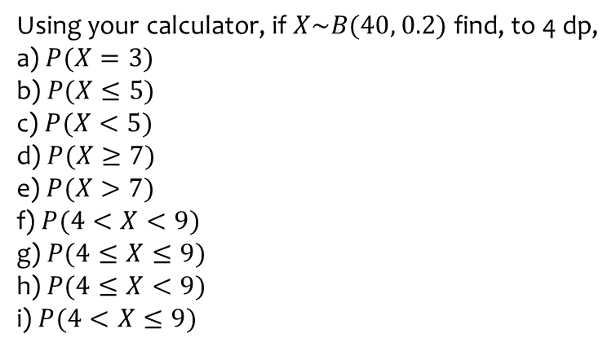

Worked example
Your turn
Using your calculator, if $X\sim B(40, 0.2)$ find, to 4 dp,
a) $P(X=3)$
b) $P(X≤5)$
c) $P(X<5)$
d) $P(X≥7)$
e) $P(X>7)$
f) $P(4<X<9)$
g) $P(4≤X≤9)$
h) $P(4≤X<9)$
i) $P(4<X≤9)$
Using your calculator, if $X\sim B(20, 0.4)$ find, to 4 dp,
a) $P(X=4)$
b) $P(X≤6)$
c) $P(X<6)$
d) $P(X≥8)$
e) $P(X>8)$
f) $P(5<X<10)$
g) $P(5≤X≤10)$
h) $P(5≤X<10)$
i) $P(5<X≤10)$
$$\text{a}\text{) }0.0345$$
$$\text{b}\text{) }0.2500$$
$$\text{c}\text{) }0.1256$$
$$\text{d}\text{) }0.5841$$
$$\text{e}\text{) }0.4044$$
f) $0.6297$
g) $0.8215$
h) $0.7044$
i) $0.7469$

Slide 3
Worked example
Your turn
Using your calculator, if $X\sim B(40, 0.2)$ find, to 4 dp,
$$P(X=3)$$
Using your calculator, if $X\sim B(20, 0.4)$ find, to 4 dp,
$$P(X=4)$$
$$0.0345$$

Slide 4
Worked example
Your turn
Using your calculator, if $X\sim B(40, 0.2)$ find, to 4 dp,
$$P(X≤5)$$
Using your calculator, if $X\sim B(20, 0.4)$ find, to 4 dp,
$$P(X≤6)$$
$$0.2500$$

Slide 5
Worked example
Your turn
Using your calculator, if $X\sim B(40, 0.2)$ find, to 4 dp,
$P(X$ is at most $5$)
Using your calculator, if $X\sim B(20, 0.4)$ find, to 4 dp,
$P(X$ is at most $6$)
$$0.2500$$

Slide 6
Worked example
Your turn
Using your calculator, if $X\sim B(40, 0.2)$ find, to 4 dp,
$$P(X<5)$$
Using your calculator, if $X\sim B(20, 0.4)$ find, to 4 dp,
$$P(X<6)$$
$$0.1256$$

Slide 7
Worked example
Your turn
Using your calculator, if $X\sim B(40, 0.2)$ find, to 4 dp,
$$P(X≥7)$$
Using your calculator, if $X\sim B(20, 0.4)$ find, to 4 dp,
$$P(X≥8)$$
$$0.5841$$

Slide 8
Worked example
Your turn
Using your calculator, if $X\sim B(40, 0.2)$ find, to 4 dp,
$P(X$ is at least $7$)
Using your calculator, if $X\sim B(20, 0.4)$ find, to 4 dp,
$P(X$ is at least $8$)
$$0.5841$$

Slide 9
Worked example
Your turn
Using your calculator, if $X\sim B(40, 0.2)$ find, to 4 dp,
$$P(X>7)$$
Using your calculator, if $X\sim B(20, 0.4)$ find, to 4 dp,
$$P(X>8)$$
$$0.4044$$

Slide 10
Worked example
Your turn
Using your calculator, if $X\sim B(40, 0.2)$ find, to 4 dp,
$$P(4<X<9)$$
Using your calculator, if $X\sim B(20, 0.4)$ find, to 4 dp,
$$P(5<X<10)$$
$$0.6297$$

Slide 11
Worked example
Your turn
Using your calculator, if $X\sim B(40, 0.2)$ find, to 4 dp,
$$P(4≤X≤9)$$
Using your calculator, if $X\sim B(20, 0.4)$ find, to 4 dp,
$$P(5≤X≤10)$$
$$0.8215$$

Slide 12
Worked example
Your turn
Using your calculator, if $X\sim B(40, 0.2)$ find, to 4 dp,
$$P(4≤X<9)$$
Using your calculator, if $X\sim B(20, 0.4)$ find, to 4 dp,
$$P(5≤X<10)$$
$$0.7044$$

Slide 13
Worked example
Your turn
Using your calculator, if $X\sim B(40, 0.2)$ find, to 4 dp,
$$P(4<X≤9)$$
Using your calculator, if $X\sim B(20, 0.4)$ find, to 4 dp,
$$P(5<X≤10)$$
$$0.7469$$

Slide 14
Worked example
Your turn
A spinner is designed so that probability it lands on red is 0.2.
Jane decides to use this spinner for a class competition.
She wants the probability of winning a prize to be less than $0.03$.
Each member of the class will have 15 spins and the number of reds will be recorded.
Find how many reds are needed to win the prize.
A spinner is designed so that probability it lands on red is 0.3.
Jane decides to use this spinner for a class competition.
She wants the probability of winning a prize to be less than $0.05$.
Each member of the class will have 12 spins and the number of reds will be recorded.
Find how many reds are needed to win the prize.
$7$ or more

Slide 15
Worked example
Your turn
At a university, students have 10 exams at the end of the year.
All students pass each individual exam with probability 0.55.
Students are only allowed to continue into the next year if they pass some minimum of exams out of the 10.
What do the university administrators need to set this minimum number such that the probability of continuing to next year is at least 80%?
At a university, students have 20 exams at the end of the year.
All students pass each individual exam with probability 0.45.
Students are only allowed to continue into the next year if they pass some minimum of exams out of the 20.
What do the university administrators need to set this minimum number such that the probability of continuing to next year is at least 90%?
$$6$$

Slide 16
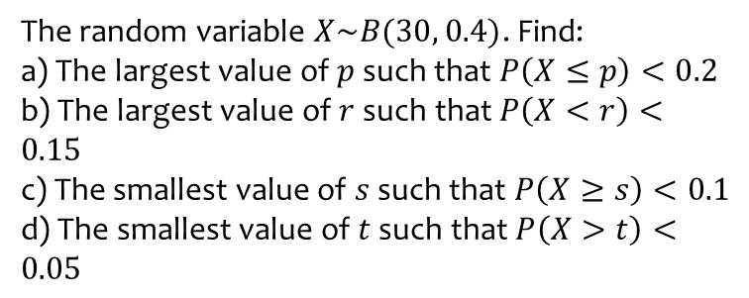
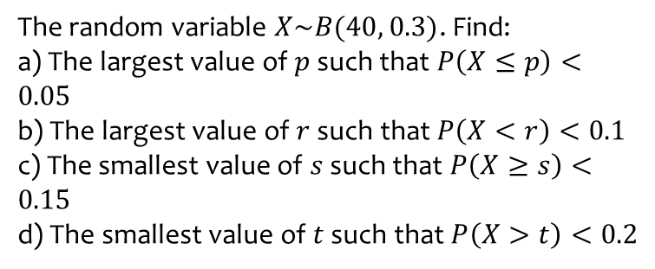
Worked example
Your turn
The random variable $X\sim B(40, 0.3)$. Find:
a) The largest value of $p$ such that $P\left(X≤p\right)<0.05$
b) The largest value of $r$ such that $P\left(X<r\right)<0.1$
c) The smallest value of $s$ such that $P\left(X≥s\right)<0.15$
d) The smallest value of $t$ such that $P\left(X>t\right)<0.2$
The random variable $X\sim B(30, 0.4)$. Find:
a) The largest value of $p$ such that $P\left(X≤p\right)<0.2$
b) The largest value of $r$ such that $P\left(X<r\right)<0.15$
c) The smallest value of $s$ such that $P\left(X≥s\right)<0.1$
d) The smallest value of $t$ such that $P\left(X>t\right)<0.05$
a) $p=9$
b) $r=9$
c) $s=16$
d) $t=16$

Slide 17
Worked example
Your turn
The random variable $X\sim B(40, 0.3)$. Find the largest value of $p$ such that $P\left(X≤p\right)<0.05$
The random variable $X\sim B(30, 0.4)$. Find the largest value of $p$ such that $P\left(X≤p\right)<0.2$
$p=9$

Slide 18
Worked example
Your turn
The random variable $X\sim B(40, 0.3)$. Find the largest value of $r$ such that $P\left(X<r\right)<0.1$
The random variable $X\sim B(30, 0.4)$. Find the largest value of $r$ such that $P\left(X<r\right)<0.15$
$$r=9$$

Slide 19
Worked example
Your turn
The random variable $X\sim B(40, 0.3)$. Find the smallest value of $s$ such that $P\left(X≥s\right)<0.15$
The random variable $X\sim B(30, 0.4)$. Find the smallest value of $s$ such that $P\left(X≥s\right)<0.1$
$$s=16$$

Slide 20
Worked example
Your turn
The random variable $X\sim B(40, 0.3)$. Find the smallest value of $t$ such that $P\left(X>t\right)<0.2$
The random variable $X\sim B(30, 0.4)$. Find the smallest value of $t$ such that $P\left(X>t\right)<0.05$
$$t=16$$

Slide 21
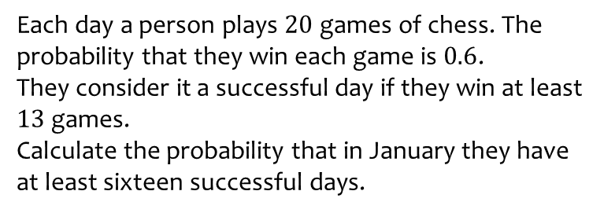
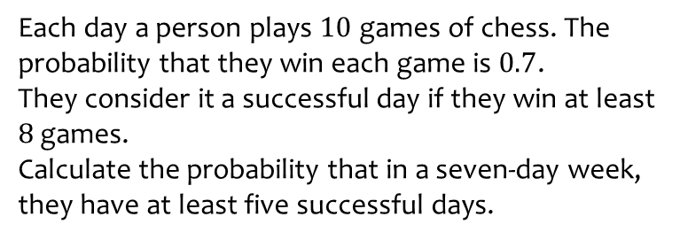
Worked example
Your turn
Each day a person plays $10$ games of chess. The probability that they win each game is $0.7$.
They consider it a successful day if they win at least $8$ games.
Calculate the probability that in a seven-day week, they have at least five successful days.
Each day a person plays $20$ games of chess. The probability that they win each game is $0.6$.
They consider it a successful day if they win at least $13$ games.
Calculate the probability that in January they have at least sixteen successful days.
$0.1708$ (4 dp)

