Slide 1
6.3) Projection at any angle

Slide 2
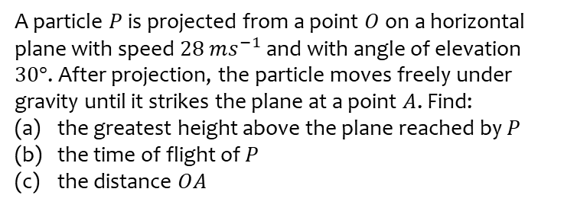
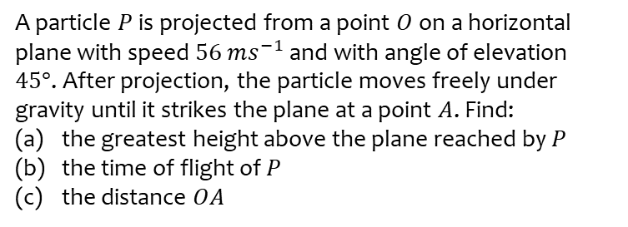
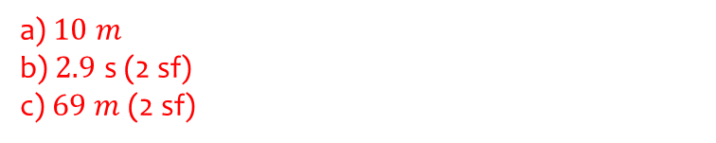
Worked example
Your turn
A particle $P$ is projected from a point $O$ on a horizontal plane with speed $56$ $ms^{−1}$ and with angle of elevation $45°$. After projection, the particle moves freely under gravity until it strikes the plane at a point $A$. Find:
the greatest height above the plane reached by $P$
the time of flight of $P$
the distance $OA$
A particle $P$ is projected from a point $O$ on a horizontal plane with speed $28$ $ms^{−1}$and with angle of elevation $30°$. After projection, the particle moves freely under gravity until it strikes the plane at a point $A$. Find:
the greatest height above the plane reached by $P$
the time of flight of $P$
the distance $OA$
a) $10 m$
b) $2.9$ s (2 sf)
c) $69 m$ (2 sf)

Slide 3
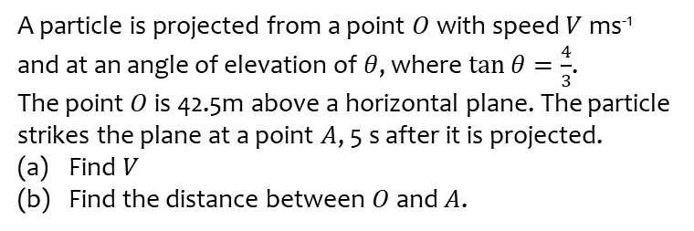
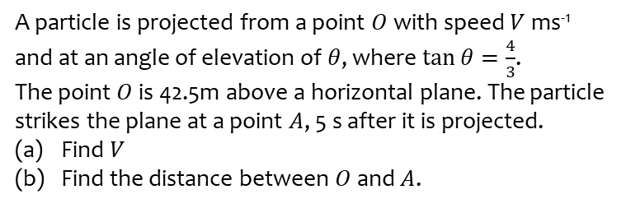
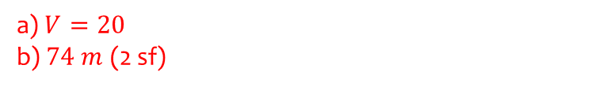
Worked example
Your turn
A particle is projected from a point $O$ with speed $V$ ms⁻¹ and at an angle of elevation of $θ$, where $\tan{θ=\frac{4}{3}}$.
The point $O$ is 42.5m above a horizontal plane. The particle strikes the plane at a point $A$, 5 s after it is projected.
Find $V$
Find the distance between $O$ and $A$.
A particle is projected from a point $O$ with speed $V$ ms⁻¹ and at an angle of elevation of $θ$, where $\tan{θ=\frac{4}{3}}$.
The point $O$ is 42.5m above a horizontal plane. The particle strikes the plane at a point $A$, 5 s after it is projected.
Find $V$
Find the distance between $O$ and $A$.
a) $V=20$
b) $74 m$ (2 sf)

Slide 4
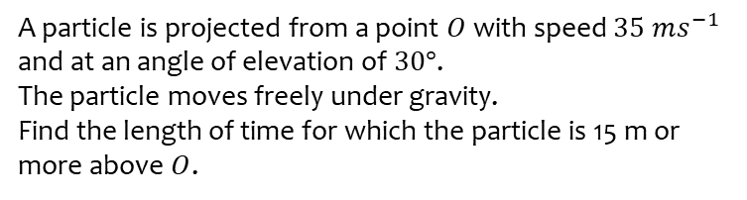
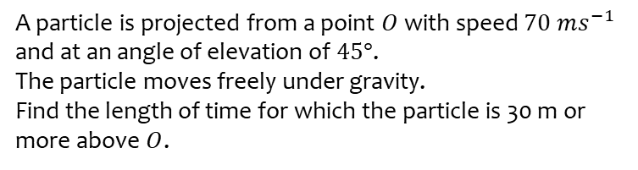
Worked example
Your turn
A particle is projected from a point $O$ with speed $70$ $ms^{−1}$ and at an angle of elevation of $45°$.
The particle moves freely under gravity.
Find the length of time for which the particle is 30 m or more above $O$.
A particle is projected from a point $O$ with speed $35$ $ms^{−1}$ and at an angle of elevation of $30°$.
The particle moves freely under gravity.
Find the length of time for which the particle is 15 m or more above $O$.
$0.71$ s (2 sf)

Slide 5
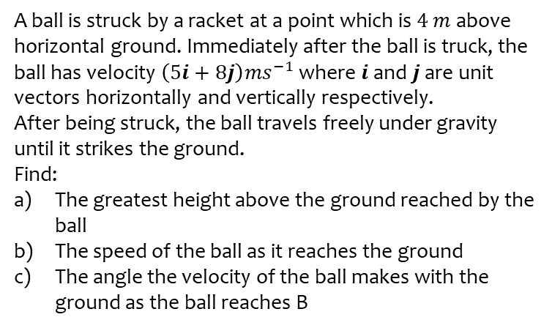
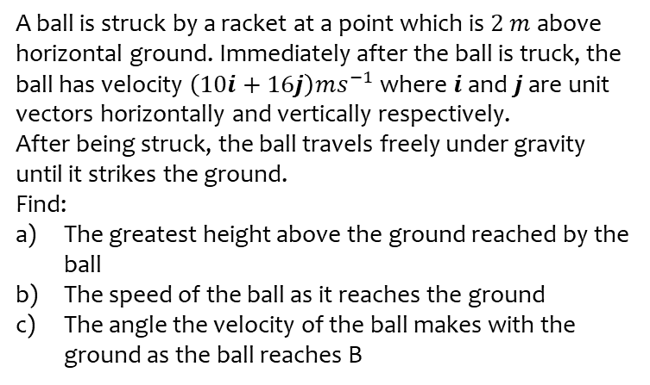
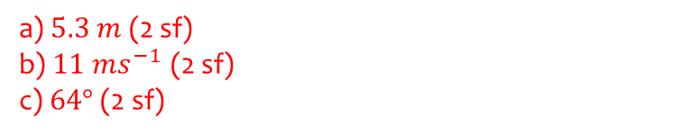
Worked example
Your turn
A ball is struck by a racket at a point which is $2 m$ above horizontal ground. Immediately after the ball is truck, the ball has velocity $\left(10i+16j\right)ms^{−1}$ where $i$ and $j$ are unit vectors horizontally and vertically respectively.
After being struck, the ball travels freely under gravity until it strikes the ground.
Find:
The greatest height above the ground reached by the ball
The speed of the ball as it reaches the ground
The angle the velocity of the ball makes with the ground as the ball reaches B
A ball is struck by a racket at a point which is $4 m$ above horizontal ground. Immediately after the ball is truck, the ball has velocity $\left(5i+8j\right)ms^{−1}$ where $i$ and $j$ are unit vectors horizontally and vertically respectively.
After being struck, the ball travels freely under gravity until it strikes the ground.
Find:
The greatest height above the ground reached by the ball
The speed of the ball as it reaches the ground
The angle the velocity of the ball makes with the ground as the ball reaches B
a) $5.3 m$ (2 sf)
b) $11 ms^{−1}$ (2 sf)
c) $64°$ (2 sf)

Slide 6
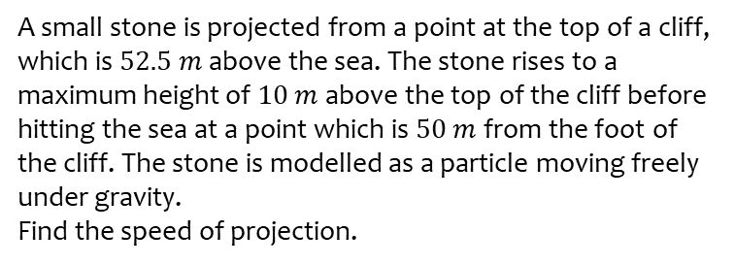
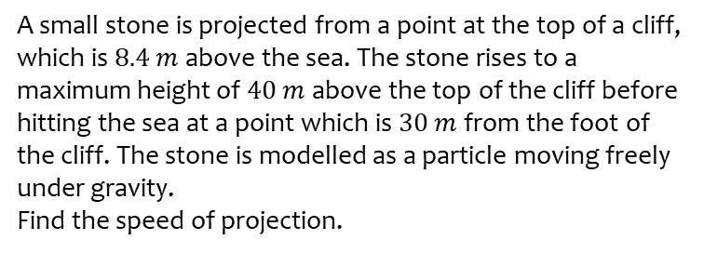
Worked example
Your turn
A small stone is projected from a point at the top of a cliff, which is $8.4 m$ above the sea. The stone rises to a maximum height of $40 m$ above the top of the cliff before hitting the sea at a point which is $30 m$ from the foot of the cliff. The stone is modelled as a particle moving freely under gravity.
Find the speed of projection.
A small stone is projected from a point at the top of a cliff, which is $52.5 m$ above the sea. The stone rises to a maximum height of $10 m$ above the top of the cliff before hitting the sea at a point which is $50 m$ from the foot of the cliff. The stone is modelled as a particle moving freely under gravity.
Find the speed of projection.
$17 ms^{−1}$ (2 sf)

Slide 7
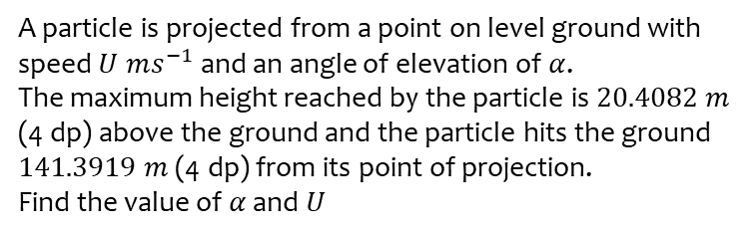
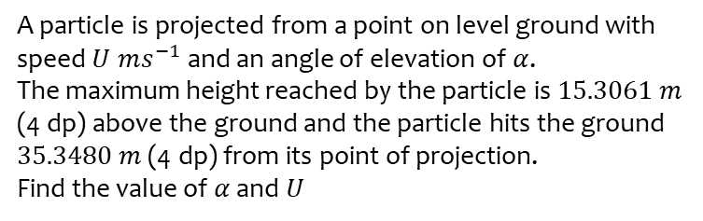
Worked example
Your turn
A particle is projected from a point on level ground with speed $U ms^{−1}$ and an angle of elevation of $α$.
The maximum height reached by the particle is $15.3061 m$ (4 dp) above the ground and the particle hits the ground $35.3480 m$ (4 dp) from its point of projection.
Find the value of $α$ and $U$
A particle is projected from a point on level ground with speed $U ms^{−1}$ and an angle of elevation of $α$.
The maximum height reached by the particle is $20.4082 m$ (4 dp) above the ground and the particle hits the ground $141.3919 m$ (4 dp) from its point of projection.
Find the value of $α$ and $U$
$$α=30° , U=40$$

