Slide 1
6.2) Graphs of $\sec{x}$, $cosec x$ and $\cot{x}$

Slide 2
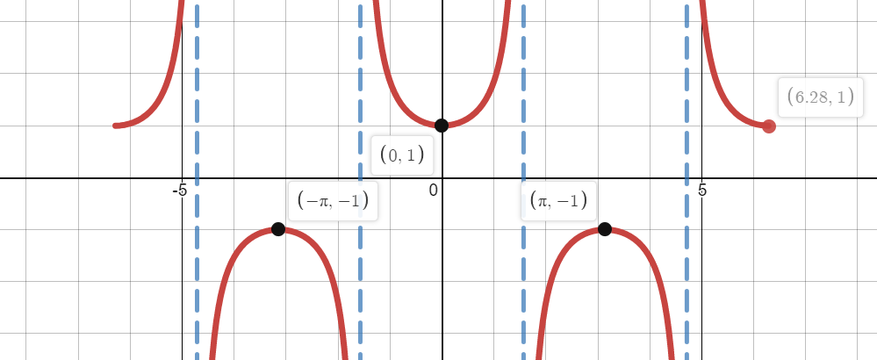
Worked example
Your turn
Sketch the graph in the interval $−2π≤x≤2π$:
$$y=cosec x$$
$$y=\cot{x}$$
Sketch the graph in the interval $−2π≤x≤2π$:
$$y=sec x$$
Graphs used with permission from DESMOS: https://www.desmos.com/

Slide 3
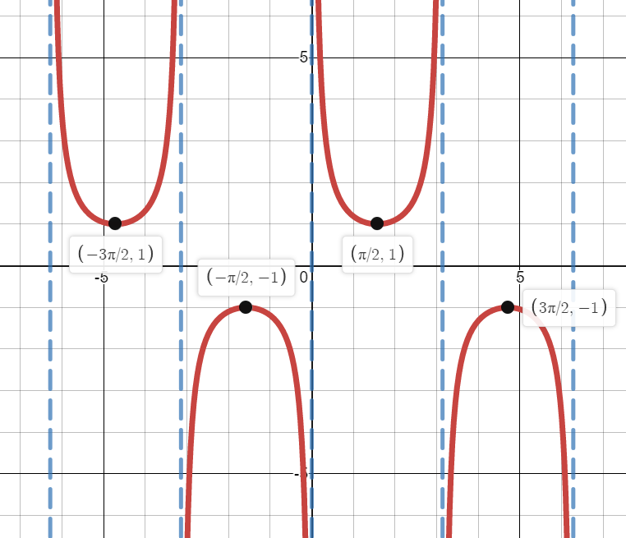
Worked example
Your turn
Sketch the graph in the interval $−2π≤x≤2π$:
$$y=cosec \left(x+\frac{π}{4}\right)$$
$$y=\cot{(x−\frac{π}{3})}$$
Sketch the graph in the interval $−2π≤x≤2π$:
$$y=sec \left(x+\frac{π}{2}\right)$$
Graphs used with permission from DESMOS: https://www.desmos.com/

Slide 4
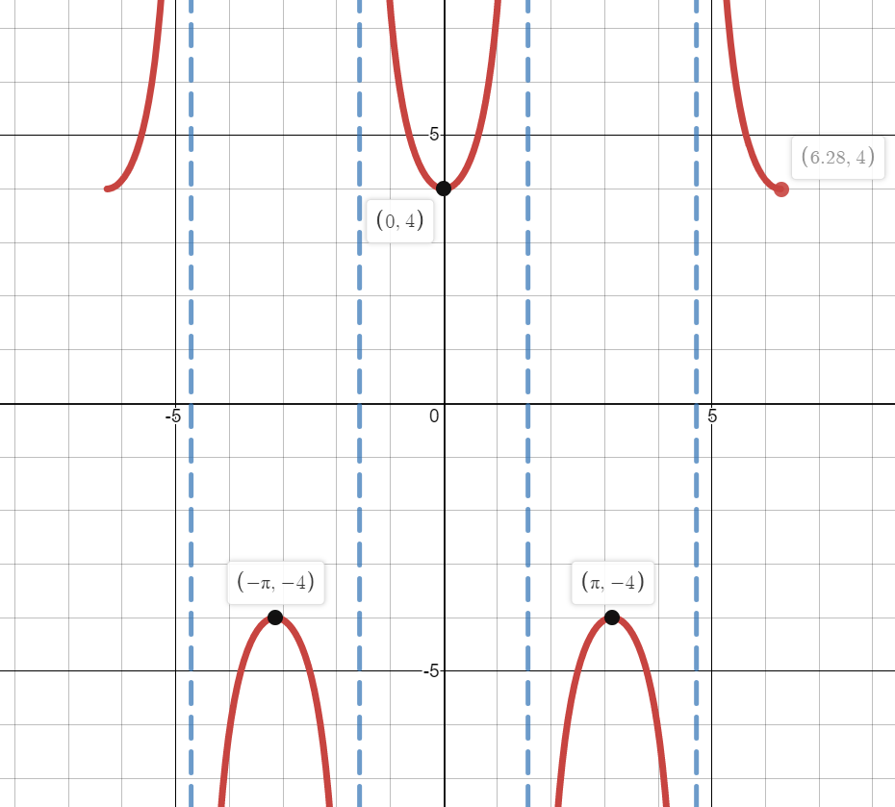
Worked example
Your turn
Sketch the graph in the interval $−2π≤x≤2π$:
$$y=2cosec x$$
$$y=3cot{x}$$
Sketch the graph in the interval $−2π≤x≤2π$:
$$y=4sec x$$
Graphs used with permission from DESMOS: https://www.desmos.com/

Slide 5
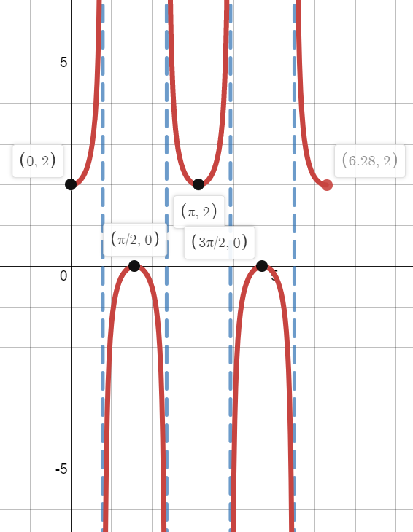
Worked example
Your turn
Sketch the graph in the interval $0≤x≤2π$:
$$y=6+cosec 4x$$
$$y=\cot{3x−5}$$
Sketch the graph in the interval $0≤x≤2π$:
$$y=1+sec 2x$$
Graphs used with permission from DESMOS: https://www.desmos.com/

Slide 6
Worked example
Your turn
State the range of:
$$y=cosec x, x∈ℝ, x≠nπ, n∈ℤ$$
$$y=cot x, x∈ℝ, x≠nπ, n∈ℤ$$
State the range of:
$$y=sec x, x∈ℝ, x≠\frac{\left(2n+1\right)π}{2}, n∈ℤ$$
$\sec{x}≤−1$ or $\sec{x}≥1$

Slide 7
Worked example
Your turn
Find the range of values of $k$ for which $2+7\sec{x}=k$ has no solutions.
Find the range of values of $k$ for which $3 cosec x −5$ $=k$ has no solutions
Find the range of values of $k$ for which $3+5\sec{x}=k$ has no solutions.
$$−2<k<8$$

Slide 8
Worked example
Your turn
Find the maximum and minimum of the graph, stating the smallest positive values of $θ$ at which they occur:
$$y=\frac{1}{2+3\sec{θ} }$$
Find the maximum and minimum of the graph, stating the smallest positive values of $θ$ at which they occur:
$$y=\frac{1}{1+2\operatorname{cosec}{θ} }$$
Maximum $\frac{1}{3}$ at $θ=\frac{π}{2}$
Minimum $−1$ at $θ=\frac{3π}{2}$

