Slide 1
6.2) Horizontal and vertical components

Slide 2
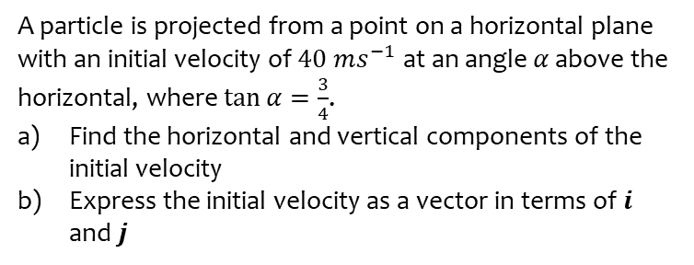
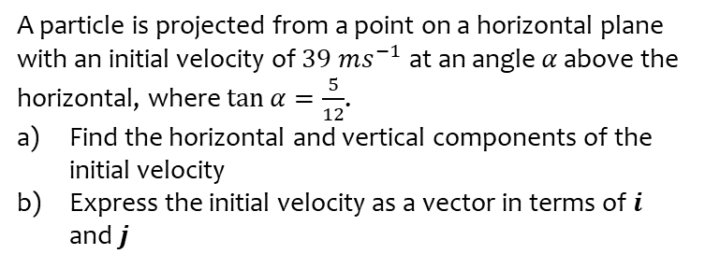
Worked example
Your turn
A particle is projected from a point on a horizontal plane with an initial velocity of $39 ms^{−1}$ at an angle $α$ above the horizontal, where $\tan{α}=\frac{5}{12}$.
Find the horizontal and vertical components of the initial velocity
Express the initial velocity as a vector in terms of $i$ and $j$
A particle is projected from a point on a horizontal plane with an initial velocity of $40 ms^{−1}$ at an angle $α$ above the horizontal, where $\tan{α}=\frac{3}{4}$.
Find the horizontal and vertical components of the initial velocity
Express the initial velocity as a vector in terms of $i$ and $j$
a) $u_{x}=32 ms^{−1}$ ; $u_{y}=24 ms^{−1}$
b) $\left(32i+24j\right) ms^{−1}$

Slide 3
Worked example
Your turn
A particle is projected with velocity $U=\left(2i+7j\right) ms^{−1}$ where $i$ and $j$ are the unit vectors in the horizontal and vertical directions respectively.
Find the initial speed of the particle and its angle of projection.
A particle is projected with velocity $U=\left(3i+5j\right) ms^{−1}$ where $i$ and $j$ are the unit vectors in the horizontal and vertical directions respectively.
Find the initial speed of the particle and its angle of projection.
$5.8 ms^{−1}$ (2 sf) at an angle of $59°$ (2 sf) above the horizontal

Slide 4
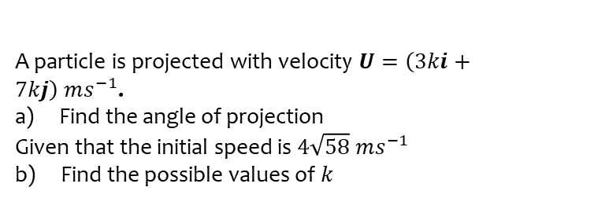
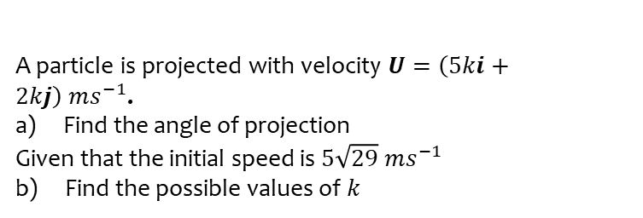
Worked example
Your turn
A particle is projected with velocity $U=\left(5ki+2kj\right) ms^{−1}$.
Find the angle of projection
Given that the initial speed is $5\sqrt{29}$ $ms^{−1}$
b) Find the possible values of $k$
A particle is projected with velocity $U=\left(3ki+7kj\right) ms^{−1}$.
Find the angle of projection
Given that the initial speed is $4\sqrt{58}$ $ms^{−1}$
b) Find the possible values of $k$
a) $66.8°$ above the horizontal
b) $k=±4$

