Slide 1
6.2) The binomial distribution

Slide 2
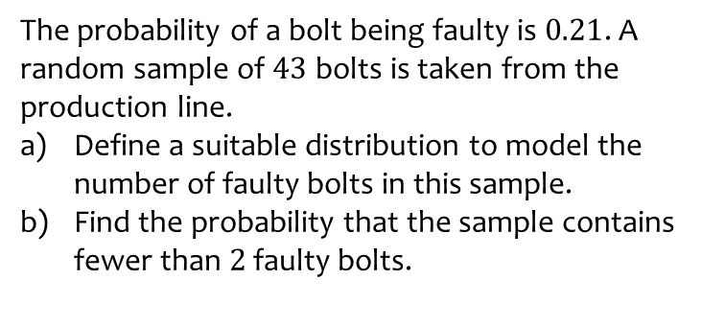
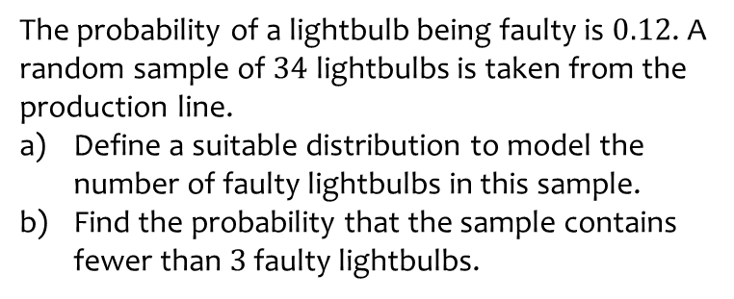
Worked example
Your turn
The probability of a lightbulb being faulty is $0.12$. A random sample of $34$ lightbulbs is taken from the production line.
Define a suitable distribution to model the number of faulty lightbulbs in this sample.
Find the probability that the sample contains fewer than $3$ faulty lightbulbs.
The probability of a bolt being faulty is $0.21$. A random sample of $43$ bolts is taken from the production line.
Define a suitable distribution to model the number of faulty bolts in this sample.
Find the probability that the sample contains fewer than $2$ faulty bolts.
a) Let $X=$ number of faulty bolts.
$$X\sim B(43, 0.21)$$
b) $0.000493$ (3 sf)

Slide 3
Worked example
Your turn
The random variable $X\sim B\left(8,\frac{1}{10}\right)$. Find:
$P\left(X=2\right)$
$P\left(X=5\right)$
$P\left(X≤1\right)$
$P(X≥7)$
The random variable $X\sim B\left(12,\frac{1}{6}\right)$. Find:
$P\left(X=2\right)$
$P\left(X=9\right)$
$P\left(X≤1\right)$
$P(X≥11)$
a) $0.2961$ (4 dp)
b) $0.0000126$ (3 sf)
c) $0.3813$ (4 dp)
d) $0.0000000280$ (3 sf)

Slide 4
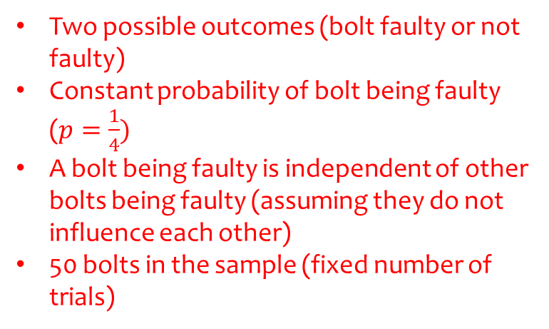
Worked example
Your turn
A company claims that a third of the lightbulbs sent to them are faulty.
To test this claim the number of faulty lightbulbs in a random sample of 100 is recorded.
Give two reasons why a binomial distribution may be a suitable model for the number of faulty lightbulbs in the sample.
A company claims that a quarter of the bolts sent to them are faulty.
To test this claim the number of faulty bolts in a random sample of 50 is recorded.
Give two reasons why a binomial distribution may be a suitable model for the number of faulty bolts in the sample.
Two possible outcomes (bolt faulty or not faulty)
Constant probability of bolt being faulty ($p=\frac{1}{4})$
A bolt being faulty is independent of other bolts being faulty (assuming they do not influence each other)
50 bolts in the sample (fixed number of trials)

