Slide 1
6.1) Horizontal projection

Slide 2
Worked example
Your turn
A particle is project horizontally at $50 ms^{−1}$ from a point 44.1 metres above a horizontal surface. Find:
the time taken by the particle to reach the surface
the horizontal distance travelled in that time.
the distance of the impact point from the original point.
A particle is project horizontally at $25 ms^{−1}$ from a point 78.4 metres above a horizontal surface. Find:
the time taken by the particle to reach the surface
the horizontal distance travelled in that time.
the distance of the impact point from the original point.
a) $4$s
b) $100 m$
c) $130 m$ (2 sf)

Slide 3
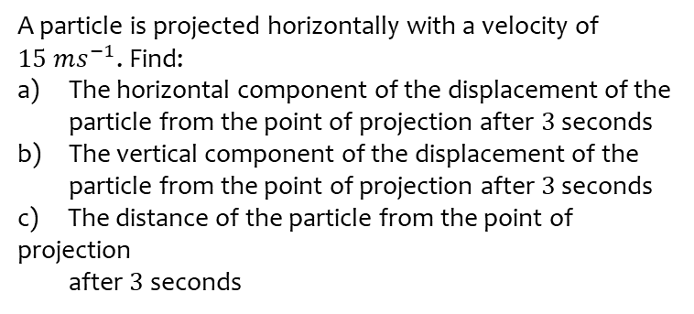
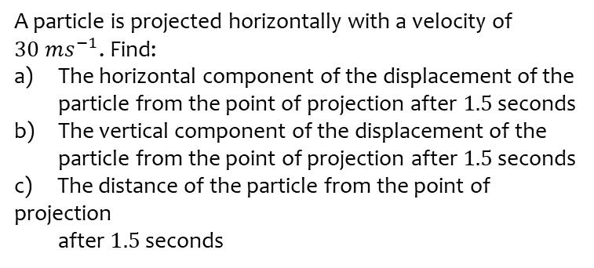
Worked example
Your turn
A particle is projected horizontally with a velocity of $30 ms^{−1}$. Find:
The horizontal component of the displacement of the particle from the point of projection after $1.5$ seconds
The vertical component of the displacement of the
particle from the point of projection after $1.5$ seconds
c) The distance of the particle from the point of projection
after $1.5$seconds
A particle is projected horizontally with a velocity of $15 ms^{−1}$. Find:
The horizontal component of the displacement of the particle from the point of projection after $3$ seconds
The vertical component of the displacement of the
particle from the point of projection after $3$ seconds
c) The distance of the particle from the point of projection
after $3$seconds
a) $45 m$
b) $44 m$ (2 sf)
c) $63 m$ (2 sf)

Slide 4
Worked example
Your turn
A particle is projected horizontally with a speed of $U$ $ms^{−1}$ from a point 176.4m above a horizontal plane.
The particle hits the plane at a point which is at a horizontal distance of 180m away from the starting point.
Find the initial speed of the particle.
A particle is projected horizontally with a speed of $U$ $ms^{−1}$ from a point 122.5m above a horizontal plane.
The particle hits the plane at a point which is at a horizontal distance of 90m away from the starting point.
Find the initial speed of the particle.
$$18 ms^{−1}$$

Slide 5
Worked example
Your turn
A particle is projected horizontally with a speed of $15$ $ms^{−1}$ from a point $h$ m above a horizontal plane.
The particle hits the plane at a point which is at a horizontal distance of 120m away from the starting point.
Determine the value of $h$.
A particle is projected horizontally with a speed of $30$ $ms^{−1}$ from a point $h$ m above a horizontal plane.
The particle hits the plane at a point which is at a horizontal distance of 210m away from the starting point.
Determine the value of $h$.
$$h=240.1$$

Slide 6
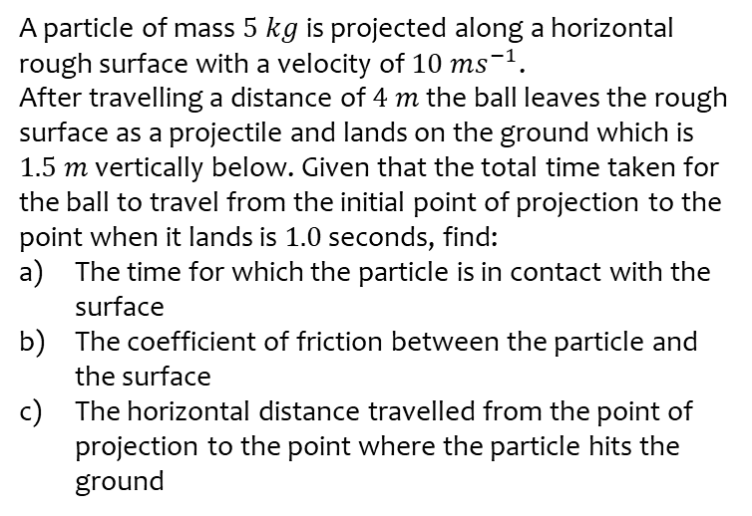
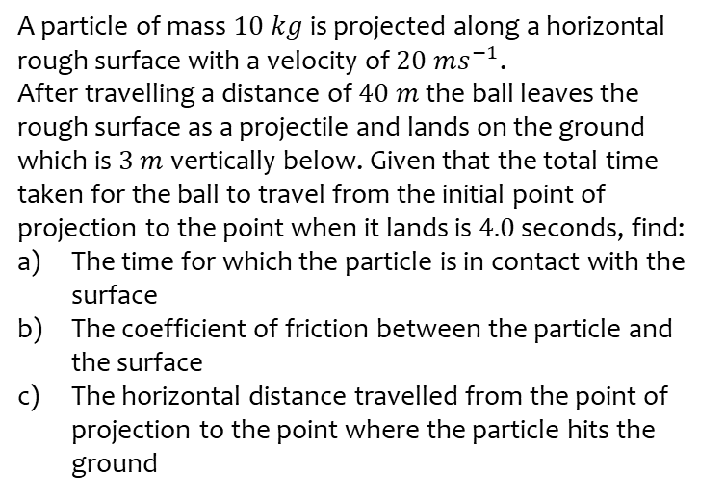
Worked example
Your turn
A particle of mass $10 kg$ is projected along a horizontal rough surface with a velocity of $20 ms^{−1}$.
After travelling a distance of $40 m$ the ball leaves the rough surface as a projectile and lands on the ground which is $3 m$ vertically below. Given that the total time taken for the ball to travel from the initial point of projection to the point when it lands is $4.0$ seconds, find:
The time for which the particle is in contact with the surface
The coefficient of friction between the particle and the surface
The horizontal distance travelled from the point of projection to the point where the particle hits the ground
A particle of mass $5 kg$ is projected along a horizontal rough surface with a velocity of $10 ms^{−1}$.
After travelling a distance of $4 m$ the ball leaves the rough surface as a projectile and lands on the ground which is $1.5 m$ vertically below. Given that the total time taken for the ball to travel from the initial point of projection to the point when it lands is $1.0$ seconds, find:
The time for which the particle is in contact with the surface
The coefficient of friction between the particle and the surface
The horizontal distance travelled from the point of projection to the point where the particle hits the ground
a) $0.45$ s (2 sf)
b) $0.48$ (2 sf)
c) $7.5 m$ (2 sf)

