Slide 1
6) Statistical distributions
6.1) Probability distributions
6.2) The binomial distribution
6.3) Cumulative probabilities

Slide 2
6.1) Probability distributions
Chapter CONTENTS

Slide 3

Worked example
Your turn
Let $X=$ number of tails when a fair coin is tossed $4$ times.
Write a list of all the possible outcomes.
Let $X=$ number of tails when a fair coin is tossed $3$ times.
Write a list of all the possible outcomes.
$$HHH$$
$$THH$$
$$HTH$$
$$HHT$$
$$TTH$$
$$THT$$
$$HTT$$
$$TTT$$

Slide 4
Worked example
Your turn
Let $X=$ number of tails when a fair coin is tossed $4$ times.
Describe the probability distribution of $X$:
Using a table
Let $X=$ number of tails when a fair coin is tossed $3$ times.
Describe the probability distribution of $X$:
Using a table
$$x$$ | 0 | 1 | 2 | 3
$$P(X=x)$$ | $$\frac{1}{8}$$ | $$\frac{3}{8}$$ | $$\frac{3}{8}$$ | $$\frac{1}{8}$$

Slide 5
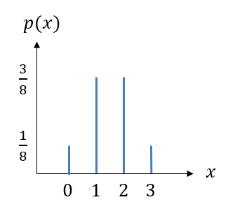
Worked example
Your turn
Let $X=$ number of tails when a fair coin is tossed $4$ times.
Describe the probability distribution of $X$:
Using a diagram
Let $X=$ number of tails when a fair coin is tossed $3$ times.
Describe the probability distribution of $X$:
Using a diagram

Slide 6
Worked example
Your turn
Let $X=$ number of tails when a fair coin is tossed $4$ times.
Describe the probability distribution of $X$:
As a probability mass function
Let $X=$ number of tails when a fair coin is tossed $3$ times.
Describe the probability distribution of $X$:
As a probability mass function
$$P\left(X=x\right)=\left\{\begin{aligned}\frac{1}{8} x=0, 3 \\ \frac{3}{8} x=1, 2 \\ 0 otherwise\end{aligned}\right.$$

Slide 7

Worked example
Your turn
A biased six-sided dice with faces numbered $1, 2, 3, 4, 5$ and $6$ is rolled. The number on the bottom-most face is modelled as a random variable $X$.
Given that $P\left(X=x\right)=\frac{k}{x}$,
Find the value of $k$
Give the probability distribution of $X$ in table form
Find the probability that:
i) $X≥2$
ii) $1≤X<4$
iii) $X<1$
iv) $2X+1>11$
A biased four-sided dice with faces numbered $1, 2, 3$ and $4$ is rolled.. The number on the bottom-most face is modelled as a random variable $X$.
Given that $P\left(X=x\right)=\frac{k}{x}$,
Find the value of $k$
Give the probability distribution of $X$ in table form
Find the probability that:
i) $X>2$
ii) $1≤X<4$
iii) $X≤4$
iv) $3X−5<0$
a) $k=\frac{12}{25}$
b)
c)
i) $\frac{7}{25}$
ii) $\frac{22}{25}$
iii) $1$
iv) $\frac{12}{25}$
$$x$$ | 1 | 2 | 3 | 4
$$P(X=x)$$ | $$\frac{12}{25}$$ | $$\frac{6}{25}$$ | $$\frac{4}{25}$$ | $$\frac{3}{25}$$

Slide 8
Worked example
Your turn
The random variable $X$ has a probability function
$$P\left(X=x\right)=\frac{k}{x^{3}}, x=1, 2, 3, 4$$
Find the value of $k$
The random variable $X$ has a probability function
$$P\left(X=x\right)=\frac{k}{x^{2}}, x=1, 2, 3, 5$$
Find the value of $k$
$$k=\frac{900}{1261}$$

Slide 9
Worked example
Your turn
The random variable $X$ has a probability function
$$P\left(X=x\right)=\left\{\begin{aligned}kx x=1, 3 \\ k\left(x−2\right) x=2, 4\end{aligned}\right.$$
Find the value of $k$
Find $P(X>1)$
The random variable $X$ has a probability function
$$P\left(X=x\right)=\left\{\begin{aligned}kx x=1, 2 \\ k\left(x−3\right) x=3, 4\end{aligned}\right.$$
Find the value of $k$
Find $P(X<4)$
a) $k=\frac{1}{4}$
b) $\frac{3}{4}$

Slide 10
Worked example
Your turn
The random variable $X$ has a probability function
$$P\left(X=x\right)=\left\{\begin{aligned}k{\left(2−x\right)}^{2} x=−2, −1, 0, 1, 2, 3 \\ 0 otherwise\end{aligned}\right.$$
Find the value of $k$
The random variable $X$ has a probability function
$$P\left(X=x\right)=\left\{\begin{aligned}k{\left(1−x\right)}^{2} x=−1, 0, 1, 2 \\ 0 otherwise\end{aligned}\right.$$
Find the value of $k$
$$k=\frac{1}{6}$$

Slide 11
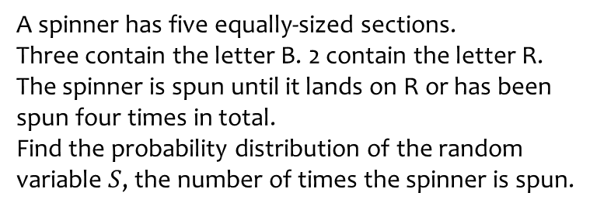
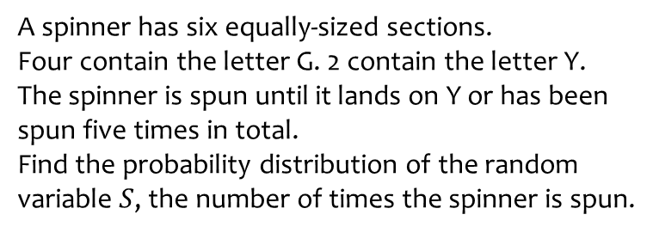
Worked example
Your turn
A spinner has six equally-sized sections.
Four contain the letter G. 2 contain the letter Y.
The spinner is spun until it lands on Y or has been spun five times in total.
Find the probability distribution of the random variable $S$, the number of times the spinner is spun.
A spinner has five equally-sized sections.
Three contain the letter B. 2 contain the letter R.
The spinner is spun until it lands on R or has been spun four times in total.
Find the probability distribution of the random variable $S$, the number of times the spinner is spun.
$$s$$ | 1 | 2 | 3 | 4
$$P(S=s)$$ | $$\frac{2}{5}$$ | $$\frac{6}{25}$$ | $$\frac{18}{125}$$ | $$\frac{27}{125}$$

Slide 12
Worked example
Your turn
The random variable $X$ can taken any integer value from $1$ to $30$. Given that $X$ has a discrete uniform distribution, find:
a) $P(X=5)$
b) $P(X≥20)$
c) $P(12<X<21)$
The random variable $X$ can taken any integer value from $1$ to $40$. Given that $X$ has a discrete uniform distribution, find:
a) $P(X=3)$
b) $P(X≥21)$
c) $P(13<X<31)$
a) $\frac{1}{40}$
b) $\frac{1}{2}$
c) $\frac{17}{40}$

Slide 13
Worked example
Your turn
A discrete random variable has a probability distribution as shown in the table. Find the value of $a$
A discrete random variable has a probability distribution as shown in the table. Find the value of $a$
$$x$$ | 0 | 1 | 2 | 3
$$P(X=x)$$ | $$a$$ | $$a−\frac{1}{4}$$ | $$a+\frac{1}{3}$$ | $$3a$$
$$x$$ | 1 | 2 | 3 | 4
$$P(X=x)$$ | $$2a$$ | $$a−\frac{1}{3}$$ | $$a+\frac{1}{4}$$ | $$5a$$
$$a=\frac{13}{108}$$

Slide 14
6.2) The binomial distribution
Chapter CONTENTS

Slide 15
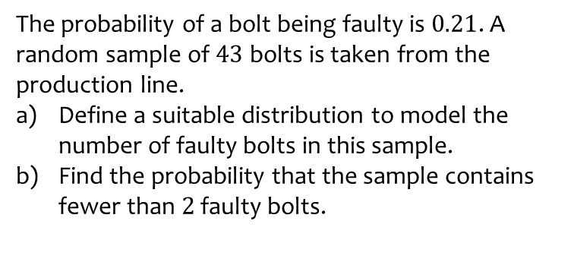
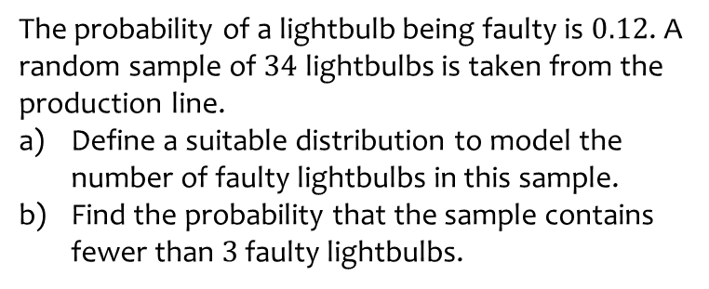
Worked example
Your turn
The probability of a lightbulb being faulty is $0.12$. A random sample of $34$ lightbulbs is taken from the production line.
Define a suitable distribution to model the number of faulty lightbulbs in this sample.
Find the probability that the sample contains fewer than $3$ faulty lightbulbs.
The probability of a bolt being faulty is $0.21$. A random sample of $43$ bolts is taken from the production line.
Define a suitable distribution to model the number of faulty bolts in this sample.
Find the probability that the sample contains fewer than $2$ faulty bolts.
a) Let $X=$ number of faulty bolts.
$$X\sim B(43, 0.21)$$
b) $0.000493$ (3 sf)

Slide 16
Worked example
Your turn
The random variable $X\sim B\left(8,\frac{1}{10}\right)$. Find:
$P\left(X=2\right)$
$P\left(X=5\right)$
$P\left(X≤1\right)$
$P(X≥7)$
The random variable $X\sim B\left(12,\frac{1}{6}\right)$. Find:
$P\left(X=2\right)$
$P\left(X=9\right)$
$P\left(X≤1\right)$
$P(X≥11)$
a) $0.2961$ (4 dp)
b) $0.0000126$ (3 sf)
c) $0.3813$ (4 dp)
d) $0.0000000280$ (3 sf)

Slide 17
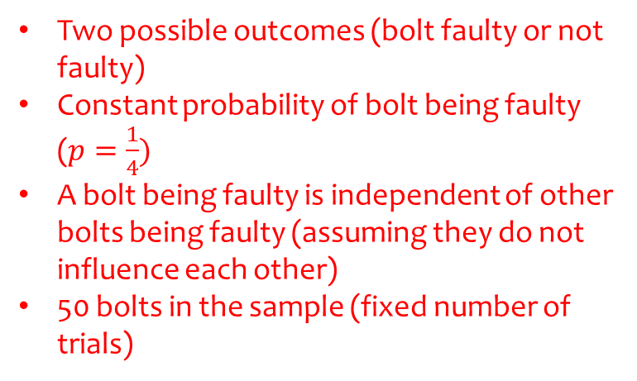
Worked example
Your turn
A company claims that a third of the lightbulbs sent to them are faulty.
To test this claim the number of faulty lightbulbs in a random sample of 100 is recorded.
Give two reasons why a binomial distribution may be a suitable model for the number of faulty lightbulbs in the sample.
A company claims that a quarter of the bolts sent to them are faulty.
To test this claim the number of faulty bolts in a random sample of 50 is recorded.
Give two reasons why a binomial distribution may be a suitable model for the number of faulty bolts in the sample.
Two possible outcomes (bolt faulty or not faulty)
Constant probability of bolt being faulty ($p=\frac{1}{4})$
A bolt being faulty is independent of other bolts being faulty (assuming they do not influence each other)
50 bolts in the sample (fixed number of trials)

Slide 18
6.3) Cumulative probabilities
Chapter CONTENTS

Slide 19
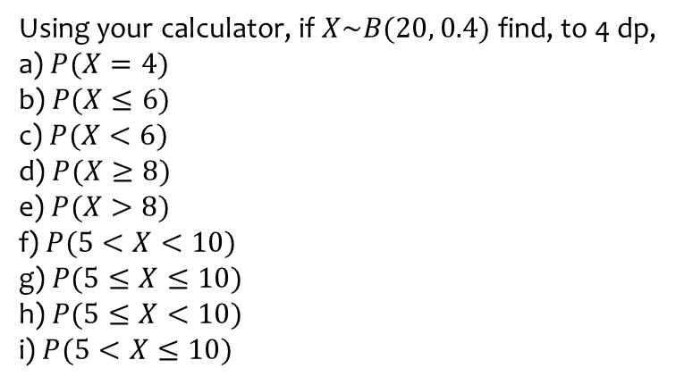
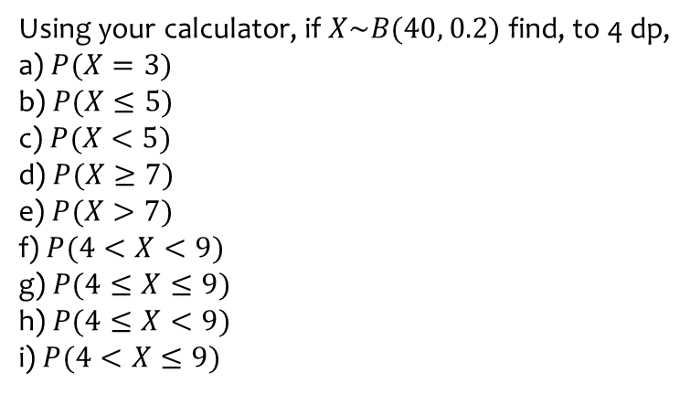

Worked example
Your turn
Using your calculator, if $X\sim B(40, 0.2)$ find, to 4 dp,
a) $P(X=3)$
b) $P(X≤5)$
c) $P(X<5)$
d) $P(X≥7)$
e) $P(X>7)$
f) $P(4<X<9)$
g) $P(4≤X≤9)$
h) $P(4≤X<9)$
i) $P(4<X≤9)$
Using your calculator, if $X\sim B(20, 0.4)$ find, to 4 dp,
a) $P(X=4)$
b) $P(X≤6)$
c) $P(X<6)$
d) $P(X≥8)$
e) $P(X>8)$
f) $P(5<X<10)$
g) $P(5≤X≤10)$
h) $P(5≤X<10)$
i) $P(5<X≤10)$
$$\text{a}\text{) }0.0345$$
$$\text{b}\text{) }0.2500$$
$$\text{c}\text{) }0.1256$$
$$\text{d}\text{) }0.5841$$
$$\text{e}\text{) }0.4044$$
f) $0.6297$
g) $0.8215$
h) $0.7044$
i) $0.7469$

Slide 20
Worked example
Your turn
Using your calculator, if $X\sim B(40, 0.2)$ find, to 4 dp,
$$P(X=3)$$
Using your calculator, if $X\sim B(20, 0.4)$ find, to 4 dp,
$$P(X=4)$$
$$0.0345$$

Slide 21
Worked example
Your turn
Using your calculator, if $X\sim B(40, 0.2)$ find, to 4 dp,
$$P(X≤5)$$
Using your calculator, if $X\sim B(20, 0.4)$ find, to 4 dp,
$$P(X≤6)$$
$$0.2500$$

Slide 22
Worked example
Your turn
Using your calculator, if $X\sim B(40, 0.2)$ find, to 4 dp,
$P(X$ is at most $5$)
Using your calculator, if $X\sim B(20, 0.4)$ find, to 4 dp,
$P(X$ is at most $6$)
$$0.2500$$

Slide 23
Worked example
Your turn
Using your calculator, if $X\sim B(40, 0.2)$ find, to 4 dp,
$$P(X<5)$$
Using your calculator, if $X\sim B(20, 0.4)$ find, to 4 dp,
$$P(X<6)$$
$$0.1256$$

Slide 24
Worked example
Your turn
Using your calculator, if $X\sim B(40, 0.2)$ find, to 4 dp,
$$P(X≥7)$$
Using your calculator, if $X\sim B(20, 0.4)$ find, to 4 dp,
$$P(X≥8)$$
$$0.5841$$

Slide 25
Worked example
Your turn
Using your calculator, if $X\sim B(40, 0.2)$ find, to 4 dp,
$P(X$ is at least $7$)
Using your calculator, if $X\sim B(20, 0.4)$ find, to 4 dp,
$P(X$ is at least $8$)
$$0.5841$$

Slide 26
Worked example
Your turn
Using your calculator, if $X\sim B(40, 0.2)$ find, to 4 dp,
$$P(X>7)$$
Using your calculator, if $X\sim B(20, 0.4)$ find, to 4 dp,
$$P(X>8)$$
$$0.4044$$

Slide 27
Worked example
Your turn
Using your calculator, if $X\sim B(40, 0.2)$ find, to 4 dp,
$$P(4<X<9)$$
Using your calculator, if $X\sim B(20, 0.4)$ find, to 4 dp,
$$P(5<X<10)$$
$$0.6297$$

Slide 28
Worked example
Your turn
Using your calculator, if $X\sim B(40, 0.2)$ find, to 4 dp,
$$P(4≤X≤9)$$
Using your calculator, if $X\sim B(20, 0.4)$ find, to 4 dp,
$$P(5≤X≤10)$$
$$0.8215$$

Slide 29
Worked example
Your turn
Using your calculator, if $X\sim B(40, 0.2)$ find, to 4 dp,
$$P(4≤X<9)$$
Using your calculator, if $X\sim B(20, 0.4)$ find, to 4 dp,
$$P(5≤X<10)$$
$$0.7044$$

Slide 30
Worked example
Your turn
Using your calculator, if $X\sim B(40, 0.2)$ find, to 4 dp,
$$P(4<X≤9)$$
Using your calculator, if $X\sim B(20, 0.4)$ find, to 4 dp,
$$P(5<X≤10)$$
$$0.7469$$

Slide 31
Worked example
Your turn
A spinner is designed so that probability it lands on red is 0.2.
Jane decides to use this spinner for a class competition.
She wants the probability of winning a prize to be less than $0.03$.
Each member of the class will have 15 spins and the number of reds will be recorded.
Find how many reds are needed to win the prize.
A spinner is designed so that probability it lands on red is 0.3.
Jane decides to use this spinner for a class competition.
She wants the probability of winning a prize to be less than $0.05$.
Each member of the class will have 12 spins and the number of reds will be recorded.
Find how many reds are needed to win the prize.
$7$ or more

Slide 32
Worked example
Your turn
At a university, students have 10 exams at the end of the year.
All students pass each individual exam with probability 0.55.
Students are only allowed to continue into the next year if they pass some minimum of exams out of the 10.
What do the university administrators need to set this minimum number such that the probability of continuing to next year is at least 80%?
At a university, students have 20 exams at the end of the year.
All students pass each individual exam with probability 0.45.
Students are only allowed to continue into the next year if they pass some minimum of exams out of the 20.
What do the university administrators need to set this minimum number such that the probability of continuing to next year is at least 90%?
$$6$$

Slide 33
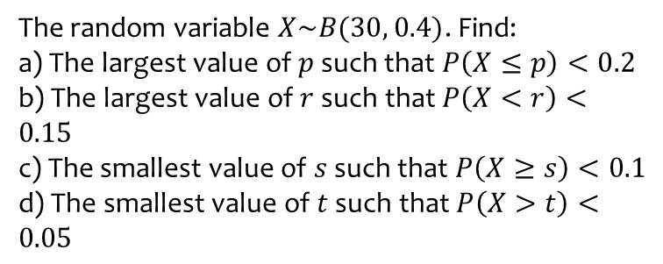
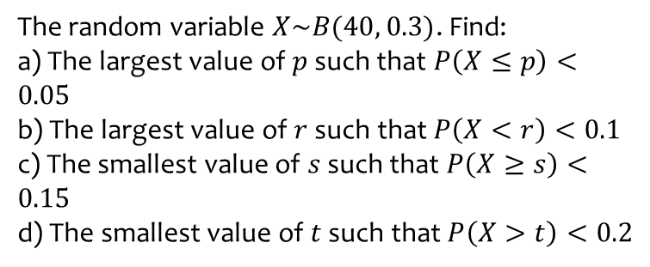
Worked example
Your turn
The random variable $X\sim B(40, 0.3)$. Find:
a) The largest value of $p$ such that $P\left(X≤p\right)<0.05$
b) The largest value of $r$ such that $P\left(X<r\right)<0.1$
c) The smallest value of $s$ such that $P\left(X≥s\right)<0.15$
d) The smallest value of $t$ such that $P\left(X>t\right)<0.2$
The random variable $X\sim B(30, 0.4)$. Find:
a) The largest value of $p$ such that $P\left(X≤p\right)<0.2$
b) The largest value of $r$ such that $P\left(X<r\right)<0.15$
c) The smallest value of $s$ such that $P\left(X≥s\right)<0.1$
d) The smallest value of $t$ such that $P\left(X>t\right)<0.05$
a) $p=9$
b) $r=9$
c) $s=16$
d) $t=16$

Slide 34
Worked example
Your turn
The random variable $X\sim B(40, 0.3)$. Find the largest value of $p$ such that $P\left(X≤p\right)<0.05$
The random variable $X\sim B(30, 0.4)$. Find the largest value of $p$ such that $P\left(X≤p\right)<0.2$
$p=9$

Slide 35
Worked example
Your turn
The random variable $X\sim B(40, 0.3)$. Find the largest value of $r$ such that $P\left(X<r\right)<0.1$
The random variable $X\sim B(30, 0.4)$. Find the largest value of $r$ such that $P\left(X<r\right)<0.15$
$$r=9$$

Slide 36
Worked example
Your turn
The random variable $X\sim B(40, 0.3)$. Find the smallest value of $s$ such that $P\left(X≥s\right)<0.15$
The random variable $X\sim B(30, 0.4)$. Find the smallest value of $s$ such that $P\left(X≥s\right)<0.1$
$$s=16$$

Slide 37
Worked example
Your turn
The random variable $X\sim B(40, 0.3)$. Find the smallest value of $t$ such that $P\left(X>t\right)<0.2$
The random variable $X\sim B(30, 0.4)$. Find the smallest value of $t$ such that $P\left(X>t\right)<0.05$
$$t=16$$

Slide 38
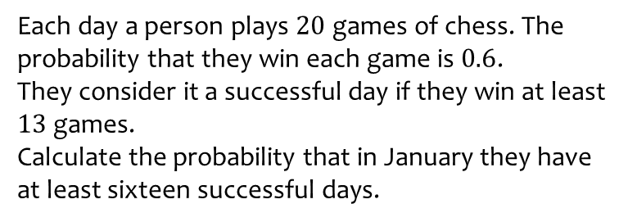
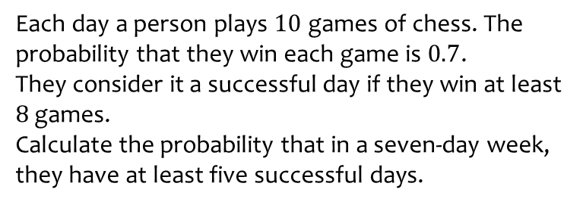
Worked example
Your turn
Each day a person plays $10$ games of chess. The probability that they win each game is $0.7$.
They consider it a successful day if they win at least $8$ games.
Calculate the probability that in a seven-day week, they have at least five successful days.
Each day a person plays $20$ games of chess. The probability that they win each game is $0.6$.
They consider it a successful day if they win at least $13$ games.
Calculate the probability that in January they have at least sixteen successful days.
$0.1708$ (4 dp)

