Slide 1
6) Circles
6.1) Midpoints and perpendicular bisectors
6.2) Equation of a circle
6.3) Intersections of straight lines and circles
6.4) Use tangent and chord properties
6.5) Circles and triangles

Slide 2
6.1) Midpoints and perpendicular bisectors
Chapter CONTENTS

Slide 3
Worked example
Your turn
Find the midpoint of the line segment between:
$(2, 4)$and$(8, 8)$
$(−2, 4)$ and $(−9, 9)$
Find the midpoint of the line segment between:
$(2, −4)$ and $(11, 8)$
$$(6.5, 2)$$

Slide 4
Worked example
Your turn
Find the perpendicular bisector of $A (2, 5)$ and $B(6, 7)$
Find the perpendicular bisector of $A (2, 5)$ and $B(6, 7)$
$$y=−2x+14$$

Slide 5
Worked example
Your turn
Find the perpendicular bisector of $A (3, 8)$ and $B(1, −2)$
Find the perpendicular bisector of $A (3, 8)$ and $B(1, −4)$
$$y=−\frac{1}{2}x+7$$

Slide 6
Worked example
Your turn
A line segment $AB$ is the diameter of a circle with centre $\left(4,−5\right)$. If $A$ has coordinates $\left(2,−1\right)$, what are the coordinates of $B$?
A line segment $AB$ is the diameter of a circle with centre $\left(5,−4\right)$. If $A$ has coordinates $\left(1,−2\right)$, what are the coordinates of $B$?
$$\left(9,−6\right)$$

Slide 7
6.2) Equation of a circle
Chapter CONTENTS

Slide 8

Worked example
Your turn
Write down the equation of the circle with centre $(6, 7)$ and radius $2$
Write down the equation of the circle with centre $(−6, 7)$ and radius $3$
Write down the equation of the circle with centre $(−6, −7)$ and radius $4$
Write down the equation of the circle with centre $(6, −7)$ and radius $5$
Write down the equation of the circle with centre $(4, 5)$ and radius $9$
Write down the equation of the circle with centre $(−4, 5)$ and radius $8$
Write down the equation of the circle with centre $(−4, −5)$ and radius $7$
Write down the equation of the circle with centre $(4, −5)$ and radius $6$
$${\left(x−4\right)}^{2}+{\left(y−5\right)}^{2}=81$$
$${\left(x+4\right)}^{2}+{\left(y−5\right)}^{2}=64$$
$${\left(x+4\right)}^{2}+{\left(y+5\right)}^{2}=49$$
$${\left(x−4\right)}^{2}+{\left(y+5\right)}^{2}=36$$

Slide 9

Worked example
Your turn
Write down the equation of the circle with centre $(0, 0)$ and radius $3$
Write down the equation of the circle with centre $(0, 3)$ and radius $2$
Write down the equation of the circle with centre $(−2, 0)$ and radius $2\sqrt{3}$
Write down the equation of the circle with centre $(0, 0)$ and radius $5$
Write down the equation of the circle with centre $(0, −5)$ and radius $4$
Write down the equation of the circle with centre $(4, 0)$ and radius $4\sqrt{5}$
$$x^{2}+y^{2}=25$$
$$x^{2}+{\left(y+5\right)}^{2}=16$$
$${\left(x−4\right)}^{2}+y^{2}=80$$

Slide 10
Worked example
Your turn
A circle has equation ${\left(x+5\right)}^{2}+{\left(y−2\right)}^{2}=80$.
Write down the centre and radius
Show that the circle passes through $(−1, 10)$
A circle has equation ${\left(x−3\right)}^{2}+{\left(y+4\right)}^{2}=20$.
Write down the centre and radius
Show that the circle passes through $(5, −8)$
Centre $(3, −4)$, radius $2\sqrt{5}$
Shown via substitution

Slide 11
Worked example
Your turn
A line segment $AB$ is the diameter of a circle, where $A$ and $B$ have coordinates $\left(5,8\right)$ and $\left(−7,4\right)$ respectively. Determine the equation of the circle.
A line segment $AB$ is the diameter of a circle, where $A$ and $B$ have coordinates $\left(4,7\right)$ and $\left(−8, 3\right)$ respectively. Determine the equation of the circle.
$${\left(x+2\right)}^{2}+{\left(y−5\right)}^{2}=40$$

Slide 12
Worked example
Your turn
Find the centre and radius of the circle with equation
$$x^{2}+y^{2}+8x−6y−2=0$$
Find the centre and radius of the circle with equation
$$x^{2}+y^{2}−14x+16y−12=0$$
Centre $(7, −8)$, radius $5\sqrt{5}$

Slide 13
Worked example
Your turn
A circle has equation $x^{2}+y^{2}+6x+4y=k$, where $k$ is a constant.
State the range of possible values of $k$
A circle has equation $x^{2}+y^{2}+10x+8y=k$, where $k$ is a constant.
State the range of possible values of $k$
$$k>−41$$

Slide 14
Worked example
Your turn
The circle with equation $x^{2}+{\left(y−k\right)}^{2}=41$ passes through the point $(5, 6)$.
Find the two possible values of $k$
The circle with equation ${\left(x−k\right)}^{2}+y^{2}=45$ passes through the point $(4, 3)$.
Find the two possible values of $k$
$$k=−2, k=10$$

Slide 15
6.3) Intersections of straight lines and circles
Chapter CONTENTS

Slide 16
Worked example
Your turn
Find the coordinates of the points where the line $y=x+4$ meets the circle $x^{2}+{\left(y−3\right)}^{2}=61$
Find the coordinates of the points where the line $y=x+5$ meets the circle $x^{2}+{\left(y−2\right)}^{2}=29$
$(−5, 0)$ and $(2, 7)$

Slide 17
Worked example
Your turn
Show that the line $y=x+4$ does not meet the circle ${\left(x−3\right)}^{2}+y^{2}=22$
Show that the line $y=x−7$ does not meet the circle ${\left(x+2\right)}^{2}+y^{2}=33$
Shown using discriminant.

Slide 18
Worked example
Your turn
The line with equation $y=kx$ intersects the circle with equation $x^{2}−8x+y^{2}+12y+32=0$ at two distinct points.
Find the range of possible values of $k$ to $2$dp
The line with equation $y=kx$ intersects the circle with equation $x^{2}−4x+y^{2}+10y+23=0$ at two distinct points.
Find the range of possible values of $k$ to $2$dp
$k=−0.87, k=10.87$ (2 dp)

Slide 19
Worked example
Your turn
Using an algebraic method, determine $k$ such that the line $y=x+k$ touches the circle with equation $x^{2}+y^{2}=9$
Using an algebraic method, determine $k$ such that the line $y=x+k$ touches the circle with equation $x^{2}+y^{2}=1$
$$k=±\sqrt{2}$$

Slide 20
Worked example
Your turn
The line with equation $y=5x+2$ meets the circle with equation $x^{2}+kx+y^{2}=6$ at exactly one point. Find the two possible values of $k$
The line with equation $y=4x+3$ meets the circle with equation $x^{2}+kx+y^{2}=7$ at exactly one point. Find the two possible values of $k$
$$k=−24±4\sqrt{6}$$

Slide 21
Worked example
Your turn
The line with equation $y=4x−3$ does not intersect the circle with equation $x^{2}+2x+y^{2}=k$.
Find the range of possible values of $k$.
The line with equation $y=3x−2$ does not intersect the circle with equation $x^{2}+4x+y^{2}=k$.
Find the range of possible values of $k$.
$$k<\frac{12}{5}$$

Slide 22
6.4) Use tangent and chord properties
Chapter CONTENTS

Slide 23
Worked example
Your turn
Find the equation of the tangent to $x^{2}+y^{2}=25$ at the point $(3, 4)$
Find the equation of the tangent to $x^{2}+y^{2}=25$ at the point $(4, 3)$
$$y=−\frac{4}{3}x+\frac{25}{3}$$

Slide 24
Worked example
Your turn
Find the equation of the tangent to $x^{2}+y^{2}=169$ at the point $(5, 12)$
Find the equation of the tangent to $x^{2}+y^{2}=169$ at the point $(−5, 12)$
$$y=\frac{5}{12}x+\frac{169}{12}$$

Slide 25
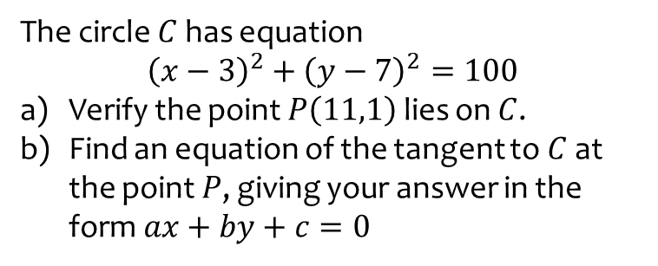
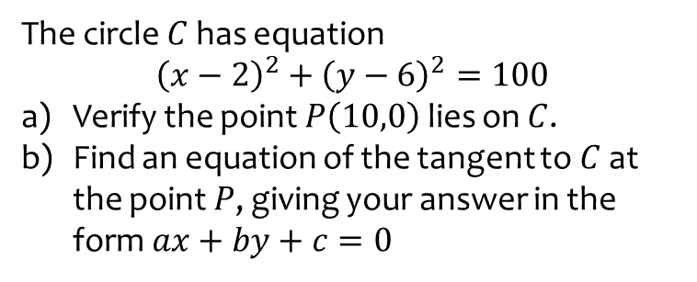
Worked example
Your turn
The circle $C$ has equation $${\left(x−3\right)}^{2}+{\left(y−7\right)}^{2}=100$$
Verify the point $P\left(11,1\right)$ lies on $C$.
Find an equation of the tangent to $C$ at the point $P$, giving your answer in the form $ax+by+c=0$
The circle $C$ has equation $${\left(x−2\right)}^{2}+{\left(y−6\right)}^{2}=100$$
Verify the point $P\left(10,0\right)$ lies on $C$.
Find an equation of the tangent to $C$ at the point $P$, giving your answer in the form $ax+by+c=0$
a) Verified using substitution
b) $4x−3y=40=0$

Slide 26
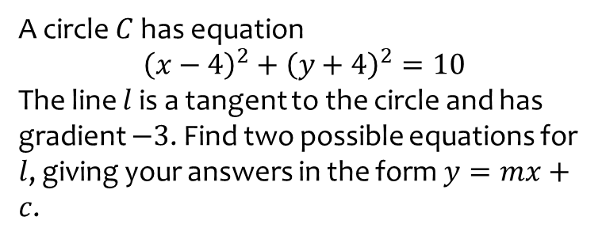
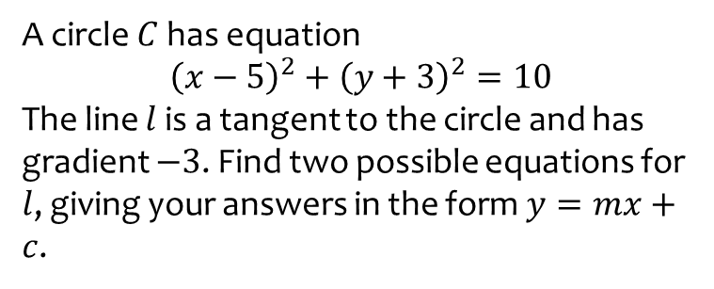
Worked example
Your turn
A circle $C$ has equation $${\left(x−4\right)}^{2}+{\left(y+4\right)}^{2}=10$$
The line $l$ is a tangent to the circle and has gradient $−3$. Find two possible equations for $l$, giving your answers in the form $y=mx+c$.
A circle $C$ has equation $${\left(x−5\right)}^{2}+{\left(y+3\right)}^{2}=10$$
The line $l$ is a tangent to the circle and has gradient $−3$. Find two possible equations for $l$, giving your answers in the form $y=mx+c$.
$y=−3x+2$ and $y=−3x+22$

Slide 27
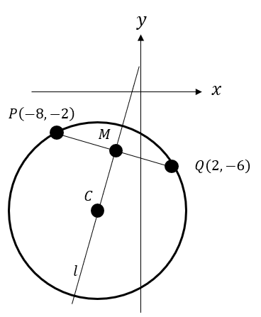
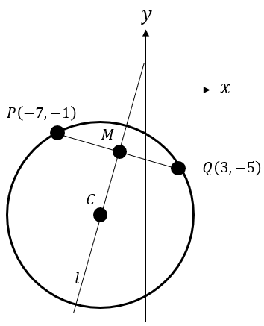
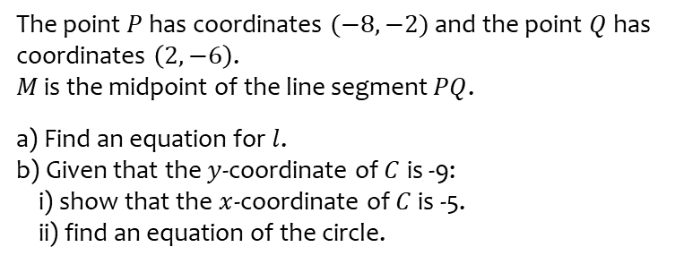
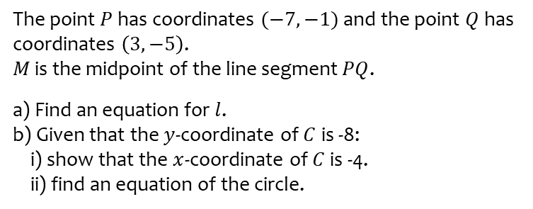
Worked example
Your turn
The point $P$ has coordinates $(−8,−2)$ and the point $Q$ has coordinates $\left(2,−6\right)$.
$M$ is the midpoint of the line segment $PQ$.
a) Find an equation for $l$.
b) Given that the $y$-coordinate of $C$ is -9: i) show that the $x$-coordinate of $C$ is -5. ii) find an equation of the circle.
The point $P$ has coordinates $(−7,−1)$ and the point $Q$ has coordinates $\left(3,−5\right)$.
$M$ is the midpoint of the line segment $PQ$.
a) Find an equation for $l$.
b) Given that the $y$-coordinate of $C$ is -8: i) show that the $x$-coordinate of $C$ is -4. ii) find an equation of the circle.
a) $y=\frac{5}{2}x+2$
b) i) Shown
ii) ${\left(x+4\right)}^{2}+{\left(y+8\right)}^{2}=58$

Slide 28
Worked example
Your turn
The line with equation $4x+y−5=0$ is a tangent to the circle with equation
${\left(x−3\right)}^{2}+{\left(y−p\right)}^{2}=2$.
Find the two possible values of $p$
The line with equation $4x+y−3=0$ is a tangent to the circle with equation
${\left(x−2\right)}^{2}+{\left(y−p\right)}^{2}=5$.
Find the two possible values of $p$
$$p=3±\sqrt{19}$$

Slide 29
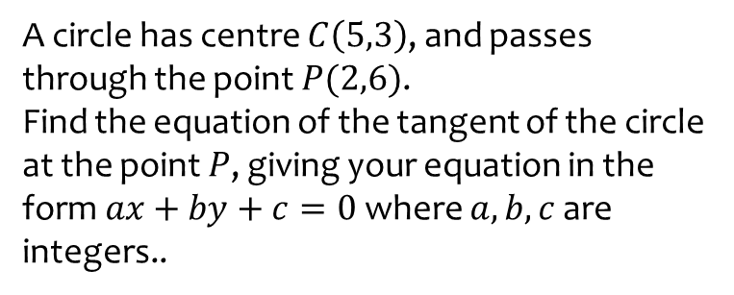
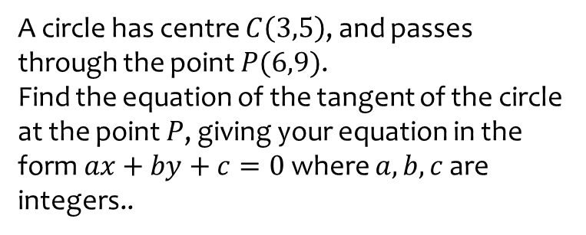
Worked example
Your turn
A circle has centre $C\left(5,3\right)$, and passes through the point $P(2,6)$.
Find the equation of the tangent of the circle at the point $P$, giving your equation in the form $ax+by+c=0$ where $a,b,c$ are integers..
A circle has centre $C\left(3,5\right)$, and passes through the point $P(6,9)$.
Find the equation of the tangent of the circle at the point $P$, giving your equation in the form $ax+by+c=0$ where $a,b,c$ are integers..
$$3x+4y−54=0$$

Slide 30
Worked example
Your turn
A circle passes through the points $A(0,0)$ and $B\left(2,8\right)$.
The centre of the circle has $x$ value $−2$. Determine the equation of the circle.
A circle passes through the points $A(0,0)$ and $B\left(4,2\right)$.
The centre of the circle has $x$ value $−1$. Determine the equation of the circle.
$${\left(x+1\right)}^{2}+{\left(y−7\right)}^{2}=50$$

Slide 31
6.5) Circles and triangles
Chapter CONTENTS

Slide 32
Worked example
Your turn
The points $A\left(−1,8\right), B\left(−5,−4\right),C\left(−9,4\right)$ lie on a circle.
Show that $AB$ is a diameter of the circle.
Hence find the equation of the circle
The points $A\left(−8,1\right), B\left(4,5\right),C\left(−4,9\right)$ lie on a circle.
Show that $AB$ is a diameter of the circle.
Hence find the equation of the circle
Shown
${\left(x+2\right)}^{2}+{\left(y−3\right)}^{2}=40$

Slide 33
Worked example
Your turn
The points $A\left(0,2\right), B\left(2,0\right),C\left(8,18\right)$ lie on the circumference of a circle.
Determine the equation of the circle.
The points $A\left(3,16\right), B\left(11,12\right),C\left(−7,6\right)$ lie on the circumference of a circle.
Determine the equation of the circle.
$${\left(x−3\right)}^{2}+{\left(y−6\right)}^{2}=100$$

