Slide 1
5.5) Modelling with straight lines

Slide 2
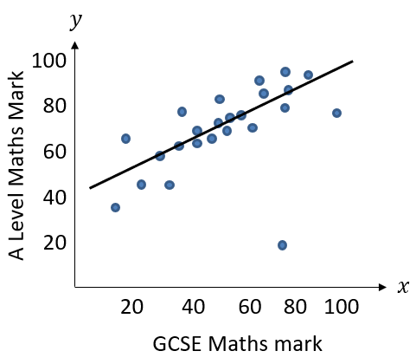
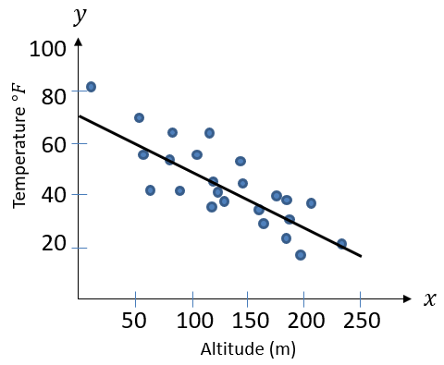
Worked example
Your turn
The A Level Maths mark, $y \%$, and GCSE Maths mark, $x \%$, is recorded for several students.
Assume the line goes through $(0, 40)$ and $(60, 80)$.
Write a linear model
Interpret the gradient and $y$-intercept in this context
Predict the A Level Maths mark of a student who got $100\%$ for their GCSE Maths mark
The temperature $y$ at different points on a mountain is recorded at different altitudes $x$.
Assume the line goes through $(0, 70)$ and $(250, 20)$.
Write a linear model
Interpret the gradient and $y$-intercept in this context
Predict at what altitude the temperature reaches $0°F$
a) $y=0.2x+70$
b) The temperature at sea level is $70°F$. The temperature decreases by $0.2°F$ for each extra metre in altitude.
c) $350 m$

Slide 3
Worked example
Your turn
In $2010$ the population of rabbits in an area was $200$. Locals projected that the number of rabbits would increase by $4$ per year.
Write a linear model for the population, $p$, of rabbits $t$ years after $2010$
Write down a reason why this might not be a realistic model.
In $2000$ there were $18500$ people in a village.
Planners projected that the number of people living in the village would increase by $350$per year.
Write a linear model for the population, $p$, of the village $t$ years after $2000$
Write down a reason why this might not be a realistic model.
a) $p=350t+18500$
b) The population is unlikely to increase by the same amount each year. An exponential model would be more suitable

