Slide 1
5.4) Length and area

Slide 2
Worked example
Your turn
Find the distance between:
$(2, 4)$and$(8, 8)$
$(−2, 4)$ and $(−9, 9)$
Find the distance between:
$(2, −4)$ and $(11, 8)$
$$15$$

Slide 3
Worked example
Your turn
In your head, find the distance between:
$$(8,2) \text{and} \left(5,6\right)$$
$$(−1,−7) \text{and} \left(11,2\right)$$
$$(−23,0) \text{and} \left(1,7\right)$$
In your head, find the distance between:
$$(1,10) \text{and} \left(4,14\right)$$
$$(−4,−2) \text{and} \left(−12,4\right)$$
$(0,−9)$ and $\left(5,3\right)$
$$5$$
$$10$$
$$13$$

Slide 4
Worked example
Your turn
The straight line $l_{1}$ with equation $2x−y=0$ and the straight line $l_{2}$ with equation $3x+2y−\frac{7}{2}=0$ intersect at point $A$.
O is the origin. $B$ is the point where $l_{2}$ meets the $x$-axis.
Work out the area of triangle $AOB$
The straight line $l_{1}$ with equation $4x−y=0$ and the straight line $l_{2}$ with equation $2x+3y−21=0$ intersect at point $A$.
O is the origin. $B$ is the point where $l_{2}$ meets the $x$-axis.
Work out the area of triangle $AOB$
$$\frac{63}{2}$$

Slide 5
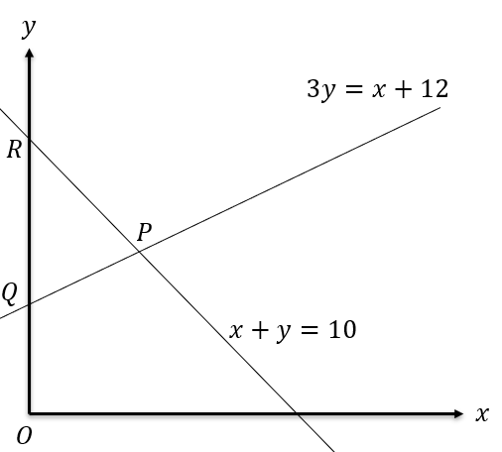
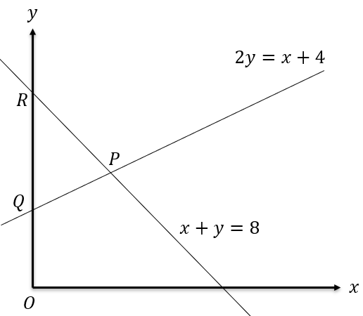
Worked example
Your turn
Determine:
The length of $PQ$
The area of triangle $PQR$
Determine:
The length of $PQ$
The area of triangle $PQR$
a) $2\sqrt{5}$
b) $12$

Slide 6
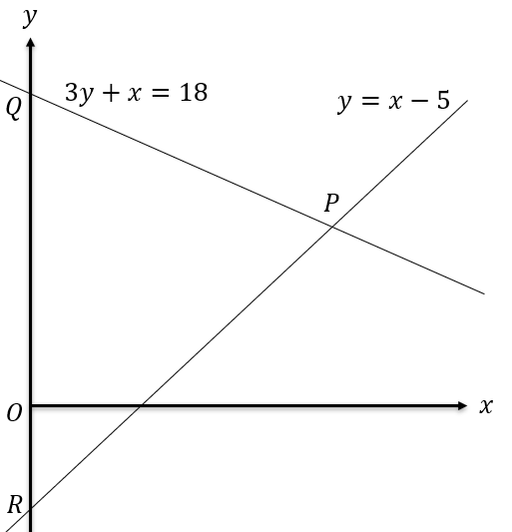
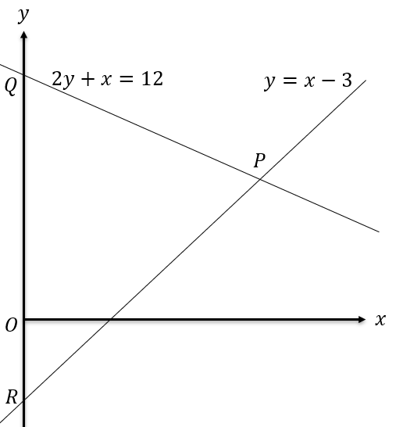
Worked example
Your turn
Determine:
The length of $PQ$
The area of triangle $PQR$
Determine:
The length of $PQ$
The area of triangle $PQR$
a) $3\sqrt{5}$
b) $27$

