Slide 1
5.3) Parallel and perpendicular lines

Slide 2
Worked example
Your turn
Determine whether the pairs of lines are parallel, perpendicular or neither:
$$5x−2y−3=0$$
$$y=\frac{5}{2}x$$
$$5x+3y−21=0$$
$$3x−5y+2=0$$
Determine whether the pairs of lines are parallel, perpendicular or neither:
$$3x−y−2=0$$
$$x+3y−6=0$$
$$y=\frac{1}{2}x$$
$$2x−y+4=0$$
Perpendicular
Neither parallel nor perpendicular

Slide 3
Worked example
Your turn
The points A, B and C have coordinates $(0, 12)$, $(−3, 0)$ and $(0, c)$ respectively.
The line through points $A$ and $B$ is perpendicular to the line through points $B$ and $C$.
Find the value of $c$
The points A, B and C have coordinates $(0, 6)$, $(−2, 0)$ and $(0, c)$ respectively.
The line through points $A$ and $B$ is perpendicular to the line through points $B$ and $C$.
Find the value of $c$
$$x=−\frac{2}{3}$$

Slide 4



Worked example
Your turn
Find the gradient of the perpendicular line to:
$$y=2x+3$$
$$y=2−3x$$
$$y=\frac{2}{3}x+1$$
$$y=8−\frac{11}{5}x$$
Find the general equation of the perpendicular line to:
$$y=4x$$
$$y=−2x+4$$
$$y=\frac{3}{4}x−5$$
$$y=7−\frac{11}{3}x$$
$$y=−\frac{1}{4}x+c$$
$$y=\frac{1}{2}x+c$$
$$y=−\frac{4}{3}x+c$$
$$y=\frac{3}{11}x+c$$

Slide 5
Worked example
Your turn
Find the equation of the line parallel to $y=3x+5$ that passes through $(−2, 5)$
Find the equation of the line parallel to $y=−\frac{1}{3}x−4$ that passes through $(−2, 5)$
Find the equation of the line parallel to $y=−\frac{1}{2}x−3$ that passes through $(−2, 5)$
$$y=−\frac{1}{2}x+4$$

Slide 6
Worked example
Your turn
Find the equation of the line perpendicular to $y=2x−4$ that passes through $(−2, 5)$
Find the equation of the line perpendicular to $y=4x+5$ that passes through $(−2, 5)$
Find the equation of the line perpendicular to $y=3x+2$ that passes through $(9, −7)$
$$y=−\frac{1}{3}x−4$$

Slide 7
Worked example
Your turn
Find the equation of the line perpendicular to $y=\frac{1}{2}x−4$ that passes through $(−2, 5)$
Find the equation of the line perpendicular to $y=−\frac{2}{3}x+5$ that passes through $(−2, 5)$
Find the equation of the line perpendicular to $y=−\frac{4}{3}x+3$ that passes through $(−12, −5)$
$$y=\frac{3}{4}x+4$$

Slide 8
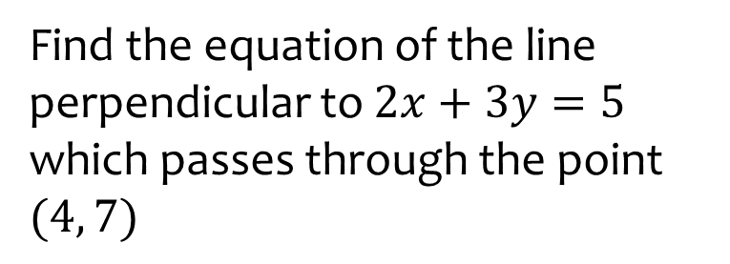
Worked example
Your turn
Find the equation of the line perpendicular to $x+2y=5$ which passes through the point $(3, 7)$
Find the equation of the line perpendicular to $3x+2y=5$ which passes through the point $(3, 7)$
Find the equation of the line perpendicular to $2x+3y=5$ which passes through the point $(4, 7)$
$$y=\frac{3}{2}x+1$$

Slide 9
Worked example
Your turn
Write down an equation of a line parallel to $y=3x−4$ which passes through the origin.
Write down an equation of a line parallel to $y=3−4x$which passes through the origin.
Write down an equation of a line parallel to $y=−2x+5$ which passes through the origin.
$$y=−2x$$

Slide 10
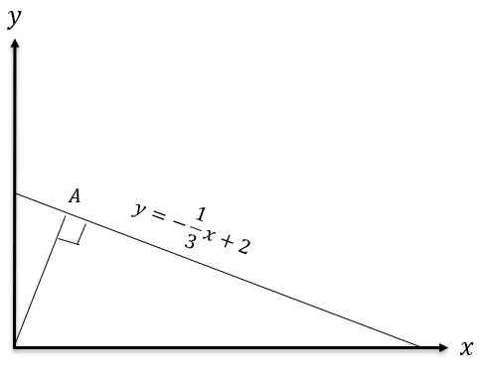
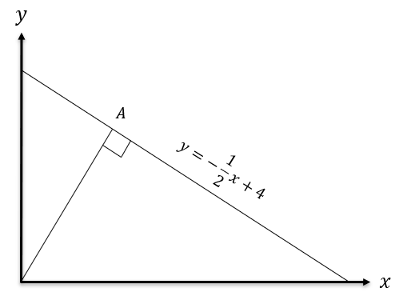
Worked example
Your turn
Determine the coordinates of $A$
Determine the coordinates of $A$
$$\left(\frac{8}{5},\frac{16}{5}\right)$$

