Slide 1
5.4) Tree diagrams

Slide 2
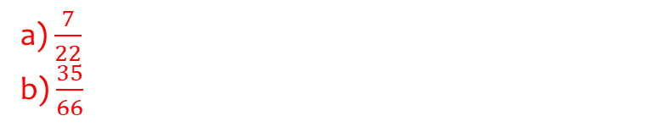
Worked example
Your turn
There are three red and nine yellow counters in a bag. A counter is taken from the bag at random and not replaced. A second counter is then taken from the bag.
Determine the probability that:
Both counters are green.
The counters are different colours.
There are seven green and five blue beads in a bag. A bead is taken from the bag at random and not replaced. A second bead is then taken from the bag.
Determine the probability that:
Both beads are green.
The beads are different colours.
a) $\frac{7}{22}$
b) $\frac{35}{66}$

Slide 3
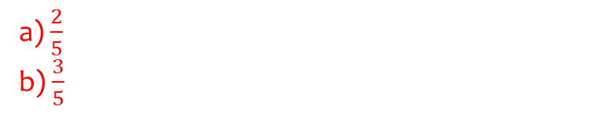
Worked example
Your turn
There are 5 blue and 4 red beads in a bag. I take two beads at random. Determine the probability that:
They are of the same colour.
They are of different colours.
There are 3 yellow and 2 green counters in a bag. I take two counters at random. Determine the probability that:
They are of the same colour.
They are of different colours.
a) $\frac{2}{5}$
b) $\frac{3}{5}$

Slide 4
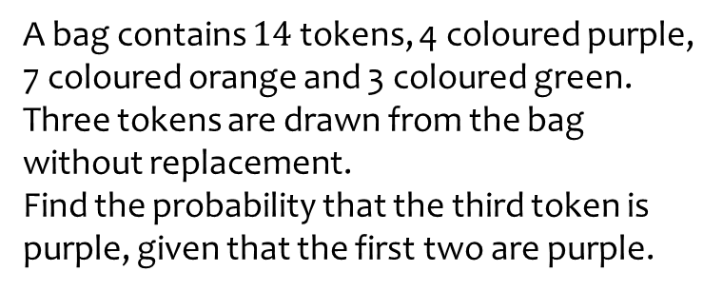
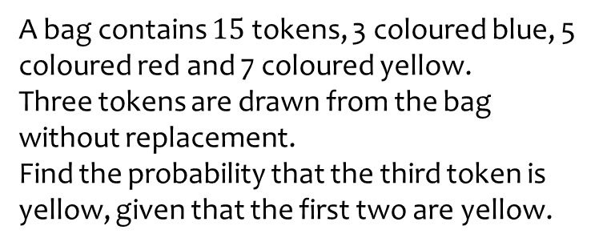

Worked example
Your turn
A bag contains $15$ tokens, 3 coloured blue, 5 coloured red and 7 coloured yellow.
Three tokens are drawn from the bag without replacement.
Find the probability that the third token is yellow, given that the first two are yellow.
A bag contains $14$ tokens, 4 coloured purple, 7 coloured orange and 3 coloured green.
Three tokens are drawn from the bag without replacement.
Find the probability that the third token is purple, given that the first two are purple.
$$\frac{2}{12}=\frac{1}{6}$$

Slide 5
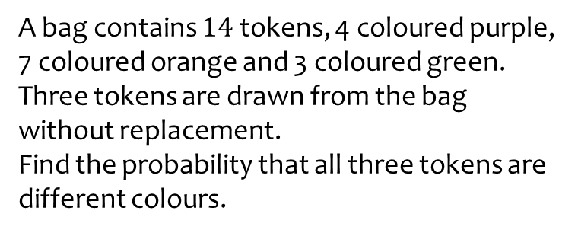
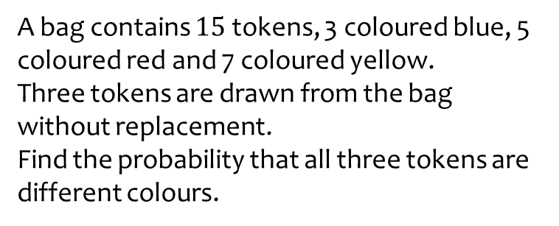

Worked example
Your turn
A bag contains $15$ tokens, 3 coloured blue, 5 coloured red and 7 coloured yellow.
Three tokens are drawn from the bag without replacement.
Find the probability that all three tokens are different colours.
A bag contains $14$ tokens, 4 coloured purple, 7 coloured orange and 3 coloured green.
Three tokens are drawn from the bag without replacement.
Find the probability that all three tokens are different colours.
$$\frac{3}{13}$$

Slide 6
Worked example
Your turn
The probability I hit a target on each shot is 0.4. I keep firing until I hit the target. Determine the probability I hit the target on the 6th shot.
The probability I hit a target on each shot is 0.3. I keep firing until I hit the target. Determine the probability I hit the target on the 5th shot.
$$0.07203$$

