Slide 1
Worked example
Your turn
Determine the point of intersection of the lines with equations $y=2x$ and $x+3y=5$
Determine the point of intersection of the lines with equations $y=3x$ and $x+2y=4$
$$\left(\frac{4}{7},\frac{12}{7}\right)$$

Slide 2
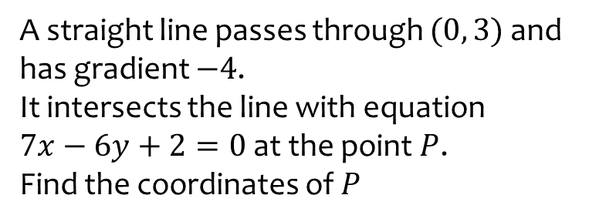
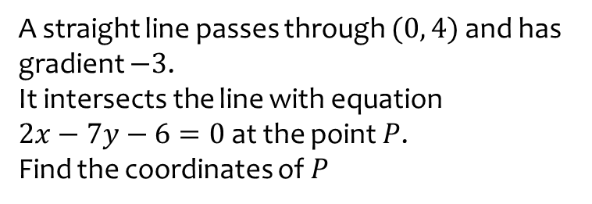
Worked example
Your turn
A straight line passes through $(0, 4)$ and has gradient $−3$.
It intersects the line with equation
$2x−7y−6=0$ at the point $P$.
Find the coordinates of $P$
A straight line passes through $(0, 3)$ and has gradient $−4$.
It intersects the line with equation
$7x−6y+2=0$ at the point $P$.
Find the coordinates of $P$
$$\left(\frac{16}{31},\frac{29}{31}\right)$$

Slide 3
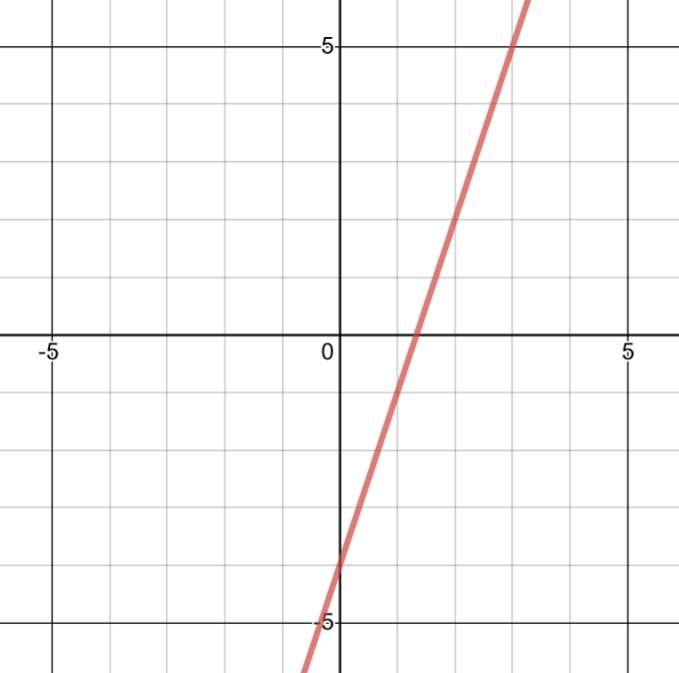



Worked example
Your turn
$$y=2x−5$$
Gradient:
$y$-intercept:
$x$-intercept:
Sketch:
$$y=3x−4$$
Gradient:
$y$-intercept:
$x$-intercept:
Sketch:
$$3$$
$$−4$$
$$\frac{4}{3}$$
Graph used with permission from DESMOS: https://www.desmos.com/

Slide 4
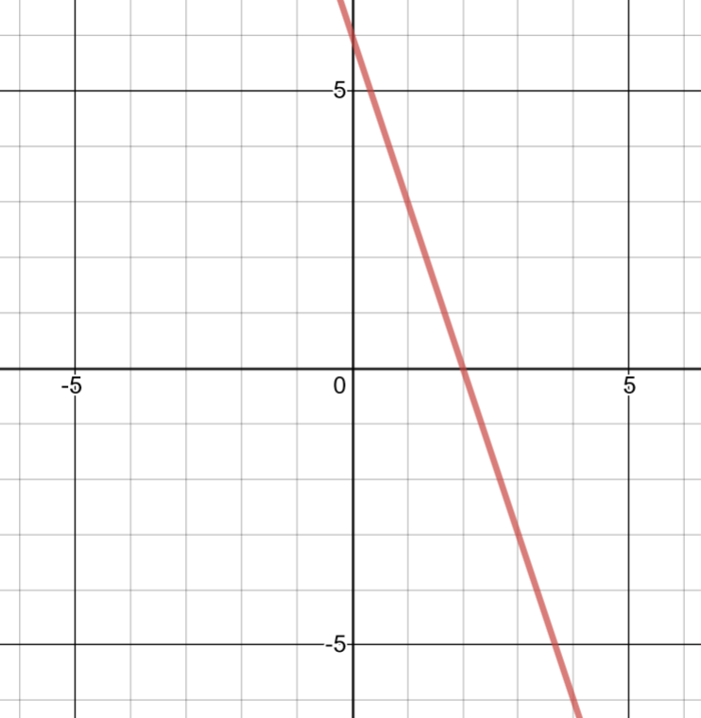


Worked example
Your turn
$$y=−2x+6$$
Gradient:
$y$-intercept:
$x$-intercept:
Sketch:
$$y=−3x+6$$
Gradient:
$y$-intercept:
$x$-intercept:
Sketch:
$$−3$$
$$6$$
$$2$$
Graph used with permission from DESMOS: https://www.desmos.com/

Slide 5
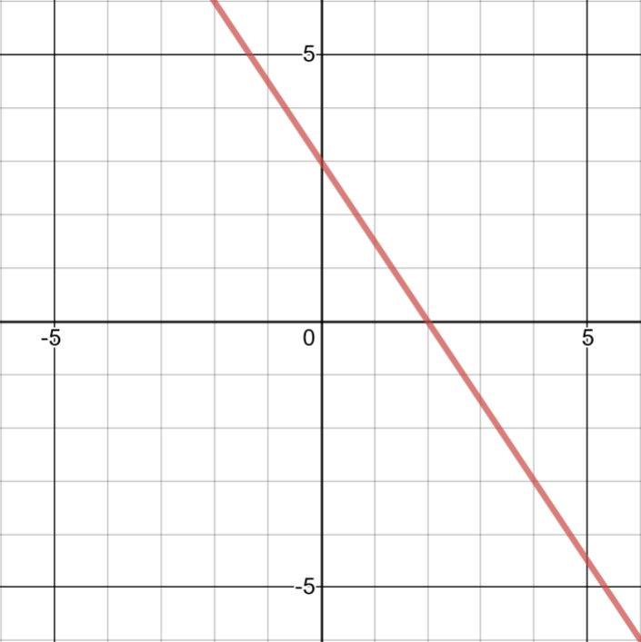


Worked example
Your turn
$$2x+3y=6$$
Gradient:
$y$-intercept:
$x$-intercept:
Sketch:
$$3x+2y=6$$
Gradient:
$y$-intercept:
$x$-intercept:
Sketch:
$$−\frac{3}{2}$$
$$3$$
$$2$$
Graph used with permission from DESMOS: https://www.desmos.com/

Slide 6
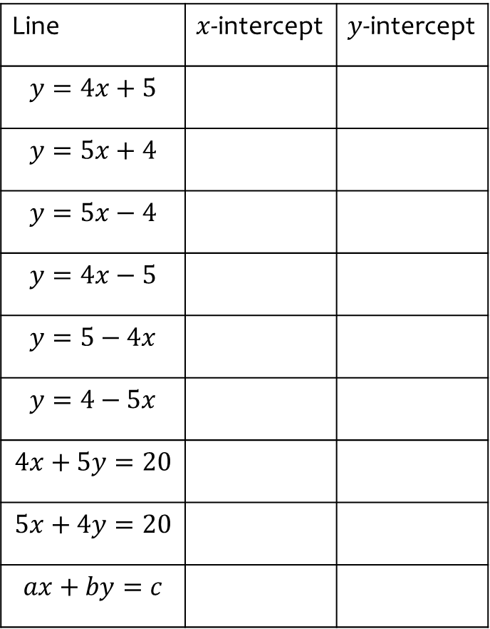
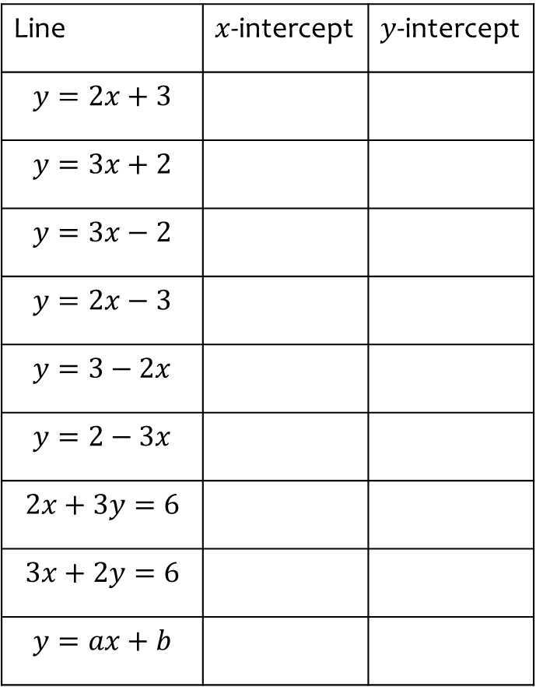
Worked example
Your turn
Find where the line intercepts the axes:
Find where the line intercepts the axes:
Line | $x$-intercept | $y$-intercept
$$y=2x+3$$
$$y=3x+2$$
$$y=3x−2$$
$$y=2x−3$$
$$y=3−2x$$
$$y=2−3x$$
$$2x+3y=6$$
$$3x+2y=6$$
$$y=ax+b$$
Line | $x$-intercept | $y$-intercept
$$y=4x+5$$
$$y=5x+4$$
$$y=5x−4$$
$$y=4x−5$$
$$y=5−4x$$
$$y=4−5x$$
$$4x+5y=20$$
$$5x+4y=20$$
$$ax+by=c$$
$$−\frac{5}{4}$$
$$−\frac{4}{5}$$
$$\frac{4}{5}$$
$$\frac{5}{4}$$
$$\frac{5}{4}$$
$$\frac{4}{5}$$
$$5$$
$$4$$
$$\frac{c}{a}$$
$$5$$
$$4$$
$$−4$$
$$−5$$
$$5$$
$$4$$
$$4$$
$$5$$
$$\frac{c}{b}$$

Slide 7
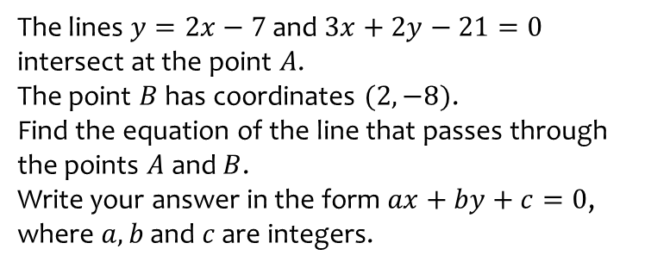
Worked example
Your turn
The lines $y=2x−7$ and $3x+2y−21=0$ intersect at the point $A$.
The point $B$ has coordinates $(2, −8)$.
Find the equation of the line that passes through the points $A$ and $B$.
Write your answer in the form $ax+by+c=0$, where $a, b$ and $c$ are integers.
The lines $y=4x−7$ and $2x+3y−21=0$ intersect at the point $A$.
The point $B$ has coordinates $(−2, 8)$.
Find the equation of the line that passes through the points $A$ and $B$.
Write your answer in the form $ax+by+c=0$, where $a, b$ and $c$ are integers.
$$3x+5y−34=0$$

