Slide 1
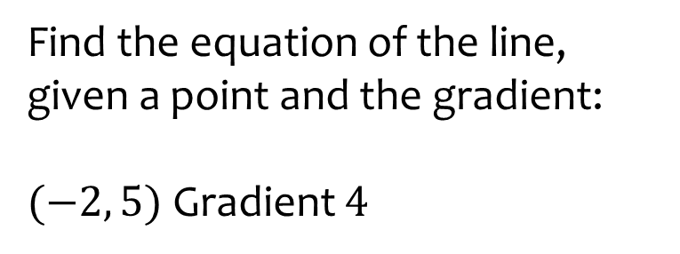
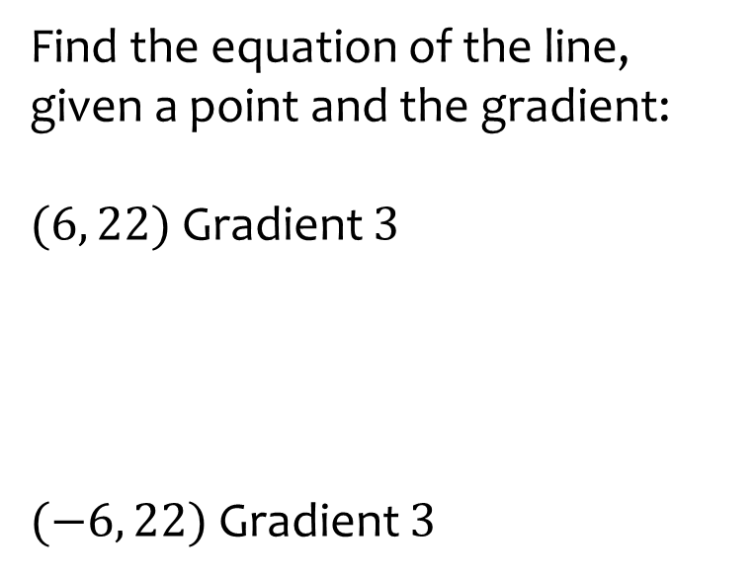
Worked example
Your turn
Find the equation of the line, given a point and the gradient:
$(6, 22)$ Gradient $3$
$(−6, 22)$ Gradient $3$
Find the equation of the line, given a point and the gradient:
$(−2, 5)$ Gradient $4$
$$y=4x+13$$

Slide 2
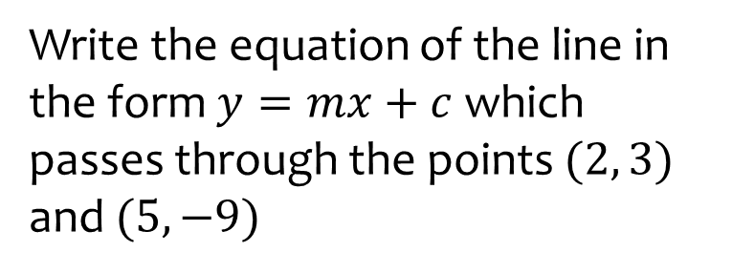
Worked example
Your turn
Write the equation of the line in the form $y=mx+c$ which passes through the points $(2, 3)$ and $(5, −9)$
Write the equation of the line in the form $y=mx+c$ which passes through the points $(3, 10)$ and $(−5, 18)$
$$y=−x−7$$

Slide 3
Worked example
Your turn
Write the equation of the line in the form $y=mx+c$ which passes through the points $(2, −3)$ and $(7, −5)$
Write the equation of the line in the form $y=mx+c$ which passes through the points $(3, −2)$ and $(−7, 5)$
$$y=−\frac{3}{10}x−\frac{11}{10}$$

