Slide 1
5.3) Oblique impact of smooth spheres

Slide 2
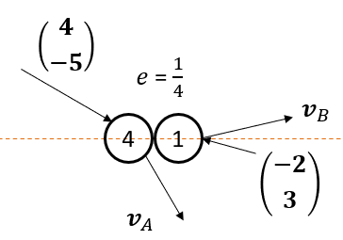
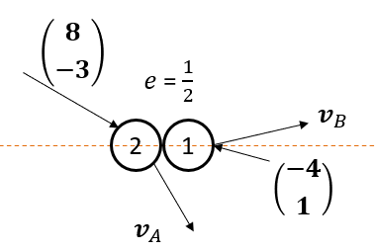
Worked example
Your turn
Two smooth spheres collide obliquely.
Find the velocity of each sphere immediately after impact.
Two smooth spheres collide obliquely.
Find the velocity of each sphere immediately after impact.
$$v_{A}=\left({2 \atop −3}\right), v_{B}=\left({8 \atop 1}\right)$$

Slide 3
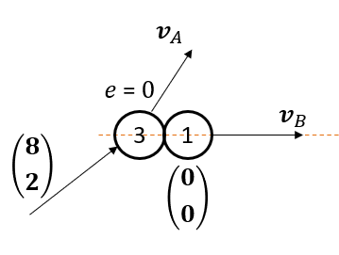
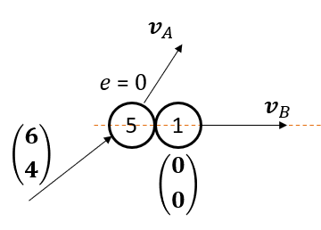
Worked example
Your turn
Two smooth spheres collide obliquely.
Find the velocity of each sphere immediately after impact.
Two smooth spheres collide obliquely.
Find the velocity of each sphere immediately after impact.
$$v_{A}=\left({5 \atop 4}\right), v_{B}=\left({5 \atop 0}\right)$$
Diagrams used with permission from DrFrostMaths: https://www.drfrostmaths.com/

Slide 4
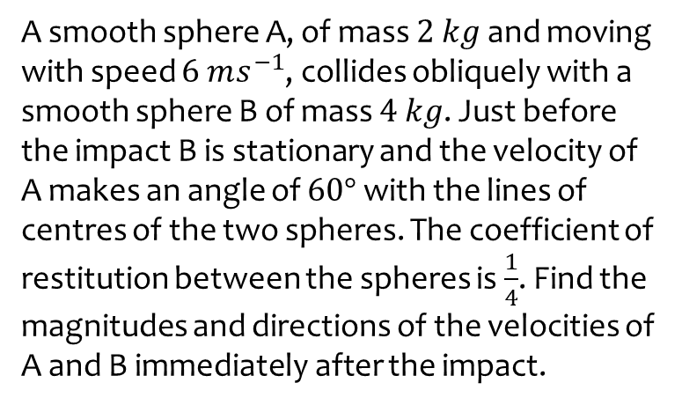
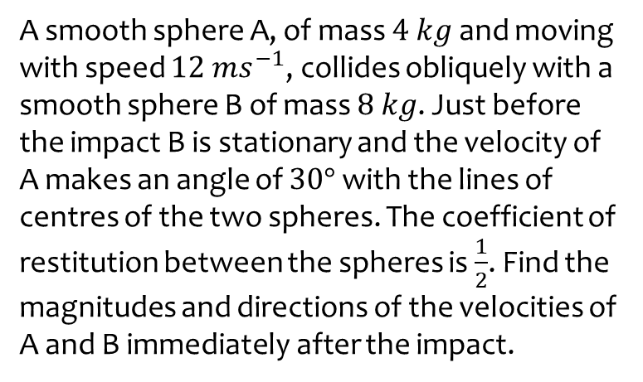
Worked example
Your turn
A smooth sphere A, of mass $4 kg$ and moving with speed $12 ms^{−1}$, collides obliquely with a smooth sphere B of mass $8 kg$. Just before the impact B is stationary and the velocity of A makes an angle of $30°$ with the lines of centres of the two spheres. The coefficient of restitution between the spheres is $\frac{1}{2}$. Find the magnitudes and directions of the velocities of A and B immediately after the impact.
A smooth sphere A, of mass $2 kg$ and moving with speed $6 ms^{−1}$, collides obliquely with a smooth sphere B of mass $4 kg$. Just before the impact B is stationary and the velocity of A makes an angle of $60°$ with the lines of centres of the two spheres. The coefficient of restitution between the spheres is $\frac{1}{4}$. Find the magnitudes and directions of the velocities of A and B immediately after the impact.
A: Speed $5.22 ms^{−1}$ (3 sf) at angle of $84.5°$ (3 sf) to the line of centres
B: Speed $1.25$ $ms^{−1}$ along the line of centres

Slide 5
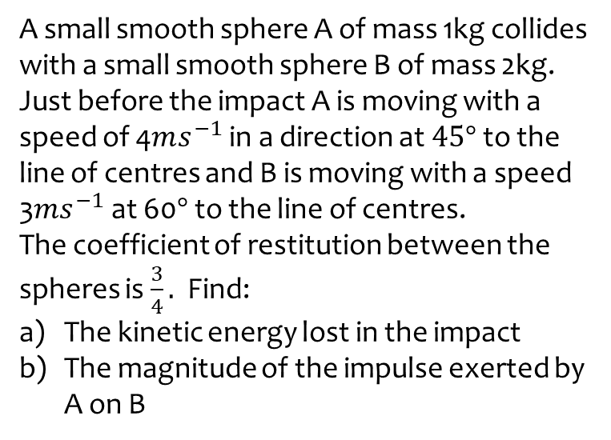
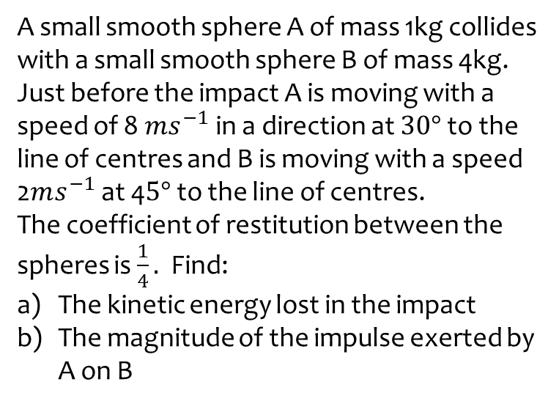
Worked example
Your turn
A small smooth sphere A of mass 1kg collides with a small smooth sphere B of mass 4kg.
Just before the impact A is moving with a speed of 8$ms^{−1}$ in a direction at $30°$ to the line of centres and B is moving with a speed 2$ms^{−1}$ at 4$5°$ to the line of centres.
The coefficient of restitution between the spheres is $\frac{1}{4}.$ Find:
The kinetic energy lost in the impact
The magnitude of the impulse exerted by A on B
A small smooth sphere A of mass 1kg collides with a small smooth sphere B of mass 2kg.
Just before the impact A is moving with a speed of 4$ms^{−1}$ in a direction at $45°$ to the line of centres and B is moving with a speed 3$ms^{−1}$ at 60$°$ to the line of centres.
The coefficient of restitution between the spheres is $\frac{3}{4}.$ Find:
The kinetic energy lost in the impact
The magnitude of the impulse exerted by A on B
a) $2.73 J$ (3 sf)
b) $5.05 Ns$ (3 sf)

Slide 6
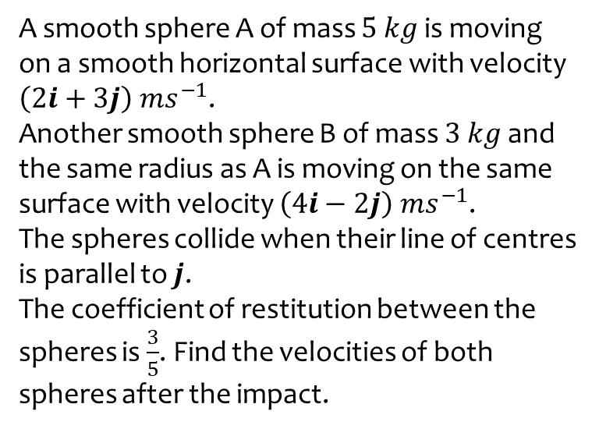
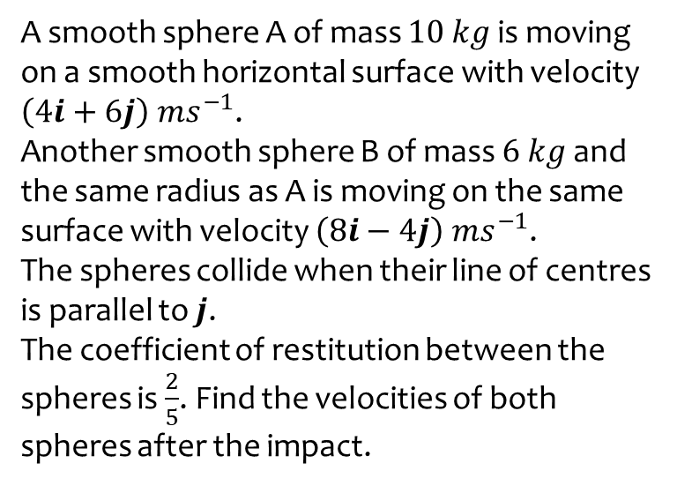
Worked example
Your turn
A smooth sphere A of mass $10 kg$ is moving on a smooth horizontal surface with velocity $\left(4i+6j\right) ms^{−1}$.
Another smooth sphere B of mass $6 kg$ and the same radius as A is moving on the same surface with velocity $\left(8i−4j\right) ms^{−1}$.
The spheres collide when their line of centres is parallel to $j$.
The coefficient of restitution between the spheres is $\frac{2}{5}$. Find the velocities of both spheres after the impact.
A smooth sphere A of mass $5 kg$ is moving on a smooth horizontal surface with velocity $\left(2i+3j\right) ms^{−1}$.
Another smooth sphere B of mass $3 kg$ and the same radius as A is moving on the same surface with velocity $\left(4i−2j\right) ms^{−1}$.
The spheres collide when their line of centres is parallel to $j$.
The coefficient of restitution between the spheres is $\frac{3}{5}$. Find the velocities of both spheres after the impact.
$v_{A}=2i ms^{−1}$ ; $v_{B}=\left(4i+3j\right) ms^{−1}$

Slide 7
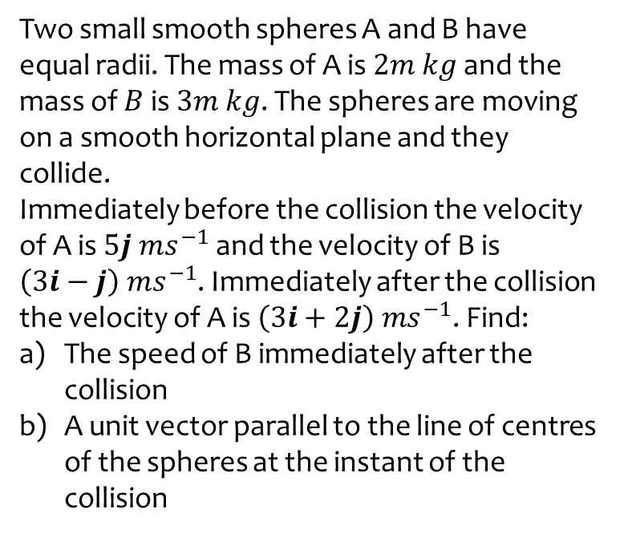
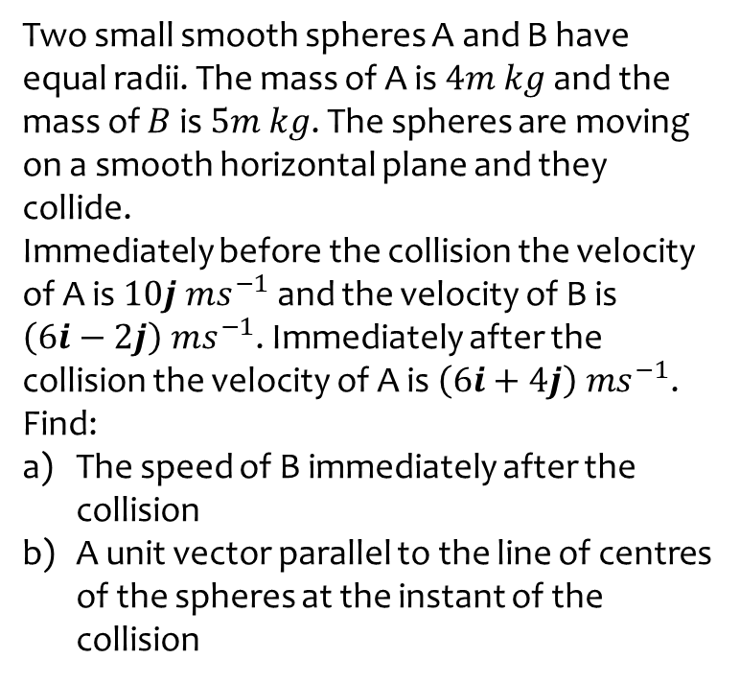
Worked example
Your turn
Two small smooth spheres A and B have equal radii. The mass of A is $4m kg$ and the mass of $B$ is $5m kg$. The spheres are moving on a smooth horizontal plane and they collide.
Immediately before the collision the velocity of A is $10j ms^{−1}$ and the velocity of B is $\left(6i−2j\right) ms^{−1}$. Immediately after the collision the velocity of A is $\left(6i+4j\right) ms^{−1}$. Find:
The speed of B immediately after the collision
A unit vector parallel to the line of centres of the spheres at the instant of the collision
Two small smooth spheres A and B have equal radii. The mass of A is $2m kg$ and the mass of $B$ is $3m kg$. The spheres are moving on a smooth horizontal plane and they collide.
Immediately before the collision the velocity of A is $5j ms^{−1}$ and the velocity of B is $\left(3i−j\right) ms^{−1}$. Immediately after the collision the velocity of A is $\left(3i+2j\right) ms^{−1}$. Find:
The speed of B immediately after the collision
A unit vector parallel to the line of centres of the spheres at the instant of the collision
a) $1.41 ms^{−1}$ (3 sf)
b) $\frac{1}{\sqrt{2}}(i−j)$

Slide 8
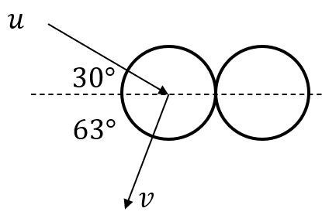
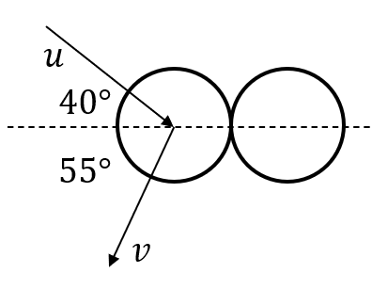
Worked example
Your turn
Find the angle of deflection
Find the angle of deflection
$$85°$$
Diagrams used with permission from DrFrostMaths: https://www.drfrostmaths.com/

Slide 9
Worked example
Your turn
A smooth uniform sphere S, of mass $m$, is moving on a smooth horizontal plane when it collides obliquely with another smooth uniform sphere T, of the same radius as S but of mass $4m$, which is at rest on the plane. Immediately before the collision the velocity of S makes an angle $α$, where $\tan{α}=\frac{5}{12}$, with the line joining the centres of the spheres. Immediately after the collision the speed of $T$ is $V$. The coefficient of restitution between the two spheres is $\frac{1}{4}$.
a) Find, in terms of $V$, the speed of S
Immediately before the collision
Immediately after the collision
b) Find the angle through which the direction
of motion of S is deflected as a result of the
collision
A smooth uniform sphere S, of mass $m$, is moving on a smooth horizontal plane when it collides obliquely with another smooth uniform sphere T, of the same radius as S but of mass $2m$, which is at rest on the plane. Immediately before the collision the velocity of S makes an angle $α$, where $\tan{α}=\frac{3}{4}$, with the line joining the centres of the spheres. Immediately after the collision the speed of $T$ is $V$. The coefficient of restitution between the two spheres is $\frac{3}{4}$.
a) Find, in terms of $V$, the speed of S
Immediately before the collision
Immediately after the collision
b) Find the angle through which the direction
of motion of S is deflected as a result of the
collision
i) $−\frac{2V}{7}$
ii) $\frac{V\sqrt{85}}{7}$
b) $65.7°$ (3 sf)

Slide 10
Worked example
Your turn
Two small smooth spheres $A$and $B$ have equal radii. The mass of $A$ is $m$kg and the mass of B is $10m$kg. The spheres are moving on a smooth horizontal plane and they collide.
Immediately before the collision the velocity of $A$ is $(4i+2j$) $ms^{−1}$ and $B$ is stationary. Immediately after the collision the velocity of $A$ is $4j ms^{−1}$. Find:
The velocity of $B$ after the collision
The coefficient of restitution between the two spheres
Two small smooth spheres $A$and $B$ have equal radii. The mass of $A$ is $2m$kg and the mass of B is $20m$kg. The spheres are moving on a smooth horizontal plane and they collide.
Immediately before the collision the velocity of $A$ is $(2i+j$) $ms^{−1}$ and $B$ is stationary. Immediately after the collision the velocity of $A$ is $2j ms^{−1}$. Find:
The velocity of $B$ after the collision
The coefficient of restitution between the two spheres
$\left(0.2i−0.1j\right) ms^{−1}$
$e=\frac{5}{6}$

