Slide 1
5.3) Mutually exclusive and independent events

Slide 2
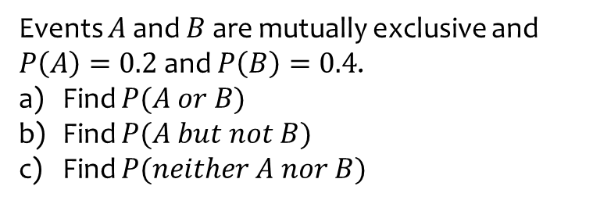
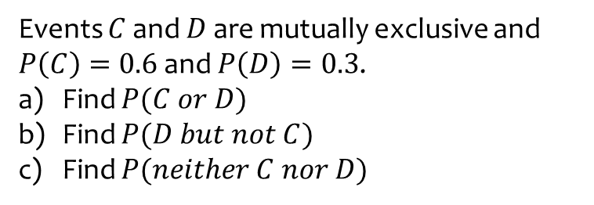
Worked example
Your turn
Events $C$ and $D$ are mutually exclusive and $P\left(C\right)=0.6$ and $P\left(D\right)=0.3$.
Find $P(C or D)$
Find $P(D but not C)$
Find $P(neither C nor D)$
Events $A$ and $B$ are mutually exclusive and $P\left(A\right)=0.2$ and $P\left(B\right)=0.4$.
Find $P(A or B)$
Find $P(A but not B)$
Find $P(neither A nor B)$
a) $0.6$
b) $0.2$
c) $0.4$

Slide 3
Worked example
Your turn
Events $C$ and $D$ are independent.
$P\left(C\right)=\frac{5}{7}$ and $P\left(D\right)=\frac{3}{8}$.
Find $P(C and D)$.
Events $A$ and $B$ are independent.
$P\left(A\right)=\frac{1}{3}$ and $P\left(B\right)=\frac{1}{5}$.
Find $P(A and B)$.
$$\frac{1}{15}$$

Slide 4
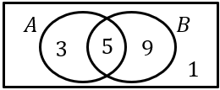
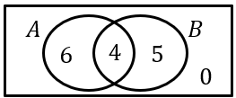
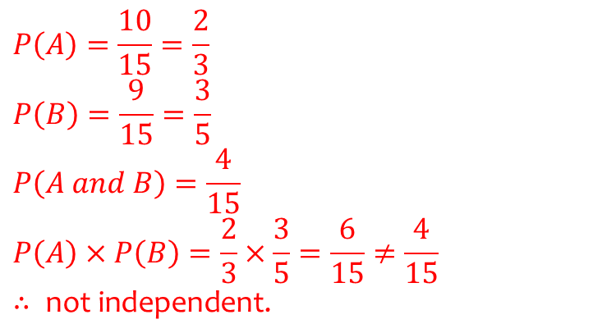
Worked example
Your turn
The Venn diagram shows the number of people who like each of two different books. Determine if $A$ and $B$ are independent.
The Venn diagram shows the number of people who like each of two different colours. Determine if $A$ and $B$ are independent.
$$P\left(A\right)=\frac{10}{15}=\frac{2}{3}$$
$$P\left(B\right)=\frac{9}{15}=\frac{3}{5}$$
$$P\left(A and B\right)=\frac{4}{15} \\ P\left(A\right)×P\left(B\right)=\frac{2}{3}×\frac{3}{5}=\frac{6}{15}≠\frac{4}{15} ∴ \text{not} \text{independent}\text{.}$$
Diagrams/Graphs used with permission from DrFrostMaths: https://www.drfrostmaths.com/

Slide 5
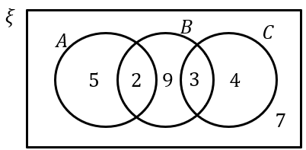
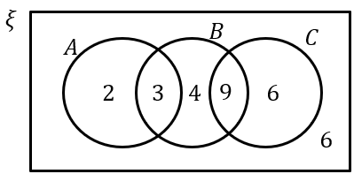
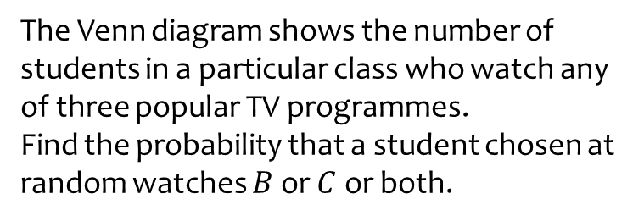
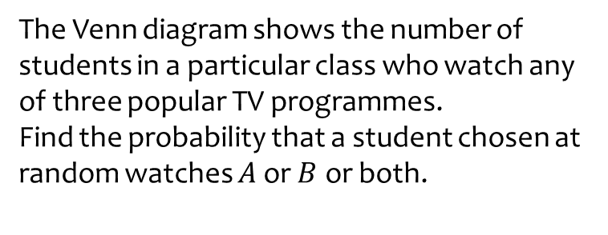
Worked example
Your turn
The Venn diagram shows the number of students in a particular class who watch any of three popular TV programmes.
Find the probability that a student chosen at random watches $A$ or $B$ or both.
The Venn diagram shows the number of students in a particular class who watch any of three popular TV programmes.
Find the probability that a student chosen at random watches $B$ or $C$ or both.
$$\frac{26}{30}=\frac{13}{15}$$
Diagrams/Graphs used with permission from DrFrostMaths: https://www.drfrostmaths.com/

Slide 6
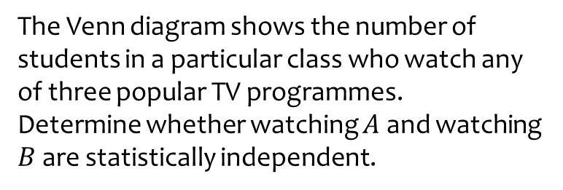
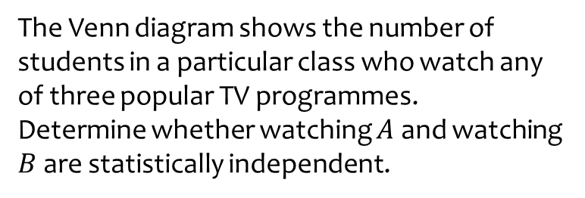
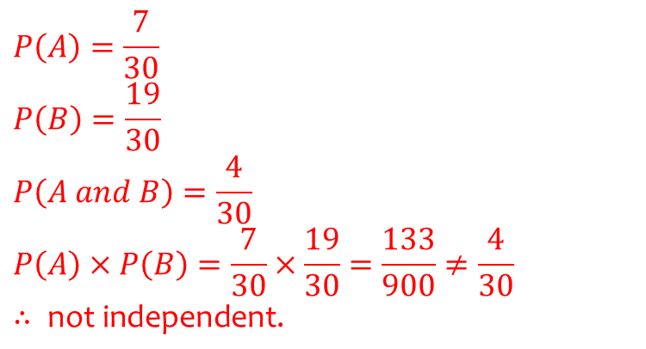
Worked example
Your turn
The Venn diagram shows the number of students in a particular class who watch any of three popular TV programmes.
Determine whether watching $A$ and watching $B$ are statistically independent.
The Venn diagram shows the number of students in a particular class who watch any of three popular TV programmes.
Determine whether watching $A$ and watching $B$ are statistically independent.
$$P\left(A\right)=\frac{7}{30}$$
$$P\left(B\right)=\frac{19}{30} \\ P\left(A and B\right)=\frac{4}{30} \\ P\left(A\right)×P\left(B\right)=\frac{7}{30}×\frac{19}{30}=\frac{133}{900}≠\frac{4}{30} \\ ∴ \text{not} \text{independent}\text{.}$$
Diagrams/Graphs used with permission from DrFrostMaths: https://www.drfrostmaths.com/

Slide 7
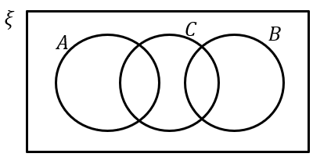
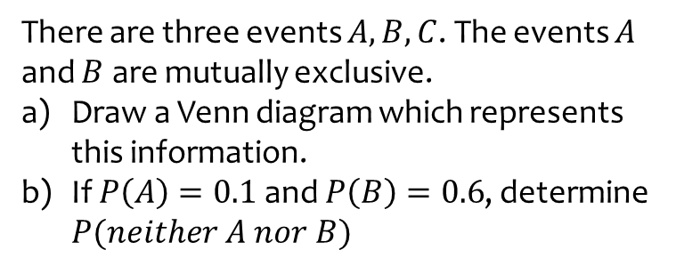
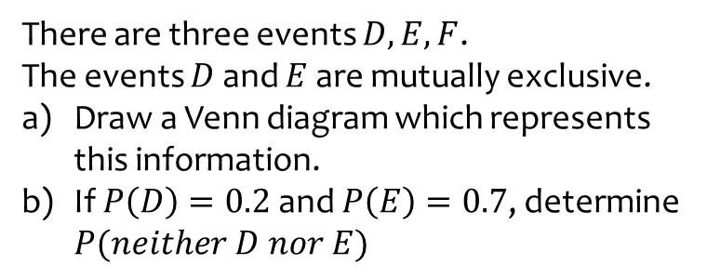
Worked example
Your turn
There are three events $D,E,F$.
The events $D$ and $E$ are mutually exclusive.
Draw a Venn diagram which represents this information.
If $P\left(D\right)=0.2$ and $P\left(E\right)=0.7$, determine $P(neither D nor E)$
There are three events $A,B,C$. The events $A$ and $B$ are mutually exclusive.
Draw a Venn diagram which represents this information.
If $P\left(A\right)=0.1$ and $P\left(B\right)=0.6$, determine $P(neither A nor B)$
a)
b) $0.3$
Diagrams/Graphs used with permission from DrFrostMaths: https://www.drfrostmaths.com/

Slide 8
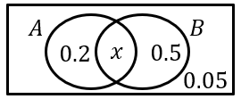
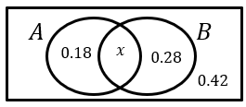
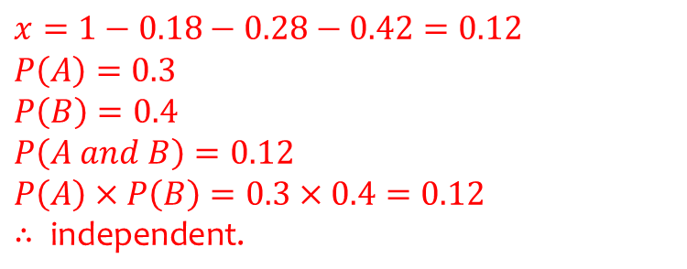
Worked example
Your turn
Determine if events A and B are independent.
Determine if events A and B are independent.
$$x=1−0.18−0.28−0.42=0.12$$
$$P\left(A\right)=0.3$$
$$P\left(B\right)=0.4 \\ P\left(A and B\right)=0.12 \\ P\left(A\right)×P\left(B\right)=0.3×0.4=0.12 \\ ∴ \text{independent}\text{.}$$
Diagrams/Graphs used with permission from DrFrostMaths: https://www.drfrostmaths.com/

Slide 9
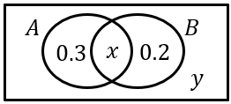
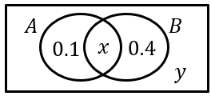
Worked example
Your turn
Given that $A$ and $B$ are independent, determine the possible values for $x$ and $y$
Given that $A$ and $B$ are independent, determine the possible values of $x$
$$x=0.3, y=0.2$$
$$x=0.2, y=0.3$$
Diagrams/Graphs used with permission from DrFrostMaths: https://www.drfrostmaths.com/

