Slide 1
Worked example
Your turn
A particle of mass 4kg is sliding down a rough slope that is inclined at $60°$ to the horizontal.
Given that the acceleration of the particle is 2 $ms^{−2}$, find the coefficient of friction $μ$ between the particle and the slope.
A particle of mass 2kg is sliding down a rough slope that is inclined at $30°$ to the horizontal.
Given that the acceleration of the particle is 1 $ms^{−2}$, find the coefficient of friction $μ$ between the particle and the slope.
$0.46$ (2 sf)

Slide 2
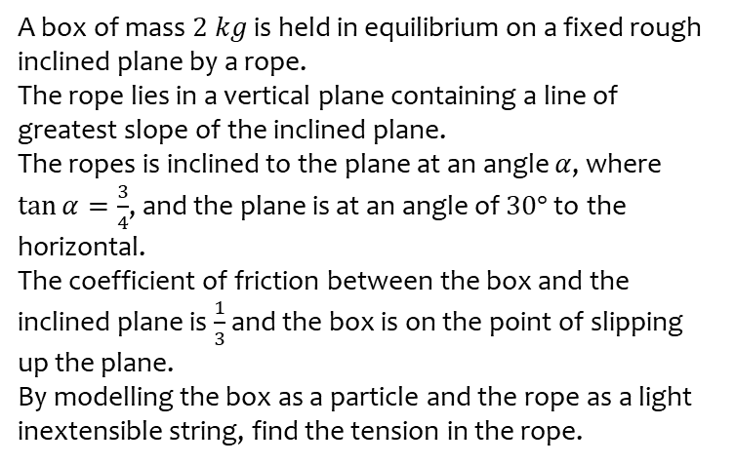
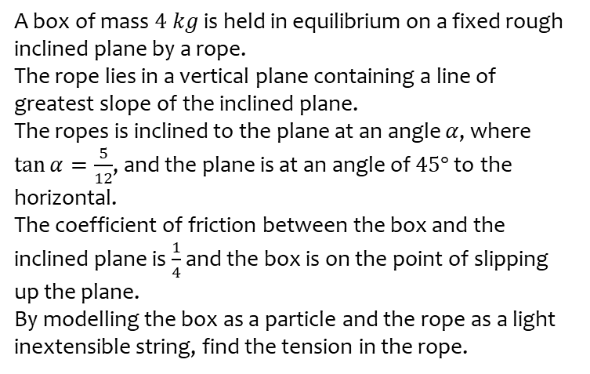
Worked example
Your turn
A box of mass $4 kg$ is held in equilibrium on a fixed rough inclined plane by a rope.
The rope lies in a vertical plane containing a line of greatest slope of the inclined plane.
The ropes is inclined to the plane at an angle $α$, where $\tan{α}=\frac{5}{12}$, and the plane is at an angle of $45°$ to the horizontal.
The coefficient of friction between the box and the inclined plane is $\frac{1}{4}$ and the box is on the point of slipping up the plane.
By modelling the box as a particle and the rope as a light inextensible string, find the tension in the rope.
A box of mass $2 kg$ is held in equilibrium on a fixed rough inclined plane by a rope.
The rope lies in a vertical plane containing a line of greatest slope of the inclined plane.
The ropes is inclined to the plane at an angle $α$, where $\tan{α}=\frac{3}{4}$, and the plane is at an angle of $30°$ to the horizontal.
The coefficient of friction between the box and the inclined plane is $\frac{1}{3}$ and the box is on the point of slipping up the plane.
By modelling the box as a particle and the rope as a light inextensible string, find the tension in the rope.
$15 N$ (2 sf)

