Slide 1
5.2) Arc length

Slide 2
Worked example
Your turn
Find the length of the arc of a circle of radius 5.2 cm, given that the arc subtends an angle of 0.4 radians at the centre of the circle.
Find the length of the arc of a circle of radius 10.4 cm, given that the arc subtends an angle of 0.2 radians at the centre of the circle.
Find the length of the arc of a circle of radius 5.2 cm, given that the arc subtends an angle of 0.8 radians at the centre of the circle.
$$4.16 cm$$

Slide 3
Worked example
Your turn
An arc $AB$ of a circle with radius 0.35 cm and centre $O$ has a length of 2.45 cm. Find the angle $∠AOB$ subtended by the arc at the centre of the circle
An arc $AB$ of a circle with radius 0.7 cm and centre $O$ has a length of 4.9 cm. Find the angle $∠AOB$ subtended by the arc at the centre of the circle
An arc $AB$ of a circle with radius 7 cm and centre $O$ has a length of 2.45 cm. Find the angle $∠AOB$ subtended by the arc at the centre of the circle
$$0.35 rad$$

Slide 4
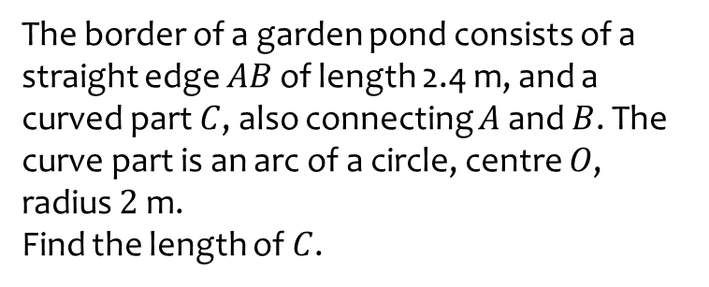
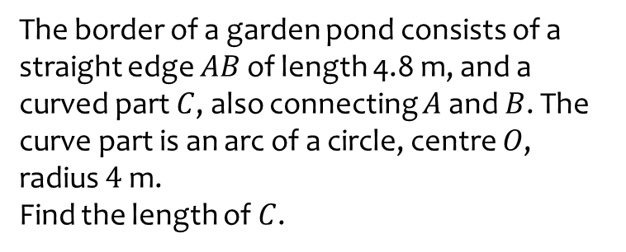
Worked example
Your turn
The border of a garden pond consists of a straight edge $AB$ of length 4.8 m, and a curved part $C$, also connecting $A$ and $B$. The curve part is an arc of a circle, centre $O$, radius $4$ m.
Find the length of $C$.
The border of a garden pond consists of a straight edge $AB$ of length 2.4 m, and a curved part $C$, also connecting $A$ and $B$. The curve part is an arc of a circle, centre $O$, radius $2$ m.
Find the length of $C$.
$9.99$m

Slide 5
Worked example
Your turn
A triangle $ABC$ is such that $AB=4 cm$, $AC=5.5 cm$ and $∠BAC=0.35$ radians.
The arc $BD$, where $D$ lies on $AC$, is an arc of a circle with centre $A$ and radius 4 cm.
A region $R$, is bounded by the straight lines $BC$ and $CD$ and the arc $BD$.
Find the perimeter of $R$
A triangle $ABC$ is such that $AB=8 cm$, $AC=11 cm$ and $∠BAC=0.7$ radians.
The arc $BD$, where $D$ lies on $AC$, is an arc of a circle with centre $A$ and radius 8 cm.
A region $R$, is bounded by the straight lines $BC$ and $CD$ and the arc $BD$.
Find the perimeter of $R$
$15.7 cm$ (3 sf)

Slide 6
Worked example
Your turn
A sector of a circle of radius $30$ cm contains an angle of $θ$ radians. Given that the perimeter of the sector is $84$ cm, find the value of $θ$
A sector of a circle of radius $15$ cm contains an angle of $θ$ radians. Given that the perimeter of the sector is $42$ cm, find the value of $θ$
$θ=0.8$rad

Slide 7
Worked example
Your turn
The perimeter of a sector OAB is four times the length of the arc AB. Find the size of angle AOB
The perimeter of a sector OAB is four times the length of the arc AB. Find the size of angle AOB
$θ=2$rad

