Slide 1
Worked example
Your turn
Determine the gradient and $y$-intercept of the line with equation $3x+5y−4=0$
Determine the gradient and $y$-intercept of the line with equation $4x−3y+5=0$
Gradient $=\frac{4}{3}$
$y$-intercept $=\frac{5}{3}$

Slide 2
Worked example
Your turn
Express in the form $ax+by+c=0$:
$$y=5x−2$$
$$y=−2x+5$$
Express $y=4x+3$ in the form
$$ax+by+c=0$$
$$4x−y+3=0$$

Slide 3
Worked example
Your turn
Express $y=\frac{2}{5}x−\frac{3}{5}$ in the form
$ax+by+c=0$, where $a,b,c$ are integers.
Express $y=\frac{1}{3}x−\frac{2}{3}$ in the form
$ax+by+c=0$, where $a,b,c$ are integers.
$$x−3y−2=0$$

Slide 4
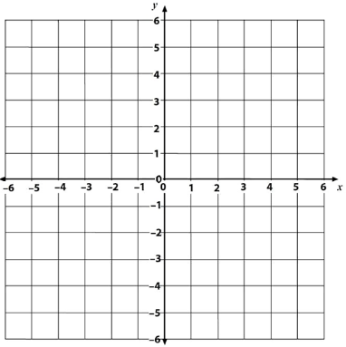
Worked example
Your turn
Gradient: $m=$
$y$-intercept: $c=$
$$y=mx+c →$$
Gradient: $m=$
$y$-intercept: $c=$
$$y=mx+c →$$
$1$
$−1$
$y=x−1$

Slide 5
Worked example
Your turn
Gradient: $m=$
$y$-intercept: $c=$
$$y=mx+c →$$
Gradient: $m=$
$y$-intercept: $c=$
$$y=mx+c →$$
$−2$
$2$
$y=−2x+1$

Slide 6
Worked example
Your turn
Gradient: $m=$
$y$-intercept: $c=$
$$y=mx+c →$$
Gradient: $m=$
$y$-intercept: $c=$
$$y=mx+c →$$
$\frac{3}{4}$
$2$
$y=\frac{3}{4}x+2$

Slide 7
Worked example
Your turn
Gradient: $m=$
$y$-intercept: $c=$
$$y=mx+c →$$
Gradient: $m=$
$y$-intercept: $c=$
$$y=mx+c →$$
$−\frac{3}{4}$
$2$
$y=−\frac{3}{4}x+2$

