Slide 1
5.2) Venn diagrams

Slide 2
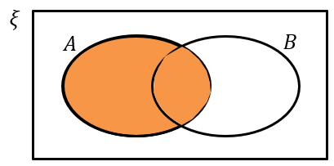
Worked example
Your turn
Draw a Venn diagram for two events $C$ and $D$.
Shade the region represented by:
$$D$$
Draw a Venn diagram for two events $A$ and $B$.
Shade the Venn diagram the region represented by:
$$A$$
Diagrams/Graphs used with permission from DrFrostMaths: https://www.drfrostmaths.com/

Slide 3
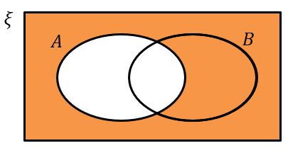
Worked example
Your turn
Draw a Venn diagram for two events $C$ and $D$.
Shade the region represented by:
Not $D$
Draw a Venn diagram for two events $A$ and $B$.
Shade the Venn diagram the region represented by:
Not $A$
Diagrams/Graphs used with permission from DrFrostMaths: https://www.drfrostmaths.com/

Slide 4
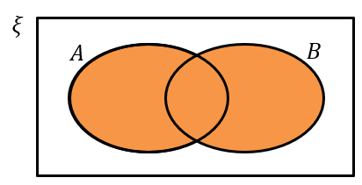
Worked example
Your turn
Draw a Venn diagram for two events $C$ and $D$.
Shade the region represented by:
$C$ or $D$
Draw a Venn diagram for two events $A$ and $B$.
Shade the Venn diagram the region represented by:
$A$ or $B$
Diagrams/Graphs used with permission from DrFrostMaths: https://www.drfrostmaths.com/

Slide 5
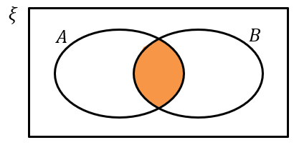
Worked example
Your turn
Draw a Venn diagram for two events $C$ and $D$.
Shade the region represented by:
$C$ and $D$
Draw a Venn diagram for two events $A$ and $B$.
Shade the Venn diagram the region represented by:
$A$ and $B$
Diagrams/Graphs used with permission from DrFrostMaths: https://www.drfrostmaths.com/

Slide 6
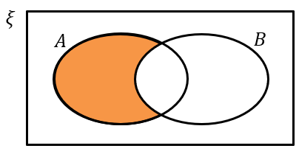
Worked example
Your turn
Draw a Venn diagram for two events $C$ and $D$.
Shade the region represented by:
$D$ and not $C$
Draw a Venn diagram for two events $A$ and $B$.
Shade the Venn diagram the region represented by:
$A$ and not $B$
Diagrams/Graphs used with permission from DrFrostMaths: https://www.drfrostmaths.com/

Slide 7
Worked example
Your turn
In a class of 30 students, 6 play the piano, 11 play the guitar and 3 play both instruments. A student is chosen at random from the class. Find the probability that the student:
Does not play the piano
Does not play the piano or the guitar
In a class of 30 students, 7 are in the choir, 5 are in the school band and 2 are in the choir and the band. A student is chosen at random from the class. Find the probability that the student:
Is not in the band
Is not in the choir or the band
a) $\frac{5}{6}$
b) $\frac{2}{3}$

Slide 8
Worked example
Your turn
In a class of 30 students, 6 play the piano only, 11 play the guitar only and 3 play neither instrument. A student is chosen at random from the class.
Find the probability that the student plays both instruments.
In a class of 30 students, 7 are in the choir only, 5 are in the school band only and 2 are in neither group. A student is chosen at random from the class. Find the probability that the student is in both groups.
$$\frac{16}{30}=\frac{8}{15}$$

Slide 9
Worked example
Your turn
In a class of 30 students, 6 play the piano, 11 play the guitar and 16 play neither instrument. A student is chosen at random from the class.
Find the probability that the student plays both instruments.
In a class of 30 students, 7 are in the choir, 5 are in the school band and 21 are in neither group. A student is chosen at random from the class. Find the probability that the student is in both groups.
$$\frac{3}{30}=\frac{1}{10}$$

Slide 10
Worked example
Your turn
Given that $P\left(D\right)=0.7$ and $P\left(C or D\right)=0.95$, find the probability of:
$P(C and not D)$
$P\left(neither C nor D\right)$
Given that $P\left(A\right)=0.6$ and $P\left(A or B\right)=0.85$, find the probability of:
$P(A and not B)$
$P\left(neither A nor B\right)$
a) $0.25$
b) $0.15$

Slide 11
Worked example
Your turn
The probability of a person having read book A is $0.46$.
The probability that they have read book B is $0.18$.
The probability that they have read book A or B or both is $0.51$.
A person is chosen at random.
Find the probability that the person has
a) Read both book A and book B
b) Read book B but not book A
c) Read neither book
The probability of a person having read book A is $0.37$.
The probability that they have read book B is $0.25$.
The probability that they have read book A or B or both is $0.54$.
A person is chosen at random.
Find the probability that the person has
a) Read both book A and book B
b) Read book A but not book B
c) Read neither book
a) $0.16$
b) $0.21$
c) $0.46$

Slide 12
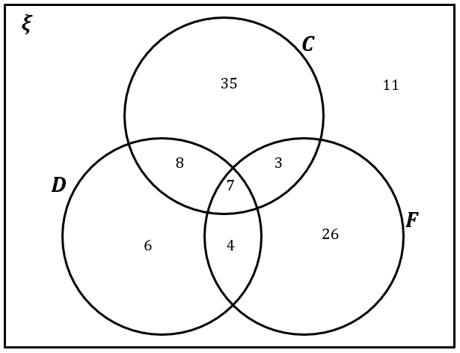
Worked example
Your turn
A gym owner surveys 100 of their clients. They find that 65 run, 40 run and swim, 35 run and cycle, 48 swim, 30 swim and cycle, 25 do all three types of exercise and 60 cycle.
Draw a Venn Diagram to represent this data.
A vet surveys 100 of their clients. They find that
25 own dogs, 15 own dogs and cats, 11 own dogs and tropical fish, 53 own cats, 10 own cats and tropical fish, 7 own dogs, cats and tropical fish, 40 own tropical fish.
Draw a Venn Diagram to represent this data.
Diagrams/Graphs used with permission from DrFrostMaths: https://www.drfrostmaths.com/

Slide 13
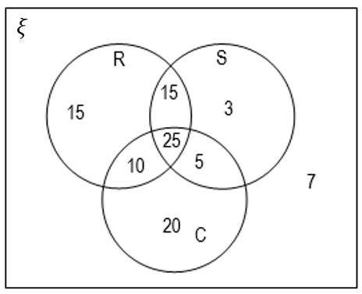
Worked example
Your turn
A gym owner surveys 100 of their clients.
A client is chosen at random.
Find the probability that the client:
a) Cycles only
b) Does not swim
c) Does not do any of these three exercises
d) Runs and swims but does not cycle.
A gym owner surveys 100 of their clients.
A client is chosen at random.
Find the probability that the client:
a) Owns dogs only
b) Does not own fish
c) Does not own dogs, cats or fish
d) Owns fish and cats but not dogs
$\frac{6}{100}=\frac{3}{50}=0.06$
$\frac{60}{100}=\frac{3}{5}=0.6$
$\frac{11}{100}=0.11$
$\frac{10}{100}=\frac{1}{10}=0.1$
Diagrams/Graphs used with permission from DrFrostMaths: https://www.drfrostmaths.com/

Slide 14
Worked example
Your turn
A gym owner surveys 100 of their clients.
A client is chosen at random.
Find the probability that the client:
Does exactly one of the exercises
Does at least two of the exercises
A gym owner surveys 100 of their clients.
A client is chosen at random.
Find the probability that the client:
a) Owns exactly one type of pet.
b) Owns at least two of the types of pet.
$\frac{67}{100}=0.67$
$\frac{22}{100}=\frac{11}{50}=0.22$
Diagrams/Graphs used with permission from DrFrostMaths: https://www.drfrostmaths.com/

Slide 15
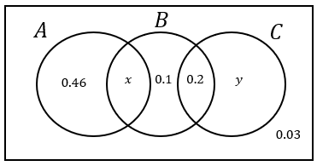
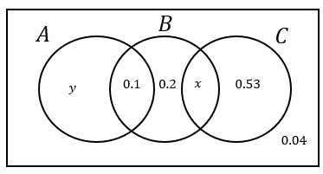
Worked example
Your turn
The Venn diagram shows the probabilities of group members taking part in activities A, B and C.
Given that $P\left(B\right)=0.39$, find $P(C)$
The Venn diagram shows the probabilities of group members taking part in activities A, B and C.
Given that $P\left(B\right)=0.35$, find $P(A)$
$$0.18$$
Diagrams/Graphs used with permission from DrFrostMaths: https://www.drfrostmaths.com/

Slide 16
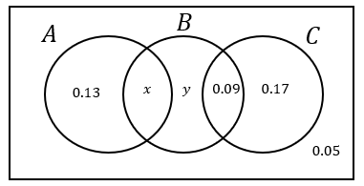
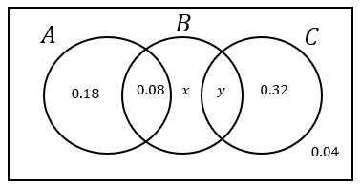
Worked example
Your turn
The Venn diagram shows the probabilities of group members taking part in activities A, B and C.
Given that $P\left(A\right)=P(B)$, find the values of $x$ and $y$
The Venn diagram shows the probabilities of group members taking part in activities A, B and C.
Given that $P\left(B\right)=P(C)$, find the values of $x$ and $y$
$$x=0.24 , y=0.14$$
Diagrams/Graphs used with permission from DrFrostMaths: https://www.drfrostmaths.com/

