Slide 1
Worked example
Your turn
Find the exact values, without a calculator:
$$\cos\left(\frac{7π}{6}\right)$$
$$\sin\left(−\frac{4π}{3}\right)$$
Find the exact values, without a calculator:
$$\cos\left(\frac{4π}{3}\right)$$
$$\sin\left(−\frac{7π}{6}\right)$$
$$−\frac{1}{2}$$
$$\frac{1}{2}$$

Slide 2
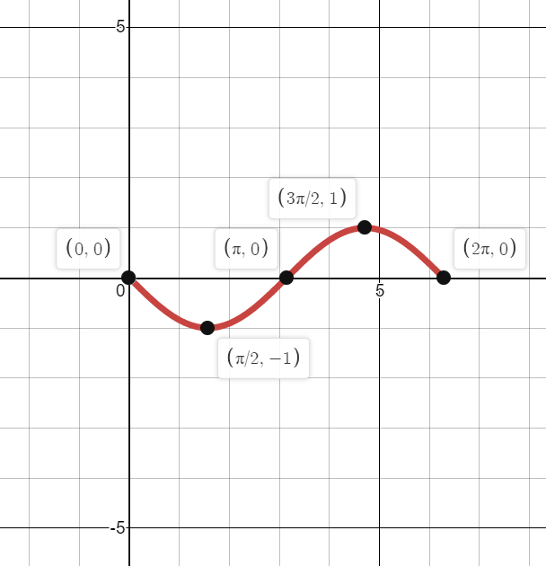

Worked example
Your turn
Sketch the graph for $0≤x≤2π$ of:
$$y=\sin{(x+\frac{π}{4})}$$
$$y=\tan\left(x−\frac{π}{3}\right)$$
Sketch the graph for $0≤x≤2π$ of:
$$y=\cos\left(x+\frac{π}{2}\right)$$
Graphs used with permission from DESMOS: https://www.desmos.com/

Slide 3
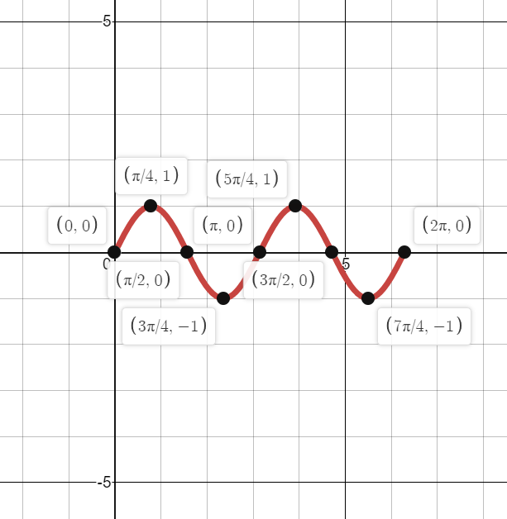

Worked example
Your turn
Sketch the graph for $0≤x≤2π$ of:
$$y=\cos{(4x)}$$
$$y=\tan\left(3x\right)$$
Sketch the graph for $0≤x≤2π$ of:
$$y=\sin\left(2x\right)$$
Graphs used with permission from DESMOS: https://www.desmos.com/

