Slide 1
5.2) Successive oblique impacts

Slide 2
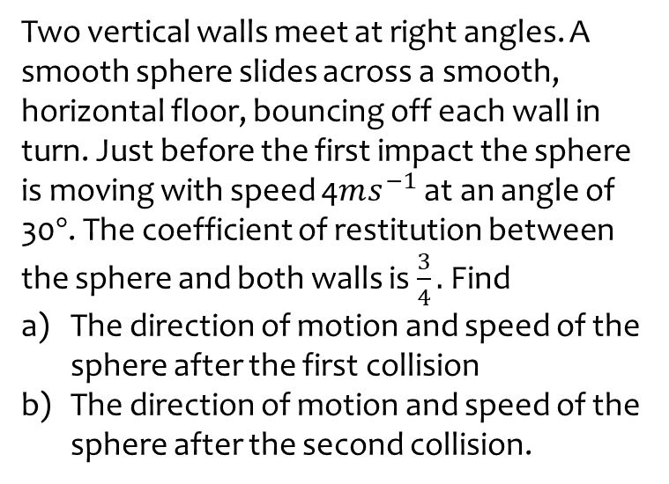
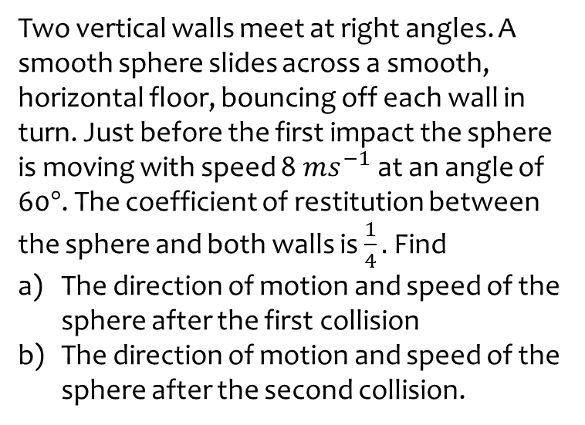
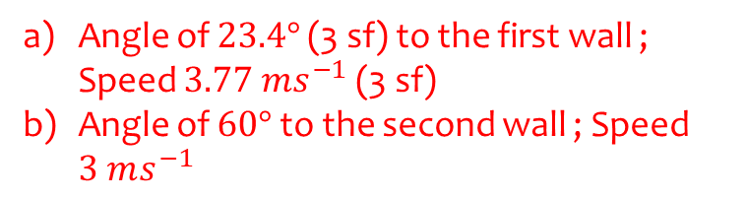
Worked example
Your turn
Two vertical walls meet at right angles. A smooth sphere slides across a smooth, horizontal floor, bouncing off each wall in turn. Just before the first impact the sphere is moving with speed 8$ms^{−1}$ at an angle of 60$°$. The coefficient of restitution between the sphere and both walls is $\frac{1}{4}.$ Find
The direction of motion and speed of the sphere after the first collision
The direction of motion and speed of the sphere after the second collision.
Two vertical walls meet at right angles. A smooth sphere slides across a smooth, horizontal floor, bouncing off each wall in turn. Just before the first impact the sphere is moving with speed 4$ms^{−1}$ at an angle of 30$°$. The coefficient of restitution between the sphere and both walls is $\frac{3}{4}.$ Find
The direction of motion and speed of the sphere after the first collision
The direction of motion and speed of the sphere after the second collision.
Angle of $23.4°$ (3 sf) to the first wall ; Speed $3.77 ms^{−1}$ (3 sf)
Angle of $60°$ to the second wall ; Speed $3 ms^{−1}$

Slide 3
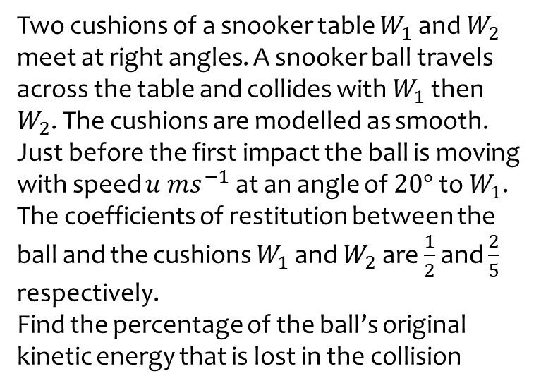
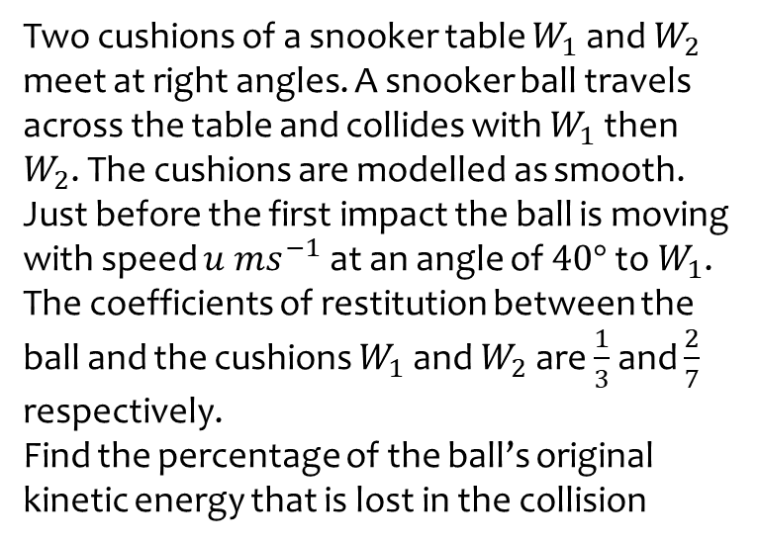
Worked example
Your turn
Two cushions of a snooker table $W_{1}$ and $W_{2}$ meet at right angles. A snooker ball travels across the table and collides with $W_{1}$ then $W_{2}$. The cushions are modelled as smooth. Just before the first impact the ball is moving with speed $u ms^{−1}$ at an angle of $40°$ to $W_{1}$. The coefficients of restitution between the ball and the cushions $W_{1}$ and $W_{2}$ are $\frac{1}{3}$ and $\frac{2}{7}$ respectively.
Find the percentage of the ball’s original kinetic energy that is lost in the collision
Two cushions of a snooker table $W_{1}$ and $W_{2}$ meet at right angles. A snooker ball travels across the table and collides with $W_{1}$ then $W_{2}$. The cushions are modelled as smooth. Just before the first impact the ball is moving with speed $u ms^{−1}$ at an angle of $20°$ to $W_{1}$. The coefficients of restitution between the ball and the cushions $W_{1}$ and $W_{2}$ are $\frac{1}{2}$ and $\frac{2}{5}$ respectively.
Find the percentage of the ball’s original kinetic energy that is lost in the collision
$$83\%$$

Slide 4
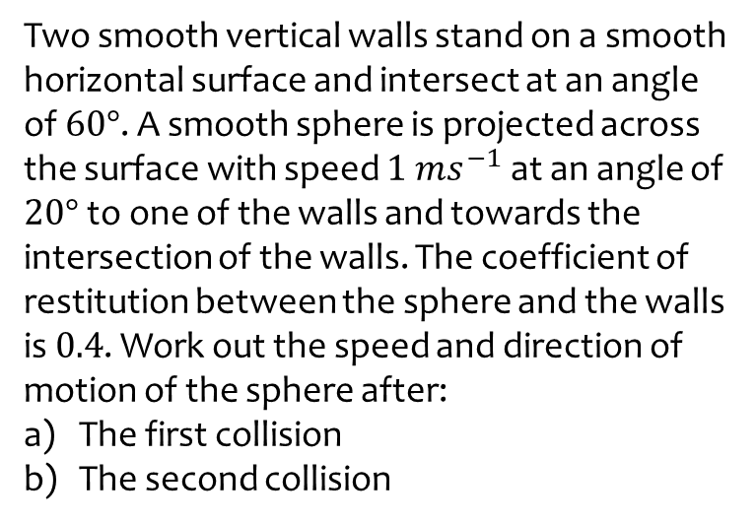
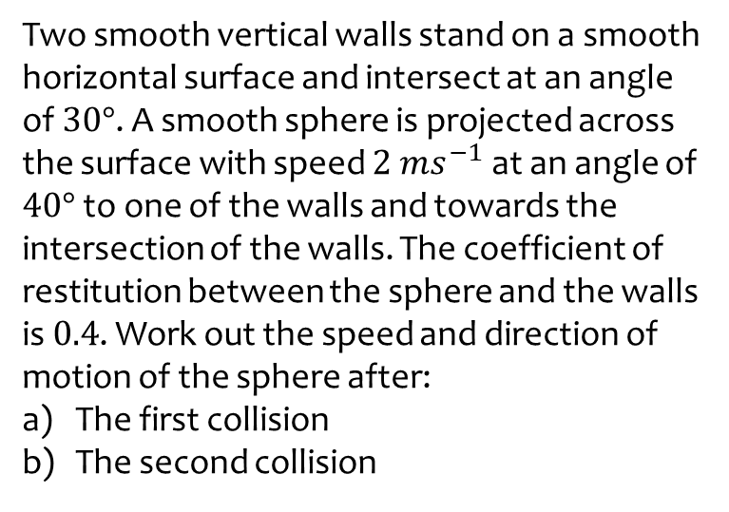
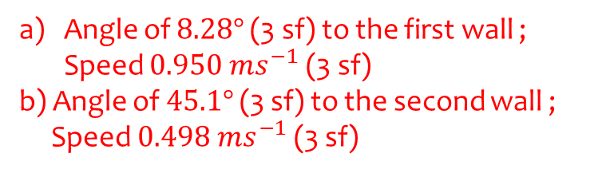
Worked example
Your turn
Two smooth vertical walls stand on a smooth horizontal surface and intersect at an angle of $30°$. A smooth sphere is projected across the surface with speed $2 ms^{−1}$ at an angle of $40°$ to one of the walls and towards the intersection of the walls. The coefficient of restitution between the sphere and the walls is $0.4$. Work out the speed and direction of motion of the sphere after:
The first collision
The second collision
Two smooth vertical walls stand on a smooth horizontal surface and intersect at an angle of $60°$. A smooth sphere is projected across the surface with speed $1 ms^{−1}$ at an angle of $20°$ to one of the walls and towards the intersection of the walls. The coefficient of restitution between the sphere and the walls is $0.4$. Work out the speed and direction of motion of the sphere after:
The first collision
The second collision
Angle of $8.28°$ (3 sf) to the first wall ; Speed $0.950 ms^{−1}$ (3 sf)
b) Angle of $45.1°$ (3 sf) to the second wall ;
Speed $0.498 ms^{−1}$ (3 sf)

Slide 5
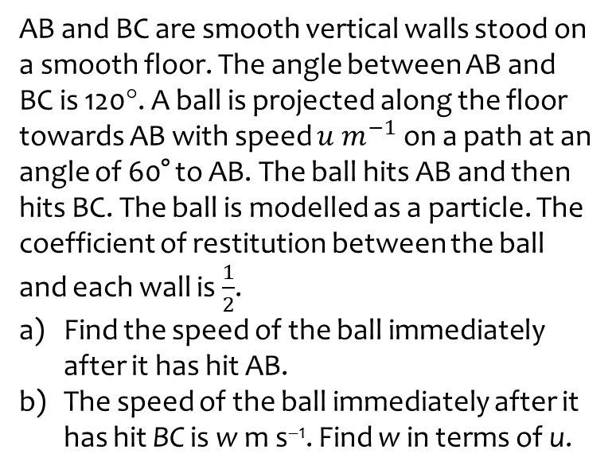
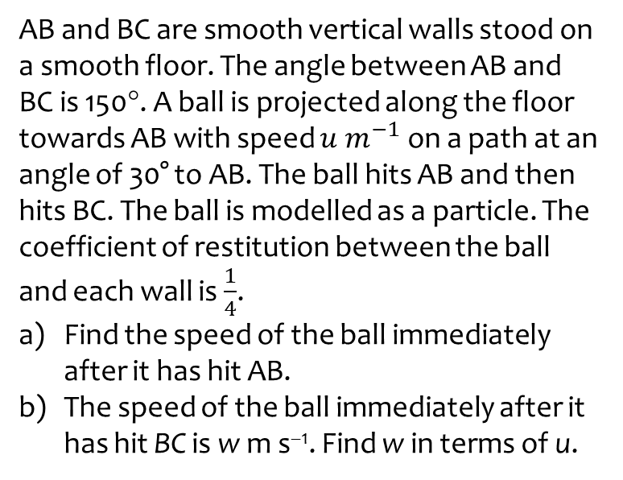
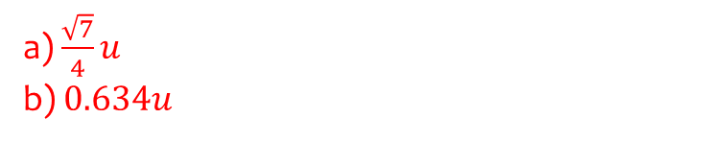
Worked example
Your turn
AB and BC are smooth vertical walls stood on a smooth floor. The angle between AB and BC is 150°. A ball is projected along the floor towards AB with speed $u m^{−1}$ on a path at an angle of 30° to AB. The ball hits AB and then hits BC. The ball is modelled as a particle. The coefficient of restitution between the ball and each wall is $\frac{1}{4}$.
Find the speed of the ball immediately after it has hit AB.
The speed of the ball immediately after it has hit BC is w m s^{–1}. Find w in terms of u.
AB and BC are smooth vertical walls stood on a smooth floor. The angle between AB and BC is 120°. A ball is projected along the floor towards AB with speed $u m^{−1}$ on a path at an angle of 60° to AB. The ball hits AB and then hits BC. The ball is modelled as a particle. The coefficient of restitution between the ball and each wall is $\frac{1}{2}$.
Find the speed of the ball immediately after it has hit AB.
The speed of the ball immediately after it has hit BC is w m s^{–1}. Find w in terms of u.
a) $\frac{\sqrt{7}}{4}u$
b) $0.634u$

Slide 6
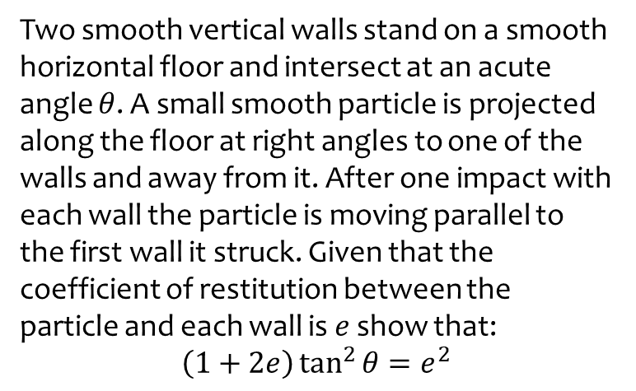
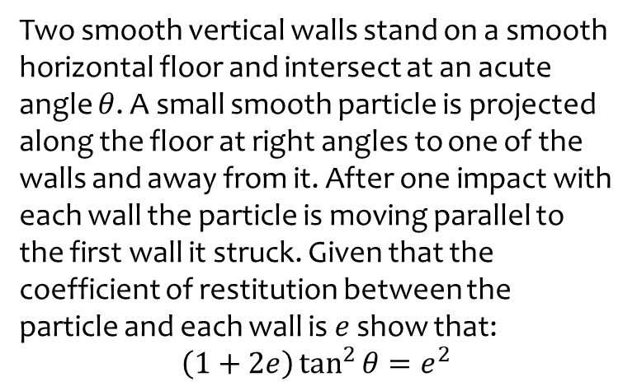
Worked example
Your turn
Two smooth vertical walls stand on a smooth horizontal floor and intersect at an acute angle $θ$. A small smooth particle is projected along the floor at right angles to one of the walls and away from it. After one impact with each wall the particle is moving parallel to the first wall it struck. Given that the coefficient of restitution between the particle and each wall is $e$ show that:
$$\left(1+2e\right)\tan^{2}{θ=e^{2}}$$
Two smooth vertical walls stand on a smooth horizontal floor and intersect at an acute angle $θ$. A small smooth particle is projected along the floor at right angles to one of the walls and away from it. After one impact with each wall the particle is moving parallel to the first wall it struck. Given that the coefficient of restitution between the particle and each wall is $e$ show that:
$$\left(1+2e\right)\tan^{2}{θ=e^{2}}$$
Shown

