Slide 1
5.2) Inclined planes

Slide 2
Worked example
Your turn
A block of mass 15kg slides down a smooth slope angled at $10°$ to the horizontal.
Calculate the magnitude of the normal reaction of the slope on the block.
Find the acceleration of the block.
A block of mass 10kg slides down a smooth slope angled at $15°$ to the horizontal.
Calculate the magnitude of the normal reaction of the slope on the block.
Find the acceleration of the block.
a) $95 N$ (2 sf)
b) $2.5 ms^{−2}$ (2 sf)

Slide 3
Worked example
Your turn
A particle of mass $m$ is pushed up a smooth slope, inclined at $60°$ by a force of magnitude $10g$ N acting at angle of $30°$ to the slope, causing the particle to accelerate up the slope at 0.25 $ms^{−2}$.
Show that the mass of the particle is $\left(\frac{20\sqrt{3}g}{1+2\sqrt{3}g}\right)$ kg
A particle of mass $m$ is pushed up a smooth slope, inclined at $30°$ by a force of magnitude $5g$ N acting at angle of $60°$ to the slope, causing the particle to accelerate up the slope at 0.5 $ms^{−2}$.
Show that the mass of the particle is $\left(\frac{5g}{1+g}\right)$ kg
Shown

Slide 4
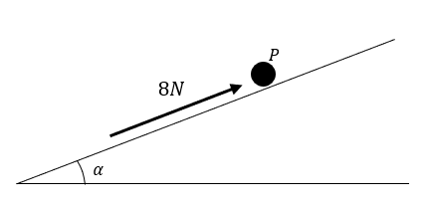
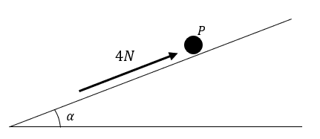
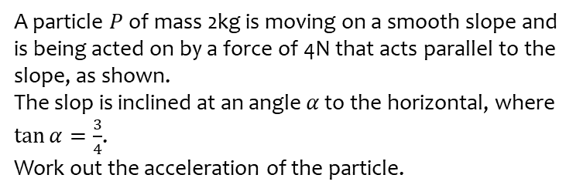
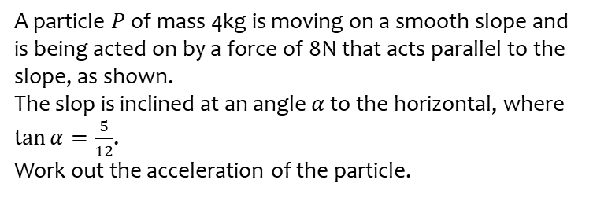
Worked example
Your turn
A particle $P$ of mass 4kg is moving on a smooth slope and is being acted on by a force of 8N that acts parallel to the slope, as shown.
The slop is inclined at an angle $α$ to the horizontal, where $\tan{α}=\frac{5}{12}$.
Work out the acceleration of the particle.
A particle $P$ of mass 2kg is moving on a smooth slope and is being acted on by a force of 4N that acts parallel to the slope, as shown.
The slop is inclined at an angle $α$ to the horizontal, where $\tan{α}=\frac{3}{4}$.
Work out the acceleration of the particle.
$3.9 ms^{−2}$ down the slope
Diagrams/Graphs used with permission from DrFrostMaths: https://www.drfrostmaths.com/

