Slide 1
5.1) Calculating probabilities

Slide 2
Worked example
Your turn
Two fair spinners each have five sectors numbered 1 to 5. The two spinners are spun together and the sum of the numbers indicated on each spinner is recorded.
Find the probability of the spinners indicating a sum of:
exactly 6
more than 6
Two fair spinners each have four sectors numbered 1 to 4. The two spinners are spun together and the sum of the numbers indicated on each spinner is recorded.
Find the probability of the spinners indicating a sum of:
exactly 5
more than 5
a) $\frac{1}{4}$
b) $\frac{3}{8}$

Slide 3
Worked example
Your turn
The table shows the times taken, in minutes, for a group of students to complete a number puzzle.
A student is chosen at random. Find the probability that they completed the number puzzle in:
under 12 minutes
over 9.5 minutes.
The table shows the times taken, in minutes, for a group of students to complete a number puzzle.
A student is chosen at random. Find the probability that they completed the number puzzle in:
under 9 minutes
over 10.5 minutes.
a) $\frac{19}{40}$
b) $\frac{3}{10}$

Slide 4
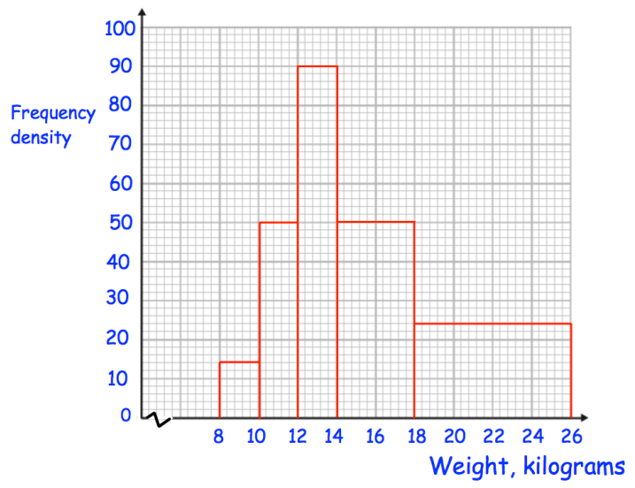
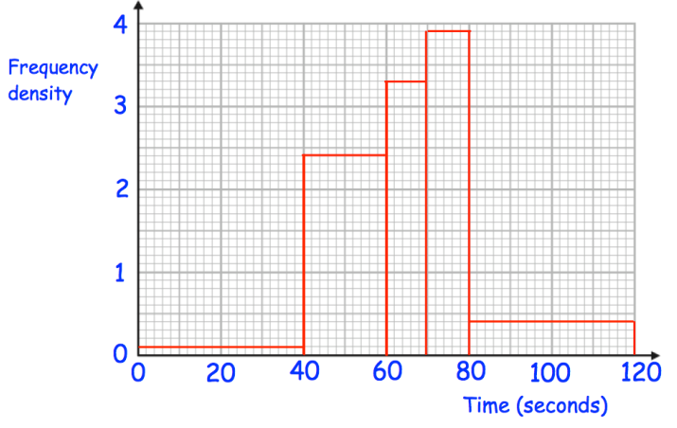
Worked example
Your turn
A participant is chosen at random.
What is the probability they took longer than 60 seconds?
A participant is chosen at random.
What is the probability they weigh more than $14 kg$?
$\frac{14}{25}=0.56$
Questions used with permission from Corbettmaths: https://corbettmaths.com/

