Slide 1
5.1) Oblique impact with a fixed surface

Slide 2
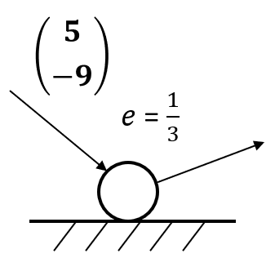
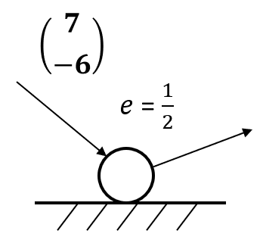
Worked example
Your turn
A smooth sphere hits a smooth horizontal plane. Find the velocity after the collision.
A smooth sphere hits a smooth horizontal plane. Find the velocity after the collision.
$$\left({7 \atop 3}\right)$$
Diagrams used with permission from DrFrostMaths: https://www.drfrostmaths.com/

Slide 3
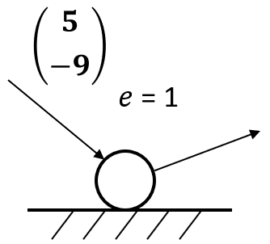
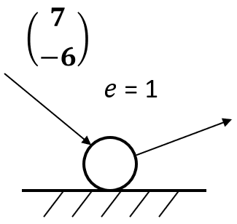
Worked example
Your turn
A smooth sphere hits a smooth horizontal plane. Find the velocity after the collision.
A smooth sphere hits a smooth horizontal plane. Find the velocity after the collision.
$$\left({7 \atop 6}\right)$$
Diagrams used with permission from DrFrostMaths: https://www.drfrostmaths.com/

Slide 4
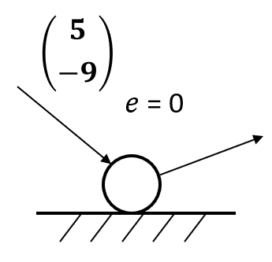
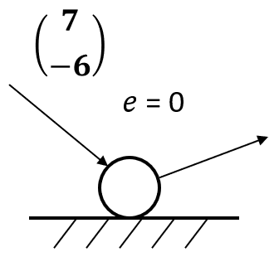
Worked example
Your turn
A smooth sphere hits a smooth horizontal plane. Find the velocity after the collision.
A smooth sphere hits a smooth horizontal plane. Find the velocity after the collision.
$$\left({7 \atop 0}\right)$$
Diagrams used with permission from DrFrostMaths: https://www.drfrostmaths.com/

Slide 5
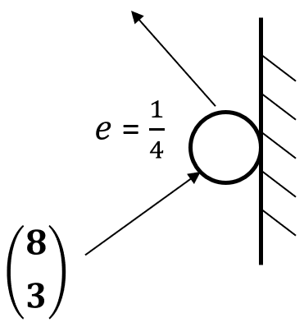
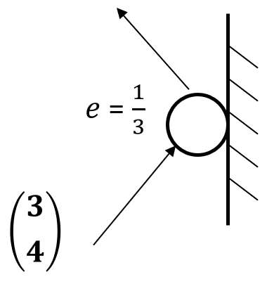
Worked example
Your turn
A smooth sphere hits a smooth vertical plane. Find the velocity after the collision.
A smooth sphere hits a smooth horizontal plane. Find the velocity after the collision.
$$\left({−1 \atop 3}\right)$$
Diagrams used with permission from DrFrostMaths: https://www.drfrostmaths.com/

Slide 6
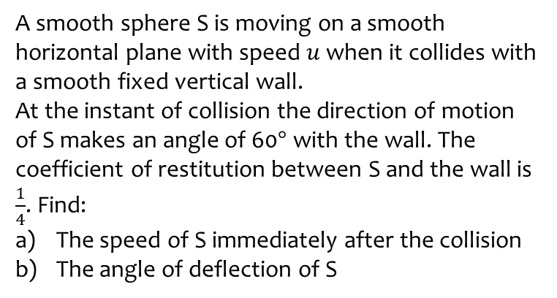
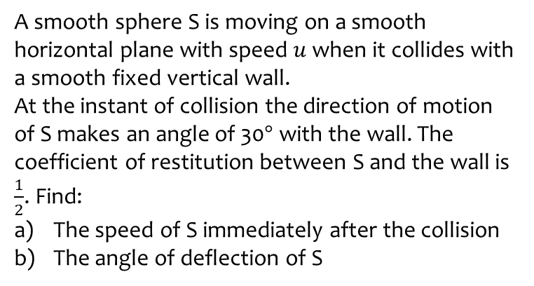
Worked example
Your turn
A smooth sphere S is moving on a smooth horizontal plane with speed $u$ when it collides with a smooth fixed vertical wall.
At the instant of collision the direction of motion of S makes an angle of 30$°$ with the wall. The coefficient of restitution between S and the wall is $\frac{1}{2}$. Find:
The speed of S immediately after the collision
The angle of deflection of S
A smooth sphere S is moving on a smooth horizontal plane with speed $u$ when it collides with a smooth fixed vertical wall.
At the instant of collision the direction of motion of S makes an angle of 60$°$ with the wall. The coefficient of restitution between S and the wall is $\frac{1}{4}$. Find:
The speed of S immediately after the collision
The angle of deflection of S
a) $\frac{\sqrt{19}}{8}u$
b) $83.4°$(3 sf)

Slide 7
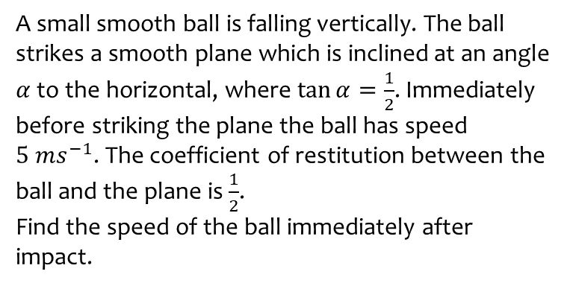
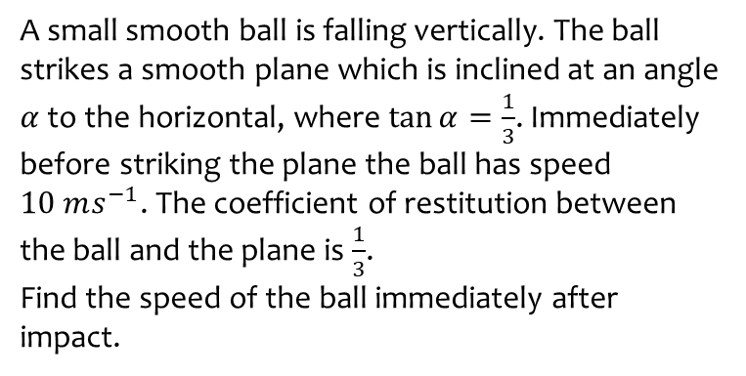
Worked example
Your turn
A small smooth ball is falling vertically. The ball strikes a smooth plane which is inclined at an angle $α$ to the horizontal, where $\tan{α}=\frac{1}{3}$. Immediately before striking the plane the ball has speed $10 ms^{−1}$. The coefficient of restitution between the ball and the plane is $\frac{1}{3}$.
Find the speed of the ball immediately after impact.
A small smooth ball is falling vertically. The ball strikes a smooth plane which is inclined at an angle $α$ to the horizontal, where $\tan{α}=\frac{1}{2}$. Immediately before striking the plane the ball has speed $5 ms^{−1}$. The coefficient of restitution between the ball and the plane is $\frac{1}{2}$.
Find the speed of the ball immediately after impact.
$3.16 ms^{−1}$ (3 sf)

Slide 8
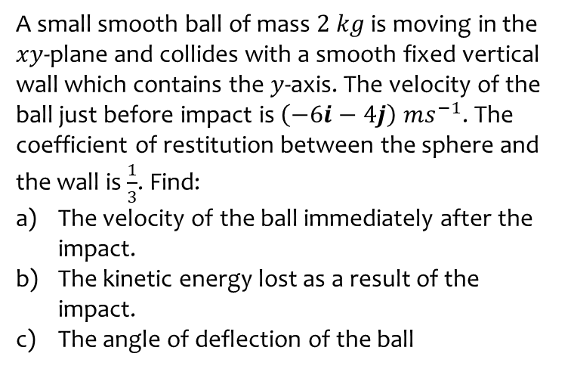
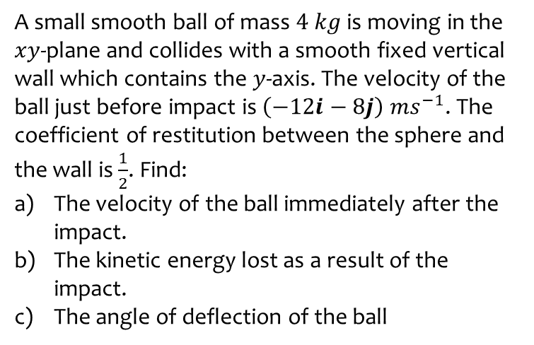
Worked example
Your turn
A small smooth ball of mass $4 kg$ is moving in the $xy$-plane and collides with a smooth fixed vertical wall which contains the $y$-axis. The velocity of the ball just before impact is $\left(−12i−8j\right) ms^{−1}$. The coefficient of restitution between the sphere and the wall is $\frac{1}{2}$. Find:
The velocity of the ball immediately after the impact.
The kinetic energy lost as a result of the impact.
The angle of deflection of the ball
A small smooth ball of mass $2 kg$ is moving in the $xy$-plane and collides with a smooth fixed vertical wall which contains the $y$-axis. The velocity of the ball just before impact is $\left(−6i−4j\right) ms^{−1}$. The coefficient of restitution between the sphere and the wall is $\frac{1}{3}$. Find:
The velocity of the ball immediately after the impact.
The kinetic energy lost as a result of the impact.
The angle of deflection of the ball
a) $\left(2i−4j\right) ms^{−1}$
b) $32 J$
c) $82.9°$ (3 sf)

Slide 9
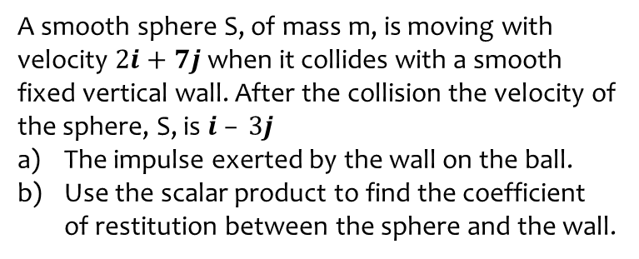
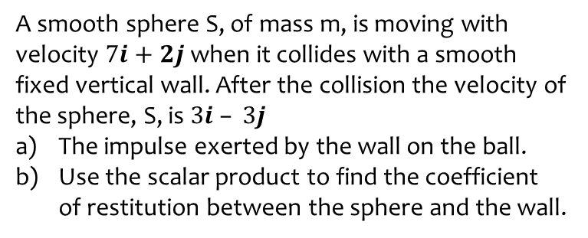
Worked example
Your turn
A smooth sphere S, of mass m, is moving with velocity $7i+2j$when it collides with a smooth fixed vertical wall. After the collision the velocity of the sphere, S, is $3i – 3j$
The impulse exerted by the wall on the ball.
Use the scalar product to find the coefficient of restitution between the sphere and the wall.
A smooth sphere S, of mass m, is moving with velocity $2i+7j$when it collides with a smooth fixed vertical wall. After the collision the velocity of the sphere, S, is $i – 3j$
The impulse exerted by the wall on the ball.
Use the scalar product to find the coefficient of restitution between the sphere and the wall.
a) $m(−i−10j)$
b) $\frac{29}{72}$

