Slide 1
5.1) Resolving forces

Slide 2
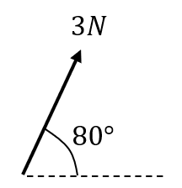
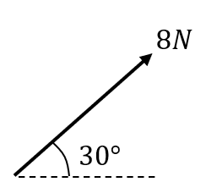
Worked example
Your turn
Convert each force to the form $ai+bj$, where $i$ and $j$ are the positive $x$ and $y$ directions respectively.
Convert each force to the form $ai+bj$, where $i$ and $j$ are the positive $x$ and $y$ directions respectively.
$$4\sqrt{3} i+4j$$
Diagrams/Graphs used with permission from DrFrostMaths: https://www.drfrostmaths.com/

Slide 3
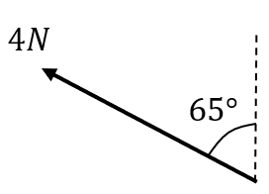
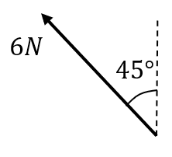
Worked example
Your turn
Convert each force to the form $ai+bj$, where $i$ and $j$ are the positive $x$ and $y$ directions respectively.
Convert each force to the form $ai+bj$, where $i$ and $j$ are the positive $x$ and $y$ directions respectively.
$$−3\sqrt{2} i+3\sqrt{2}j$$
Diagrams/Graphs used with permission from DrFrostMaths: https://www.drfrostmaths.com/

Slide 4
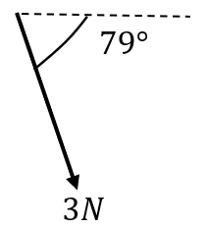
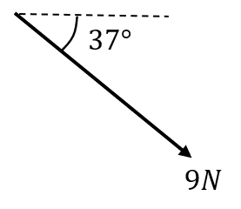
Worked example
Your turn
Convert each force to the form $ai+bj$, where $i$ and $j$ are the positive $x$ and $y$ directions respectively.
Convert each force to the form $ai+bj$, where $i$ and $j$ are the positive $x$ and $y$ directions respectively.
$7.19i−5.42j$ (3 sf)
Diagrams/Graphs used with permission from DrFrostMaths: https://www.drfrostmaths.com/

Slide 5
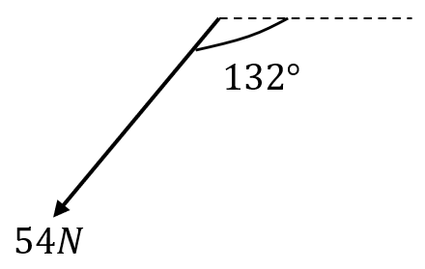
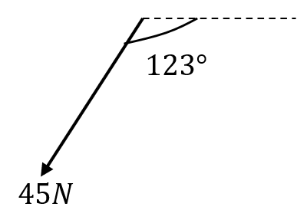
Worked example
Your turn
Convert each force to the form $ai+bj$, where $i$ and $j$ are the positive $x$ and $y$ directions respectively.
Convert each force to the form $ai+bj$, where $i$ and $j$ are the positive $x$ and $y$ directions respectively.
$$−24.5i−37.7j$$
Diagrams/Graphs used with permission from DrFrostMaths: https://www.drfrostmaths.com/

Slide 6
Worked example
Your turn
A box of mass 10kg lies on a smooth horizontal floor.
A force of 8N is applied at an angle of $50°$ causing the box to accelerate horizontally along the floor.
Work out the acceleration of the box.
Calculate the normal reaction between the box and the floor.
A box of mass 8kg lies on a smooth horizontal floor.
A force of 10N is applied at an angle of $30°$ causing the box to accelerate horizontally along the floor.
Work out the acceleration of the box.
Calculate the normal reaction between the box and the floor.
a) $\frac{5\sqrt{3}}{8} ms^{−2}=1.1 ms^{−2}$ (2 sf)
b) $73 N$ (2 sf)

Slide 7
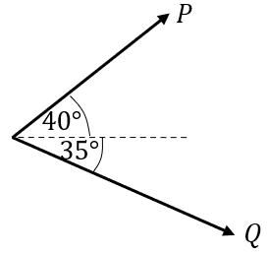
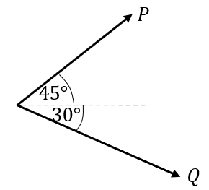
Worked example
Your turn
Two forces $P$ and $Q$ act on a particle as shown.
$P$ has a magnitude of $5$N and $Q$ has a magnitude of $4$N. Work out the magnitude and direction of the resultant force.
Two forces $P$ and $Q$ act on a particle as shown. $P$ has a magnitude of $10$N and $Q$ has a magnitude of $8$N.
Work out the magnitude and direction of the resultant force.
$14.3 N$ (3 sf) acting at an angle of $12.4°$(3 sf) above the horizontal.
Diagrams/Graphs used with permission from DrFrostMaths: https://www.drfrostmaths.com/

Slide 8
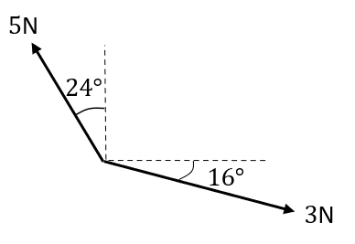
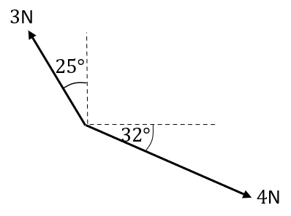
Worked example
Your turn
Two forces act on a particle as shown.
Determine the magnitude and direction (anticlockwise from the positive $x$ direction) of the resultant force.
Two forces act on a particle as shown.
Determine the magnitude and direction (anticlockwise from the positive $x$ direction) of the resultant force.
$2.21 N$ (3 sf) acting at an angle of $15.8°$ (3 sf)
Diagrams/Graphs used with permission from DrFrostMaths: https://www.drfrostmaths.com/

Slide 9
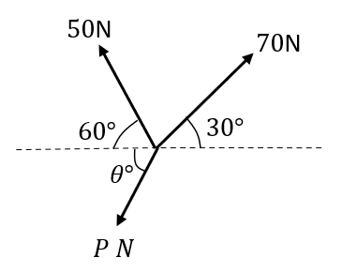
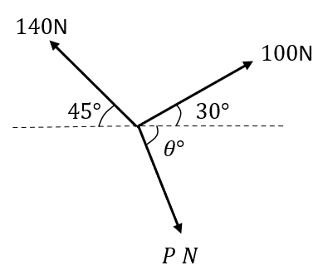
Worked example
Your turn
Three forces act on a particle as shown.
Given that the particle is in equilibrium, calculate the magnitude of $P$
Three forces act on a particle as shown.
Given that the particle is in equilibrium, calculate the magnitude of $P$
$150 N$ (3 sf)
Diagrams/Graphs used with permission from DrFrostMaths: https://www.drfrostmaths.com/

