Slide 1
5.1) Radian measure

Slide 2
Worked example
Your turn
Convert to radians:
$$180°$$
$$90°$$
$$60°$$
$$135°$$
$$720°$$
Convert to radians:
$$360°$$
$$45°$$
$$120°$$
$$315°$$
$$72°$$
$$2π$$
$$\frac{π}{4}$$
$$\frac{π}{3}$$
$$\frac{7π}{4}$$
$$\frac{2π}{5}$$

Slide 3
Worked example
Your turn
Convert to degrees:
$$3π$$
$$\frac{π}{2}$$
$$\frac{π}{6}$$
$$\frac{5π}{4}$$
$$\frac{3π}{5}$$
Convert to degrees:
$$5π$$
$$\frac{π}{3}$$
$$\frac{5π}{6}$$
$$\frac{9π}{4}$$
$$\frac{4π}{5}$$
$$900°$$
$$60°$$
$$150°$$
$$405°$$
$$144°$$

Slide 4
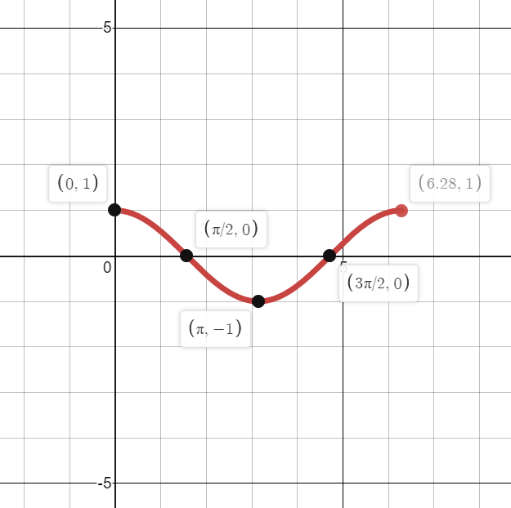
Worked example
Your turn
Sketch the graph for $0≤x≤2π$ of:
$$y=\sin{x}$$
$$y=\tan{x}$$
Sketch the graph for $0≤x≤2π$ of:
$$y=\cos{x}$$
Graphs used with permission from DESMOS: https://www.desmos.com/

