Slide 1
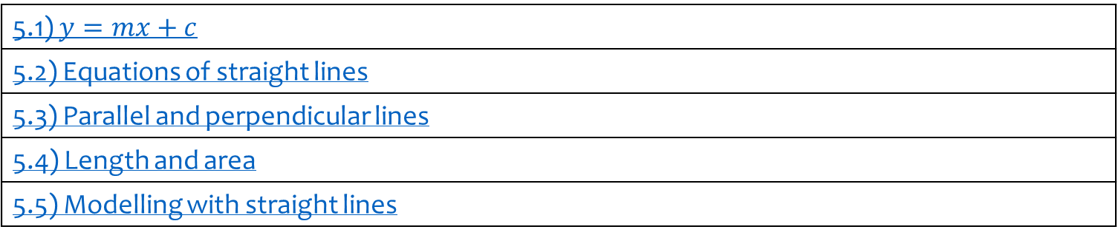
5) Straight line graphs
5.1) $y=mx+c$
5.2) Equations of straight lines
5.3) Parallel and perpendicular lines
5.4) Length and area
5.5) Modelling with straight lines

Slide 2
5.1) $y=mx+c$
Chapter CONTENTS

Slide 3
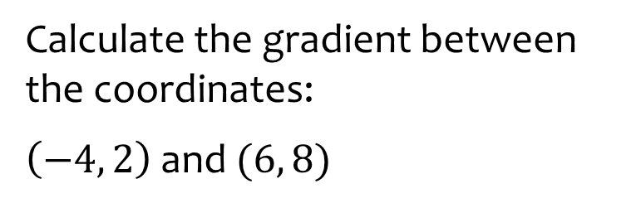


Worked example
Your turn
Calculate the gradient between the coordinates:
$\left(2, 1\right)$ and $(5, 7)$
$(−2, −1)$ and $(5, 7)$
Calculate the gradient between the coordinates:
$\left(−4, 2\right)$ and $(6, 8)$
$$\frac{3}{5}$$

Slide 4
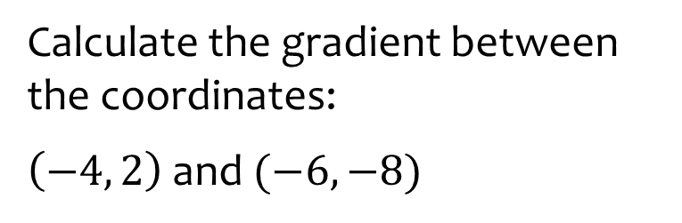


Worked example
Your turn
Calculate the gradient between the coordinates:
$\left(2, 1\right)$ and $(5, −7)$
$(2, −1)$ and $(−5, −7)$
Calculate the gradient between the coordinates:
$\left(−4, 2\right)$ and $(−6, −8)$
$$5$$

Slide 5
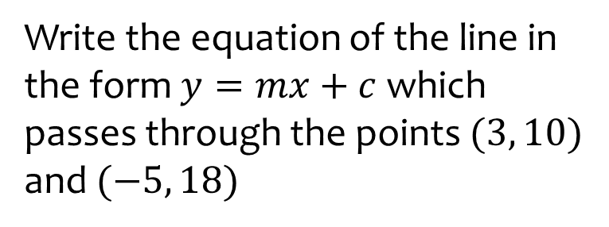
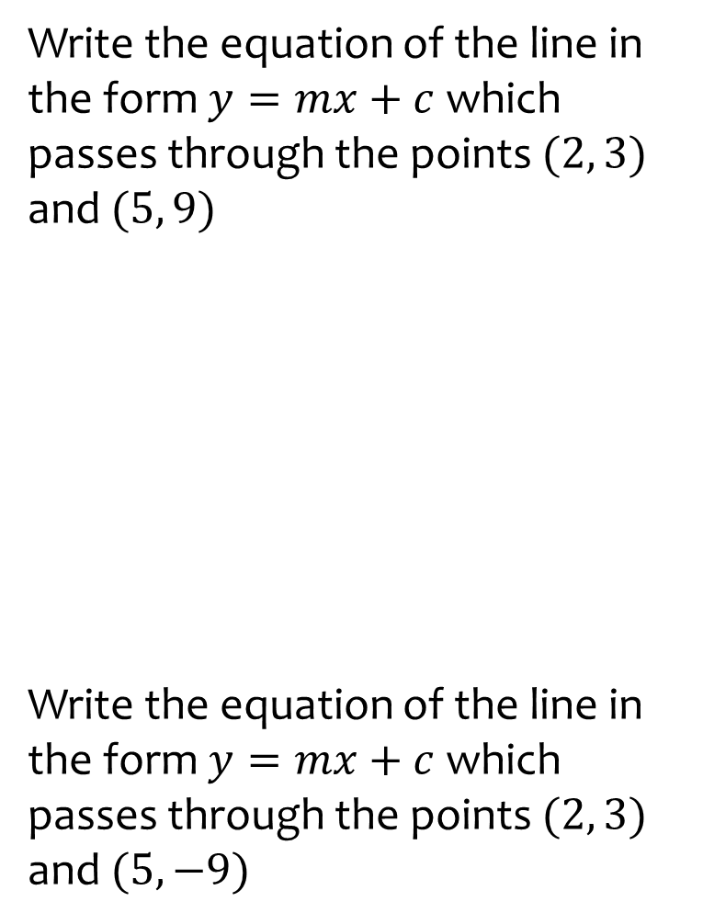

Worked example
Your turn
Write the equation of the line in the form $y=mx+c$ which passes through the points $(2, 3)$ and $(5, 9)$
Write the equation of the line in the form $y=mx+c$ which passes through the points $(2, 3)$ and $(5, −9)$
Write the equation of the line in the form $y=mx+c$ which passes through the points $(3, 10)$ and $(−5, 18)$
$$y=−x−7$$

Slide 6
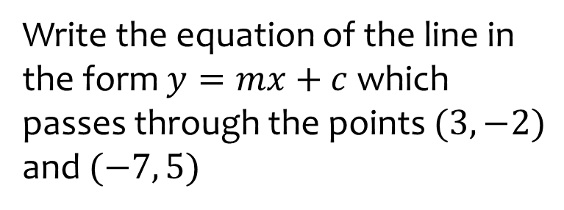
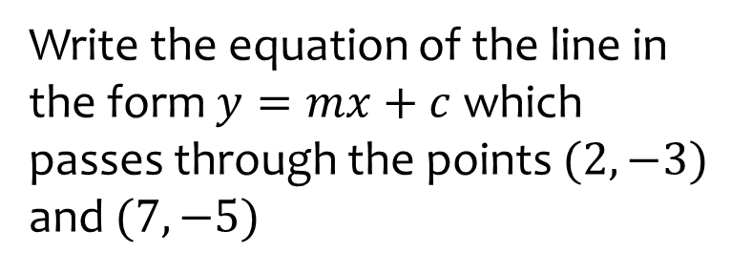

Worked example
Your turn
Write the equation of the line in the form $y=mx+c$ which passes through the points $(2, −3)$ and $(7, −5)$
Write the equation of the line in the form $y=mx+c$ which passes through the points $(3, −2)$ and $(−7, 5)$
$$y=−\frac{3}{10}x−\frac{11}{10}$$

Slide 7
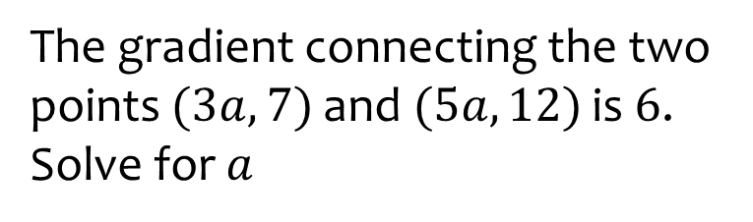
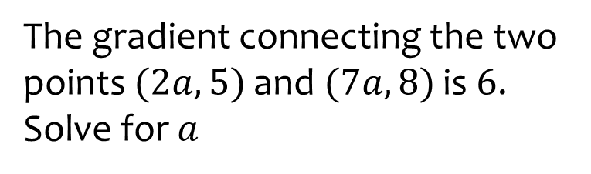

Worked example
Your turn
The gradient connecting the two points $(2a, 5)$ and $(7a, 8)$ is $6$. Solve for $a$
The gradient connecting the two points $(3a, 7)$ and $(5a, 12)$ is $6$. Solve for $a$
$$a=\frac{5}{12}$$

Slide 8
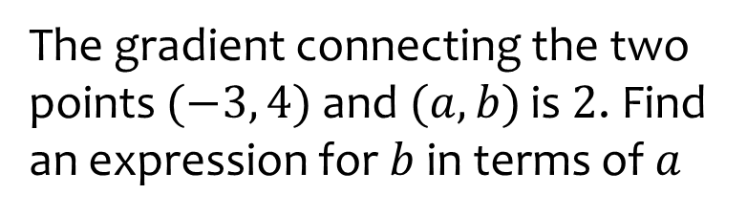
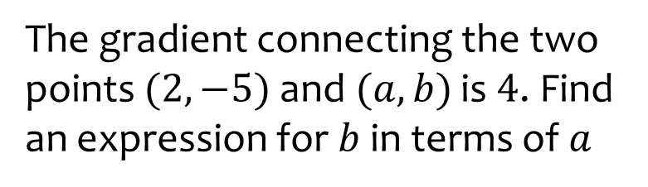

Worked example
Your turn
The gradient connecting the two points $(2, −5)$ and $(a, b)$ is $4$. Find an expression for $b$ in terms of $a$
The gradient connecting the two points $(−3, 4)$ and $(a, b)$ is $2$. Find an expression for $b$ in terms of $a$
$$b=2a+10$$

Slide 9
5.2) Equations of straight lines
Chapter CONTENTS

Slide 10
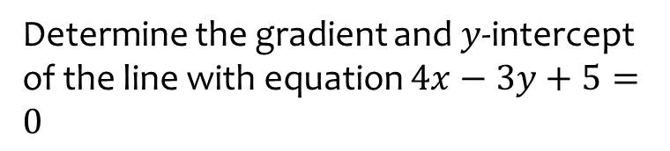
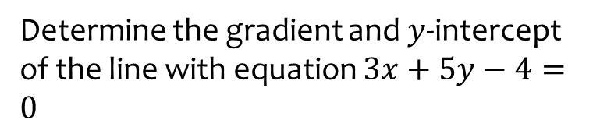

Worked example
Your turn
Determine the gradient and $y$-intercept of the line with equation $3x+5y−4=0$
Determine the gradient and $y$-intercept of the line with equation $4x−3y+5=0$
Gradient $=\frac{4}{3}$
$y$-intercept $=\frac{5}{3}$

Slide 11


Worked example
Your turn
Express in the form $ax+by+c=0$:
$$y=5x−2$$
$$y=−2x+5$$
Express $y=4x+3$ in the form
$$ax+by+c=0$$
$$4x−y+3=0$$

Slide 12
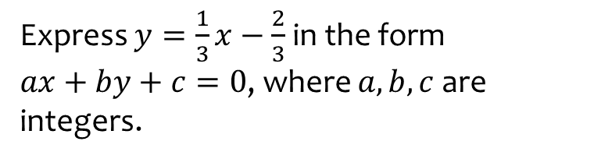
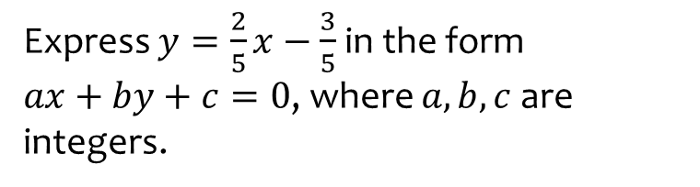

Worked example
Your turn
Express $y=\frac{2}{5}x−\frac{3}{5}$ in the form
$ax+by+c=0$, where $a,b,c$ are integers.
Express $y=\frac{1}{3}x−\frac{2}{3}$ in the form
$ax+by+c=0$, where $a,b,c$ are integers.
$$x−3y−2=0$$

Slide 13
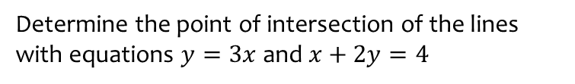
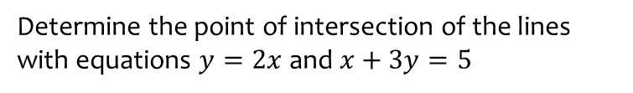

Worked example
Your turn
Determine the point of intersection of the lines with equations $y=2x$ and $x+3y=5$
Determine the point of intersection of the lines with equations $y=3x$ and $x+2y=4$
$$\left(\frac{4}{7},\frac{12}{7}\right)$$

Slide 14
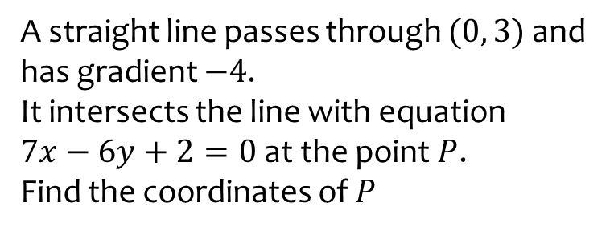
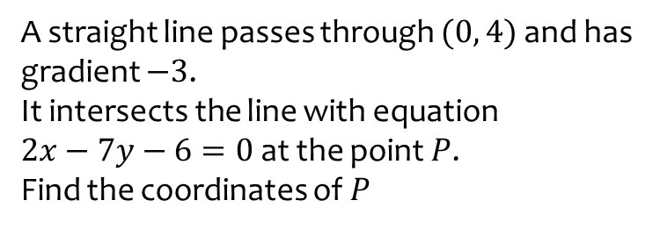

Worked example
Your turn
A straight line passes through $(0, 4)$ and has gradient $−3$.
It intersects the line with equation
$2x−7y−6=0$ at the point $P$.
Find the coordinates of $P$
A straight line passes through $(0, 3)$ and has gradient $−4$.
It intersects the line with equation
$7x−6y+2=0$ at the point $P$.
Find the coordinates of $P$
$$\left(\frac{16}{31},\frac{29}{31}\right)$$

Slide 15
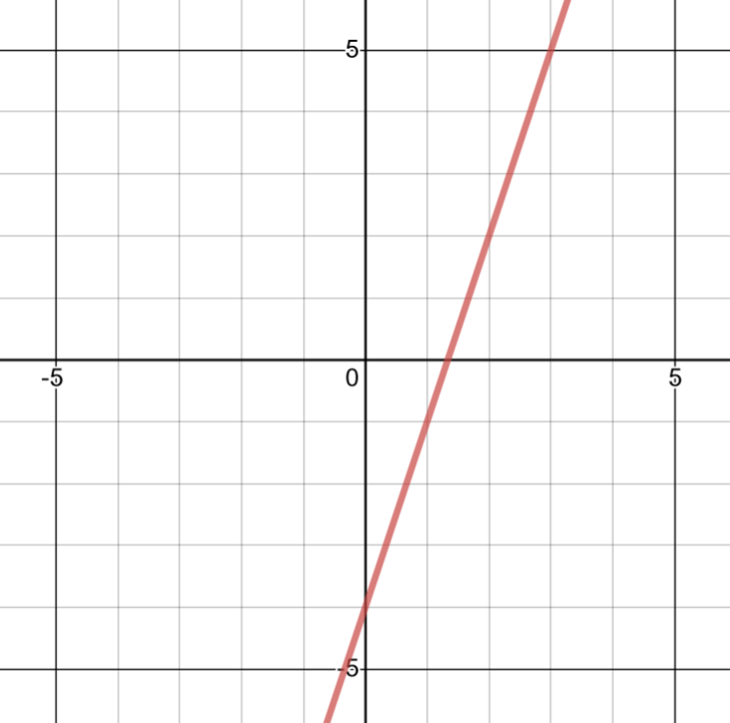



Worked example
Your turn
$$y=2x−5$$
Gradient:
$y$-intercept:
$x$-intercept:
Sketch:
$$y=3x−4$$
Gradient:
$y$-intercept:
$x$-intercept:
Sketch:
$$3$$
$$−4$$
$$\frac{4}{3}$$
Graph used with permission from DESMOS: https://www.desmos.com/

Slide 16
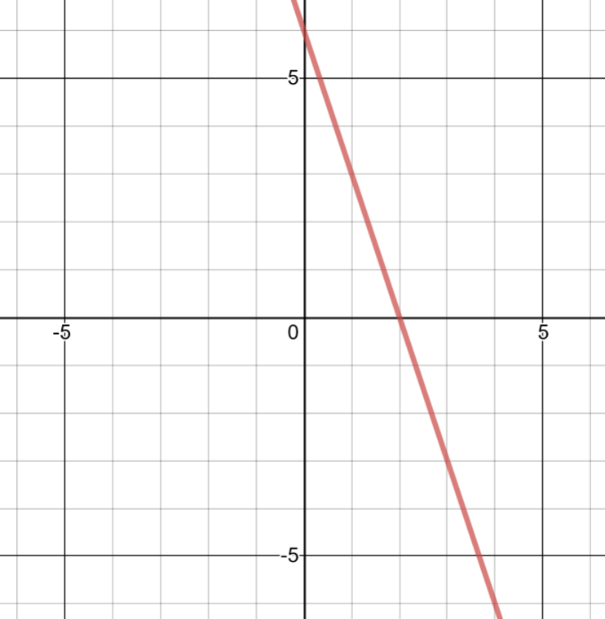



Worked example
Your turn
$$y=−2x+6$$
Gradient:
$y$-intercept:
$x$-intercept:
Sketch:
$$y=−3x+6$$
Gradient:
$y$-intercept:
$x$-intercept:
Sketch:
$$−3$$
$$6$$
$$2$$
Graph used with permission from DESMOS: https://www.desmos.com/

Slide 17
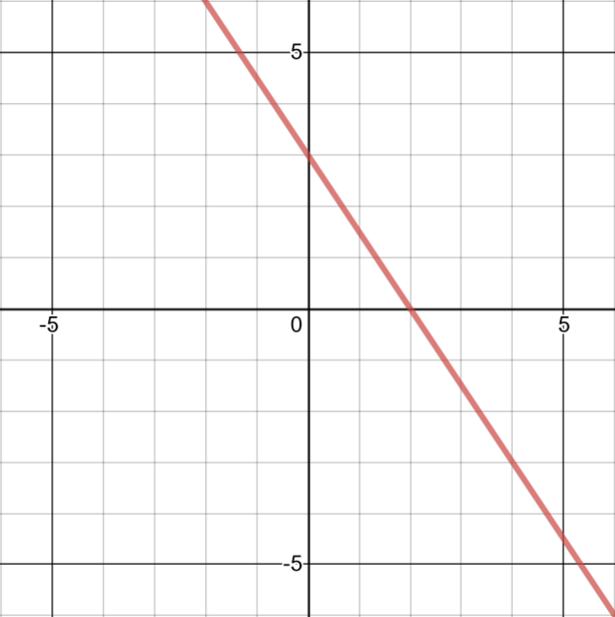



Worked example
Your turn
$$2x+3y=6$$
Gradient:
$y$-intercept:
$x$-intercept:
Sketch:
$$3x+2y=6$$
Gradient:
$y$-intercept:
$x$-intercept:
Sketch:
$$−\frac{3}{2}$$
$$3$$
$$2$$
Graph used with permission from DESMOS: https://www.desmos.com/

Slide 18
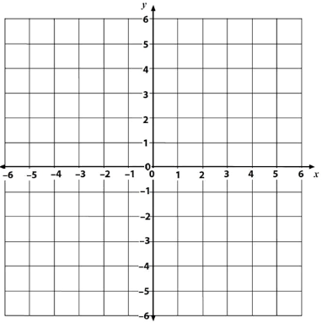



Worked example
Your turn
Gradient: $m=$
$y$-intercept: $c=$
$$y=mx+c →$$
Gradient: $m=$
$y$-intercept: $c=$
$$y=mx+c →$$
$1$
$−1$
$y=x−1$

Slide 19

Worked example
Your turn
Gradient: $m=$
$y$-intercept: $c=$
$$y=mx+c →$$
Gradient: $m=$
$y$-intercept: $c=$
$$y=mx+c →$$
$−2$
$2$
$y=−2x+1$

Slide 20

Worked example
Your turn
Gradient: $m=$
$y$-intercept: $c=$
$$y=mx+c →$$
Gradient: $m=$
$y$-intercept: $c=$
$$y=mx+c →$$
$\frac{3}{4}$
$2$
$y=\frac{3}{4}x+2$

Slide 21

Worked example
Your turn
Gradient: $m=$
$y$-intercept: $c=$
$$y=mx+c →$$
Gradient: $m=$
$y$-intercept: $c=$
$$y=mx+c →$$
$−\frac{3}{4}$
$2$
$y=−\frac{3}{4}x+2$

Slide 22
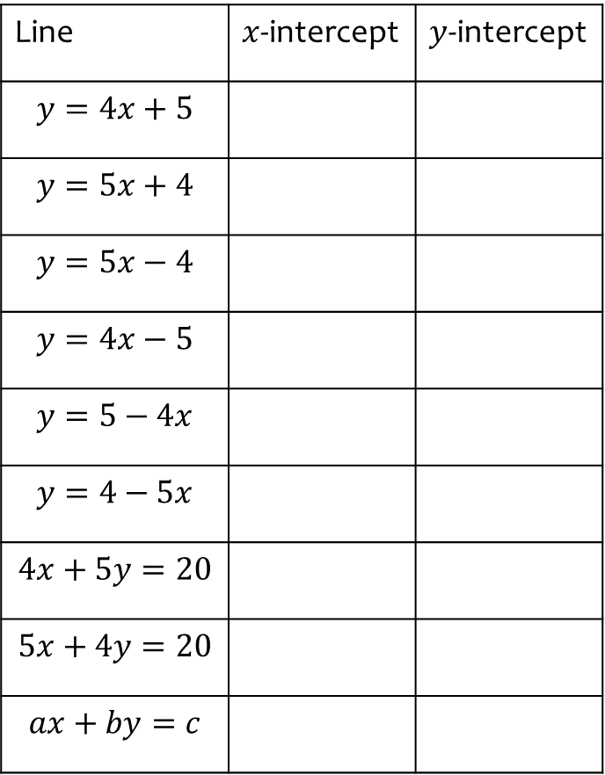
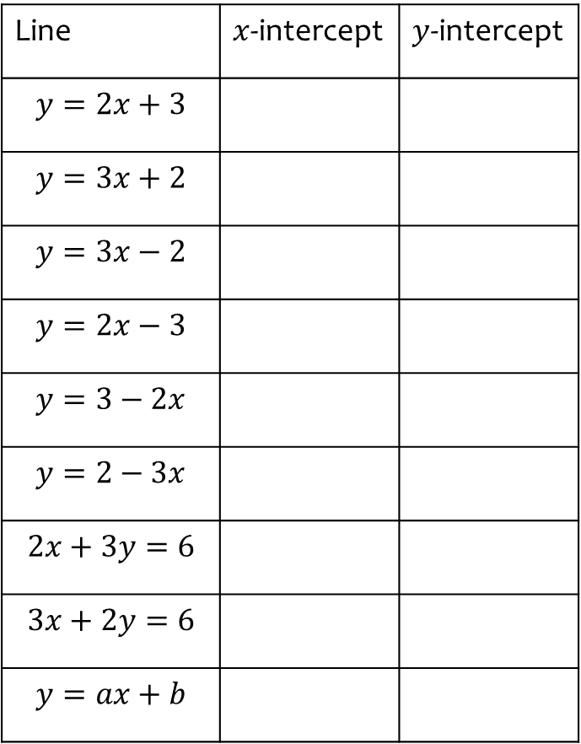
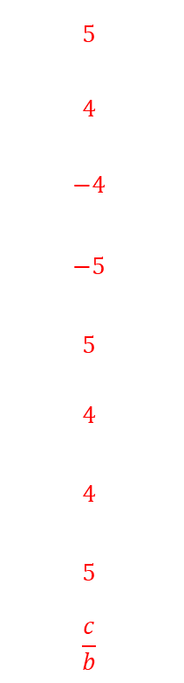
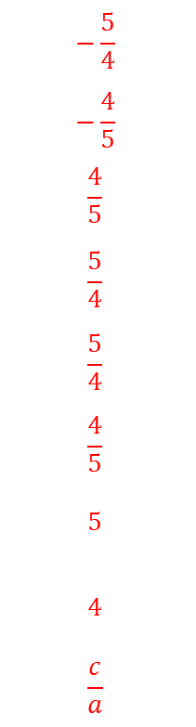
Worked example
Your turn
Find where the line intercepts the axes:
Find where the line intercepts the axes:
Line | $x$-intercept | $y$-intercept
$$y=2x+3$$
$$y=3x+2$$
$$y=3x−2$$
$$y=2x−3$$
$$y=3−2x$$
$$y=2−3x$$
$$2x+3y=6$$
$$3x+2y=6$$
$$y=ax+b$$
Line | $x$-intercept | $y$-intercept
$$y=4x+5$$
$$y=5x+4$$
$$y=5x−4$$
$$y=4x−5$$
$$y=5−4x$$
$$y=4−5x$$
$$4x+5y=20$$
$$5x+4y=20$$
$$ax+by=c$$
$$−\frac{5}{4}$$
$$−\frac{4}{5}$$
$$\frac{4}{5}$$
$$\frac{5}{4}$$
$$\frac{5}{4}$$
$$\frac{4}{5}$$
$$5$$
$$4$$
$$\frac{c}{a}$$
$$5$$
$$4$$
$$−4$$
$$−5$$
$$5$$
$$4$$
$$4$$
$$5$$
$$\frac{c}{b}$$

Slide 23
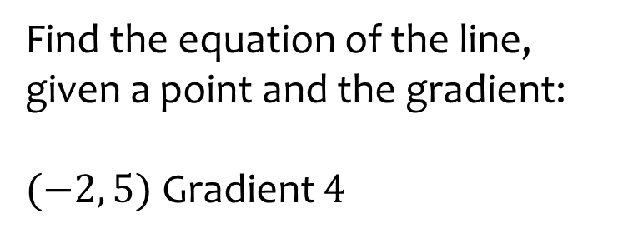
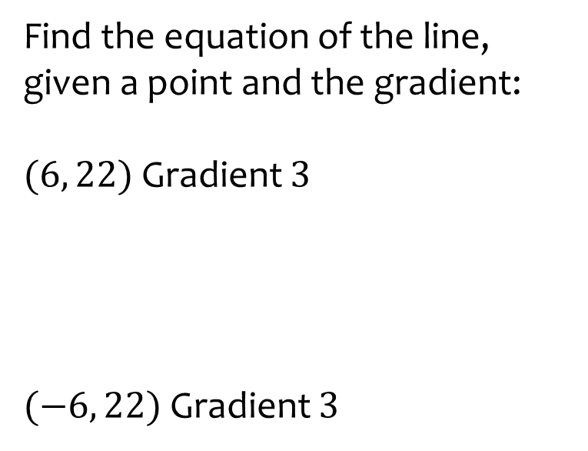

Worked example
Your turn
Find the equation of the line, given a point and the gradient:
$(6, 22)$ Gradient $3$
$(−6, 22)$ Gradient $3$
Find the equation of the line, given a point and the gradient:
$(−2, 5)$ Gradient $4$
$$y=4x+13$$

Slide 24
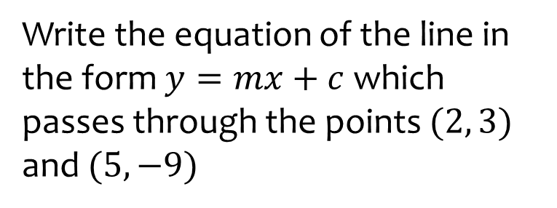
Worked example
Your turn
Write the equation of the line in the form $y=mx+c$ which passes through the points $(2, 3)$ and $(5, −9)$
Write the equation of the line in the form $y=mx+c$ which passes through the points $(3, 10)$ and $(−5, 18)$
$$y=−x−7$$

Slide 25
Worked example
Your turn
Write the equation of the line in the form $y=mx+c$ which passes through the points $(2, −3)$ and $(7, −5)$
Write the equation of the line in the form $y=mx+c$ which passes through the points $(3, −2)$ and $(−7, 5)$
$$y=−\frac{3}{10}x−\frac{11}{10}$$

Slide 26
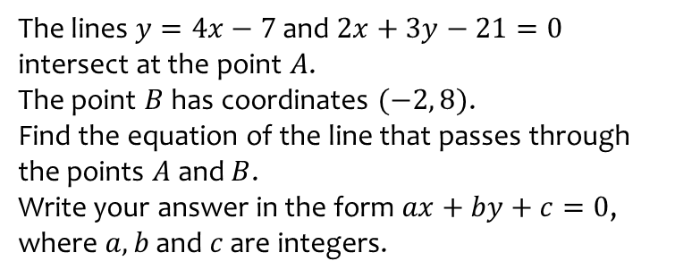
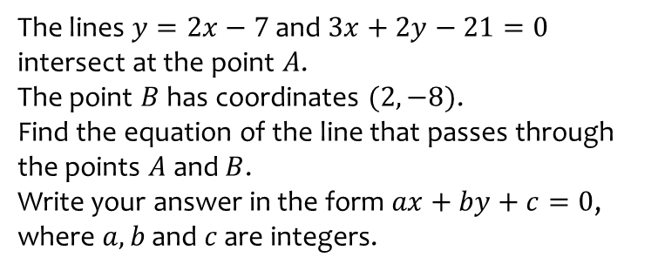
Worked example
Your turn
The lines $y=2x−7$ and $3x+2y−21=0$ intersect at the point $A$.
The point $B$ has coordinates $(2, −8)$.
Find the equation of the line that passes through the points $A$ and $B$.
Write your answer in the form $ax+by+c=0$, where $a, b$ and $c$ are integers.
The lines $y=4x−7$ and $2x+3y−21=0$ intersect at the point $A$.
The point $B$ has coordinates $(−2, 8)$.
Find the equation of the line that passes through the points $A$ and $B$.
Write your answer in the form $ax+by+c=0$, where $a, b$ and $c$ are integers.
$$3x+5y−34=0$$

Slide 27
5.3) Parallel and perpendicular lines
Chapter CONTENTS

Slide 28


Worked example
Your turn
Determine whether the pairs of lines are parallel, perpendicular or neither:
$$5x−2y−3=0$$
$$y=\frac{5}{2}x$$
$$5x+3y−21=0$$
$$3x−5y+2=0$$
Determine whether the pairs of lines are parallel, perpendicular or neither:
$$3x−y−2=0$$
$$x+3y−6=0$$
$$y=\frac{1}{2}x$$
$$2x−y+4=0$$
Perpendicular
Neither parallel nor perpendicular

Slide 29



Worked example
Your turn
The points A, B and C have coordinates $(0, 12)$, $(−3, 0)$ and $(0, c)$ respectively.
The line through points $A$ and $B$ is perpendicular to the line through points $B$ and $C$.
Find the value of $c$
The points A, B and C have coordinates $(0, 6)$, $(−2, 0)$ and $(0, c)$ respectively.
The line through points $A$ and $B$ is perpendicular to the line through points $B$ and $C$.
Find the value of $c$
$$x=−\frac{2}{3}$$

Slide 30



Worked example
Your turn
Find the gradient of the perpendicular line to:
$$y=2x+3$$
$$y=2−3x$$
$$y=\frac{2}{3}x+1$$
$$y=8−\frac{11}{5}x$$
Find the general equation of the perpendicular line to:
$$y=4x$$
$$y=−2x+4$$
$$y=\frac{3}{4}x−5$$
$$y=7−\frac{11}{3}x$$
$$y=−\frac{1}{4}x+c$$
$$y=\frac{1}{2}x+c$$
$$y=−\frac{4}{3}x+c$$
$$y=\frac{3}{11}x+c$$

Slide 31



Worked example
Your turn
Find the equation of the line parallel to $y=3x+5$ that passes through $(−2, 5)$
Find the equation of the line parallel to $y=−\frac{1}{3}x−4$ that passes through $(−2, 5)$
Find the equation of the line parallel to $y=−\frac{1}{2}x−3$ that passes through $(−2, 5)$
$$y=−\frac{1}{2}x+4$$

Slide 32



Worked example
Your turn
Find the equation of the line perpendicular to $y=2x−4$ that passes through $(−2, 5)$
Find the equation of the line perpendicular to $y=4x+5$ that passes through $(−2, 5)$
Find the equation of the line perpendicular to $y=3x+2$ that passes through $(9, −7)$
$$y=−\frac{1}{3}x−4$$

Slide 33



Worked example
Your turn
Find the equation of the line perpendicular to $y=\frac{1}{2}x−4$ that passes through $(−2, 5)$
Find the equation of the line perpendicular to $y=−\frac{2}{3}x+5$ that passes through $(−2, 5)$
Find the equation of the line perpendicular to $y=−\frac{4}{3}x+3$ that passes through $(−12, −5)$
$$y=\frac{3}{4}x+4$$

Slide 34



Worked example
Your turn
Find the equation of the line perpendicular to $x+2y=5$ which passes through the point $(3, 7)$
Find the equation of the line perpendicular to $3x+2y=5$ which passes through the point $(3, 7)$
Find the equation of the line perpendicular to $2x+3y=5$ which passes through the point $(4, 7)$
$$y=\frac{3}{2}x+1$$

Slide 35



Worked example
Your turn
Write down an equation of a line parallel to $y=3x−4$ which passes through the origin.
Write down an equation of a line parallel to $y=3−4x$which passes through the origin.
Write down an equation of a line parallel to $y=−2x+5$ which passes through the origin.
$$y=−2x$$

Slide 36





Worked example
Your turn
Determine the coordinates of $A$
Determine the coordinates of $A$
$$\left(\frac{8}{5},\frac{16}{5}\right)$$

Slide 37
5.4) Length and area
Chapter CONTENTS

Slide 38



Worked example
Your turn
Find the distance between:
$(2, 4)$and$(8, 8)$
$(−2, 4)$ and $(−9, 9)$
Find the distance between:
$(2, −4)$ and $(11, 8)$
$$15$$

Slide 39



Worked example
Your turn
In your head, find the distance between:
$$(8,2) \text{and} \left(5,6\right)$$
$$(−1,−7) \text{and} \left(11,2\right)$$
$$(−23,0) \text{and} \left(1,7\right)$$
In your head, find the distance between:
$$(1,10) \text{and} \left(4,14\right)$$
$$(−4,−2) \text{and} \left(−12,4\right)$$
$(0,−9)$ and $\left(5,3\right)$
$$5$$
$$10$$
$$13$$

Slide 40



Worked example
Your turn
The straight line $l_{1}$ with equation $2x−y=0$ and the straight line $l_{2}$ with equation $3x+2y−\frac{7}{2}=0$ intersect at point $A$.
O is the origin. $B$ is the point where $l_{2}$ meets the $x$-axis.
Work out the area of triangle $AOB$
The straight line $l_{1}$ with equation $4x−y=0$ and the straight line $l_{2}$ with equation $2x+3y−21=0$ intersect at point $A$.
O is the origin. $B$ is the point where $l_{2}$ meets the $x$-axis.
Work out the area of triangle $AOB$
$$\frac{63}{2}$$

Slide 41





Worked example
Your turn
Determine:
The length of $PQ$
The area of triangle $PQR$
Determine:
The length of $PQ$
The area of triangle $PQR$
a) $2\sqrt{5}$
b) $12$

Slide 42




Worked example
Your turn
Determine:
The length of $PQ$
The area of triangle $PQR$
Determine:
The length of $PQ$
The area of triangle $PQR$
a) $3\sqrt{5}$
b) $27$

Slide 43
5.5) Modelling with straight lines
Chapter CONTENTS

Slide 44





Worked example
Your turn
The A Level Maths mark, $y \%$, and GCSE Maths mark, $x \%$, is recorded for several students.
Assume the line goes through $(0, 40)$ and $(60, 80)$.
Write a linear model
Interpret the gradient and $y$-intercept in this context
Predict the A Level Maths mark of a student who got $100\%$ for their GCSE Maths mark
The temperature $y$ at different points on a mountain is recorded at different altitudes $x$.
Assume the line goes through $(0, 70)$ and $(250, 20)$.
Write a linear model
Interpret the gradient and $y$-intercept in this context
Predict at what altitude the temperature reaches $0°F$
a) $y=0.2x+70$
b) The temperature at sea level is $70°F$. The temperature decreases by $0.2°F$ for each extra metre in altitude.
c) $350 m$

Slide 45



Worked example
Your turn
In $2010$ the population of rabbits in an area was $200$. Locals projected that the number of rabbits would increase by $4$ per year.
Write a linear model for the population, $p$, of rabbits $t$ years after $2010$
Write down a reason why this might not be a realistic model.
In $2000$ there were $18500$ people in a village.
Planners projected that the number of people living in the village would increase by $350$per year.
Write a linear model for the population, $p$, of the village $t$ years after $2000$
Write down a reason why this might not be a realistic model.
a) $p=350t+18500$
b) The population is unlikely to increase by the same amount each year. An exponential model would be more suitable

