Slide 1
5) Probability
5.1) Calculating probabilities
5.2) Venn diagrams
5.3) Mutually exclusive and independent events
5.4) Tree diagrams

Slide 2
5.1) Calculating probabilities
Chapter CONTENTS

Slide 3
Worked example
Your turn
Two fair spinners each have five sectors numbered 1 to 5. The two spinners are spun together and the sum of the numbers indicated on each spinner is recorded.
Find the probability of the spinners indicating a sum of:
exactly 6
more than 6
Two fair spinners each have four sectors numbered 1 to 4. The two spinners are spun together and the sum of the numbers indicated on each spinner is recorded.
Find the probability of the spinners indicating a sum of:
exactly 5
more than 5
a) $\frac{1}{4}$
b) $\frac{3}{8}$

Slide 4
Worked example
Your turn
The table shows the times taken, in minutes, for a group of students to complete a number puzzle.
A student is chosen at random. Find the probability that they completed the number puzzle in:
under 12 minutes
over 9.5 minutes.
The table shows the times taken, in minutes, for a group of students to complete a number puzzle.
A student is chosen at random. Find the probability that they completed the number puzzle in:
under 9 minutes
over 10.5 minutes.
a) $\frac{19}{40}$
b) $\frac{3}{10}$

Slide 5
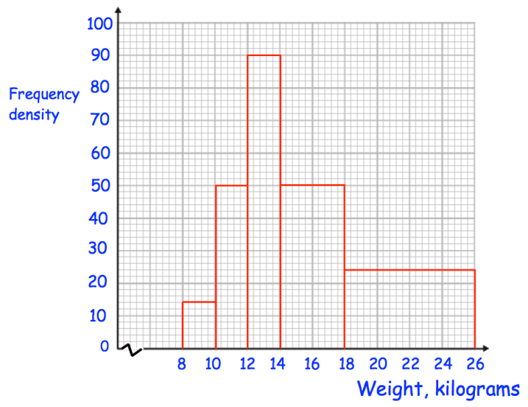
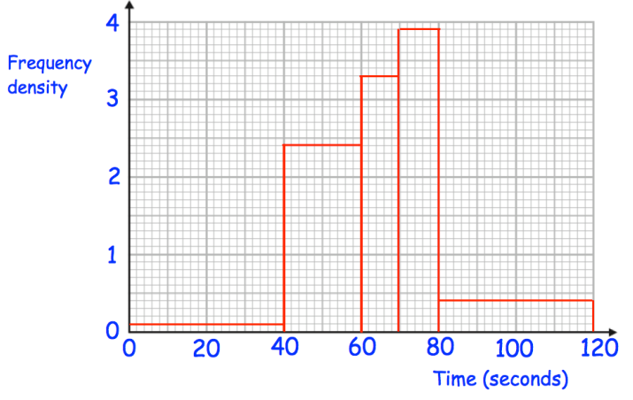
Worked example
Your turn
A participant is chosen at random.
What is the probability they took longer than 60 seconds?
A participant is chosen at random.
What is the probability they weigh more than $14 kg$?
$\frac{14}{25}=0.56$
Questions used with permission from Corbettmaths: https://corbettmaths.com/

Slide 6
5.2) Venn diagrams
Chapter CONTENTS

Slide 7
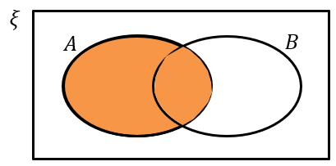
Worked example
Your turn
Draw a Venn diagram for two events $C$ and $D$.
Shade the region represented by:
$$D$$
Draw a Venn diagram for two events $A$ and $B$.
Shade the Venn diagram the region represented by:
$$A$$
Diagrams/Graphs used with permission from DrFrostMaths: https://www.drfrostmaths.com/

Slide 8
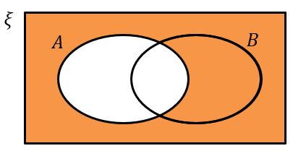
Worked example
Your turn
Draw a Venn diagram for two events $C$ and $D$.
Shade the region represented by:
Not $D$
Draw a Venn diagram for two events $A$ and $B$.
Shade the Venn diagram the region represented by:
Not $A$
Diagrams/Graphs used with permission from DrFrostMaths: https://www.drfrostmaths.com/

Slide 9
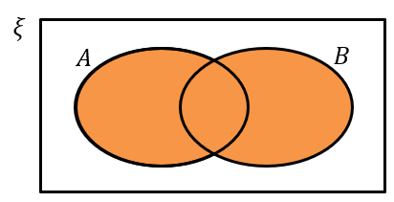
Worked example
Your turn
Draw a Venn diagram for two events $C$ and $D$.
Shade the region represented by:
$C$ or $D$
Draw a Venn diagram for two events $A$ and $B$.
Shade the Venn diagram the region represented by:
$A$ or $B$
Diagrams/Graphs used with permission from DrFrostMaths: https://www.drfrostmaths.com/

Slide 10
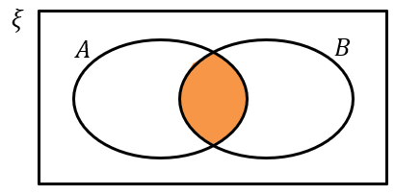
Worked example
Your turn
Draw a Venn diagram for two events $C$ and $D$.
Shade the region represented by:
$C$ and $D$
Draw a Venn diagram for two events $A$ and $B$.
Shade the Venn diagram the region represented by:
$A$ and $B$
Diagrams/Graphs used with permission from DrFrostMaths: https://www.drfrostmaths.com/

Slide 11
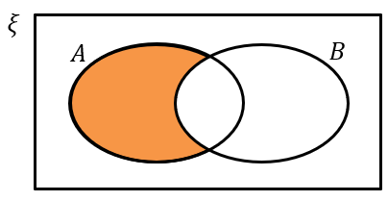
Worked example
Your turn
Draw a Venn diagram for two events $C$ and $D$.
Shade the region represented by:
$D$ and not $C$
Draw a Venn diagram for two events $A$ and $B$.
Shade the Venn diagram the region represented by:
$A$ and not $B$
Diagrams/Graphs used with permission from DrFrostMaths: https://www.drfrostmaths.com/

Slide 12
Worked example
Your turn
In a class of 30 students, 6 play the piano, 11 play the guitar and 3 play both instruments. A student is chosen at random from the class. Find the probability that the student:
Does not play the piano
Does not play the piano or the guitar
In a class of 30 students, 7 are in the choir, 5 are in the school band and 2 are in the choir and the band. A student is chosen at random from the class. Find the probability that the student:
Is not in the band
Is not in the choir or the band
a) $\frac{5}{6}$
b) $\frac{2}{3}$

Slide 13
Worked example
Your turn
In a class of 30 students, 6 play the piano only, 11 play the guitar only and 3 play neither instrument. A student is chosen at random from the class.
Find the probability that the student plays both instruments.
In a class of 30 students, 7 are in the choir only, 5 are in the school band only and 2 are in neither group. A student is chosen at random from the class. Find the probability that the student is in both groups.
$$\frac{16}{30}=\frac{8}{15}$$

Slide 14
Worked example
Your turn
In a class of 30 students, 6 play the piano, 11 play the guitar and 16 play neither instrument. A student is chosen at random from the class.
Find the probability that the student plays both instruments.
In a class of 30 students, 7 are in the choir, 5 are in the school band and 21 are in neither group. A student is chosen at random from the class. Find the probability that the student is in both groups.
$$\frac{3}{30}=\frac{1}{10}$$

Slide 15
Worked example
Your turn
Given that $P\left(D\right)=0.7$ and $P\left(C or D\right)=0.95$, find the probability of:
$P(C and not D)$
$P\left(neither C nor D\right)$
Given that $P\left(A\right)=0.6$ and $P\left(A or B\right)=0.85$, find the probability of:
$P(A and not B)$
$P\left(neither A nor B\right)$
a) $0.25$
b) $0.15$

Slide 16
Worked example
Your turn
The probability of a person having read book A is $0.46$.
The probability that they have read book B is $0.18$.
The probability that they have read book A or B or both is $0.51$.
A person is chosen at random.
Find the probability that the person has
a) Read both book A and book B
b) Read book B but not book A
c) Read neither book
The probability of a person having read book A is $0.37$.
The probability that they have read book B is $0.25$.
The probability that they have read book A or B or both is $0.54$.
A person is chosen at random.
Find the probability that the person has
a) Read both book A and book B
b) Read book A but not book B
c) Read neither book
a) $0.16$
b) $0.21$
c) $0.46$

Slide 17
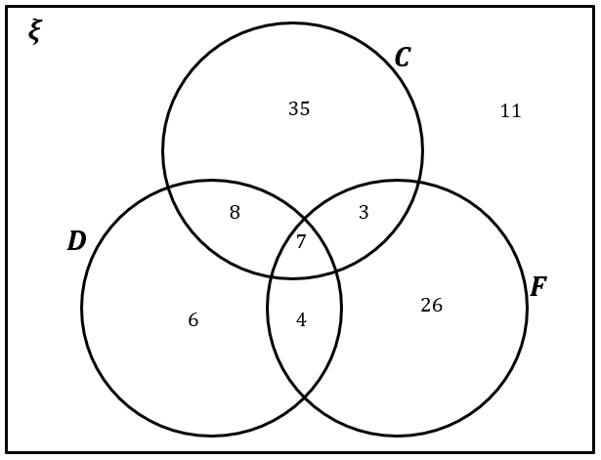
Worked example
Your turn
A gym owner surveys 100 of their clients. They find that 65 run, 40 run and swim, 35 run and cycle, 48 swim, 30 swim and cycle, 25 do all three types of exercise and 60 cycle.
Draw a Venn Diagram to represent this data.
A vet surveys 100 of their clients. They find that
25 own dogs, 15 own dogs and cats, 11 own dogs and tropical fish, 53 own cats, 10 own cats and tropical fish, 7 own dogs, cats and tropical fish, 40 own tropical fish.
Draw a Venn Diagram to represent this data.
Diagrams/Graphs used with permission from DrFrostMaths: https://www.drfrostmaths.com/

Slide 18
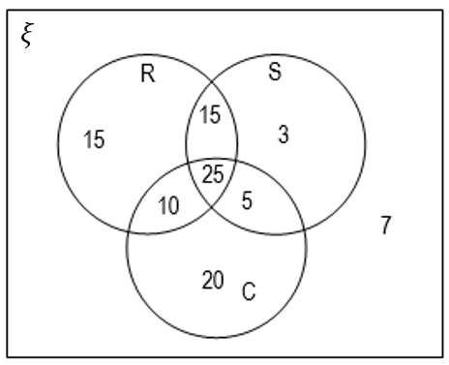
Worked example
Your turn
A gym owner surveys 100 of their clients.
A client is chosen at random.
Find the probability that the client:
a) Cycles only
b) Does not swim
c) Does not do any of these three exercises
d) Runs and swims but does not cycle.
A gym owner surveys 100 of their clients.
A client is chosen at random.
Find the probability that the client:
a) Owns dogs only
b) Does not own fish
c) Does not own dogs, cats or fish
d) Owns fish and cats but not dogs
$\frac{6}{100}=\frac{3}{50}=0.06$
$\frac{60}{100}=\frac{3}{5}=0.6$
$\frac{11}{100}=0.11$
$\frac{10}{100}=\frac{1}{10}=0.1$
Diagrams/Graphs used with permission from DrFrostMaths: https://www.drfrostmaths.com/

Slide 19
Worked example
Your turn
A gym owner surveys 100 of their clients.
A client is chosen at random.
Find the probability that the client:
Does exactly one of the exercises
Does at least two of the exercises
A gym owner surveys 100 of their clients.
A client is chosen at random.
Find the probability that the client:
a) Owns exactly one type of pet.
b) Owns at least two of the types of pet.
$\frac{67}{100}=0.67$
$\frac{22}{100}=\frac{11}{50}=0.22$
Diagrams/Graphs used with permission from DrFrostMaths: https://www.drfrostmaths.com/

Slide 20
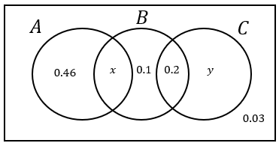
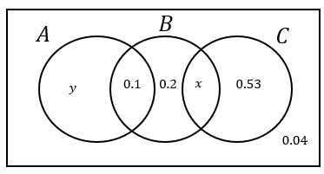
Worked example
Your turn
The Venn diagram shows the probabilities of group members taking part in activities A, B and C.
Given that $P\left(B\right)=0.39$, find $P(C)$
The Venn diagram shows the probabilities of group members taking part in activities A, B and C.
Given that $P\left(B\right)=0.35$, find $P(A)$
$$0.18$$
Diagrams/Graphs used with permission from DrFrostMaths: https://www.drfrostmaths.com/

Slide 21
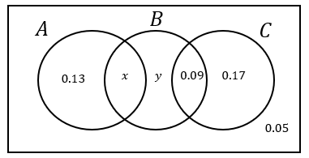
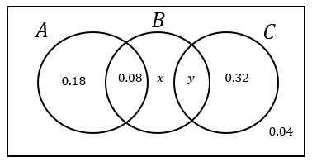
Worked example
Your turn
The Venn diagram shows the probabilities of group members taking part in activities A, B and C.
Given that $P\left(A\right)=P(B)$, find the values of $x$ and $y$
The Venn diagram shows the probabilities of group members taking part in activities A, B and C.
Given that $P\left(B\right)=P(C)$, find the values of $x$ and $y$
$$x=0.24 , y=0.14$$
Diagrams/Graphs used with permission from DrFrostMaths: https://www.drfrostmaths.com/

Slide 22
5.3) Mutually exclusive and independent events
Chapter CONTENTS

Slide 23
Worked example
Your turn
Events $C$ and $D$ are mutually exclusive and $P\left(C\right)=0.6$ and $P\left(D\right)=0.3$.
Find $P(C or D)$
Find $P(D but not C)$
Find $P(neither C nor D)$
Events $A$ and $B$ are mutually exclusive and $P\left(A\right)=0.2$ and $P\left(B\right)=0.4$.
Find $P(A or B)$
Find $P(A but not B)$
Find $P(neither A nor B)$
a) $0.6$
b) $0.2$
c) $0.4$

Slide 24
Worked example
Your turn
Events $C$ and $D$ are independent.
$P\left(C\right)=\frac{5}{7}$ and $P\left(D\right)=\frac{3}{8}$.
Find $P(C and D)$.
Events $A$ and $B$ are independent.
$P\left(A\right)=\frac{1}{3}$ and $P\left(B\right)=\frac{1}{5}$.
Find $P(A and B)$.
$$\frac{1}{15}$$

Slide 25
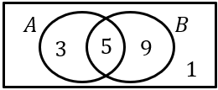
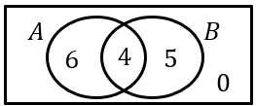
Worked example
Your turn
The Venn diagram shows the number of people who like each of two different books. Determine if $A$ and $B$ are independent.
The Venn diagram shows the number of people who like each of two different colours. Determine if $A$ and $B$ are independent.
$$P\left(A\right)=\frac{10}{15}=\frac{2}{3}$$
$$P\left(B\right)=\frac{9}{15}=\frac{3}{5}$$
$$P\left(A and B\right)=\frac{4}{15} \\ P\left(A\right)×P\left(B\right)=\frac{2}{3}×\frac{3}{5}=\frac{6}{15}≠\frac{4}{15} ∴ \text{not} \text{independent}\text{.}$$
Diagrams/Graphs used with permission from DrFrostMaths: https://www.drfrostmaths.com/

Slide 26
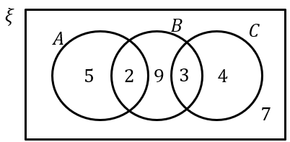
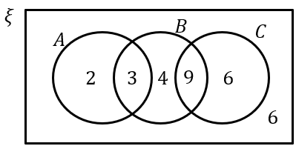
Worked example
Your turn
The Venn diagram shows the number of students in a particular class who watch any of three popular TV programmes.
Find the probability that a student chosen at random watches $A$ or $B$ or both.
The Venn diagram shows the number of students in a particular class who watch any of three popular TV programmes.
Find the probability that a student chosen at random watches $B$ or $C$ or both.
$$\frac{26}{30}=\frac{13}{15}$$
Diagrams/Graphs used with permission from DrFrostMaths: https://www.drfrostmaths.com/

Slide 27
Worked example
Your turn
The Venn diagram shows the number of students in a particular class who watch any of three popular TV programmes.
Determine whether watching $A$ and watching $B$ are statistically independent.
The Venn diagram shows the number of students in a particular class who watch any of three popular TV programmes.
Determine whether watching $A$ and watching $B$ are statistically independent.
$$P\left(A\right)=\frac{7}{30}$$
$$P\left(B\right)=\frac{19}{30} \\ P\left(A and B\right)=\frac{4}{30} \\ P\left(A\right)×P\left(B\right)=\frac{7}{30}×\frac{19}{30}=\frac{133}{900}≠\frac{4}{30} \\ ∴ \text{not} \text{independent}\text{.}$$
Diagrams/Graphs used with permission from DrFrostMaths: https://www.drfrostmaths.com/

Slide 28
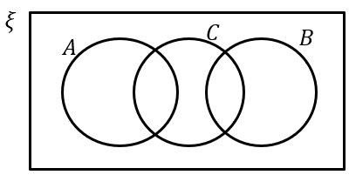
Worked example
Your turn
There are three events $D,E,F$.
The events $D$ and $E$ are mutually exclusive.
Draw a Venn diagram which represents this information.
If $P\left(D\right)=0.2$ and $P\left(E\right)=0.7$, determine $P(neither D nor E)$
There are three events $A,B,C$. The events $A$ and $B$ are mutually exclusive.
Draw a Venn diagram which represents this information.
If $P\left(A\right)=0.1$ and $P\left(B\right)=0.6$, determine $P(neither A nor B)$
a)
b) $0.3$
Diagrams/Graphs used with permission from DrFrostMaths: https://www.drfrostmaths.com/

Slide 29
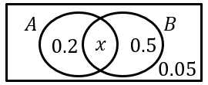
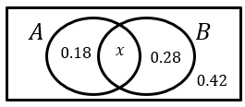
Worked example
Your turn
Determine if events A and B are independent.
Determine if events A and B are independent.
$$x=1−0.18−0.28−0.42=0.12$$
$$P\left(A\right)=0.3$$
$$P\left(B\right)=0.4 \\ P\left(A and B\right)=0.12 \\ P\left(A\right)×P\left(B\right)=0.3×0.4=0.12 \\ ∴ \text{independent}\text{.}$$
Diagrams/Graphs used with permission from DrFrostMaths: https://www.drfrostmaths.com/

Slide 30
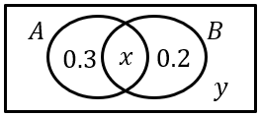
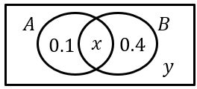
Worked example
Your turn
Given that $A$ and $B$ are independent, determine the possible values for $x$ and $y$
Given that $A$ and $B$ are independent, determine the possible values of $x$
$$x=0.3, y=0.2$$
$$x=0.2, y=0.3$$
Diagrams/Graphs used with permission from DrFrostMaths: https://www.drfrostmaths.com/

Slide 31
5.4) Tree diagrams
Chapter CONTENTS

Slide 32
Worked example
Your turn
There are three red and nine yellow counters in a bag. A counter is taken from the bag at random and not replaced. A second counter is then taken from the bag.
Determine the probability that:
Both counters are green.
The counters are different colours.
There are seven green and five blue beads in a bag. A bead is taken from the bag at random and not replaced. A second bead is then taken from the bag.
Determine the probability that:
Both beads are green.
The beads are different colours.
a) $\frac{7}{22}$
b) $\frac{35}{66}$

Slide 33
Worked example
Your turn
There are 5 blue and 4 red beads in a bag. I take two beads at random. Determine the probability that:
They are of the same colour.
They are of different colours.
There are 3 yellow and 2 green counters in a bag. I take two counters at random. Determine the probability that:
They are of the same colour.
They are of different colours.
a) $\frac{2}{5}$
b) $\frac{3}{5}$

Slide 34
Worked example
Your turn
A bag contains $15$ tokens, 3 coloured blue, 5 coloured red and 7 coloured yellow. Three tokens are drawn from the bag without replacement.
Find the probability that the third token is yellow, given that the first two are yellow.
A bag contains $14$ tokens, 4 coloured purple, 7 coloured orange and 3 coloured green. Three tokens are drawn from the bag without replacement.
Find the probability that the third token is purple, given that the first two are purple.
$$\frac{2}{12}=\frac{1}{6}$$

Slide 35
Worked example
Your turn
A bag contains $15$ tokens, 3 coloured blue, 5 coloured red and 7 coloured yellow. Three tokens are drawn from the bag without replacement.
Find the probability that all three tokens are different colours.
A bag contains $14$ tokens, 4 coloured purple, 7 coloured orange and 3 coloured green. Three tokens are drawn from the bag without replacement.
Find the probability that all three tokens are different colours.
$$\frac{3}{13}$$

Slide 36
Worked example
Your turn
The probability I hit a target on each shot is 0.4. I keep firing until I hit the target. Determine the probability I hit the target on the 6th shot.
The probability I hit a target on each shot is 0.3. I keep firing until I hit the target. Determine the probability I hit the target on the 5th shot.
$$0.07203$$

