Slide 1
5) Radians
5.1) Radian measure
5.2) Arc length
5.3) Areas of sectors and segments
5.4) Solving trigonometric equations
5.5) Small angle approximations

Slide 2
5.1) Radian measure
Chapter CONTENTS

Slide 3

Worked example
Your turn
Convert to radians:
$$180°$$
$$90°$$
$$60°$$
$$135°$$
$$720°$$
Convert to radians:
$$360°$$
$$45°$$
$$120°$$
$$315°$$
$$72°$$
$$2π$$
$$\frac{π}{4}$$
$$\frac{π}{3}$$
$$\frac{7π}{4}$$
$$\frac{2π}{5}$$

Slide 4


Worked example
Your turn
Convert to degrees:
$$3π$$
$$\frac{π}{2}$$
$$\frac{π}{6}$$
$$\frac{5π}{4}$$
$$\frac{3π}{5}$$
Convert to degrees:
$$5π$$
$$\frac{π}{3}$$
$$\frac{5π}{6}$$
$$\frac{9π}{4}$$
$$\frac{4π}{5}$$
$$900°$$
$$60°$$
$$150°$$
$$405°$$
$$144°$$

Slide 5
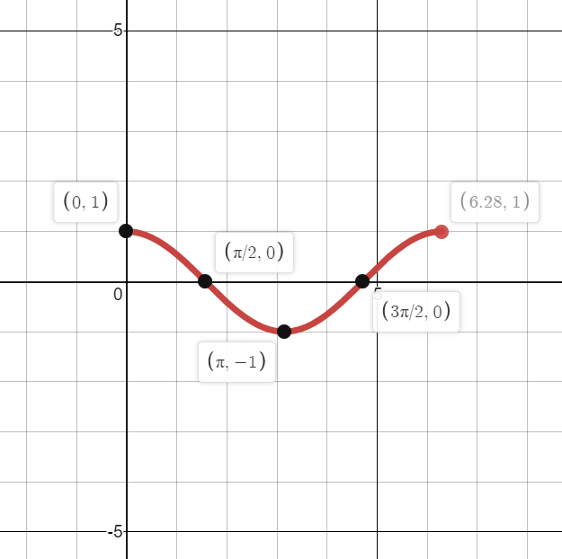

Worked example
Your turn
Sketch the graph for $0≤x≤2π$ of:
$$y=\sin{x}$$
$$y=\tan{x}$$
Sketch the graph for $0≤x≤2π$ of:
$$y=\cos{x}$$
Graphs used with permission from DESMOS: https://www.desmos.com/

Slide 6
Worked example
Your turn
Find the exact values, without a calculator:
$$\cos\left(\frac{7π}{6}\right)$$
$$\sin\left(−\frac{4π}{3}\right)$$
Find the exact values, without a calculator:
$$\cos\left(\frac{4π}{3}\right)$$
$$\sin\left(−\frac{7π}{6}\right)$$
$$−\frac{1}{2}$$
$$\frac{1}{2}$$

Slide 7
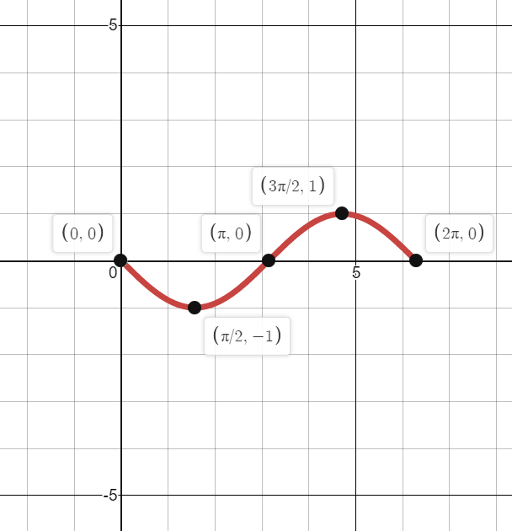

Worked example
Your turn
Sketch the graph for $0≤x≤2π$ of:
$$y=\sin{(x+\frac{π}{4})}$$
$$y=\tan\left(x−\frac{π}{3}\right)$$
Sketch the graph for $0≤x≤2π$ of:
$$y=\cos\left(x+\frac{π}{2}\right)$$
Graphs used with permission from DESMOS: https://www.desmos.com/

Slide 8
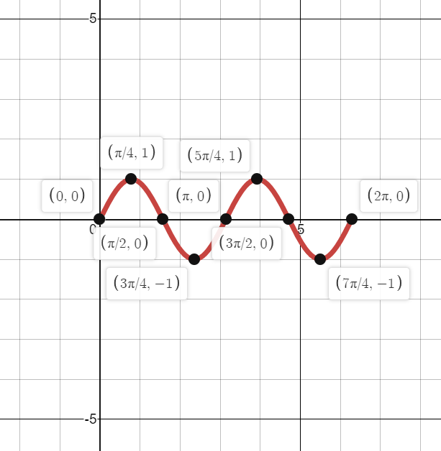

Worked example
Your turn
Sketch the graph for $0≤x≤2π$ of:
$$y=\cos{(4x)}$$
$$y=\tan\left(3x\right)$$
Sketch the graph for $0≤x≤2π$ of:
$$y=\sin\left(2x\right)$$
Graphs used with permission from DESMOS: https://www.desmos.com/

Slide 9
5.2) Arc length
Chapter CONTENTS

Slide 10
Worked example
Your turn
Find the length of the arc of a circle of radius 5.2 cm, given that the arc subtends an angle of 0.4 radians at the centre of the circle.
Find the length of the arc of a circle of radius 10.4 cm, given that the arc subtends an angle of 0.2 radians at the centre of the circle.
Find the length of the arc of a circle of radius 5.2 cm, given that the arc subtends an angle of 0.8 radians at the centre of the circle.
$$4.16 cm$$

Slide 11
Worked example
Your turn
An arc $AB$ of a circle with radius 0.35 cm and centre $O$ has a length of 2.45 cm. Find the angle $∠AOB$ subtended by the arc at the centre of the circle
An arc $AB$ of a circle with radius 0.7 cm and centre $O$ has a length of 4.9 cm. Find the angle $∠AOB$ subtended by the arc at the centre of the circle
An arc $AB$ of a circle with radius 7 cm and centre $O$ has a length of 2.45 cm. Find the angle $∠AOB$ subtended by the arc at the centre of the circle
$$0.35 rad$$

Slide 12
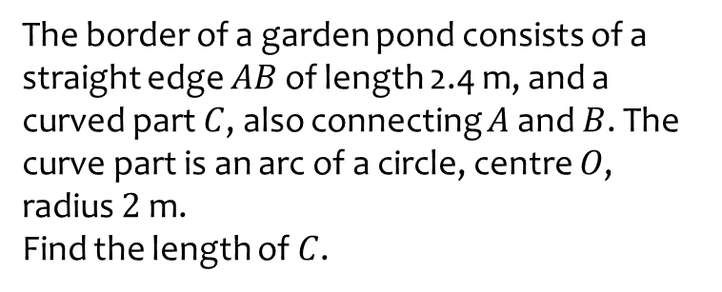
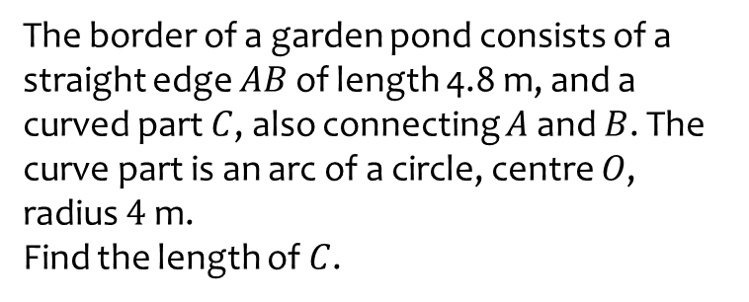
Worked example
Your turn
The border of a garden pond consists of a straight edge $AB$ of length 4.8 m, and a curved part $C$, also connecting $A$ and $B$. The curve part is an arc of a circle, centre $O$, radius $4$ m.
Find the length of $C$.
The border of a garden pond consists of a straight edge $AB$ of length 2.4 m, and a curved part $C$, also connecting $A$ and $B$. The curve part is an arc of a circle, centre $O$, radius $2$ m.
Find the length of $C$.
$9.99$m

Slide 13
Worked example
Your turn
A triangle $ABC$ is such that $AB=4 cm$, $AC=5.5 cm$ and $∠BAC=0.35$ radians.
The arc $BD$, where $D$ lies on $AC$, is an arc of a circle with centre $A$ and radius 4 cm.
A region $R$, is bounded by the straight lines $BC$ and $CD$ and the arc $BD$.
Find the perimeter of $R$
A triangle $ABC$ is such that $AB=8 cm$, $AC=11 cm$ and $∠BAC=0.7$ radians.
The arc $BD$, where $D$ lies on $AC$, is an arc of a circle with centre $A$ and radius 8 cm.
A region $R$, is bounded by the straight lines $BC$ and $CD$ and the arc $BD$.
Find the perimeter of $R$
$15.7 cm$ (3 sf)

Slide 14
Worked example
Your turn
A sector of a circle of radius $30$ cm contains an angle of $θ$ radians. Given that the perimeter of the sector is $84$ cm, find the value of $θ$
A sector of a circle of radius $15$ cm contains an angle of $θ$ radians. Given that the perimeter of the sector is $42$ cm, find the value of $θ$
$θ=0.8$rad

Slide 15
Worked example
Your turn
The perimeter of a sector OAB is four times the length of the arc AB. Find the size of angle AOB
The perimeter of a sector OAB is four times the length of the arc AB. Find the size of angle AOB
$θ=2$rad

Slide 16
5.3) Areas of sectors and segments
Chapter CONTENTS

Slide 17
Worked example
Your turn
A circle, centre O, radius 5.2 cm has a minor sector OAB where the arc AB subtends an angle of 0.4 radians at the centre of the circle.
Find the area of the sector.
A circle, centre O, radius 5.2 cm has a minor sector OAB where the arc AB subtends an angle of 0.2 radians at the centre of the circle.
Find the area of the sector.
A circle, centre O, radius 5.2 cm has a minor sector OAB where the arc AB subtends an angle of 0.8 radians at the centre of the circle.
Find the area of the sector.
$$10.816 cm^{2}$$

Slide 18
Worked example
Your turn
A circle, centre O, radius 5.2 cm has a minor sector OAB where the arc AB subtends an angle of 0.4 radians at the centre of the circle.
A segment is enclosed by a chord AB and the arc AB.
Find the area of the segment.
A circle, centre O, radius 5.2 cm has a minor sector OAB where the arc AB subtends an angle of 0.2 radians at the centre of the circle.
A segment is enclosed by a chord AB and the arc AB.
Find the area of the segment.
A circle, centre O, radius 5.2 cm has a minor sector OAB where the arc AB subtends an angle of 0.8 radians at the centre of the circle.
A segment is enclosed by a chord AB and the arc AB.
Find the area of the segment.
$1.12 cm^{2}$ (3 sf)

Slide 19
Worked example
Your turn
The area of the minor sector $AOB$ is 14.45 cm². Given that $∠AOB=0.4$ radians and O is the centre of the circle, calculate the length of the radius
The area of the minor sector $AOB$ is 28.9 cm². Given that $∠AOB=0.8$ radians and O is the centre of the circle, calculate the length of the radius
$$8.5 cm$$

Slide 20
Worked example
Your turn
A sector of a circle of radius 110 m and perimeter 352 m.
Calculate the area of the sector
A sector of a circle of radius 110 m and perimeter 176 m.
Calculate the area of the sector
$$1815 m^{2}$$

Slide 21
Worked example
Your turn
OAB is a sector of a circle, centre O, radius $8m$.
The chord $AB$ is 10m long.
Find the area of the segment.
OAB is a sector of a circle, centre O, radius $4m$.
The chord $AB$ is 5m long.
Find the area of the segment.
$3.00 m^{2}$ (3 sf)

Slide 22
Worked example
Your turn
AB is the diameter of a semicircle, centre O, radius $r$ cm.
C is a point on the semicircle.
<BOC $=θ$ radians.
Given that the area of $∆$AOC is six times the segment enclosed by CB, show that $6θ−7\sin{θ}=0$
AB is the diameter of a semicircle, centre O, radius $r$ cm.
C is a point on the semicircle.
<BOC $=θ$ radians.
Given that the area of $∆$AOC is three times the segment enclosed by CB, show that $3θ−4\sin{θ}=0$
Shown

Slide 23
Worked example
Your turn
OAB is a sector of a circle, centre O, radius $18$ cm and angle $0.35$radians.
C lies outside the sector.
AC is a straight line, perpendicular to OA.
OBC is a straight line.
Find the area of the region bounded by the arc AB and the lines AC and BC
OAB is a sector of a circle, centre O, radius $9$ cm and angle $0.7$radians.
C lies outside the sector.
AC is a straight line, perpendicular to OA.
OBC is a straight line.
Find the area of the region bounded by the arc AB and the lines AC and BC
$5.76 cm^{2}$ (3 sf)

Slide 24
Worked example
Your turn
OPQ is a sector of a circle, centre O, radius $20$ cm where <POQ$=0.6$ radians.
The point R is on OQ such that the ratio OR:RQ is $1:3$
A region is bounded by the arc PQ, QR and a line RP.
Find the perimeter of the region
Find the area of the region
OPQ is a sector of a circle, centre O, radius $10$ cm where <POQ$=0.3$ radians.
The point R is on OQ such that the ratio OR:RQ is $1:3$
A region is bounded by the arc PQ, QR and a line RP.
Find the perimeter of the region
Find the area of the region
a) $18.1 cm$ (3 sf)
b) $11.3 cm^{2}$ (3 sf)

Slide 25
5.4) Solving trigonometric equations
Chapter CONTENTS

Slide 26
Worked example
Your turn
Solve in the interval $0≤θ≤2π$: $$\cos{θ}=\frac{1}{2}$$
$$\tan{θ}=1$$
Solve in the interval $0≤θ≤2π$: $$\sin{θ}=\frac{1}{2}$$
$$θ=\frac{π}{6},\frac{5π}{6}$$

Slide 27
Worked example
Your turn
Solve in the interval $0≤θ≤2π$: $$\cos{θ}+1=\frac{1}{2}$$
$$\tan{θ}−2=1$$
Solve in the interval $0≤θ≤2π$: $$\sin{θ}+1=\frac{1}{2}$$
$$θ=\frac{7π}{6},\frac{11π}{6}$$

Slide 28

Worked example
Your turn
Solve in the interval $0≤θ≤2π$: $$5\cos{θ}+2=2.3$$
$$4\tan{θ}−5=1$$
Solve in the interval $0≤θ≤2π$: $$3\sin{θ}+1=0.4$$
$θ=3.34, 6.08$ (3 sf)

Slide 29

Worked example
Your turn
Solve in the interval $0≤θ≤2π$: $$\cos{(θ}−\frac{π}{2})=\frac{1}{2}$$
$$\tan{(θ+\frac{π}{3})}=1$$
Solve in the interval $0≤θ≤2π$: $$\sin{(θ}−\frac{π}{4})=\frac{1}{2}$$
$$θ=\frac{5π}{12},\frac{13π}{12}$$

Slide 30
Worked example
Your turn
Solve in the interval $0≤θ≤2π$: $$\cos{5θ}=\frac{\sqrt{3}}{2}$$
$$\tan{4θ}=\sqrt{3}$$
Solve in the interval $0≤θ≤2π$: $$\sin{3θ}=\frac{\sqrt{3}}{2}$$
$$θ=\frac{π}{9},\frac{2π}{9},\frac{7π}{9},\frac{8π}{9},\frac{13π}{9},\frac{14π}{9}$$

Slide 31
Worked example
Your turn
Solve in the interval $0≤θ≤2π$: $$\cos^{2}{θ=\frac{3}{4}}$$
$$\tan^{2}{θ}=3$$
Solve in the interval $0≤θ≤2π$: $$\sin^{2}{θ}=\frac{1}{4}$$
$$θ=\frac{π}{6},\frac{5π}{6},\frac{7π}{6},\frac{11π}{6}$$

Slide 32

Worked example
Your turn
Solve in the interval $0≤θ≤2π$: $${2cos}^{2}{θ+5\cos{θ}−3=0}$$
$$2\tan^{2}{θ}−5\tan{θ−3=0}$$
Solve in the interval $0≤θ≤2π$: $${2sin}^{2}{θ−5\sin{θ}−3=0}$$
$$θ=\frac{7π}{6},\frac{11π}{6}$$

Slide 33

Worked example
Your turn
Solve in the interval $0≤θ≤2π$: $${5cos}^{2}{θ+2\cos{θ}=0}$$
$$4\tan^{2}{θ}−3\tan{θ=0}$$
Solve in the interval $0≤θ≤2π$: $${5sin}^{2}{θ−2\sin{θ}=0}$$
$$θ=0, 0.412, 2.73, π, 2π$$

Slide 34
Worked example
Your turn
Solve in the interval $0≤θ≤2π$: $$5\cos{θ}sinθ+2cos{θ=0}$$
Solve in the interval $0≤θ≤2π$: $$5\cos{θ}sinθ+2sin{θ=0}$$
$$θ=0, 1.98, π, 4.30, 2π$$

Slide 35
Worked example
Your turn
Solve in the interval $0≤θ<2π$: $$4\tan{x}=5\cos{x}$$
Solve in the interval $0≤θ<2π$: $$2\tan{x}=3\sin{x}$$
$$θ=0, 0.841, π, 5.44$$

Slide 36
Worked example
Your turn
Find all the solutions, in the interval
$0 ≤ x < 2π$, of the equation
$2 sin2 x + 1 =−5 cos⁡x$,
giving each solution in terms of $π$.
Find all the solutions, in the interval
$0 ≤ x < 2π$, of the equation
$2 cos2 x + 1 = 5 sin⁡x$,
giving each solution in terms of $π$.
$$x=\frac{π}{6},\frac{5π}{6}$$

Slide 37
5.5) Small angle approximations
Chapter CONTENTS

Slide 38
Worked example
Your turn
When $θ$ is small, find the approximate value of:
$\frac{\sin{θ}+\tan{4θ}}{3θ}$
$\frac{\cos{6θ}−1}{θ\tan{3θ}}$
$\sin{3θ}+\tan{4θ}−\cos{5θ}$
When $θ$ is small, find the approximate value of:
$\frac{\sin{2θ}+\tan{θ}}{2θ}$
$\frac{\cos{4θ}−1}{θ\sin{2θ}}$
$\sin{5θ}+\tan{2θ}−\cos{2θ}$
a) $\frac{3}{2}$
b) $−4$
c) $−1$

Slide 39
Worked example
Your turn
Find the percentage error when calculating the value of $\cos{(0.123} rad)$ using the small-angle approximations
Find the percentage error when calculating the value of $\cos{(0.246} rad)$ using the small-angle approximations
$0.015701\%$ (6 dp)

Slide 40
Worked example
Your turn
When $θ$ is small, find the approximate value of:
$$\frac{\sin{θ}−\cos{6θ}−4}{\sin{2θ}−1}$$
When $θ$ is small, find the approximate value of:
$$\frac{1−2\tan{θ−}4\cos{2θ}}{\tan{2θ}+1}$$
$$−3$$

