Slide 1
5) Forces and friction
5.1) Resolving forces
5.2) Inclined planes
5.3) Friction

Slide 2
5.1) Resolving forces
Chapter CONTENTS

Slide 3
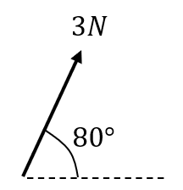
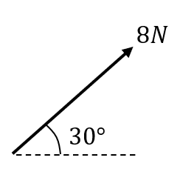
Worked example
Your turn
Convert each force to the form $ai+bj$, where $i$ and $j$ are the positive $x$ and $y$ directions respectively.
Convert each force to the form $ai+bj$, where $i$ and $j$ are the positive $x$ and $y$ directions respectively.
$$4\sqrt{3} i+4j$$
Diagrams/Graphs used with permission from DrFrostMaths: https://www.drfrostmaths.com/

Slide 4
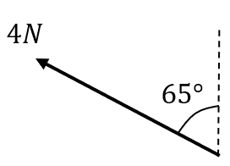
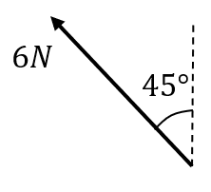
Worked example
Your turn
Convert each force to the form $ai+bj$, where $i$ and $j$ are the positive $x$ and $y$ directions respectively.
Convert each force to the form $ai+bj$, where $i$ and $j$ are the positive $x$ and $y$ directions respectively.
$$−3\sqrt{2} i+3\sqrt{2}j$$
Diagrams/Graphs used with permission from DrFrostMaths: https://www.drfrostmaths.com/

Slide 5
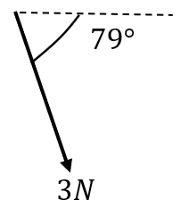
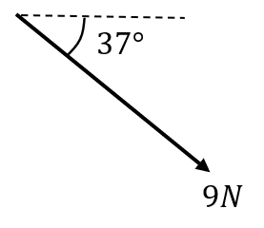
Worked example
Your turn
Convert each force to the form $ai+bj$, where $i$ and $j$ are the positive $x$ and $y$ directions respectively.
Convert each force to the form $ai+bj$, where $i$ and $j$ are the positive $x$ and $y$ directions respectively.
$7.19i−5.42j$ (3 sf)
Diagrams/Graphs used with permission from DrFrostMaths: https://www.drfrostmaths.com/

Slide 6
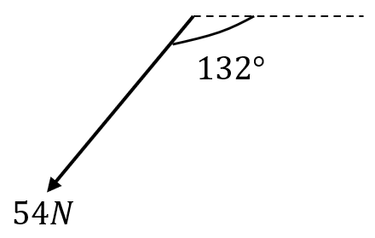
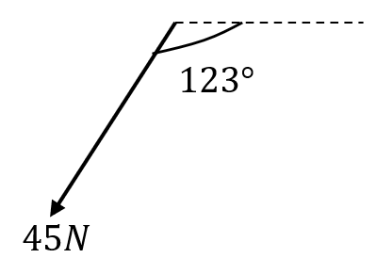
Worked example
Your turn
Convert each force to the form $ai+bj$, where $i$ and $j$ are the positive $x$ and $y$ directions respectively.
Convert each force to the form $ai+bj$, where $i$ and $j$ are the positive $x$ and $y$ directions respectively.
$$−24.5i−37.7j$$
Diagrams/Graphs used with permission from DrFrostMaths: https://www.drfrostmaths.com/

Slide 7
Worked example
Your turn
A box of mass 10kg lies on a smooth horizontal floor.
A force of 8N is applied at an angle of $50°$ causing the box to accelerate horizontally along the floor.
Work out the acceleration of the box.
Calculate the normal reaction between the box and the floor.
A box of mass 8kg lies on a smooth horizontal floor.
A force of 10N is applied at an angle of $30°$ causing the box to accelerate horizontally along the floor.
Work out the acceleration of the box.
Calculate the normal reaction between the box and the floor.
a) $\frac{5\sqrt{3}}{8} ms^{−2}=1.1 ms^{−2}$ (2 sf)
b) $73 N$ (2 sf)

Slide 8
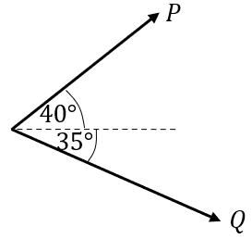
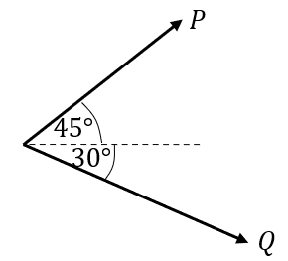
Worked example
Your turn
Two forces $P$ and $Q$ act on a particle as shown.
$P$ has a magnitude of $5$N and $Q$ has a magnitude of $4$N. Work out the magnitude and direction of the resultant force.
Two forces $P$ and $Q$ act on a particle as shown. $P$ has a magnitude of $10$N and $Q$ has a magnitude of $8$N.
Work out the magnitude and direction of the resultant force.
$14.3 N$ (3 sf) acting at an angle of $12.4°$(3 sf) above the horizontal.
Diagrams/Graphs used with permission from DrFrostMaths: https://www.drfrostmaths.com/

Slide 9
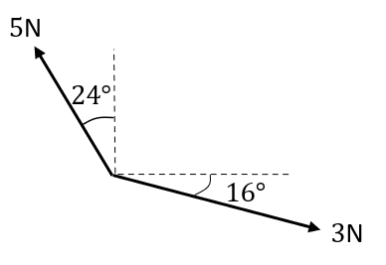
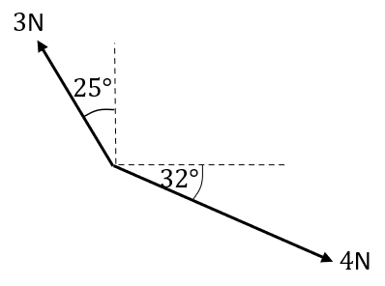
Worked example
Your turn
Two forces act on a particle as shown.
Determine the magnitude and direction (anticlockwise from the positive $x$ direction) of the resultant force.
Two forces act on a particle as shown.
Determine the magnitude and direction (anticlockwise from the positive $x$ direction) of the resultant force.
$2.21 N$ (3 sf) acting at an angle of $15.8°$ (3 sf)
Diagrams/Graphs used with permission from DrFrostMaths: https://www.drfrostmaths.com/

Slide 10
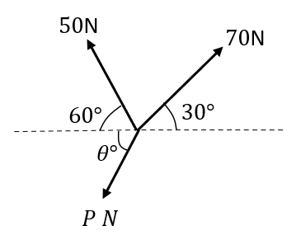
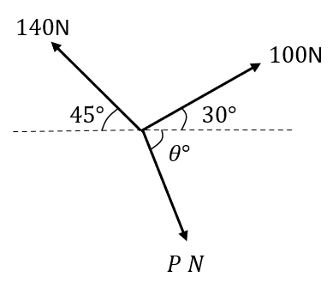
Worked example
Your turn
Three forces act on a particle as shown.
Given that the particle is in equilibrium, calculate the magnitude of $P$
Three forces act on a particle as shown.
Given that the particle is in equilibrium, calculate the magnitude of $P$
$150 N$ (3 sf)
Diagrams/Graphs used with permission from DrFrostMaths: https://www.drfrostmaths.com/

Slide 11
5.2) Inclined planes
Chapter CONTENTS

Slide 12
Worked example
Your turn
A block of mass 15kg slides down a smooth slope angled at $10°$ to the horizontal.
Calculate the magnitude of the normal reaction of the slope on the block.
Find the acceleration of the block.
A block of mass 10kg slides down a smooth slope angled at $15°$ to the horizontal.
Calculate the magnitude of the normal reaction of the slope on the block.
Find the acceleration of the block.
a) $95 N$ (2 sf)
b) $2.5 ms^{−2}$ (2 sf)

Slide 13
Worked example
Your turn
A particle of mass $m$ is pushed up a smooth slope, inclined at $60°$ by a force of magnitude $10g$ N acting at angle of $30°$ to the slope, causing the particle to accelerate up the slope at 0.25 $ms^{−2}$.
Show that the mass of the particle is $\left(\frac{20\sqrt{3}g}{1+2\sqrt{3}g}\right)$ kg
A particle of mass $m$ is pushed up a smooth slope, inclined at $30°$ by a force of magnitude $5g$ N acting at angle of $60°$ to the slope, causing the particle to accelerate up the slope at 0.5 $ms^{−2}$.
Show that the mass of the particle is $\left(\frac{5g}{1+g}\right)$ kg
Shown

Slide 14
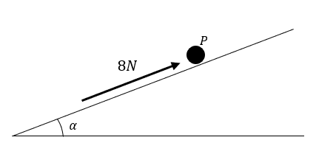
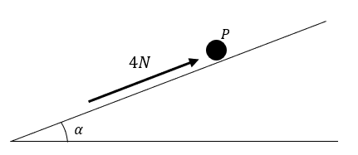
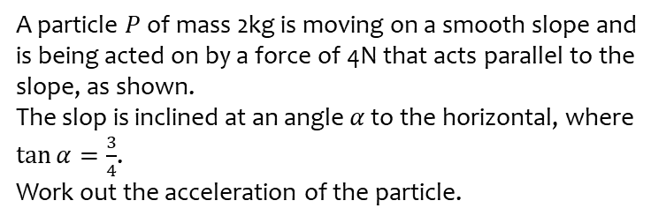
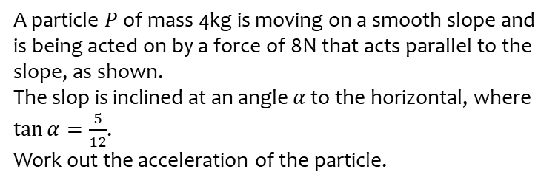
Worked example
Your turn
A particle $P$ of mass 4kg is moving on a smooth slope and is being acted on by a force of 8N that acts parallel to the slope, as shown.
The slop is inclined at an angle $α$ to the horizontal, where $\tan{α}=\frac{5}{12}$.
Work out the acceleration of the particle.
A particle $P$ of mass 2kg is moving on a smooth slope and is being acted on by a force of 4N that acts parallel to the slope, as shown.
The slop is inclined at an angle $α$ to the horizontal, where $\tan{α}=\frac{3}{4}$.
Work out the acceleration of the particle.
$3.9 ms^{−2}$ down the slope
Diagrams/Graphs used with permission from DrFrostMaths: https://www.drfrostmaths.com/

Slide 15
5.3) Friction
Chapter CONTENTS

Slide 16
Worked example
Your turn
A particle of mass 10kg is pulled along a rough horizontal surface by a horizontal force of magnitude 40N. The coefficient of friction between the particle and the floor is 0.4. Calculate:
the magnitude of frictional force
the acceleration of the particle.
A particle of mass 5kg is pulled along a rough horizontal surface by a horizontal force of magnitude 20N. The coefficient of friction between the particle and the floor is 0.2. Calculate:
the magnitude of frictional force
the acceleration of the particle.
a) $9.8 N$ (2 sf)
b) $2.0 ms^{−2}$ (2 sf)

Slide 17
Worked example
Your turn
A block of mass $10 kg$ lies on rough horizontal ground.
The coefficient of friction between the block and the ground is $0.4$.
A horizontal force $P$ is applied to the block.
Find the magnitude of the frictional force acting on the block and the acceleration of the block when the magnitude of $P$ is:
a) $30 N$
b) $39.2 N$
c) $90 N$
A block of mass $5 kg$ lies on rough horizontal ground.
The coefficient of friction between the block and the ground is $0.4$.
A horizontal force $P$ is applied to the block.
Find the magnitude of the frictional force acting on the block and the acceleration of the block when the magnitude of $P$ is:
a) $10 N$
b) $19.6 N$
c) $30 N$
a) $10 N$ ; $0 ms^{−2}$ ; Block at rest in equilibrium
b) $19.6 N$ ; $0 ms^{−2}$ ; Block at rest in limiting equilibrium
c) $19.6 N$ ; $2.1 ms^{−2}$ in the direction of $P$

Slide 18
Worked example
Your turn
A particle of mass 4kg is sliding down a rough slope that is inclined at $60°$ to the horizontal.
Given that the acceleration of the particle is 2 $ms^{−2}$, find the coefficient of friction $μ$ between the particle and the slope.
A particle of mass 2kg is sliding down a rough slope that is inclined at $30°$ to the horizontal.
Given that the acceleration of the particle is 1 $ms^{−2}$, find the coefficient of friction $μ$ between the particle and the slope.
$0.46$ (2 sf)

Slide 19
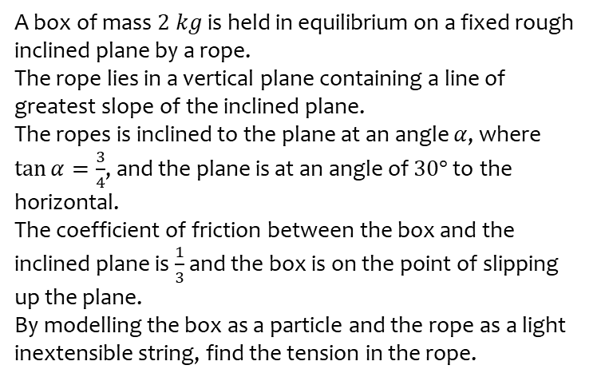
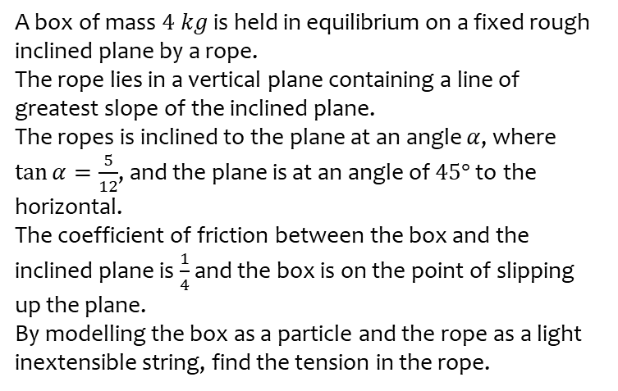
Worked example
Your turn
A box of mass $4 kg$ is held in equilibrium on a fixed rough inclined plane by a rope.
The rope lies in a vertical plane containing a line of greatest slope of the inclined plane.
The ropes is inclined to the plane at an angle $α$, where $\tan{α}=\frac{5}{12}$, and the plane is at an angle of $45°$ to the horizontal.
The coefficient of friction between the box and the inclined plane is $\frac{1}{4}$ and the box is on the point of slipping up the plane.
By modelling the box as a particle and the rope as a light inextensible string, find the tension in the rope.
A box of mass $2 kg$ is held in equilibrium on a fixed rough inclined plane by a rope.
The rope lies in a vertical plane containing a line of greatest slope of the inclined plane.
The ropes is inclined to the plane at an angle $α$, where $\tan{α}=\frac{3}{4}$, and the plane is at an angle of $30°$ to the horizontal.
The coefficient of friction between the box and the inclined plane is $\frac{1}{3}$ and the box is on the point of slipping up the plane.
By modelling the box as a particle and the rope as a light inextensible string, find the tension in the rope.
$15 N$ (2 sf)

