Slide 1
5) Elastic collisions in two dimensions
5.1) Oblique impact with a fixed surface
5.2) Successive oblique impacts
5.3) Oblique impact of smooth spheres

Slide 2
5.1) Oblique impact with a fixed surface
Chapter CONTENTS

Slide 3
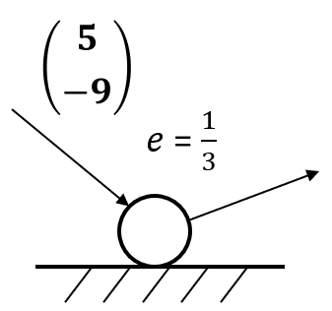
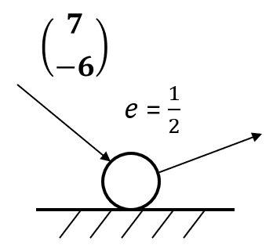
Worked example
Your turn
A smooth sphere hits a smooth horizontal plane. Find the velocity after the collision.
A smooth sphere hits a smooth horizontal plane. Find the velocity after the collision.
$$\left({7 \atop 3}\right)$$
Diagrams used with permission from DrFrostMaths: https://www.drfrostmaths.com/

Slide 4
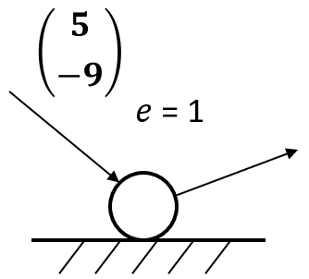
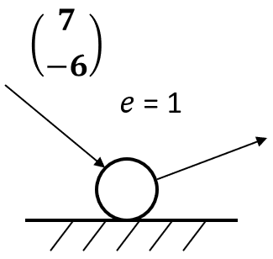
Worked example
Your turn
A smooth sphere hits a smooth horizontal plane. Find the velocity after the collision.
A smooth sphere hits a smooth horizontal plane. Find the velocity after the collision.
$$\left({7 \atop 6}\right)$$
Diagrams used with permission from DrFrostMaths: https://www.drfrostmaths.com/

Slide 5
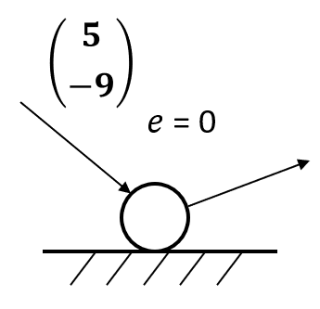
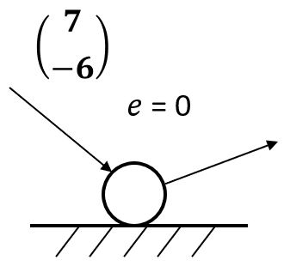
Worked example
Your turn
A smooth sphere hits a smooth horizontal plane. Find the velocity after the collision.
A smooth sphere hits a smooth horizontal plane. Find the velocity after the collision.
$$\left({7 \atop 0}\right)$$
Diagrams used with permission from DrFrostMaths: https://www.drfrostmaths.com/

Slide 6
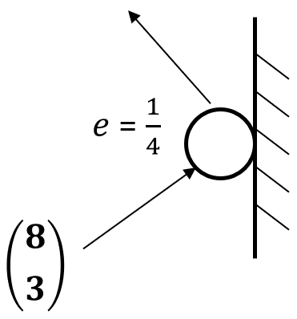
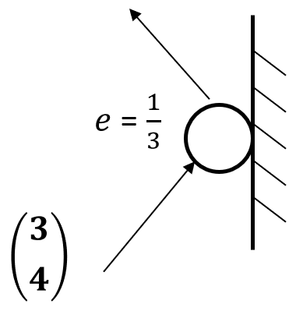
Worked example
Your turn
A smooth sphere hits a smooth vertical plane. Find the velocity after the collision.
A smooth sphere hits a smooth horizontal plane. Find the velocity after the collision.
$$\left({−1 \atop 3}\right)$$
Diagrams used with permission from DrFrostMaths: https://www.drfrostmaths.com/

Slide 7
Worked example
Your turn
A smooth sphere S is moving on a smooth horizontal plane with speed $u$ when it collides with a smooth fixed vertical wall.
At the instant of collision the direction of motion of S makes an angle of 30$°$ with the wall. The coefficient of restitution between S and the wall is $\frac{1}{2}$. Find:
The speed of S immediately after the collision
The angle of deflection of S
A smooth sphere S is moving on a smooth horizontal plane with speed $u$ when it collides with a smooth fixed vertical wall.
At the instant of collision the direction of motion of S makes an angle of 60$°$ with the wall. The coefficient of restitution between S and the wall is $\frac{1}{4}$. Find:
The speed of S immediately after the collision
The angle of deflection of S
a) $\frac{\sqrt{19}}{8}u$
b) $83.4°$(3 sf)

Slide 8
Worked example
Your turn
A small smooth ball is falling vertically. The ball strikes a smooth plane which is inclined at an angle $α$ to the horizontal, where $\tan{α}=\frac{1}{3}$. Immediately before striking the plane the ball has speed $10 ms^{−1}$. The coefficient of restitution between the ball and the plane is $\frac{1}{3}$.
Find the speed of the ball immediately after impact.
A small smooth ball is falling vertically. The ball strikes a smooth plane which is inclined at an angle $α$ to the horizontal, where $\tan{α}=\frac{1}{2}$. Immediately before striking the plane the ball has speed $5 ms^{−1}$. The coefficient of restitution between the ball and the plane is $\frac{1}{2}$.
Find the speed of the ball immediately after impact.
$3.16 ms^{−1}$ (3 sf)

Slide 9
Worked example
Your turn
A small smooth ball of mass $4 kg$ is moving in the $xy$-plane and collides with a smooth fixed vertical wall which contains the $y$-axis. The velocity of the ball just before impact is $\left(−12i−8j\right) ms^{−1}$. The coefficient of restitution between the sphere and the wall is $\frac{1}{2}$. Find:
The velocity of the ball immediately after the impact.
The kinetic energy lost as a result of the impact.
The angle of deflection of the ball
A small smooth ball of mass $2 kg$ is moving in the $xy$-plane and collides with a smooth fixed vertical wall which contains the $y$-axis. The velocity of the ball just before impact is $\left(−6i−4j\right) ms^{−1}$. The coefficient of restitution between the sphere and the wall is $\frac{1}{3}$. Find:
The velocity of the ball immediately after the impact.
The kinetic energy lost as a result of the impact.
The angle of deflection of the ball
a) $\left(2i−4j\right) ms^{−1}$
b) $32 J$
c) $82.9°$ (3 sf)

Slide 10
Worked example
Your turn
A smooth sphere S, of mass m, is moving with velocity $7i+2j$when it collides with a smooth fixed vertical wall. After the collision the velocity of the sphere, S, is $3i – 3j$
The impulse exerted by the wall on the ball.
Use the scalar product to find the coefficient of restitution between the sphere and the wall.
A smooth sphere S, of mass m, is moving with velocity $2i+7j$when it collides with a smooth fixed vertical wall. After the collision the velocity of the sphere, S, is $i – 3j$
The impulse exerted by the wall on the ball.
Use the scalar product to find the coefficient of restitution between the sphere and the wall.
a) $m(−i−10j)$
b) $\frac{29}{72}$

Slide 11
5.2) Successive oblique impacts
Chapter CONTENTS

Slide 12
Worked example
Your turn
Two vertical walls meet at right angles. A smooth sphere slides across a smooth, horizontal floor, bouncing off each wall in turn. Just before the first impact the sphere is moving with speed 8$ms^{−1}$ at an angle of 60$°$. The coefficient of restitution between the sphere and both walls is $\frac{1}{4}.$ Find
The direction of motion and speed of the sphere after the first collision
The direction of motion and speed of the sphere after the second collision.
Two vertical walls meet at right angles. A smooth sphere slides across a smooth, horizontal floor, bouncing off each wall in turn. Just before the first impact the sphere is moving with speed 4$ms^{−1}$ at an angle of 30$°$. The coefficient of restitution between the sphere and both walls is $\frac{3}{4}.$ Find
The direction of motion and speed of the sphere after the first collision
The direction of motion and speed of the sphere after the second collision.
Angle of $23.4°$ (3 sf) to the first wall ; Speed $3.77 ms^{−1}$ (3 sf)
Angle of $60°$ to the second wall ; Speed $3 ms^{−1}$

Slide 13
Worked example
Your turn
Two cushions of a snooker table $W_{1}$ and $W_{2}$ meet at right angles. A snooker ball travels across the table and collides with $W_{1}$ then $W_{2}$. The cushions are modelled as smooth. Just before the first impact the ball is moving with speed $u ms^{−1}$ at an angle of $40°$ to $W_{1}$. The coefficients of restitution between the ball and the cushions $W_{1}$ and $W_{2}$ are $\frac{1}{3}$ and $\frac{2}{7}$ respectively.
Find the percentage of the ball’s original kinetic energy that is lost in the collision
Two cushions of a snooker table $W_{1}$ and $W_{2}$ meet at right angles. A snooker ball travels across the table and collides with $W_{1}$ then $W_{2}$. The cushions are modelled as smooth. Just before the first impact the ball is moving with speed $u ms^{−1}$ at an angle of $20°$ to $W_{1}$. The coefficients of restitution between the ball and the cushions $W_{1}$ and $W_{2}$ are $\frac{1}{2}$ and $\frac{2}{5}$ respectively.
Find the percentage of the ball’s original kinetic energy that is lost in the collision
$$83\%$$

Slide 14
Worked example
Your turn
Two smooth vertical walls stand on a smooth horizontal surface and intersect at an angle of $30°$. A smooth sphere is projected across the surface with speed $2 ms^{−1}$ at an angle of $40°$ to one of the walls and towards the intersection of the walls. The coefficient of restitution between the sphere and the walls is $0.4$. Work out the speed and direction of motion of the sphere after:
The first collision
The second collision
Two smooth vertical walls stand on a smooth horizontal surface and intersect at an angle of $60°$. A smooth sphere is projected across the surface with speed $1 ms^{−1}$ at an angle of $20°$ to one of the walls and towards the intersection of the walls. The coefficient of restitution between the sphere and the walls is $0.4$. Work out the speed and direction of motion of the sphere after:
The first collision
The second collision
Angle of $8.28°$ (3 sf) to the first wall ; Speed $0.950 ms^{−1}$ (3 sf)
b) Angle of $45.1°$ (3 sf) to the second wall ;
Speed $0.498 ms^{−1}$ (3 sf)

Slide 15
Worked example
Your turn
AB and BC are smooth vertical walls stood on a smooth floor. The angle between AB and BC is 150°. A ball is projected along the floor towards AB with speed $u m^{−1}$ on a path at an angle of 30° to AB. The ball hits AB and then hits BC. The ball is modelled as a particle. The coefficient of restitution between the ball and each wall is $\frac{1}{4}$.
Find the speed of the ball immediately after it has hit AB.
The speed of the ball immediately after it has hit BC is w m s^{–1}. Find w in terms of u.
AB and BC are smooth vertical walls stood on a smooth floor. The angle between AB and BC is 120°. A ball is projected along the floor towards AB with speed $u m^{−1}$ on a path at an angle of 60° to AB. The ball hits AB and then hits BC. The ball is modelled as a particle. The coefficient of restitution between the ball and each wall is $\frac{1}{2}$.
Find the speed of the ball immediately after it has hit AB.
The speed of the ball immediately after it has hit BC is w m s^{–1}. Find w in terms of u.
a) $\frac{\sqrt{7}}{4}u$
b) $0.634u$

Slide 16
Worked example
Your turn
Two smooth vertical walls stand on a smooth horizontal floor and intersect at an acute angle $θ$. A small smooth particle is projected along the floor at right angles to one of the walls and away from it. After one impact with each wall the particle is moving parallel to the first wall it struck. Given that the coefficient of restitution between the particle and each wall is $e$ show that: $$\left(1+2e\right)\tan^{2}{θ=e^{2}}$$
Two smooth vertical walls stand on a smooth horizontal floor and intersect at an acute angle $θ$. A small smooth particle is projected along the floor at right angles to one of the walls and away from it. After one impact with each wall the particle is moving parallel to the first wall it struck. Given that the coefficient of restitution between the particle and each wall is $e$ show that: $$\left(1+2e\right)\tan^{2}{θ=e^{2}}$$
Shown

Slide 17
5.3) Oblique impact of smooth spheres
Chapter CONTENTS

Slide 18
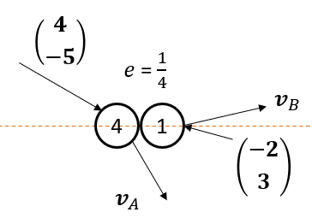
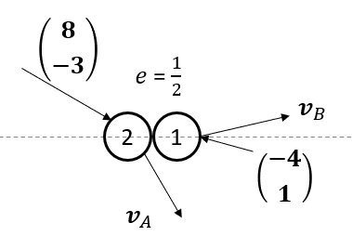
Worked example
Your turn
Two smooth spheres collide obliquely.
Find the velocity of each sphere immediately after impact.
Two smooth spheres collide obliquely.
Find the velocity of each sphere immediately after impact.
$$v_{A}=\left({2 \atop −3}\right), v_{B}=\left({8 \atop 1}\right)$$

Slide 19
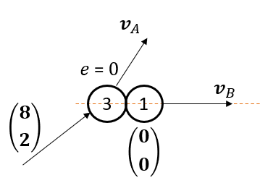
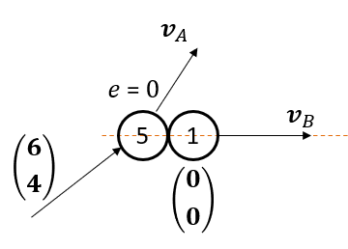
Worked example
Your turn
Two smooth spheres collide obliquely.
Find the velocity of each sphere immediately after impact.
Two smooth spheres collide obliquely.
Find the velocity of each sphere immediately after impact.
$$v_{A}=\left({5 \atop 4}\right), v_{B}=\left({5 \atop 0}\right)$$
Diagrams used with permission from DrFrostMaths: https://www.drfrostmaths.com/

Slide 20
Worked example
Your turn
A smooth sphere A, of mass $4 kg$ and moving with speed $12 ms^{−1}$, collides obliquely with a smooth sphere B of mass $8 kg$. Just before the impact B is stationary and the velocity of A makes an angle of $30°$ with the lines of centres of the two spheres. The coefficient of restitution between the spheres is $\frac{1}{2}$. Find the magnitudes and directions of the velocities of A and B immediately after the impact.
A smooth sphere A, of mass $2 kg$ and moving with speed $6 ms^{−1}$, collides obliquely with a smooth sphere B of mass $4 kg$. Just before the impact B is stationary and the velocity of A makes an angle of $60°$ with the lines of centres of the two spheres. The coefficient of restitution between the spheres is $\frac{1}{4}$. Find the magnitudes and directions of the velocities of A and B immediately after the impact.
A: Speed $5.22 ms^{−1}$ (3 sf) at angle of $84.5°$ (3 sf) to the line of centres
B: Speed $1.25$ $ms^{−1}$ along the line of centres

Slide 21
Worked example
Your turn
A small smooth sphere A of mass 1kg collides with a small smooth sphere B of mass 4kg.
Just before the impact A is moving with a speed of 8$ms^{−1}$ in a direction at $30°$ to the line of centres and B is moving with a speed 2$ms^{−1}$ at 4$5°$ to the line of centres.
The coefficient of restitution between the spheres is $\frac{1}{4}.$ Find:
The kinetic energy lost in the impact
The magnitude of the impulse exerted by A on B
A small smooth sphere A of mass 1kg collides with a small smooth sphere B of mass 2kg.
Just before the impact A is moving with a speed of 4$ms^{−1}$ in a direction at $45°$ to the line of centres and B is moving with a speed 3$ms^{−1}$ at 60$°$ to the line of centres.
The coefficient of restitution between the spheres is $\frac{3}{4}.$ Find:
The kinetic energy lost in the impact
The magnitude of the impulse exerted by A on B
a) $2.73 J$ (3 sf)
b) $5.05 Ns$ (3 sf)

Slide 22
Worked example
Your turn
A smooth sphere A of mass $10 kg$ is moving on a smooth horizontal surface with velocity $\left(4i+6j\right) ms^{−1}$.
Another smooth sphere B of mass $6 kg$ and the same radius as A is moving on the same surface with velocity $\left(8i−4j\right) ms^{−1}$.
The spheres collide when their line of centres is parallel to $j$.
The coefficient of restitution between the spheres is $\frac{2}{5}$. Find the velocities of both spheres after the impact.
A smooth sphere A of mass $5 kg$ is moving on a smooth horizontal surface with velocity $\left(2i+3j\right) ms^{−1}$.
Another smooth sphere B of mass $3 kg$ and the same radius as A is moving on the same surface with velocity $\left(4i−2j\right) ms^{−1}$.
The spheres collide when their line of centres is parallel to $j$.
The coefficient of restitution between the spheres is $\frac{3}{5}$. Find the velocities of both spheres after the impact.
$v_{A}=2i ms^{−1}$ ; $v_{B}=\left(4i+3j\right) ms^{−1}$

Slide 23
Worked example
Your turn
Two small smooth spheres A and B have equal radii. The mass of A is $4m kg$ and the mass of $B$ is $5m kg$. The spheres are moving on a smooth horizontal plane and they collide.
Immediately before the collision the velocity of A is $10j ms^{−1}$ and the velocity of B is $\left(6i−2j\right) ms^{−1}$. Immediately after the collision the velocity of A is $\left(6i+4j\right) ms^{−1}$. Find:
The speed of B immediately after the collision
A unit vector parallel to the line of centres of the spheres at the instant of the collision
Two small smooth spheres A and B have equal radii. The mass of A is $2m kg$ and the mass of $B$ is $3m kg$. The spheres are moving on a smooth horizontal plane and they collide.
Immediately before the collision the velocity of A is $5j ms^{−1}$ and the velocity of B is $\left(3i−j\right) ms^{−1}$. Immediately after the collision the velocity of A is $\left(3i+2j\right) ms^{−1}$. Find:
The speed of B immediately after the collision
A unit vector parallel to the line of centres of the spheres at the instant of the collision
a) $1.41 ms^{−1}$ (3 sf)
b) $\frac{1}{\sqrt{2}}(i−j)$

Slide 24
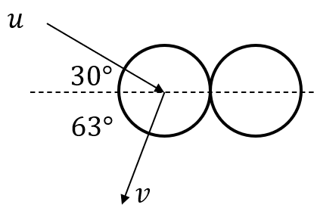
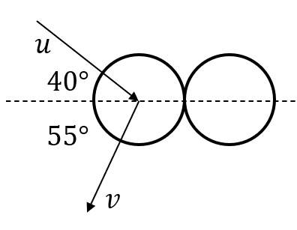
Worked example
Your turn
Find the angle of deflection
Find the angle of deflection
$$85°$$
Diagrams used with permission from DrFrostMaths: https://www.drfrostmaths.com/

Slide 25
Worked example
Your turn
A smooth uniform sphere S, of mass $m$, is moving on a smooth horizontal plane when it collides obliquely with another smooth uniform sphere T, of the same radius as S but of mass $4m$, which is at rest on the plane. Immediately before the collision the velocity of S makes an angle $α$, where $\tan{α}=\frac{5}{12}$, with the line joining the centres of the spheres. Immediately after the collision the speed of $T$ is $V$. The coefficient of restitution between the two spheres is $\frac{1}{4}$.
a) Find, in terms of $V$, the speed of S
Immediately before the collision
Immediately after the collision
b) Find the angle through which the direction
of motion of S is deflected as a result of the
collision
A smooth uniform sphere S, of mass $m$, is moving on a smooth horizontal plane when it collides obliquely with another smooth uniform sphere T, of the same radius as S but of mass $2m$, which is at rest on the plane. Immediately before the collision the velocity of S makes an angle $α$, where $\tan{α}=\frac{3}{4}$, with the line joining the centres of the spheres. Immediately after the collision the speed of $T$ is $V$. The coefficient of restitution between the two spheres is $\frac{3}{4}$.
a) Find, in terms of $V$, the speed of S
Immediately before the collision
Immediately after the collision
b) Find the angle through which the direction
of motion of S is deflected as a result of the
collision
i) $−\frac{2V}{7}$
ii) $\frac{V\sqrt{85}}{7}$
b) $65.7°$ (3 sf)

Slide 26
Worked example
Your turn
Two small smooth spheres $A$and $B$ have equal radii. The mass of $A$ is $m$kg and the mass of B is $10m$kg. The spheres are moving on a smooth horizontal plane and they collide.
Immediately before the collision the velocity of $A$ is $(4i+2j$) $ms^{−1}$ and $B$ is stationary. Immediately after the collision the velocity of $A$ is $4j ms^{−1}$. Find:
The velocity of $B$ after the collision
The coefficient of restitution between the two spheres
Two small smooth spheres $A$and $B$ have equal radii. The mass of $A$ is $2m$kg and the mass of B is $20m$kg. The spheres are moving on a smooth horizontal plane and they collide.
Immediately before the collision the velocity of $A$ is $(2i+j$) $ms^{−1}$ and $B$ is stationary. Immediately after the collision the velocity of $A$ is $2j ms^{−1}$. Find:
The velocity of $B$ after the collision
The coefficient of restitution between the two spheres
$\left(0.2i−0.1j\right) ms^{−1}$
$e=\frac{5}{6}$

