Slide 1
4.7) Transforming functions

Slide 2
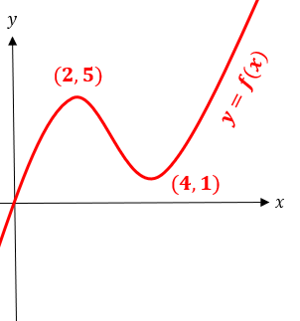
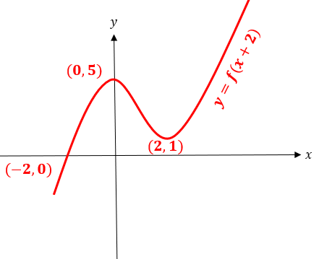


Worked example
Your turn
A sketch of the curve $y=f(x)$ is shown.
Sketch:
$$y=f(x−3)$$
A sketch of the curve $y=f(x)$ is shown.
Sketch:
$$y=f(x+2)$$

Slide 3
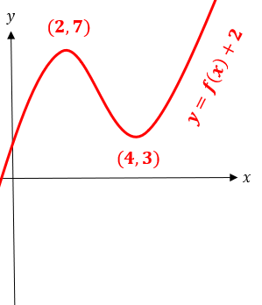


Worked example
Your turn
A sketch of the curve $y=f(x)$ is shown.
Sketch:
$$y=f\left(x\right)−3$$
A sketch of the curve $y=f(x)$ is shown.
Sketch:
$$y=f\left(x\right)+2$$

Slide 4
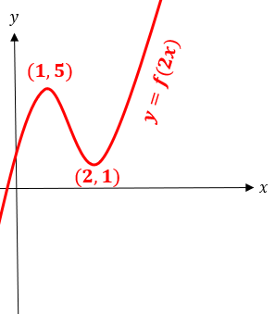


Worked example
Your turn
A sketch of the curve $y=f(x)$ is shown.
Sketch:
$$y=f\left(4x\right)$$
A sketch of the curve $y=f(x)$ is shown.
Sketch:
$$y=f\left(2x\right)$$

Slide 5
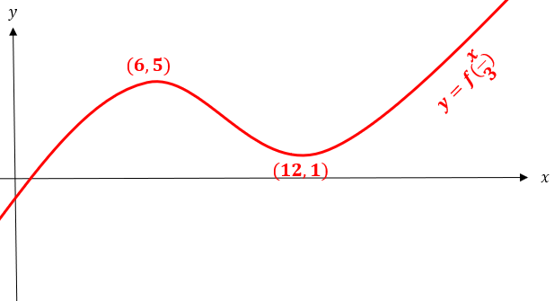


Worked example
Your turn
A sketch of the curve $y=f(x)$ is shown.
Sketch:
$$y=f\left(\frac{x}{4}\right)$$
A sketch of the curve $y=f(x)$ is shown.
Sketch:
$$y=f\left(\frac{x}{3}\right)$$

Slide 6
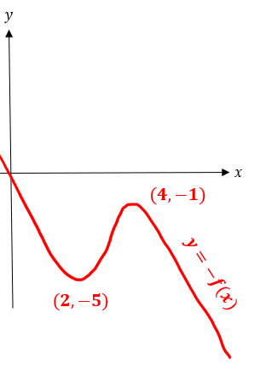


Worked example
Your turn
A sketch of the curve $y=f(x)$ is shown.
Sketch:
$$y=f\left(−x\right)$$
A sketch of the curve $y=f(x)$ is shown.
Sketch:
$$y=−f\left(x\right)$$

Slide 7
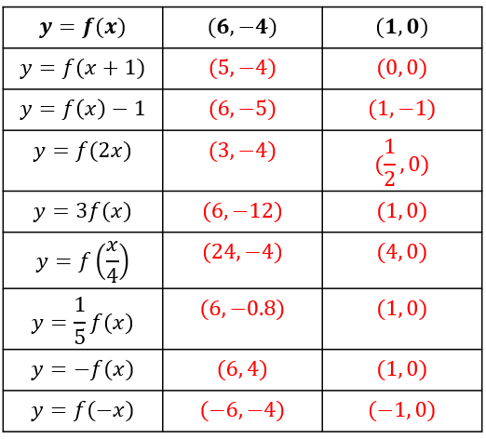
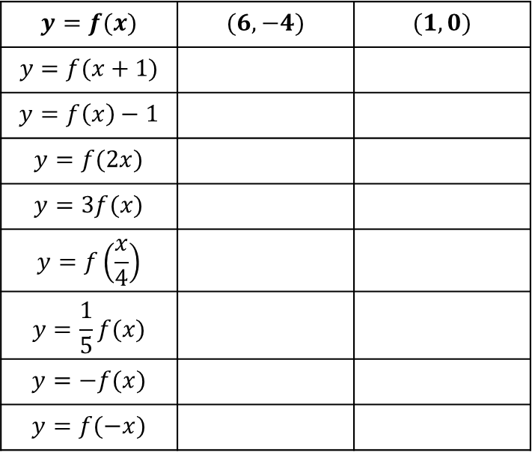
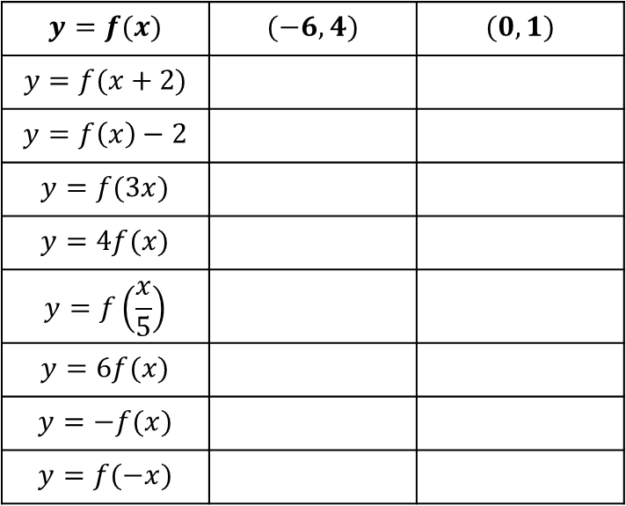
Worked example
Your turn
Find the new coordinates under the transformations
Find the new coordinates under the transformations
$$y=f(x)$$ | $$(−6, 4)$$ | $$(0, 1)$$
$$y=f(x+2)$$
$$y=f\left(x\right)−2$$
$$y=f(3x)$$
$$y=4f(x)$$
$$y=f\left(\frac{x}{5}\right)$$
$$y=6f(x)$$
$$y=−f(x)$$
$$y=f(−x)$$
$$y=f(x)$$ | $$(6, −4)$$ | $$(1, 0)$$
$$y=f(x+1)$$
$$y=f\left(x\right)−1$$
$$y=f(2x)$$
$$y=3f(x)$$
$$y=f\left(\frac{x}{4}\right)$$
$$y=\frac{1}{5}f(x)$$
$$y=−f(x)$$
$$y=f(−x)$$

Slide 8
Worked example
Your turn
The point $A(2, 5)$is the minimum of the curve with equation $y=f\left(x\right)$. Write the new coordinates of the new minimum of the curve:
$$y=2f\left(x\right)+3$$
$$y=3f\left(x\right)−2$$
The point $A(3, 4)$is on the graph of $y=f\left(x\right)$. Write the new coordinates of $A$ after the transformation:
$$y=5f\left(x\right)−6$$
$$(3, 14)$$

Slide 9
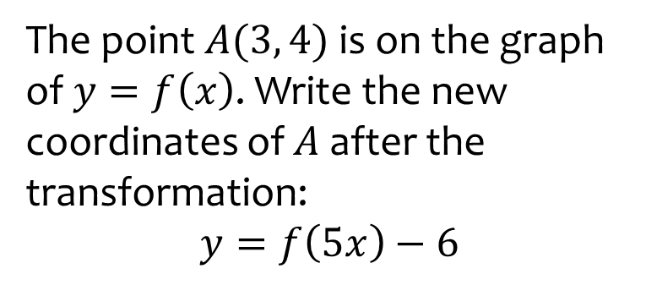
Worked example
Your turn
The point $A(2, 5)$is the minimum of the curve with equation $y=f\left(x\right)$. Write the new coordinates of the new minimum of the curve:
$$y=f\left(2x\right)+3$$
$$y=f\left(3x\right)−2$$
The point $A(3, 4)$is on the graph of $y=f\left(x\right)$. Write the new coordinates of $A$ after the transformation:
$$y=f\left(5x\right)−6$$
$$(\frac{3}{5}, −2)$$

Slide 10
Worked example
Your turn
The point $A(2, 5)$is the minimum of the curve with equation $y=f\left(x\right)$. Write the new coordinates of the new minimum of the curve:
$$y=−f\left(x\right)+3$$
$$y=−f\left(x\right)−2$$
The point $A(3, 4)$is on the graph of $y=f\left(x\right)$. Write the new coordinates of $A$ after the transformation:
$$y=−f\left(x\right)−6$$
$$(3, −10)$$

Slide 11
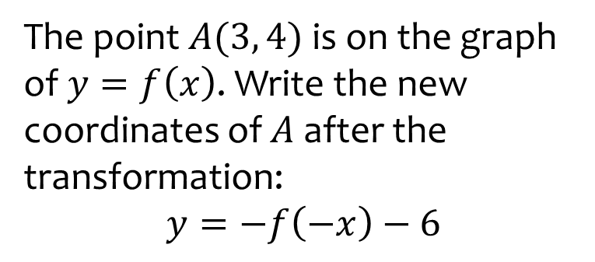
Worked example
Your turn
The point $A(2, 5)$is the minimum of the curve with equation $y=f\left(x\right)$. Write the new coordinates of the new minimum of the curve:
$$y=f\left(−x\right)+3$$
$$y=f\left(−x\right)−2$$
The point $A(3, 4)$is on the graph of $y=f\left(x\right)$. Write the new coordinates of $A$ after the transformation:
$$y=−f\left(−x\right)−6$$
$$(−3, −10)$$

Slide 12
Worked example
Your turn
The point $A(2, 5)$is the minimum of the curve with equation $y=f\left(x\right)$. Write the new coordinates of the new minimum of the curve:
$$y=−2f\left(x\right)+3$$
$$y=−3f\left(x\right)−2$$
The point $A(3, 4)$is on the graph of $y=f\left(x\right)$. Write the new coordinates of $A$ after the transformation:
$$y=−5f\left(x\right)−6$$
$$(3, −26)$$

Slide 13
Worked example
Your turn
The point $A(2, 5)$is the minimum of the curve with equation $y=f\left(x\right)$. Write the new coordinates of the new minimum of the curve:
$$y=2f\left(−x\right)+3$$
$$y=3f\left(−x\right)−2$$
The point $A(3, 4)$is on the graph of $y=f\left(x\right)$. Write the new coordinates of $A$ after the transformation:
$$y=5f\left(−x\right)−6$$
$$(−3, 14)$$

Slide 14
Worked example
Your turn
The point $A(2, 5)$is the minimum of the curve with equation $y=f\left(x\right)$. Write the new coordinates of the new minimum of the curve:
$$y=−2f\left(−x\right)+3$$
$$y=−3f\left(−x\right)−2$$
The point $A(3, 4)$is on the graph of $y=f\left(x\right)$. Write the new coordinates of $A$ after the transformation:
$$y=−5f\left(−x\right)−6$$
$$(−3, −26)$$

Slide 15
Worked example
Your turn
The point $A(2, 5)$is the minimum of the curve with equation $y=f\left(x\right)$. Write the new coordinates of the new minimum of the curve:
$$y=3f\left(2x\right)+7$$
$$y=7f\left(5x\right)−2$$
The point $A(3, 4)$is on the graph of $y=f\left(x\right)$. Write the new coordinates of $A$ after the transformation:
$$y=5f\left(3x\right)−7$$
$$(1, 13)$$

Slide 16
Worked example
Your turn
The point $A(2, 5)$is the minimum of the curve with equation $y=f\left(x\right)$. Write the new coordinates of the new minimum of the curve:
$$y=−3f\left(2x\right)+7$$
$$y=−7f\left(5x\right)−2$$
The point $A(3, 4)$is on the graph of $y=f\left(x\right)$. Write the new coordinates of $A$ after the transformation:
$$y=−5f\left(3x\right)−7$$
$$(1, −27)$$

Slide 17
Worked example
Your turn
The point $A(2, 5)$is the minimum of the curve with equation $y=f\left(x\right)$. Write the new coordinates of the new minimum of the curve:
$$y=−3f\left(−2x\right)+7$$
$$y=−7f\left(−5x\right)−2$$
The point $A(3, 4)$is on the graph of $y=f\left(x\right)$. Write the new coordinates of $A$ after the transformation:
$$y=−5f\left(−3x\right)−7$$
$$(−1, −27)$$

