Slide 1
4.6) Stretching graphs

Slide 2


Worked example
Your turn
Describe the effect on the graph of $y=f(x)$ of:
$$f(9x)$$
$$f(\frac{1}{8}x)$$
$$7f\left(x\right)$$
$$\frac{1}{6}f\left(x\right)$$
Describe the effect on the graph of $y=f(x)$ of:
$$f(2x)$$
$$f(\frac{1}{3}x)$$
$$4f\left(x\right)$$
$$\frac{1}{5}f\left(x\right)$$
Stretch, scale factor $\frac{1}{2}$, in the $x$-direction
Stretch, scale factor $3$, in the $x$-direction
Stretch, scale factor $4$, in the $y$-direction
Stretch, scale factor $\frac{1}{5}$, in the $y$-direction

Slide 3
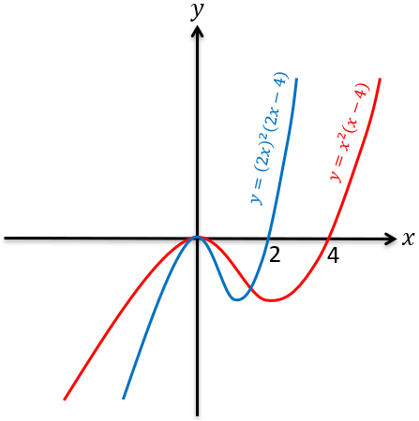
Worked example
Your turn
Sketch $y=x^{2}\left(x+8\right)$. On the same axes, sketch the graph with equation
$$y={\left(4x\right)}^{2}\left(4x+8\right)$$
Sketch $y=x^{2}\left(x−4\right)$. On the same axes, sketch the graph with equation
$$y={\left(2x\right)}^{2}\left(2x−4\right)$$

Slide 4
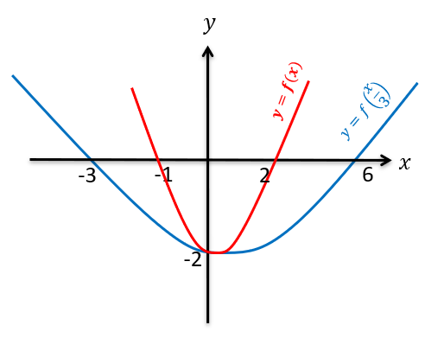
Worked example
Your turn
If $y=(x+2)(x−1)$, sketch $y=f(x)$ and $y=f(\frac{x}{4})$ on the same axes.
If $y=(x+1)(x−2)$, sketch $y=f(x)$ and $y=f(\frac{x}{3})$ on the same axes.

Slide 5
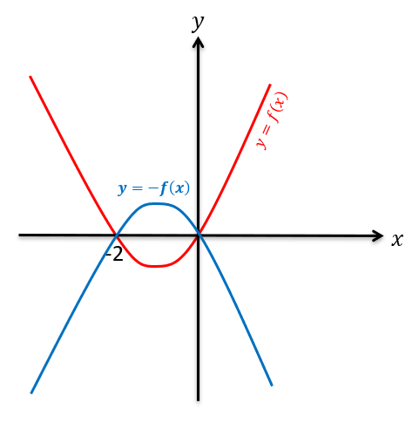
Worked example
Your turn
If $y=x(x−3)$, sketch
$y=f(x)$ and $y=−f(x)$ on the same axes.
If $y=x(x+2)$, sketch
$y=f(x)$ and $y=−f(x)$ on the same axes.

Slide 6
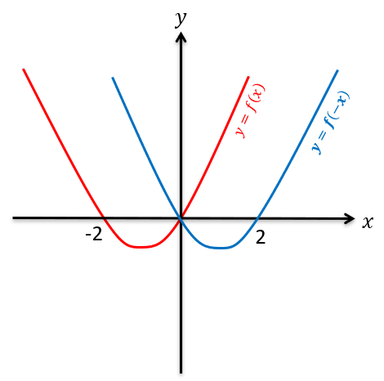
Worked example
Your turn
If $y=x(x−3)$, sketch
$y=f(x)$ and $y=f(−x)$ on the same axes.
If $y=x(x+2)$, sketch
$y=f(x)$ and $y=f(−x)$ on the same axes.

Slide 7
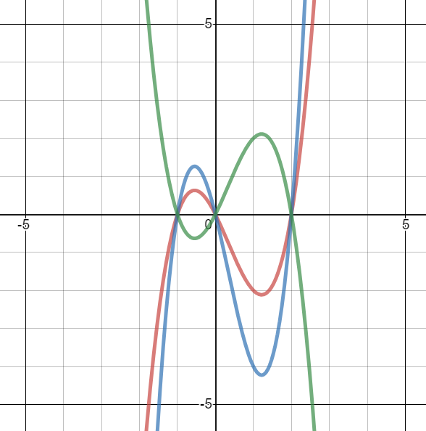
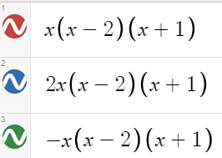
Worked example
Your turn
On the same axes, sketch:
$$y=x(x+2)(x−1)$$
$$y=4x\left(4x+2\right)(4x−1)$$
$$y=−x(x+2)(x−1)$$
On the same axes, sketch:
$$y=x(x−2)(x+1)$$
$$y=2x\left(2x−2\right)(2x+1)$$
$$y=−x(x−2)(x+1)$$

