Slide 1
4.5) Translating graphs

Slide 2
Worked example
Your turn
Describe the effect on the graph of $y=f(x)$ of:
$$f(x+9)$$
$$f(x−8)$$
$$f\left(x\right)+7$$
$$f\left(x\right)−6$$
Describe the effect on the graph of $y=f(x)$ of:
$$f(x+2)$$
$$f(x−3)$$
$$f\left(x\right)+4$$
$$f\left(x\right)−5$$
Translation by vector $\left(\begin{matrix}−2 \\ 0\end{matrix}\right)$
Translation by vector $\left(\begin{matrix}3 \\ 0\end{matrix}\right)$
Translation by vector $\left(\begin{matrix}0 \\ 4\end{matrix}\right)$
Translation by vector $\left(\begin{matrix}0 \\ −5\end{matrix}\right)$

Slide 3
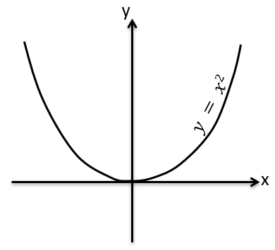
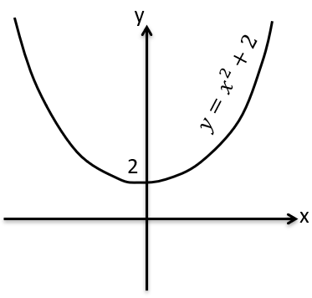
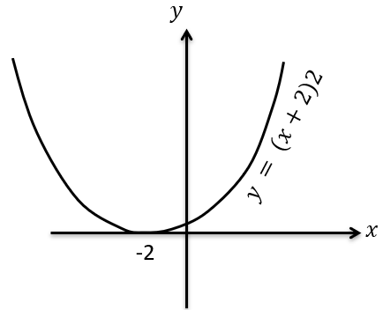
Worked example
Your turn
Sketch:
$$y=−x^{2}$$
$$y=−x^{2}−3$$
$$y=−{\left(x−3\right)}^{2}$$
Sketch:
$$y=x^{2}$$
$$y=x^{2}+2$$
$$y={\left(x+2\right)}^{2}$$

Slide 4
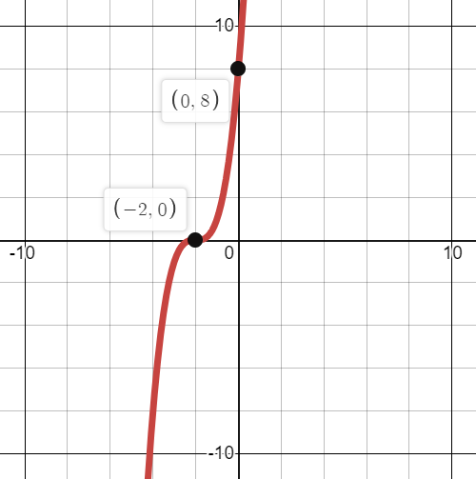
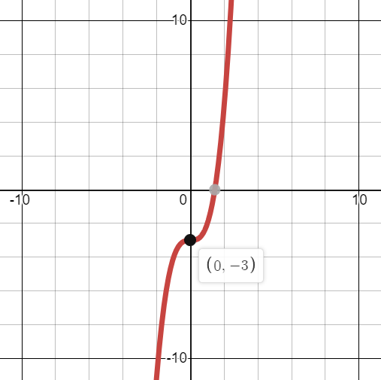
Worked example
Your turn
$$f\left(x\right)=−x^{3}$$
Sketch:
$$f(x−3)$$
$$f\left(x\right)+2$$
$$g\left(x\right)=x^{3}$$
Sketch:
$$g(x+2)$$
$$g\left(x\right)−3$$

Slide 5
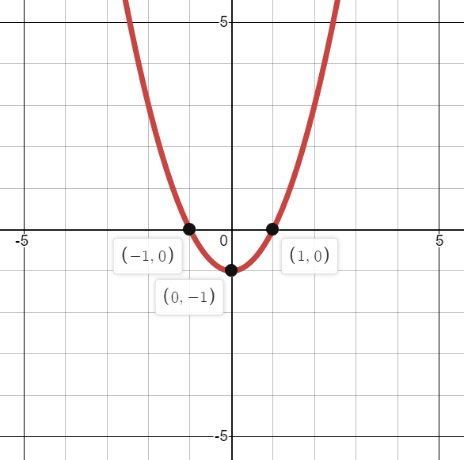
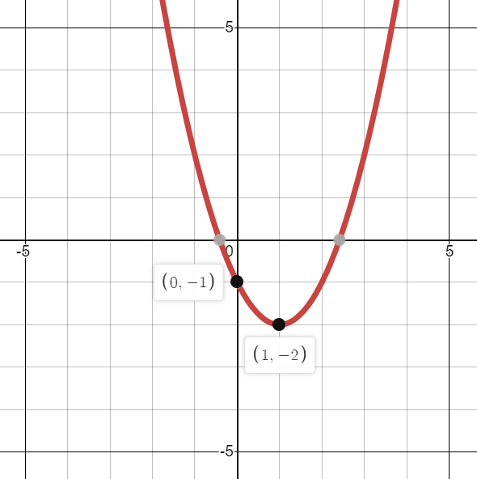
Worked example
Your turn
$$f\left(x\right)=x(x+3)$$
Sketch:
$$f(x−3)$$
$$f\left(x\right)+2$$
$$g\left(x\right)=x(x−2)$$
Sketch:
$$g(x+1)$$
$$g\left(x\right)−1$$

Slide 6
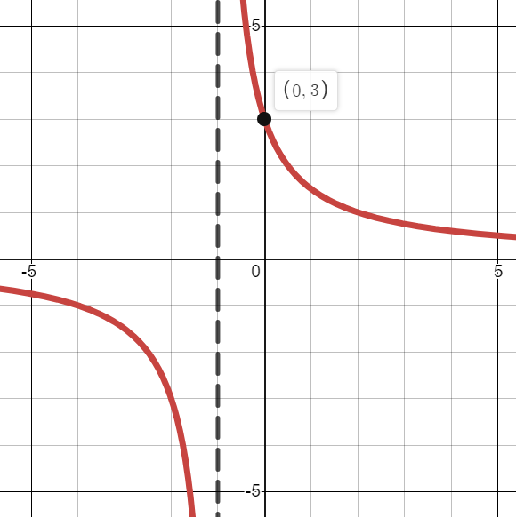
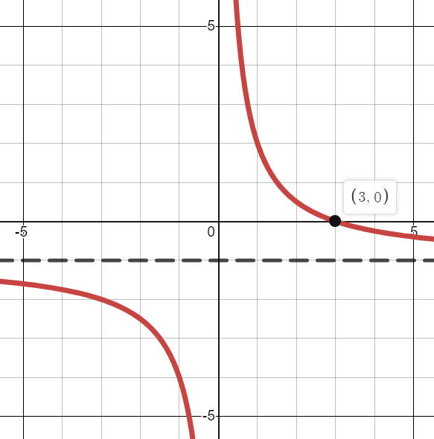
Worked example
Your turn
$$f\left(x\right)=−\frac{2}{x}$$
Sketch:
$$f(x−3)$$
$$f\left(x\right)+2$$
$$g\left(x\right)=\frac{3}{x}$$
Sketch:
$$g(x+1)$$
$$g\left(x\right)−1$$

Slide 7
Worked example
Your turn
The point with coordinates $(−1.5, 0)$ lies on the curve with equation
$$y={\left(x+a\right)}^{3}+6{\left(x+a\right)}^{2}+9(x+a)$$
where $a$ is a constant. Find the two possible values of $a$
The point with coordinates $(−2, 0)$ lies on the curve with equation
$$y={\left(x+a\right)}^{3}+8{\left(x+a\right)}^{2}+16(x+a)$$
where $a$ is a constant. Find the two possible values of $a$
$$a=±2$$

Slide 8
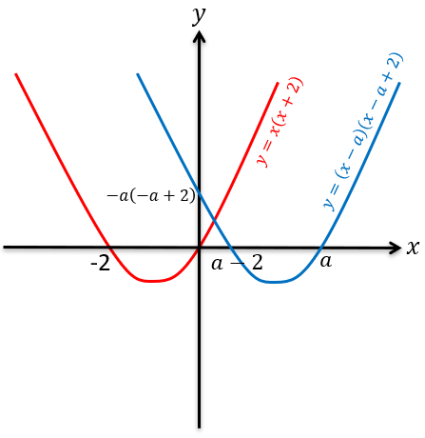
Worked example
Your turn
Sketch $y=x(x−3)$. On the same axes, sketch $y=\left(x+a\right)\left(x+a−3\right)$, where $a>3$.
Sketch $y=x(x+2)$. On the same axes, sketch $y=\left(x−a\right)\left(x−a+2\right)$, where $a>2$.

