Slide 1
4.5) Tilting

Slide 2
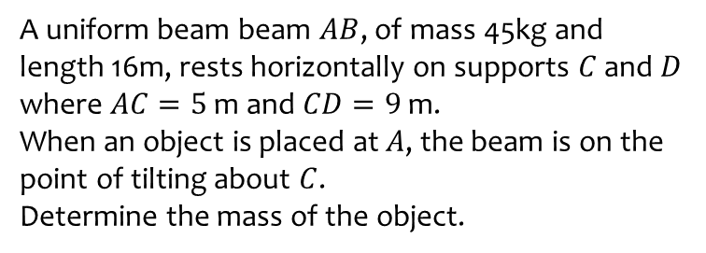
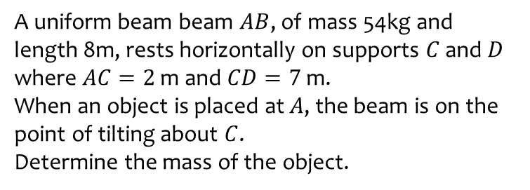
Worked example
Your turn
A uniform beam beam $AB$, of mass 54kg and length 8m, rests horizontally on supports $C$ and $D$ where $AC=2$ m and $CD=7$ m.
When an object is placed at $A$, the beam is on the point of tilting about $C$.
Determine the mass of the object.
A uniform beam beam $AB$, of mass 45kg and length 16m, rests horizontally on supports $C$ and $D$ where $AC=5$ m and $CD=9$ m.
When an object is placed at $A$, the beam is on the point of tilting about $C$.
Determine the mass of the object.
$$27 kg$$

Slide 3
Worked example
Your turn
A non-uniform rod $AB$, of length 5 m and weight 80 N, is suspended from a pair of light cables attached to $C$ and $D$ where $AC=2$ m and $BD=1$ m.
When a weight of 50 N is hung from $A$ the rod is on the point of rotating.
Find the distance of the centre of mass of the rod from $A$.
A non-uniform rod $AB$, of length 10 m and weight 40 N, is suspended from a pair of light cables attached to $C$ and $D$ where $AC=3$ m and $BD=2$ m.
When a weight of 25 N is hung from $A$ the rod is on the point of rotating.
Find the distance of the centre of mass of the rod from $A$.
$$4.875 m$$

Slide 4
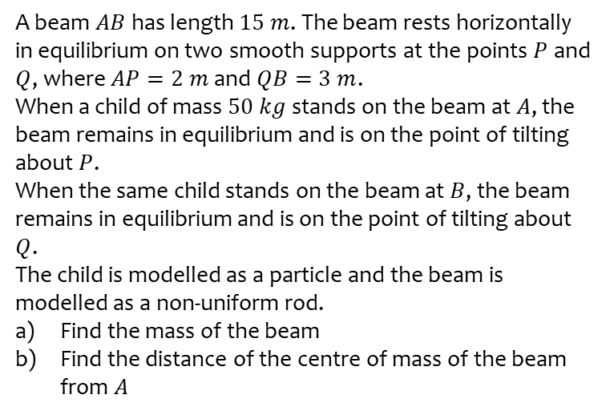
Worked example
Your turn
A beam $AB$has length $25 m$. The beam rests horizontally in equilibrium on two smooth supports at the points $P$ and $Q$, where $AP=4 m$ and $QB=5 m$.
When an adult of mass $60 kg$ stands on the beam at $A$, the beam remains in equilibrium and is on the point of tilting about $P$.
When the same child stands on the beam at $B$, the beam remains in equilibrium and is on the point of tilting about $Q$.
The child is modelled as a particle and the beam is modelled as a non-uniform rod.
Find the mass of the beam
Find the distance of the centre of mass of the beam from $A$
A beam $AB$has length $15 m$. The beam rests horizontally in equilibrium on two smooth supports at the points $P$ and $Q$, where $AP=2 m$ and $QB=3 m$.
When a child of mass $50 kg$ stands on the beam at $A$, the beam remains in equilibrium and is on the point of tilting about $P$.
When the same child stands on the beam at $B$, the beam remains in equilibrium and is on the point of tilting about $Q$.
The child is modelled as a particle and the beam is modelled as a non-uniform rod.
Find the mass of the beam
Find the distance of the centre of mass of the beam from $A$
a) $25 kg$
b) $6 m$

